Slide 2
Unit
10
HOUSES IN THE FUTURE
LESSON 7: LOOKING BACK & PROJECT
1

Slide 3
LESSON 7: LOOKING BACK & PROJECT
LESSON 1: GETTING STARTED
WARM-UP
Vocabulary brainstorming
Vocabulary
ask 1: Write the words / phrases.
Task 2: Fill in the table.
Grammar
﻿Task 3: Complete the sentence with “will” (‘ll) and “won’t”.
Task 4: Complete the sentences with “might” or “might not”.
LOOKING BACK
PROJECT
Poster: My future appliance
CONSOLIDATION
Wrap-up
Homework

Slide 4
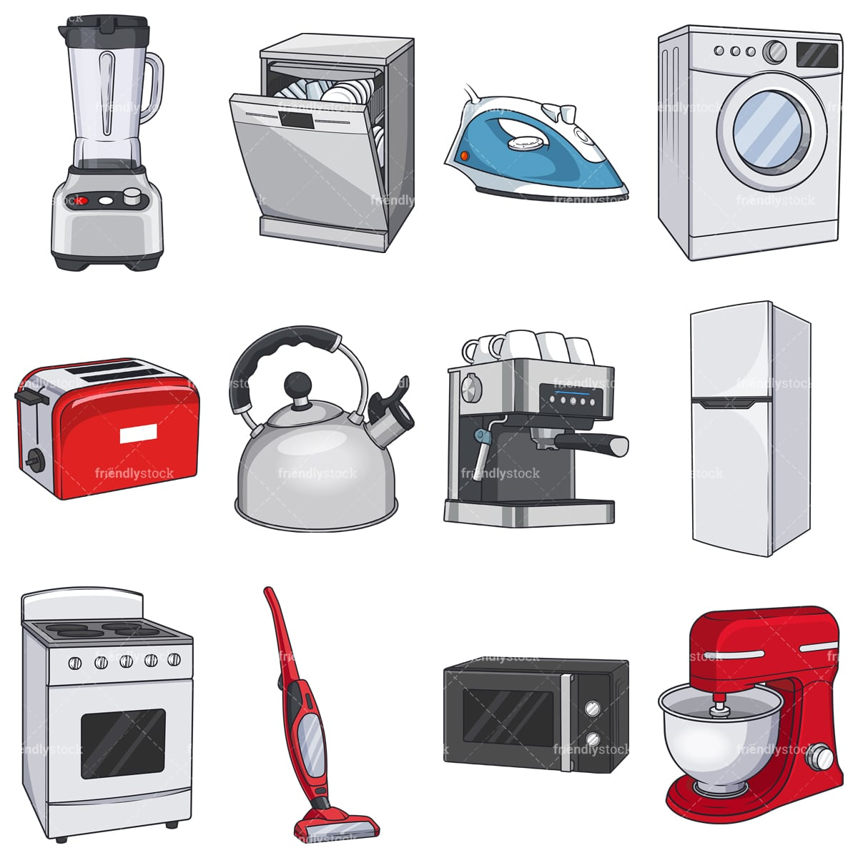
WARM-UP
HOUSEHOLD APPLIANCES
VOCABULARY
BRAIN STORMING

Slide 5
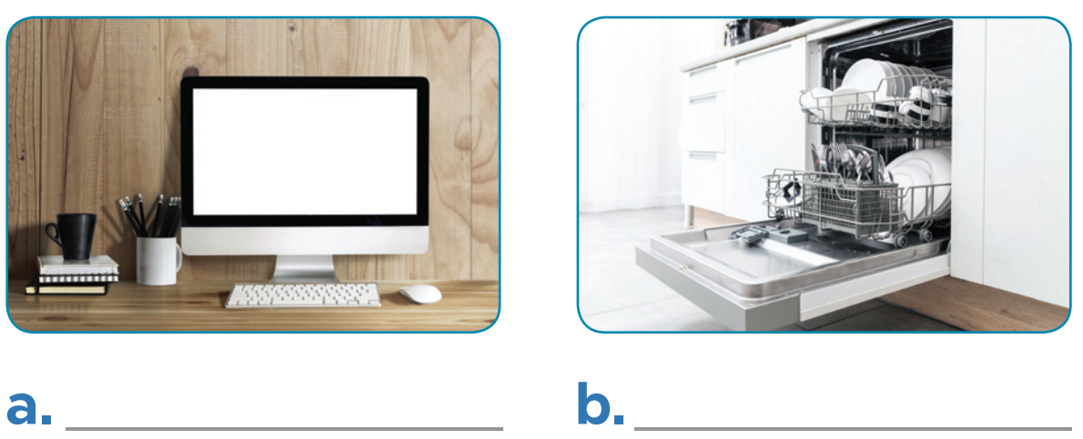
LOOKING BACK
1
1
Write the words / phrases under the correct pictures.
computer | fridge | smart clock
dishwasher | wireless TV | washing machine
computer
dishwasher

Slide 6
LOOKING BACK
1
1
Write the words / phrases under the correct pictures.
computer | fridge | smart clock
dishwasher | wireless TV | washing machine
wireless TV
washing machine

Slide 7
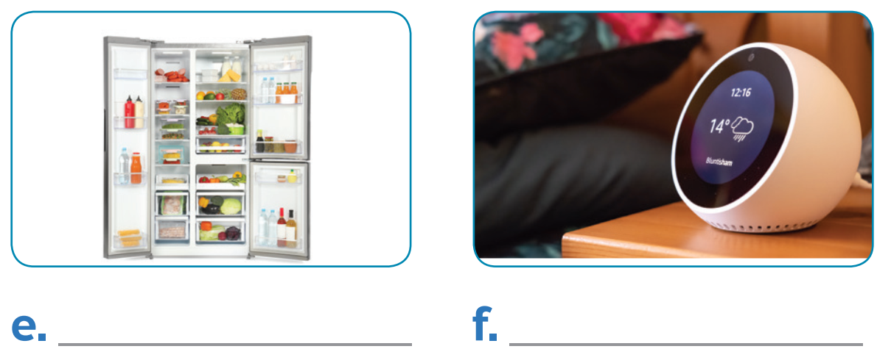
LOOKING BACK
1
1
Write the words / phrases under the correct pictures.
computer | fridge | smart clock
dishwasher | wireless TV | washing machine
fridge
smart clock

Slide 8
LOOKING BACK
2
Think about what the appliances will do in the future. Fill the table.
1. robots | look after the house
2. washing machines
3. wireless TVs
4. super cars
5. smart clocks
6. dishwashers

Slide 9
LOOKING BACK
3
Complete the sentences with will ('ll) or won’t.
won’t
1. Tomorrow is Sunday, so I _______ have to get up early.
2. When I see Tom tomorrow, I _______ invite him to our party.
3. You must meet Anna. I am sure you _______ like her.
4. We _______ start our dinner until Jack arrives.
5. I _______ phone you when I get home from school.
6. Tony _______ pass his examination. He hasn’t studied yet.
will/’ll
will/’ll
won’t
will/’ll
won’t

Slide 10
LOOKING BACK
4
Complete the sentences with might or might not.
might
1. I am still not sure where to go for my holiday. I _______ go to Da Lat.
2. The weather is not very good. It _______ rain this afternoon.
3. There ___________ be a meeting on Friday because the teacher is ill.
4. Ann ___________ come to the party tonight because she is busy.
5. Phong is thinking about what he will do on Sunday. He _______ go to a judo club, or he _______ stay at home and study English.
might
might not
might not
might
might

Slide 11
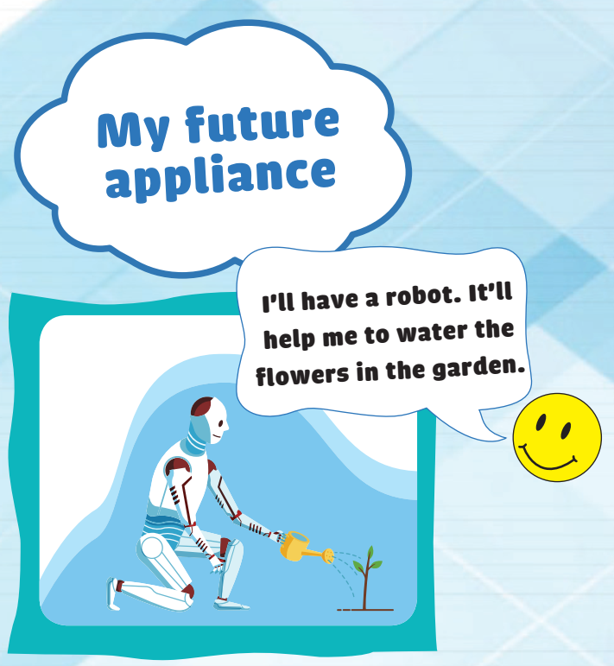
PROJECT
+ Think about an appliance you would like to have in the future.
+ Make a poster about it.
+ Write the details of the appliance in the poster.
+ Share the poster with the whole class.

Slide 12
CONSOLIDATION
1
Wrap-up
What have we learnt in this lesson?
Review the vocabulary items and grammar points in the unit

Slide 13
CONSOLIDATION
2
Homework
- Prepare for the next lesson: Unit 11 – Lesson 1: Getting started.
- Do exercises in the workbook.

Slide 14
Website: hoclieu.vn
Fanpage: facebook.com/www.tienganhglobalsuccess.vn/

