Slide 2



Unit
10
HOUSES IN THE FUTURE
LESSON 3: A CLOSER LOOK 2
1

Slide 3
LESSON 3: A CLOSER LOOK 2
LESSON 1: GETTING STARTED
WARM-UP
Game: Sentence puzzling
THE FUTURE SIMPLE TENSE
Task 1: Fill in the blanks.
Task 2: Complete the conversation
Task 3: Make sentences.
MIGHT FOR FUTURE POSSIBILITY
Task 4: True or false
Task 5: Share what you might do or have in the future.
PRODUCTION
CONSOLIDATION
Wrap-up
Homework

Slide 4
WARM-UP
ENGLISH | NEXT YEAR. | SHE | WILL LEARN
WILL | HIS FATHER | OVERNIGHT. | WORK
SENTENCES PUZZLING
WILL | PHONG AND NICK | SOON. | COME
FINISH | SAM | WON’T | HIS WORK.

Slide 5
WARM-UP
SHE | WILL LEARN | ENGLISH | NEXT YEAR.
HIS FATHER | WILL | WORK | OVERNIGHT.
SENTENCES PUZZLING
PHONG AND NICK | WILL | COME | SOON.
SAM | WON’T | FINISH | HIS WORK.

Slide 6
PRESENTATION
*Grammar
FUTURE SIMPLE
+
S + will + V
STRUCTURES:
-
S + will not (won’t) + V
?
Will + S + V ?

Slide 7
PRACTICE
1
Fill in the blanks with will or won’t.
will / won’t
1. I think I _______ stay at home tonight.
2. My friends _______ go to the library this afternoon.
3. My mum _______ make a cake today.
4. I _______ have an English test tomorrow.
5. Our family _______ move to the new house next week.

Slide 8
PRACTICE
2
Complete the conversation with will ('ll) or won’t.
A: Oh, no. The dog ran away again!
B: Don’t worry – he (1) _______ come back.
A: Are you sure he (2) _______?
B: OK, he might not come back today. But I’m sure he (3) _______ come back tomorrow.
A: I don’t believe you! He (4) _______ come back. We (5) _______ never see him again. I’m sure.
B: Oh, look ... Here he is!
will / ‘ll
will
will / ‘ll
won’t
will / ’ll

Slide 9
PRACTICE
3
Write sentences, using will ('ll) or won't and the words/phrases given.
1.
computer / do / housework
A computer will / won’t help me to do my housework.
2.
robot / water / ﬂowers
A robot will help me to water the flowers.
3.
smart TV / cook / meal
A smart TV won’t help me to cook meals.
4.
washing machine / iron / clothes
A washing machine will / won’t help me to iron the clothes.
5.
smartphone / take care / children
A smartphone won’t help me to take care of the children.

Slide 10
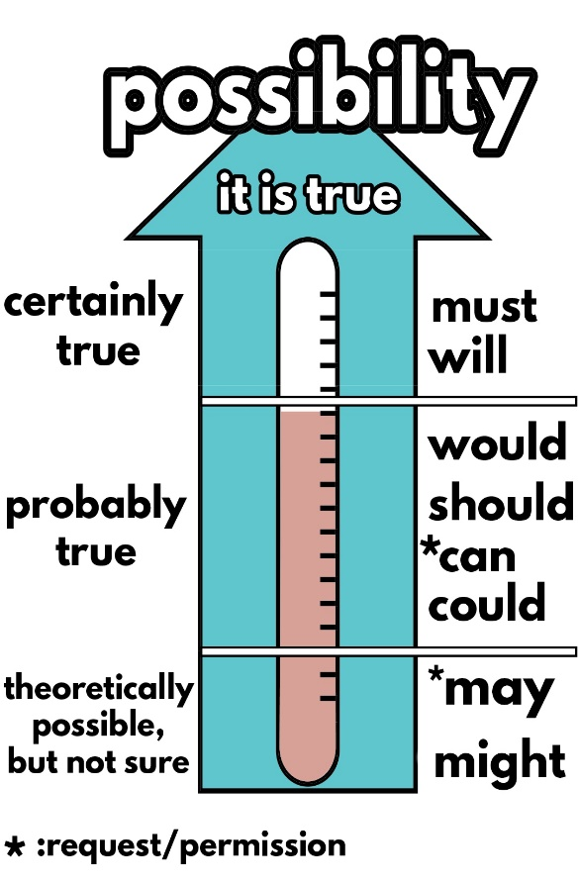
“We might live in a UFO.”
PRESENTATION
What structure do I use in this sentence?
might + V
Why do I use “might” instead of “will”?
We use might for future possibility.
Notes:
I’m not sure but I think robots might not do everything we want, because they are not human, they don’t have feelings …
- What verb do I use in this sentence? (might)
- Why do I use ‘might’ instead of ‘will’?
Let’s see it more clearly.

Slide 11


Might for future possibility
PRESENTATION
We use might + V to talk about actions that are possible in the future (We are not sure if they will happen or not).
Example:
We might live in a UFO.
They might not travel in cars.

Slide 12

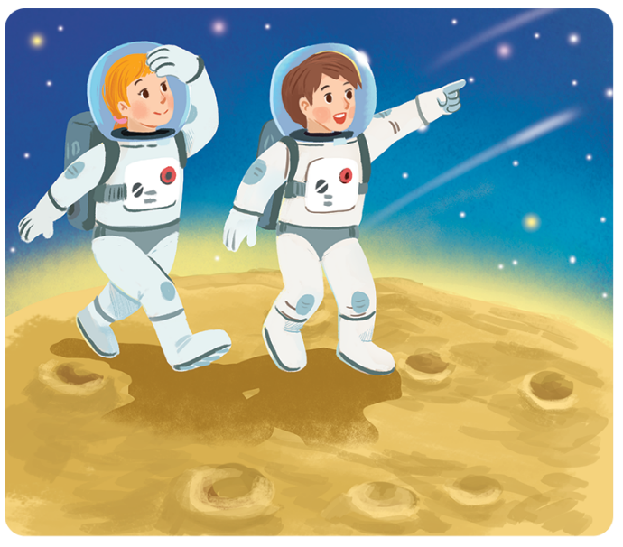
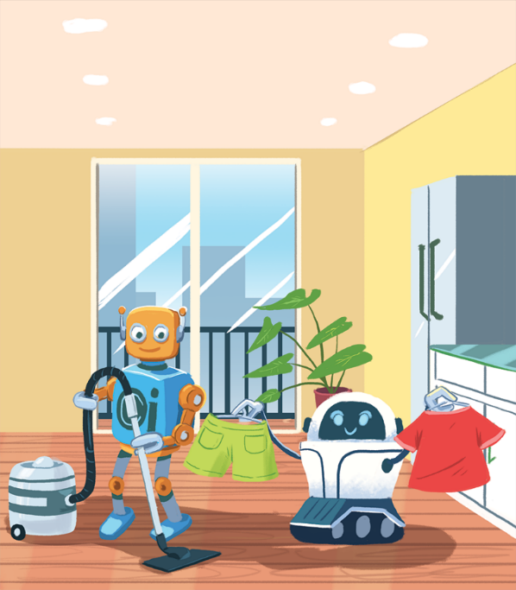
PRACTICE
4
Read the poems and tick true or false.
In the future
We might live with robots.
They might clean our houses.
They might wash our clothes.
They might not talk to us.
In the future
Jenny, aged 12
We might go on holiday to the Moon.
We might stay there for a long time.
We might have a great time.
We might come home soon.
Henry, aged 11

Slide 13
PRACTICE
 | T | F
1. Jenny thinks we might live with robots.
2. Henry thinks we might travel to the Moon.
3. Jenny thinks robots might not clean our houses.
4. Henry thinks we will stay on the Moon for a short time.
5. Jenny thinks robots might help us to do the housework.
6. Henry thinks we might not have a great time on the Moon.







Slide 14
PRODUCTION
5
Think about what you might do or have in the future. Share your ideas with your classmates.
Example:
I might have a smartphone to surf the internet.

Slide 15

CONSOLIDATION
1
Wrap-up
What have we learnt in this lesson?
Future Simple and Might for future possibility.

Slide 16

CONSOLIDATION
2
Homework
Do exercises in the workbook.

Slide 17






Website: hoclieu.vn
Fanpage: facebook.com/www.tienganhglobalsuccess.vn/

