Slide 2
Unit
10
HOUSES IN THE FUTURE
LESSON 2: A CLOSER LOOK 1
1

Slide 3
LESSON 2: A CLOSER LOOK 1
LESSON 1: GETTING STARTED
WARM-UP
Game: Jumbled words
Task 1: Listen and repeat
Task 2: Matching
Task 3: Ask and answer questions.
VOCABULARY
PRONUNCIATION
Task 4: Listen and repeat the words.
Task 5: Listen and repeat the sentences.
EXTRA ACTIVITY
Game: Up and down.
CONSOLIDATION
Wrap-up
Homework

Slide 4
WARM-UP
- Work in 4 groups.
- Unscramble the letters to find the correct word.
- Raise hands to answer.
JUMBLED WORDS

Slide 5
WARM-UP
LSRAO
→ SOLAR

Slide 6
WARM-UP
GYNEER
→ ENERGY

Slide 7
WARM-UP
TRTMSVA
→ SMART TV

Slide 8
WARM-UP
TROBO
→ ROBOT

Slide 9
WARM-UP
CEALPPAIN
→ APPLIANCE

Slide 10
VOCABULARY
1
Put the words in the appropriate columns.
electric cooker
fridge
dishwasher
electric fan
washing machine
computer
wireless TV
smart clock
living room | bedroom | kitchen
wireless TV
wireless TV
fridge
electric fan
electric fan
electric cooker
computer
computer
dishwasher
smart clock
smart clock
washing machine

Slide 11
VOCABULARY
2
Match the appliances in A with what they can help us to do in B.
A
B
1. electric cooker
a. receive and send emails
2. dishwasher
b. keep food fresh
3. fridge
c. cook rice
4. washing machine
d. wash and dry dishes
5. computer
e. wash and dry clothes
What do you think these appliances can or might do more?

Slide 12
VOCABULARY
3
Ask and answer questions about what appliances can help us to do.
In pairs
Ask and answer.
Suggested answer:
A: What does a wireless TV do?
B: It helps us watch TV programmes from space.

Slide 13
PRONUNCIATION
4
4
Listen and repeat the words.
'picture 'robot 'bedroom
'kitchen 'housework 'palace
'village 'mountains

Slide 14
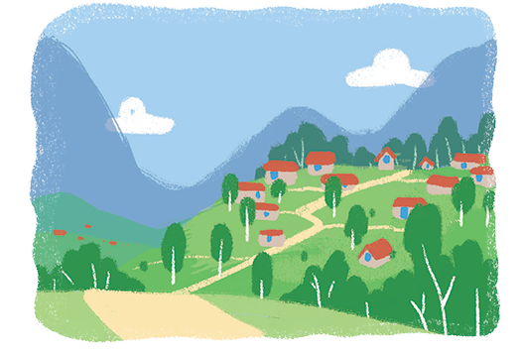
PRONUNCIATION
5
Listen and repeat the sentences.
1.The picture is on the wall of the bedroom.
2. The robot helps me to do the housework.
3. There's a very big kitchen in the palace.
4. Their village is in the mountains.
pic
bed
ro
house
kit
pa
vil
moun

Slide 15
EXTRA ACTIVITY
UP AND DOWN
● Round 1: Teacher says 1-10 appliances. Students stand up for the ones in the kitchen, sit down for the ones in the bedroom.
● Round 2: Teacher says 1-10 words. Students stand up for the ones with the first stressed syllable, sit down for the second stressed syllable.

Slide 16
CONSOLIDATION
1
Wrap-up
What have we learnt in this lesson?
Vocabulary and structures about household appliances.
Pronounce the two-syllable words correctly.

Slide 17
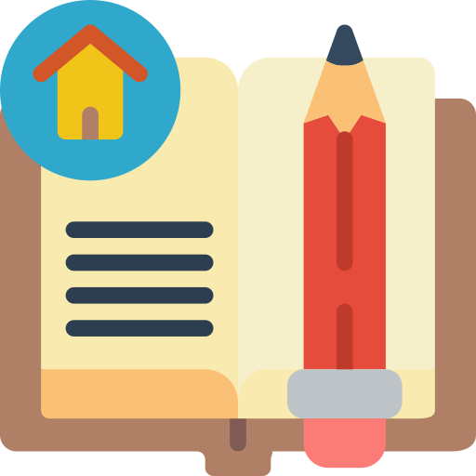
CONSOLIDATION
2
Homework
- Do exercises in the workbook.
- Find 5 more two-syllable words which have the first syllable stressed. Write them down and practice pronouncing the words.

Slide 18
Website: hoclieu.vn
Fanpage: facebook.com/www.tienganhglobalsuccess.vn/

