Slide 2



Unit
10
HOUSES IN THE FUTURE
LESSON 1: GETTING STARTED
Our houses in the future
1

Slide 3
LESSON 1: GETTING STARTED
LESSON 1: GETTING STARTED
WARM-UP
The Household race
PRESENTATION
Vocabulary
Task 1: Listen and read.
Task 2: Find the words and phrases.
Task 3: True or false.
Task 4: Make phrases
PRACTICE
PRODUCTION
Task 5: Describe your view from your future house.
CONSOLIDATION
Wrap-up
Homework

Slide 4
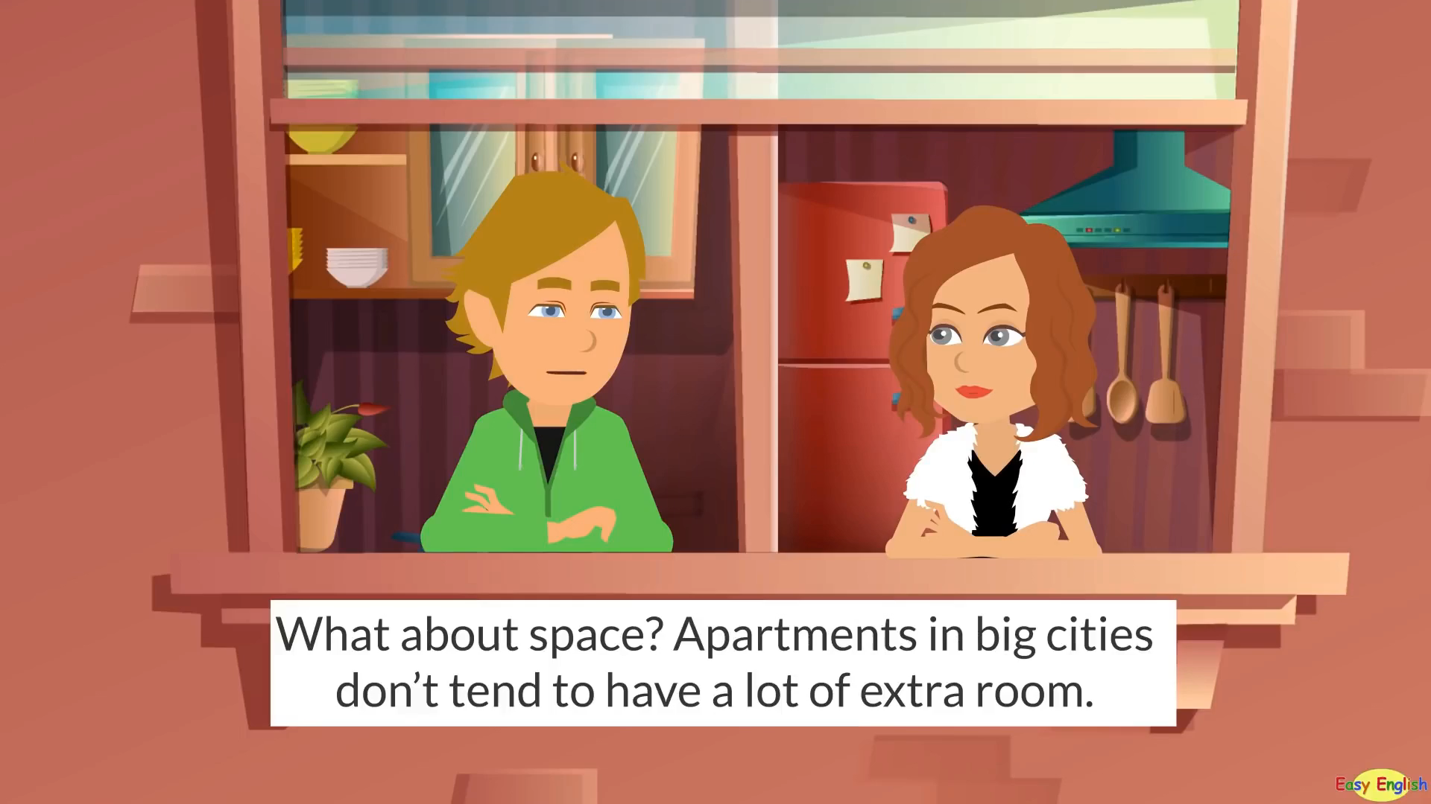
WARM-UP
Watch the video
Household race

Slide 5
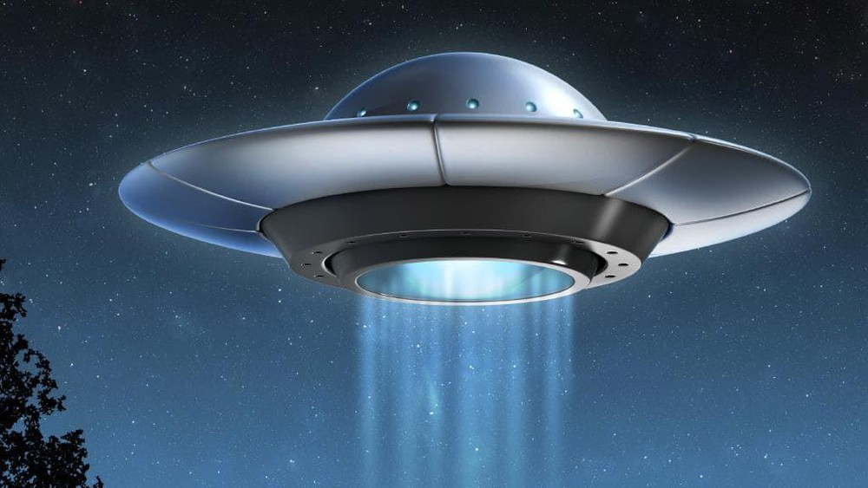

PRESENTATION
UFO (n)
/ˌjuː ef ˈəʊ/
vật thể bay không xác định

Slide 6
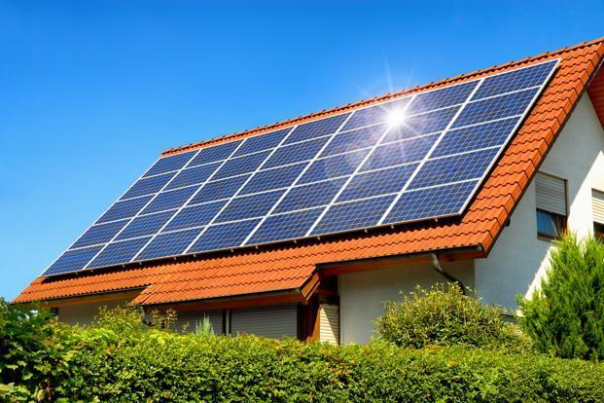
PRESENTATION
solar energy (n)
/ˈsəʊlə(r) ˈenə(r)dʒi/
năng lượng mặt trời

Slide 7

PRESENTATION
smart TV (n)
/ smɑːt ˌtiː ˈviː /
TV thông minh

Slide 8
PRESENTATION
New words | Pronunciation | Meaning
1. UFO (n) | /ˈneɪbəhʊd/ | vật thể bay không xác định
2. solar energy (n) | /ˌsəʊ.lər ˈen.ə.dʒi/ | năng lượng mặt trời
3. smart TV (n) | / smɑːt ˌtiː ˈviː / | TV thông minh

Slide 9

1. Who are they?
PRACTICE
Nick
2. What is Phong doing?
3. What are they talking about?
Phong

Slide 10
PRACTICE
2
Find and write down the words or phrases that show:
Type of house:
Location:
Appliances in the house:

Slide 11
PRACTICE
2
Find and write down the words or phrases that show:
TYPE OF HOUSE:
UFO
Nick: What are you doing, Phong?
Phong: I'm painting a picture of my house.
Nick: Your house! That's a UFO.
Phong: It looks like a UFO but it's my house in the future.

Slide 12
PRACTICE
2
Find and write down the words or phrases that show:
LOCATION:
in the mountains
Nick: Where will it be?
Phong: It'll be in the mountains.

Slide 13
PRACTICE
2
Find and write down the words or phrases that show:
Appliances in the house:
some smart TVs and 10 robots.
Nick: What appliances might the house have?
Phong: My house might have some smart TVs and ten robots.

Slide 14

PRACTICE
3
Read the conversation again. Tick ✓ True (T) or False (F).
T
F
1. Phong's house will be in the mountains.
2. His house will be large.
3. There'll be a lot of rooms in his house.
4. He might have a smart TV and five robots.
have some smart TVs and ten robots.
Nick: What appliances might the house have?
Phong: My house might have some smart TVs and ten robots.

Slide 15
PRACTICE
4
Order the words to make a phrase about a place.
1. sea/ a/ by/ the
...........................................
2. on/ in/ the / city
............................................
3. the / in/ at / town
..........................................
4. the/ on/ in/ mountains
...........................................
5. countryside / a/ the / in
.............................................
6. Moon / in / the / on
............................................
7. in / at/ the / sky
...........................................
by the sea
in the countryside
in the city
on the Moon
in the town
in the sky
in the mountains

Slide 16

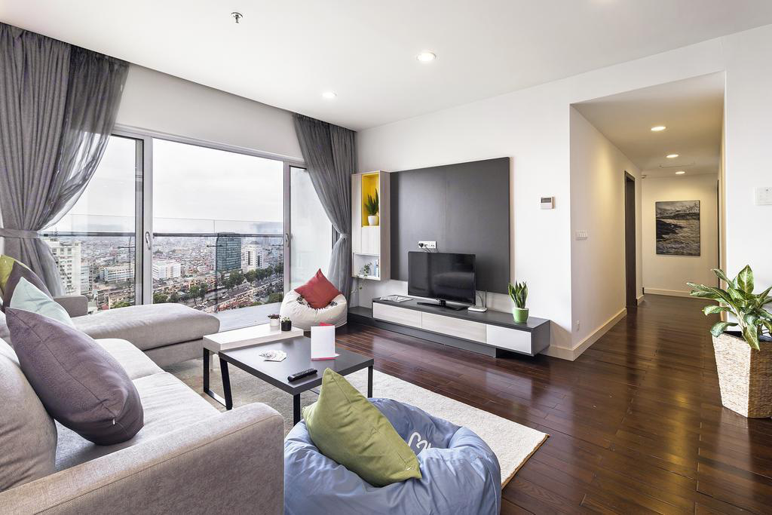
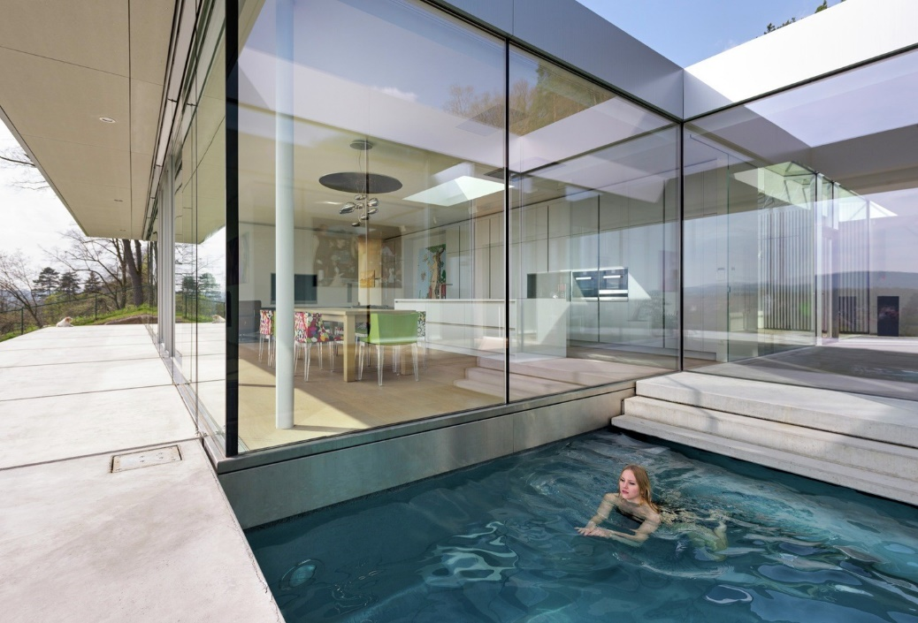
PRODUCTION
5
Describe to your classmates what can you see outside the window of your future houses. Your group tries to guess where your house is.

Slide 17

CONSOLIDATION
1
Wrap-up
What have we learnt in this lesson?
identify the topic of the unit
use lexical items related to the unit topic
identify the language features that are covered in the unit

Slide 18

CONSOLIDATION
2
Homework
Do exercises in the workbook.
Prepare for the Project in Lesson 7.

Slide 19






Website: hoclieu.vn
Fanpage: facebook.com/www.tienganhglobalsuccess.vn/

