Slide 2
Unit
11
OUR GREENER WORLD
LESSON 6: SKILLS 2
1

Slide 3
LESSON 6: SKILLS 2
LESSON 1: GETTING STARTED
WARM-UP
Brainstorming
Task 1: Listen and fill in the blanks.
Task 2: True or False.
LISTENING
Task 3: Interview a classmate and take notes.
Task 4: Write a paragraph.
WRITING
CONSOLIDATION
Wrap-up
Homework

Slide 4
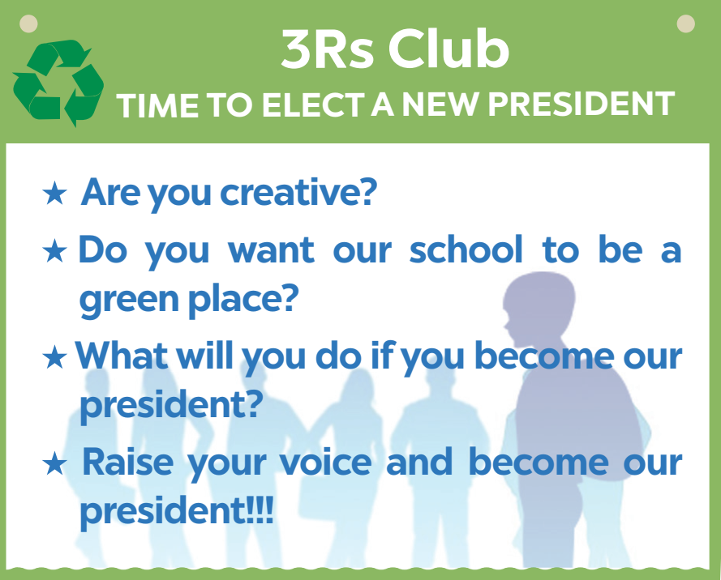
WARM-UP
BRAINSTORMING
What are the necessary qualities of the club president?

Slide 5
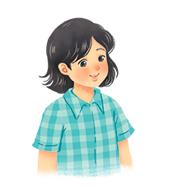
LISTENING
Listen to two students talking about what they will do if they become the president of the 3Rs Club. Fill each blank with a word or a number.
Mi
Nam

Slide 6
LISTENING
Listen to two students talking about what they will do if they become the president of the 3Rs Club. Fill each blank with a word or a number.
Name | Mi
Class | (1) _______
Idea 1 | Putting a (2) _________ bin in every classroom
Idea 2 | Having (3) _______ fairs
6A
recycling
book

Slide 7
LISTENING
Listen to two students talking about what they will do if they become the president of the 3Rs Club. Fill each blank with a word or a number.
Name | Nam
Class | (4) _______
Idea 1 | Encouraging students to use (5) _______
Idea 2 | Organising (6) ________ fairs
6E
bus
uniform

Slide 8
LISTENING
Listen again and tick () T (True) or F (False).
 | T | F
1. Mi thinks they can recycle things in the bins.
2. At book fairs, students can exchange their old books.
3. Nam thinks students will save money if they go to school by bus.
4. Students can exchange their used uniforms at uniform fairs.





Slide 9
WRITING
Interview a classmate. Ask him/ her what two things he / she will do if he / she becomes the president of the 3Rs Club. Take notes below.
Name ___________________________
Idea 1 ___________________________
Idea 2 ___________________________
Study Skill - Writing
Giving explanations and / or examples is an important writing skill.
You should give explanations and / or examples to support your ideas.
Example:
Secondly, I’ll organise some book fairs. At these events students can exchange their used books.

Slide 10
WRITING
Write a paragraph about your classmate’s ideas in 3. Write about 50 words.
My classmate is _________________. If _______ becomes the president of the 3Rs Club, ________ will do two things. Firstly, ___________________

Slide 11
CONSOLIDATION
1
Wrap-up
What have we learnt in this lesson?
Listen for details about ideas for a green club.
Write a paragraph about ideas for a green club.

Slide 12
CONSOLIDATION
2
Homework
- Rewrite the paragraph in the notebooks.
- Do exercises in the workbook.

Slide 13
Website: hoclieu.vn
Fanpage: facebook.com/www.tienganhglobalsuccess.vn/

