Slide 2
Unit
11
OUR GREENER WORLD
LESSON 5: SKILLS 1
1

Slide 3
LESSON 5: SKILLS 1
LESSON 1: GETTING STARTED
WARM-UP
Warm-up: Game: Who’s faster?
Task 1: Find and underline words/phrases.
Task 2: Matching.
Vocabulary
Task 3: Answer the questions.
READING
Task 4: Order the tips.
Task 5: Find creative ways to reuse old items.
SPEAKING
CONSOLIDATION
Wrap-up
Homework

Slide 4
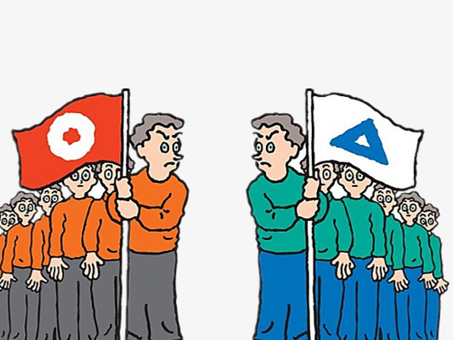
WARM-UP
GAME: WHO’S FASTER?
The class works in two teams
Run to the board to write as many ways to make your school greener as possible.
Which team has more correct answer will be the winner.

Slide 5
READING
A reporter is interviewing Nam, a member of the 3Rs Club. Read the interview. Find these words or phrases and underline them.
instead of
exchange
recycling bins
reusable
charity

Slide 6
READING
A reporter is interviewing Nam, a member of the 3Rs Club. Read the interview. Find these words or phrases and underline them.
exchange
reusable
charity
instead of
recycling bins
Reporter: Can you share with us some tips to make your school greener?
Nam: Sure. Firstly, we put recycling bins in every classroom.
Reporter: What about old books and uniforms?
Nam: We exchange them with our friends or give them to charity. We don’t throw them away.
Reporter: Anything else?
Nam: We borrow books from the school library instead of buying new ones.
Reporter: Great! You can save much paper.
Nam: And there’s another tip. We bring reusable water bottles to school.
Reporter: I see lots of trees in your school. Is planting trees a good tip?
Nam: Yeah. It makes our school greener.
Reporter: Thanks for sharing. Do you want to add anything?
Nam: Finally, we usually find creative ways to reuse old items before throwing them away.

Slide 7
READING
Match the words / phrases with their meanings.
e. in the place of somebody or something
a. give something to a person and receive something from him / her
1. instead of
d. giving things to people in need
b. can be used again
2. charity
a. give something to a person and receive something from him / her
3. exchange
c. containers for things that can be recycled
b. can be used again
4. reusable
d. giving things to people in need
c. containers for things that can be recycled
5. recycling bins
e. in the place of somebody or something

Slide 8
VOCABULARY
charity (n)
/ˈtʃær.ə.ti/
an organization for helping people in need

Slide 9
VOCABULARY
recycling bin (n)
/ˌriːˈsaɪ.klɪŋ bɪn /
a container used to hold recyclables before they are taken to recycling centers

Slide 10
VOCABULARY
instead of (prep.)
/ɪnˈsted əv/
in the place of somebody or something

Slide 11
VOCABULARY
exchange (v)
/ɪksˈtʃeɪndʒ/
give something to a person and receive something from him / her

Slide 12
VOCABULARY
reusable (adj)
/ˌriːˈjuː.zə.bəl/
able to be used more than once

Slide 13
VOCABULARY
New words | Pronunciation | Meaning
1. instead of (prep.) | /ɪnˈsted əv/ | thay vì
2. charity (n) | /ˈtʃærəti/ | từ thiện
3. exchange (v) | /ɪksˈtʃeɪndʒ/ | trao đổi
4. reusable (adj) | /ˌriːˈjuːzəbl/ | có thể tái sử dụng
5. recycling bin (n) | /ˌriːˈsaɪklɪŋ bɪn/ | thùng rác tái chế

Slide 14
READING
Read the text again. Answer the questions.
1.
What is the interview about?
2.
What will they put in every classroom?
3.
What can they do with their old uniforms?
4.
What do they do instead of buying new books?
5.
What type of water bottles do they bring to school?

Slide 15
READING
Read the text again. Answer the questions.
1.
What is the interview about?
Ways to become greener at school/ tips to make school greener.
Reporter: Can you share with us some tips to make your school greener?
Nam: Sure. Firstly, we put recycling bins in every classroom.
Reporter: What about old books and uniforms?
Nam: We exchange them with our friends or give them to charity. We don’t throw them away.

Slide 16
READING
Read the text again. Answer the questions.
2.
What will they put in every classroom?
Recycling bins
Reporter: Can you share with us some tips to make your school greener?
Nam: Sure. Firstly, we put recycling bins in every classroom.
Reporter: What about old books and uniforms?
Nam: We exchange them with our friends or give them to charity. We don’t throw them away.

Slide 17
READING
Read the text again. Answer the questions.
3.
What can they do with their old uniforms?
Exchange old uniforms with friends or give them to charity
Reporter: Can you share with us some tips to make your school greener?
Nam: Sure. Firstly, we put recycling bins in every classroom.
Reporter: What about old books and uniforms?
Nam: We exchange them with our friends or give them to charity. We don’t throw them away.

Slide 18
READING
Read the text again. Answer the questions.
4.
What do they do instead of buying new books?
Borrow books from the library
Nam: We borrow books from the school library instead of buying new ones.
Reporter: Great! You can save much paper.
Nam: And there’s another tip. We bring reusable water bottles to school.
Reporter: I see lots of trees in your school. Is planting trees a good tip?

Slide 19
READING
Read the text again. Answer the questions.
5.
What type of water bottles do they bring to school?
Reusable water bottles
Nam: We borrow books from the school library instead of buying new ones.
Reporter: Great! You can save much paper.
Nam: And there’s another tip. We bring reusable water bottles to school.
Reporter: I see lots of trees in your school. Is planting trees a good tip?

Slide 20
SPEAKING
Discuss to put the tips in order from the easiest to the most difficult.
a.
Putting recycling bins in every classroom.
b.
Exchanging old books and uniforms with friends or giving them to charity.
c.
Borrowing books from the school library instead of buying new ones.
d.
d.
Bringing reusable water bottles to school.
Bringing reusable water bottles to school.
e.
Planting trees at school.
f.
Finding creative ways to reuse old items before throwing them away.
Can you add more tips to the list?

Slide 21
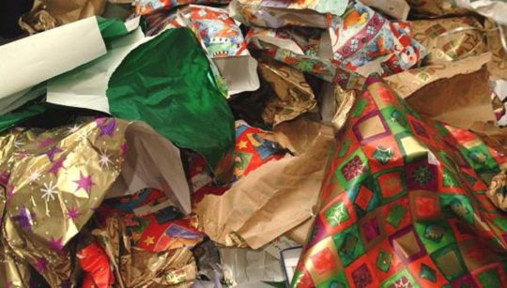
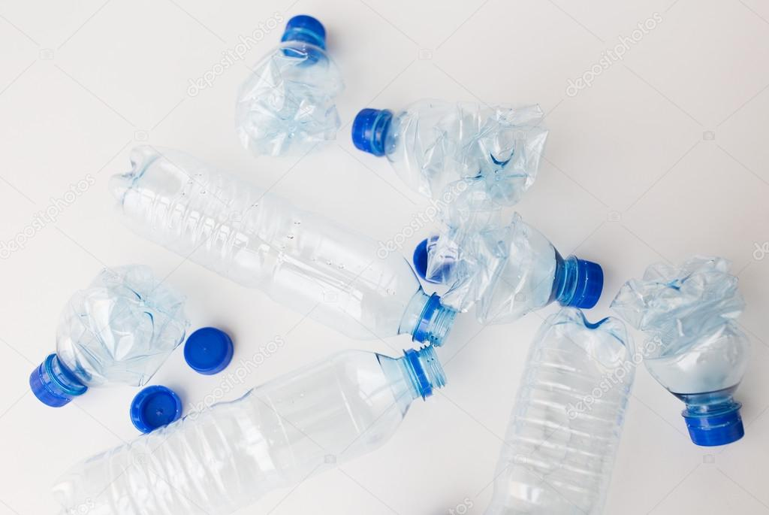
SPEAKING
Can you think of any ways to reuse
a. used gift wrap?
b. used water bottles?
c. used books?

Slide 22
CONSOLIDATION
1
Wrap-up
What have we learnt in this lesson?
Read the interview about some tips to make the schools greener.
Talk about tips for going green.

Slide 23
CONSOLIDATION
2
Homework
- Do exercises in the workbook.
- Prepare for the next lesson.

Slide 24
Website: hoclieu.vn
Fanpage: facebook.com/www.tienganhglobalsuccess.vn/

