Slide 2



Unit
11
OUR GREENER WORLD
LESSON 2: A CLOSER LOOK 1

Slide 3
LESSON 2: A CLOSER LOOK 1
WARM-UP
Listen to a song
Task 1: Match column A, B and C
Task 2: Write the words / phrases under each picture.
Task 3: Put the words / phrases into groups.
VOCABULARY
Task 4: Listen and repeat.
Task 5: Listen and practice.
PRONUNCIATION
Game: Board race
EXTRA ACTIVITY
CONSOLIDATION
Wrap-up
Homework

Slide 4

WARM-UP
Listen to a song!
-
Notes:
https://youtu.be/AOvcW8l3RzE?si=a7xItOoCUQib4Dbp

Slide 5




VOCABULARY
Draw a line from a symbol in column A to its matching word in column B and its meaning in column C.
A | B | C
 | Reduce | use something again
 | Reuse | create new products from used materials
 | Recycle | use less of something

Slide 6

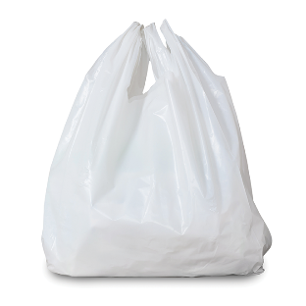
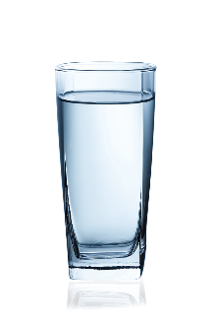

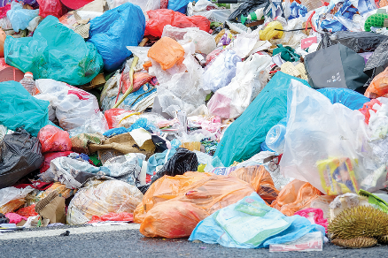

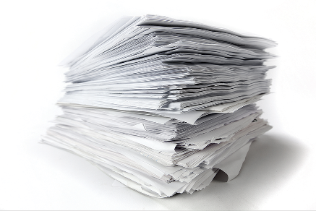

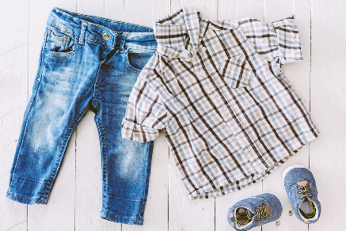
VOCABULARY
Write a word / phrase in the box under each picture.
rubbish
plastic bottle
glass
noise
plastic bag
paper
water
clothes

Slide 7
VOCABULARY
Write a word / phrase in the box under each picture.
rubbish
plastic bottle
glass
noise
plastic bag
paper
water
clothes
rubbish
plastic bag

Slide 8
VOCABULARY
Write a word / phrase in the box under each picture.
rubbish
plastic bottle
glass
noise
plastic bag
paper
water
clothes
glass
plastic bottle

Slide 9
VOCABULARY
Write a word / phrase in the box under each picture.
rubbish
plastic bottle
glass
noise
plastic bag
paper
water
clothes
noise
paper

Slide 10
VOCABULARY
Write a word / phrase in the box under each picture.
rubbish
plastic bottle
glass
noise
plastic bag
paper
water
clothes
water
clothes

Slide 11

VOCABULARY
Put the words from 2 into groups. Some words can belong to more than one group.
Reduce | Reuse | Recycle
rubbish
plastic bag
rubbish
plastic bag
glass
plastic bag
noise
plastic bottle
glass
plastic bottle
paper
plastic bottle
paper
water
paper
water
clothes

Slide 12


PRONUNCIATION
Listen to these sentences, then repeat.
1. If you cycle, it’ll help the Earth.
2. Water is good for your body.
3. The students are planting trees in the garden.
4. Is it better to use paper bags?
5. We are happy to walk to school.

Slide 13

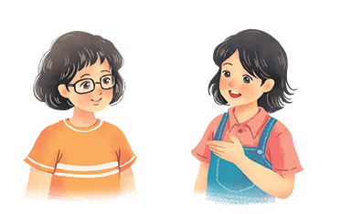
PRONUNCIATION
Listen to the conversation. Pay attention to the bold syllables.
Then practise the conversation with a classmate.
Vy: What are you doing?
Mi: I’m writing an article about going green.
Vy: Great! I’m writing a poem about the 3Rs.
Mi: Let me read it.
Vy: I’m still writing. Wait for a minute.

Slide 14

EXTRA ACTIVITY
Objects can be:
• Reduce
• Reuse
• Recycle

Slide 15

CONSOLIDATION
1
Wrap-up
What have we learnt in this lesson?
Vocabulary: The lexical items related to the 3Rs and 3Rs products.
Pronunciation: Rhythm in sentences

Slide 16

CONSOLIDATION
2
Homework
- Do exercises in the workbook.
- Find more words in the topic “Going green”.

Slide 17






Website: hoclieu.vn
Fanpage: facebook.com/www.tienganhglobalsuccess.vn/

