Slide 2



Unit
11
OUR GREENER WORLD
LESSON 1: GETTING STARTED
Let’s go green

Slide 3
LESSON 1: GETTING STARTED
WARM-UP
Crossword puzzle
PRESENTATION
Vocabulary
Task 1: Listen and read
Task 2: Read and complete the sentences.
Task 3: Match column A and B.
Task 4: Match the pictures.
PRACTICE
PRODUCTION
Task 5: Quiz: Find someone who…
Wrap-up
Homework
CONSOLIDATION

Slide 4
WARM-UP
Chitchatting
Do you like to live in a green world? Why or why not?

Slide 5
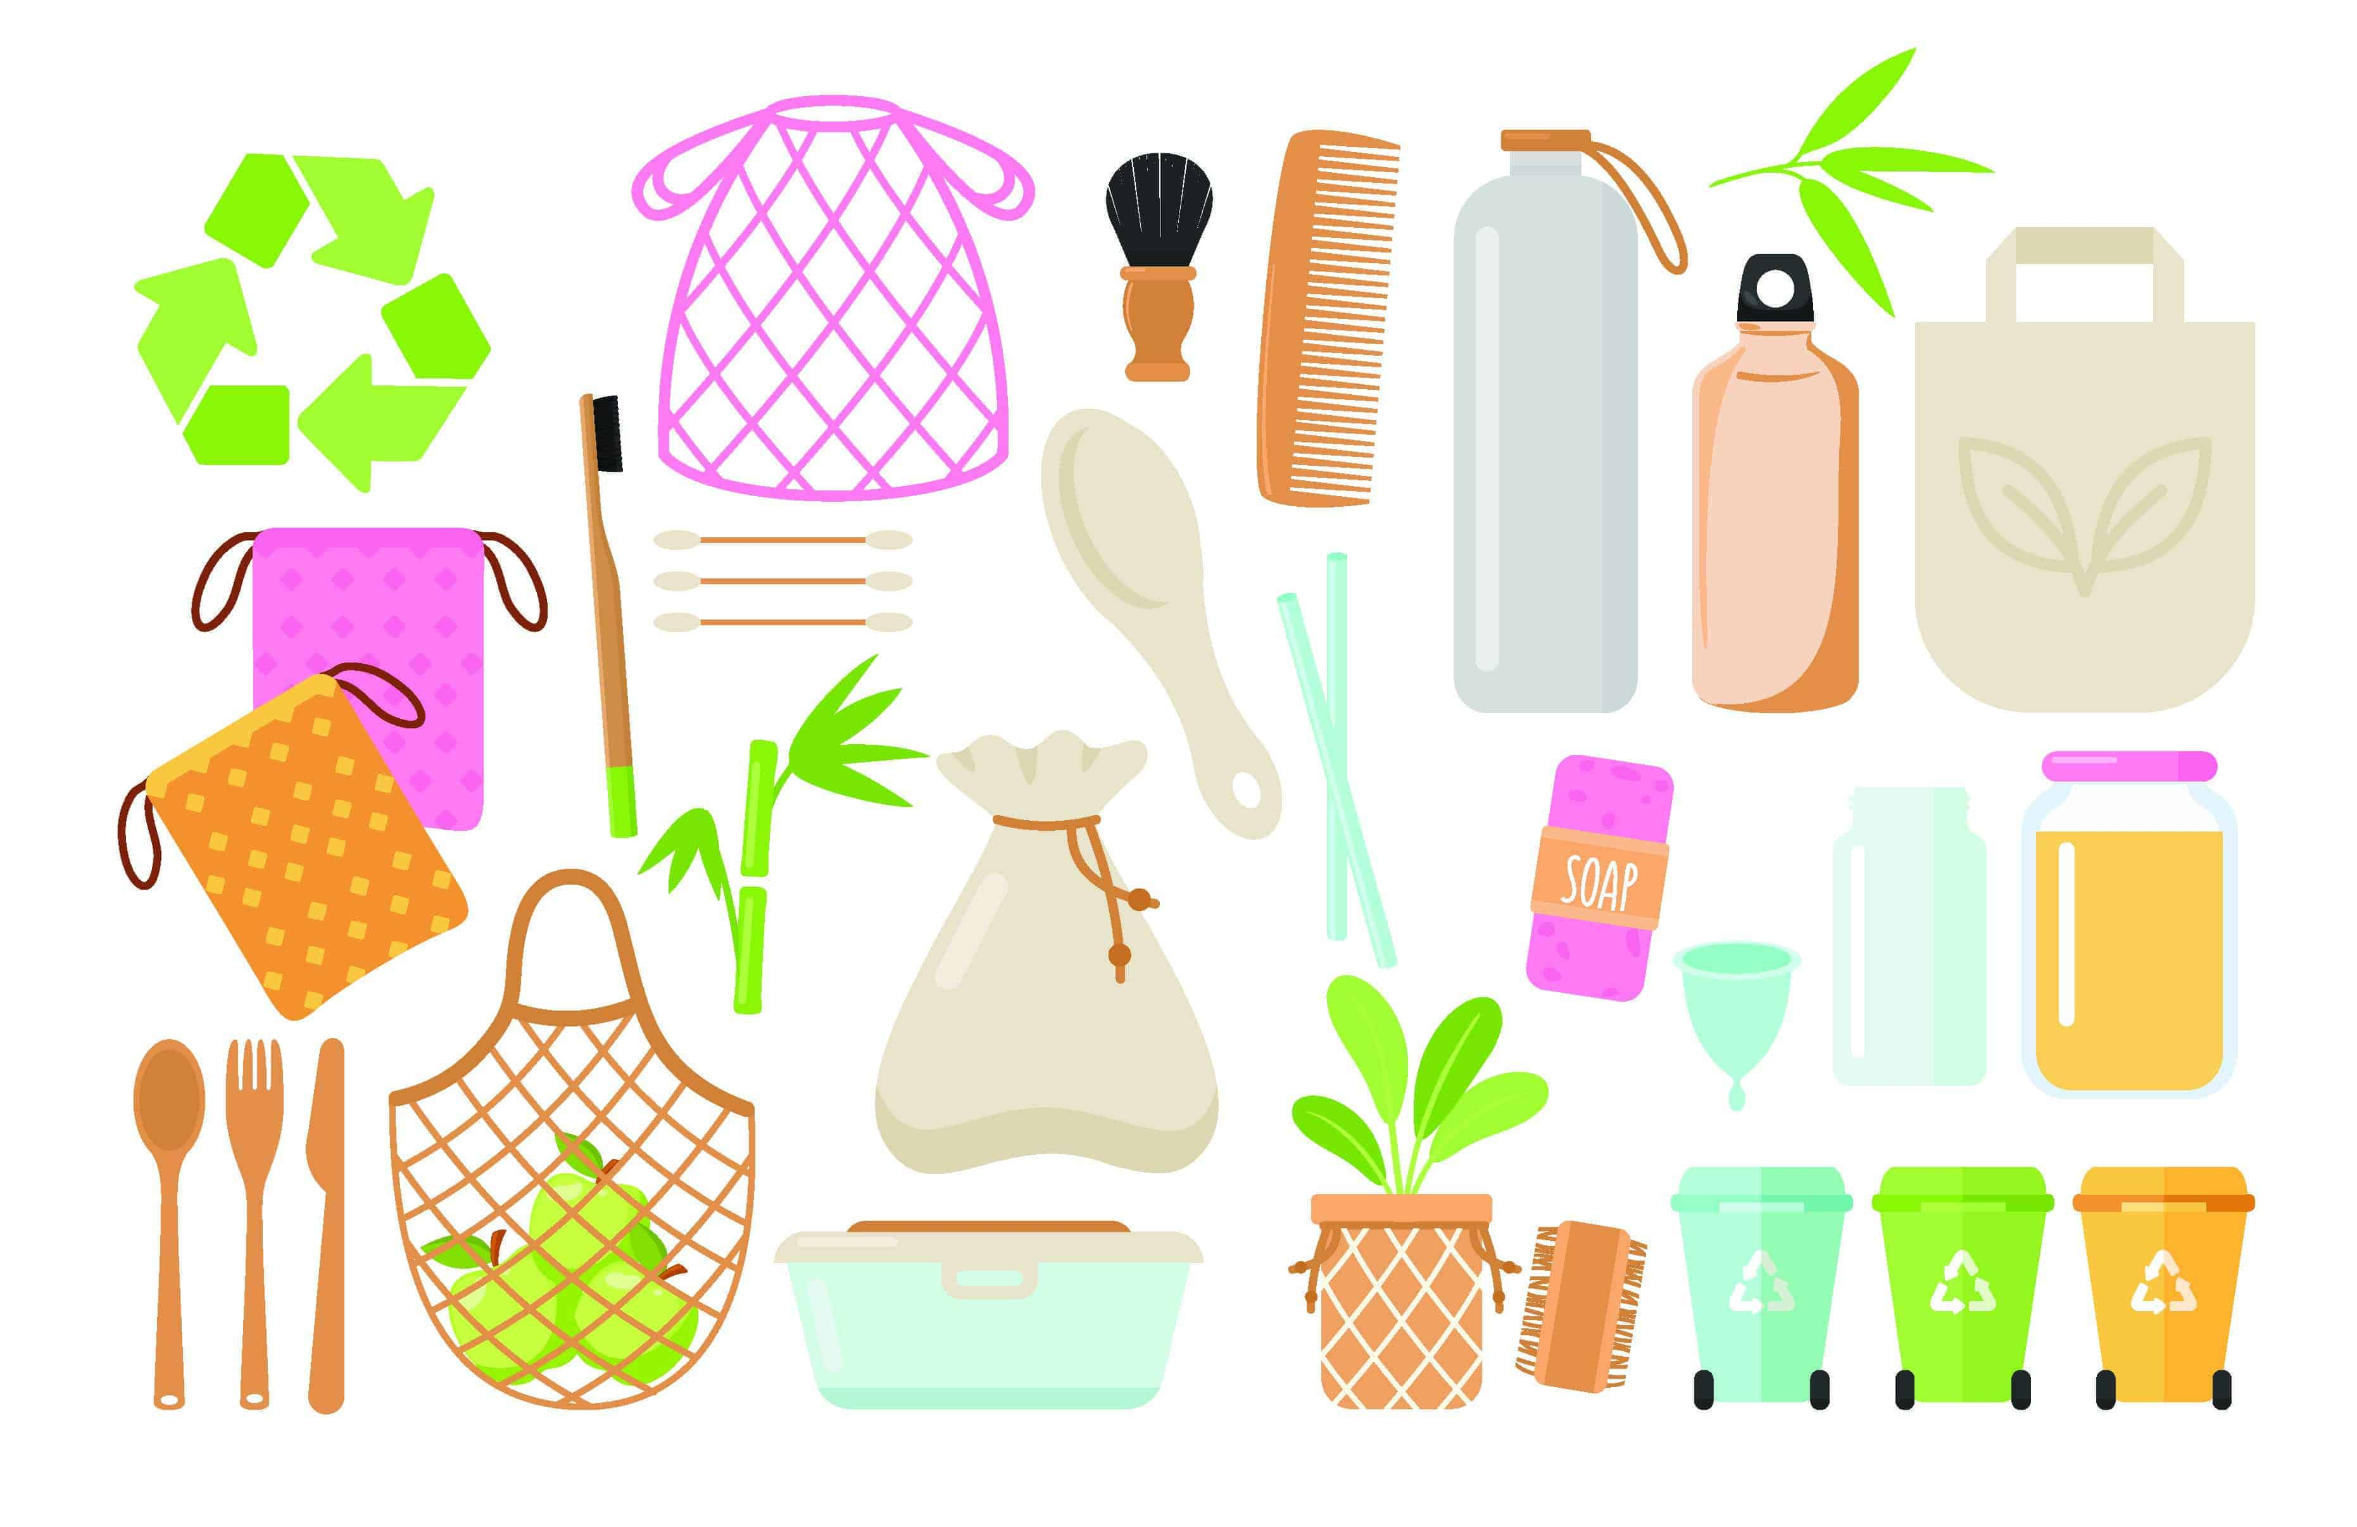

PRESENTATION
reusable (adj)
/ˌriːˈjuːzəbl/
có thể tái sử dụng

Slide 6
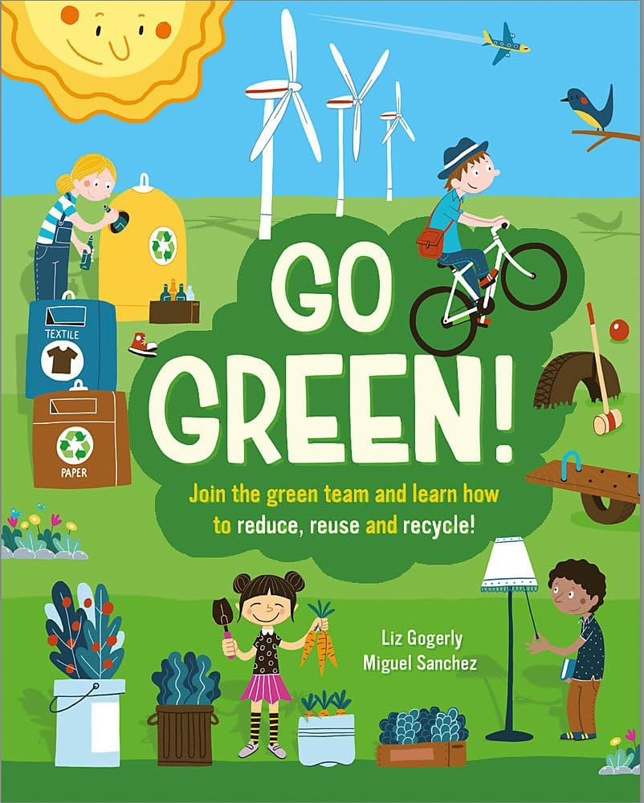
PRESENTATION
go green
/ɡəʊ ɡriːn/
sống xanh (thân thiện với môi trường)

Slide 7

PRESENTATION
environment
/ɪnˈvaɪrənmənt/
môi trường

Slide 8
PRESENTATION
New words | Pronunciation | Meaning
1. go green | /ɡəʊ ɡriːn/ | sống xanh
2. reusable (adj) | /ˌriːˈjuːzəbl/ | có thể tái sử dụng
3. environment (n) | /ɪnˈvaɪrənmənt/ | môi trường

Slide 9

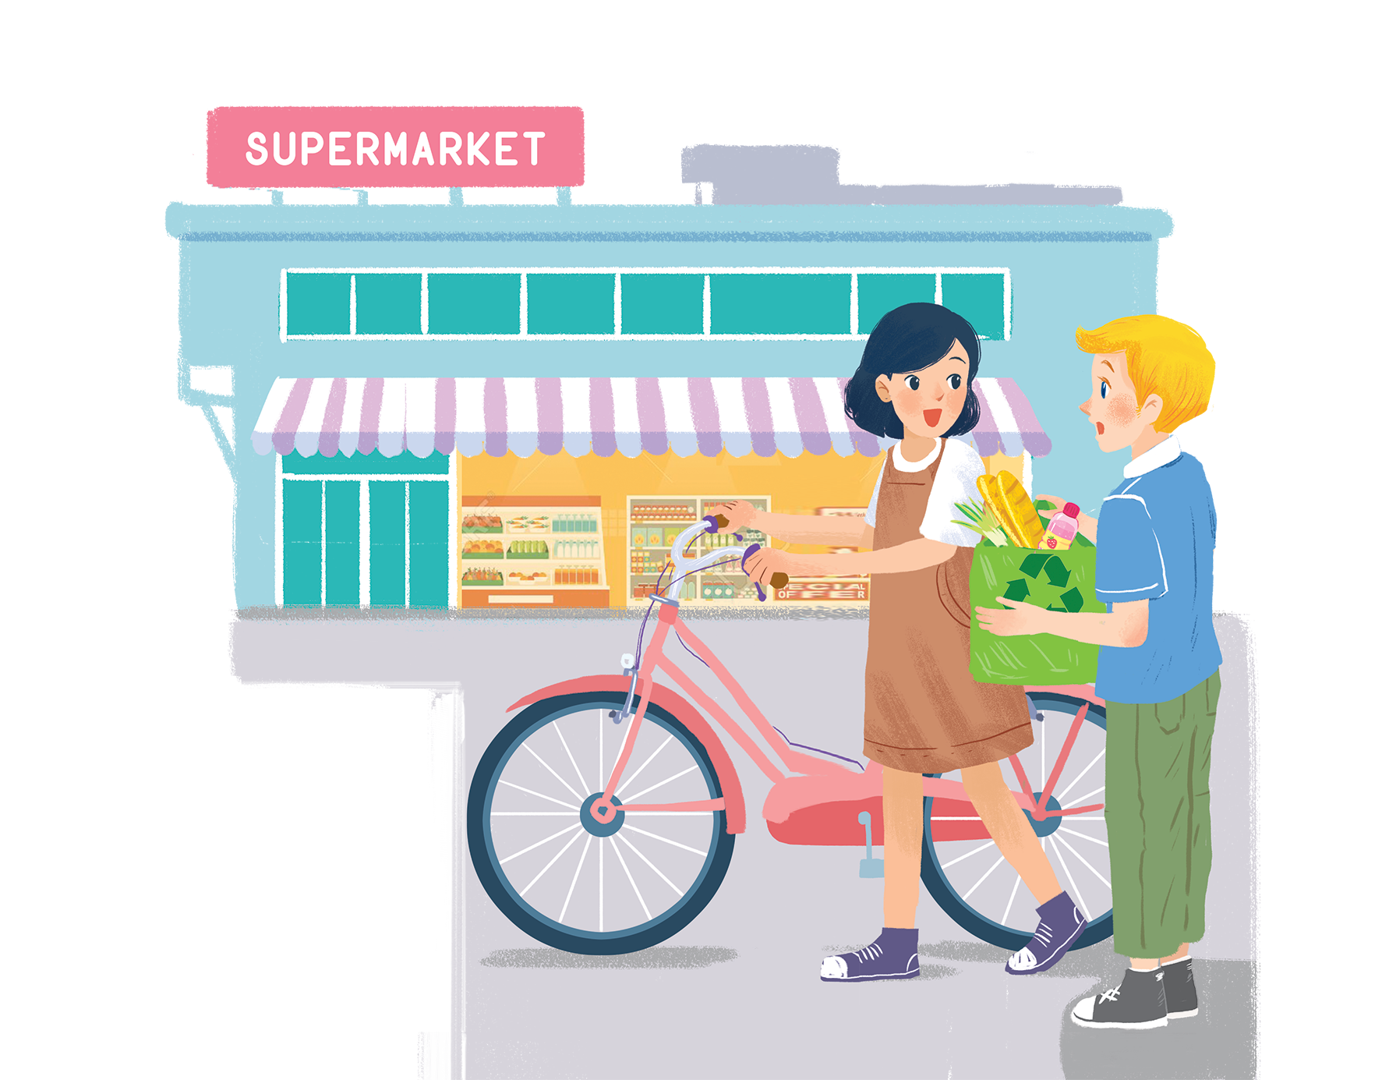
PRACTICE
Let’s go green!
Listen and read.
1. Who are they?
→ Nick and Mi.
2. Where are they?
→ At the supermarket.
3. What might they be talking about?
→ Ways to go green.

Slide 10

PRACTICE
Complete the following sentences. Use no more than three words in each blank.
1.
Nick is going on
a picnic tomorrow.
_______ tomorrow.
The green shopping bag is better than the
plastic one.
2.
_______.
3.
_______.
People can buy green bags at
the check-out.
4.
_______ bag for her mum.
Mi wants to buy
a reusable bag for her mum.
_______.
5.
Nick thinks that Mi is green because
she’s cycling.

Slide 11

PRACTICE
Based on the ideas in the conversation, match the first half of the sentence in column A with its second half in column B.
A
1. Green bags are better
2. The air will be cleaner
3. If people use reusable bags for shopping,
B
B
b. than plastic bags.
c. if more people cycle.
a. they will help the environment.
a. they will help the environment.
b. than plastic bags.
c. if more people cycle.

Slide 12

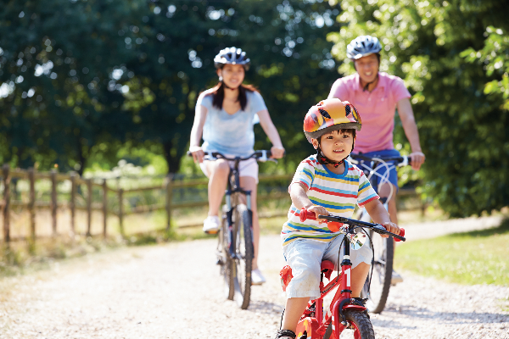
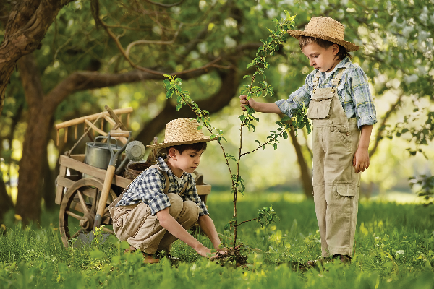
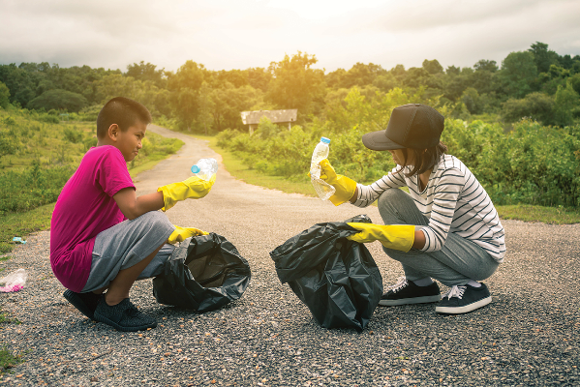
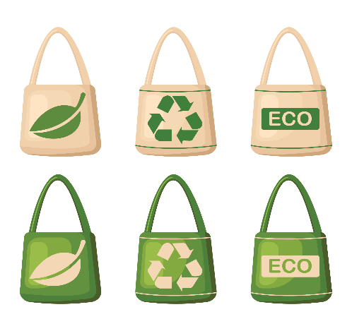
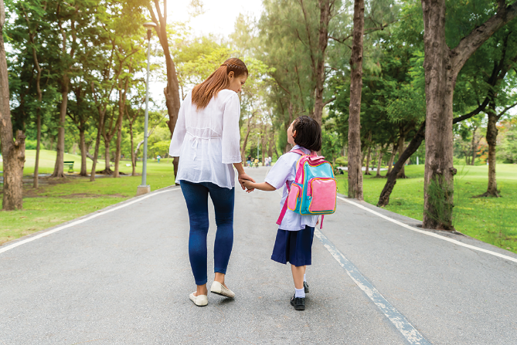
PRACTICE
Match the pictures with the ways to help the environment.
a.
planting trees and flowers
b.
picking up rubbish
d.
walking to school
e.
using reusable bags when shopping
c.
cycling
1
2
3
4
5

Slide 13
PRACTICE
Match the pictures with the ways to help the environment.
a.
planting trees and flowers
b.
picking up rubbish
d.
walking to school
e.
using reusable bags when shopping
c.
cycling
1
c.
cycling

Slide 14
PRACTICE
Match the pictures with the ways to help the environment.
a.
planting trees and flowers
b.
picking up rubbish
d.
walking to school
e.
using reusable bags when shopping
2
planting trees and flowers
a.

Slide 15
PRACTICE
Match the pictures with the ways to help the environment.
b.
picking up rubbish
d.
walking to school
e.
using reusable bags when shopping
3
picking up rubbish
b.

Slide 16
PRACTICE
Match the pictures with the ways to help the environment.
d.
walking to school
e.
using reusable bags when shopping
4
e.
using reusable bags when shopping

Slide 17
PRACTICE
Match the pictures with the ways to help the environment.
d.
walking to school
5
d.
walking to school

Slide 18


PRODUCTION
Find someone who ... Work in groups. Ask and answer to find someone who does the things in 4.
Ways to help the environment | Names
1. Planting trees and flowers
2. Picking up rubbish
3. Cycling
4. Walking to school
5. Using reusable bags when shopping
A: Do you plant trees?
B: No, I don’t.
A: Do you pick up rubbish?
B: Yes, I do.

Slide 19

CONSOLIDATION
1
Wrap-up
What have we learnt in this lesson?
Vocabulary: The lexical items related to Go Green
Some ways to help the environment

Slide 20

CONSOLIDATION
2
Homework
- Do exercises in the workbook.
- Start preparing for the Project in Lesson 7

Slide 21






Website: hoclieu.vn
Fanpage: facebook.com/www.tienganhglobalsuccess.vn/

