Slide 1

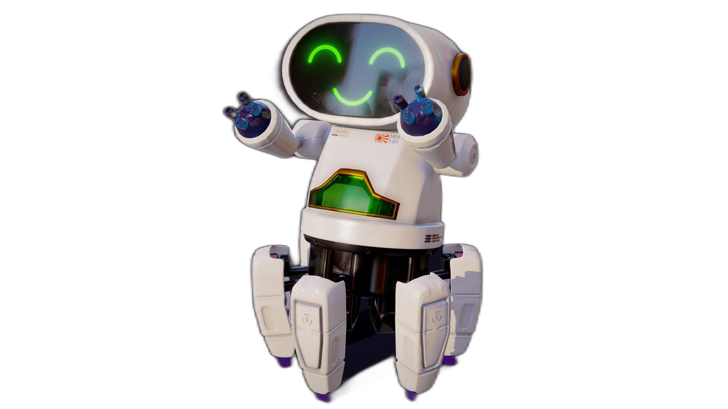

Slide 2


Unit
12
ROBOTS
LESSON 7: LOOKING BACK & PROJECT

Slide 3

LESSON 7: LOOKING BACK & PROJECT
LESSON 1: GETTING STARTED
WARM-UP
Quiz
Vocabulary
Task 1: Write the correct words.
Task 2: Fill in the blank.
Grammar
Task 3: Complete the paragraph.
Task 4: Complete the sentences.
LOOKING BACK
PROJECT
Robot design competition
CONSOLIDATION
Wrap-up
Homework

Slide 4

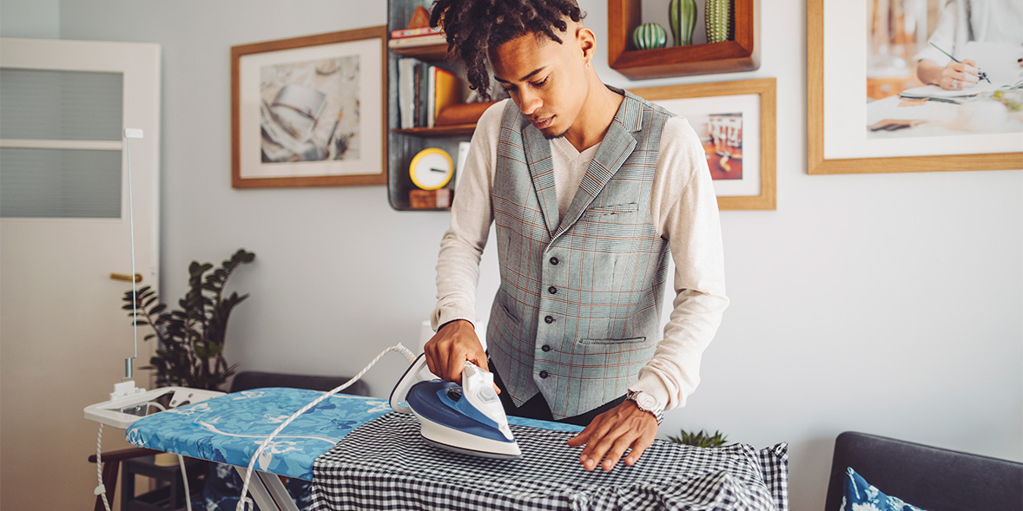
WARM-UP
QUIZ
TIME

Slide 5
WARM-UP
Look at the pictures.
Write your answers in your miniboard.
The one having the most correct answers is the winner.

Slide 6

WARM-UP
iron the clothes
1. ________________________

Slide 7
WARM-UP
move heavy things
2. ________________________

Slide 8
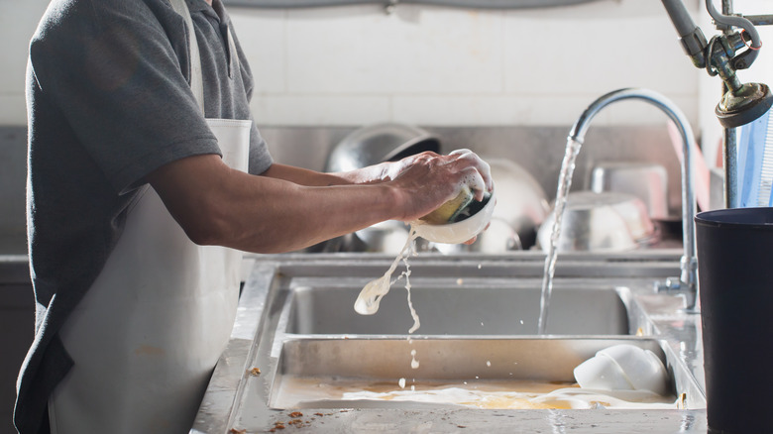
WARM-UP
pick fruit
3. ________________________

Slide 9
WARM-UP
do the dishes/wash dishes
4. ________________________

Slide 10
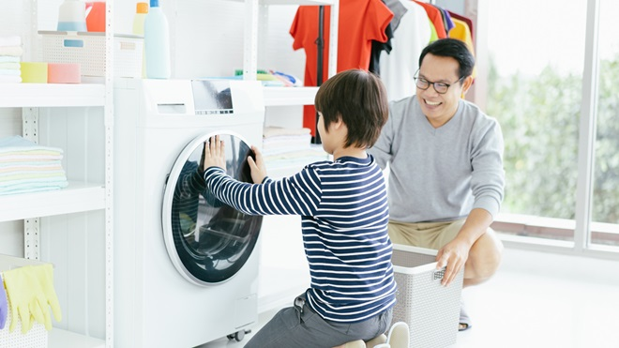
WARM-UP
do the washing/wash clothes
5. ________________________

Slide 11


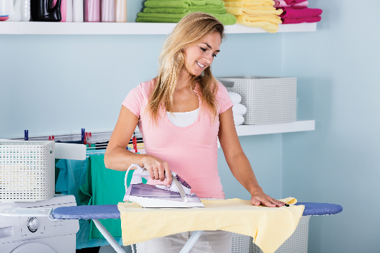
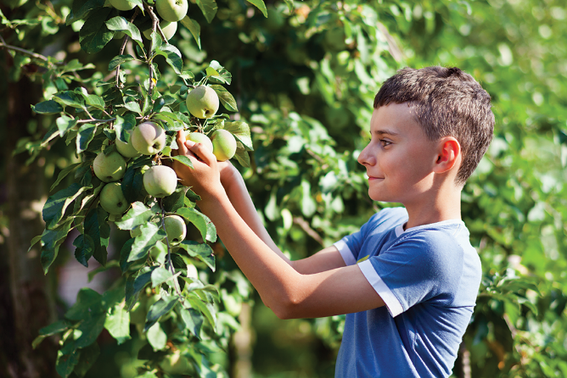
LOOKING BACK
Write the correct words to complete the phrases.
2.
_______ heavy things
1.
_______ the clothes
2.
move heavy things
1.
iron the clothes
3.
_______ fruit
3.
pick fruit

Slide 12
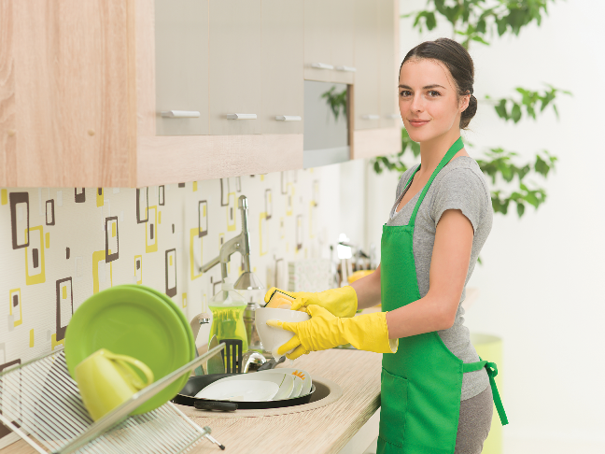

LOOKING BACK
Write the correct words to complete the phrases.
4.
4.
_______ the dishes
do the washing
5.
do the _______
5.
do the dishes

Slide 13

LOOKING BACK
Fill in the blanks with the verbs from the box.
water | make | repair | work | understand
work
1. Robots can_______ as guards when we’re away.
2. We rarely go to restaurants because my father can _______ delicious meals at home.
make
repair
3. Can you_______ my broken clock?

Slide 14
LOOKING BACK
Fill in the blanks with the verbs from the box.
water | make | repair | work | understand
understand
4. Can robots_______ our feelings
water
5. My father and I _______ the plants in our garden every morning.

Slide 15

LOOKING BACK
Welcome to our company. We’ve made the (1. smart) __________ robot in the world. It’s the (2. small) __________ and the (3. light) __________ we’ve made but it can do many things in your house. It can even fly to clean the ceilings. It can teach children all school
subjects. It’s also the (4. strong) __________ in our lab because it can move more than 200 kg. It’s not difficult to own a robot like this because it’s one of the (5. cheap) __________ robots in the world.
smartest
Use the correct form of the adjectives in brackets to complete the paragraph.
smallest
lightest
strongest
cheapest

Slide 16

LOOKING BACK
Complete the sentences with the superlative form of the adjectives in the brackets.
highest
1. What is the (high) mountain in the world?
largest
2. What is the (large) lake in Viet Nam?
longest
3. What is the (long) beach in Viet Nam?
widest
4. What is the (wide) river in the world?
hottest
5. What is the (hot) desert in the world?
Do you know the answers?

Slide 17

Robot Design Competition

Slide 18
Robot
Design
Competition
PROJECT
Work in groups
Think about the robot you will design and fill in the table
Design your amazing robot in the A0 paper.
Robot Design Competition

Slide 19
PROJECT
Robot name
Appearance (weight, height, etc.)
Where it can work
What it can do
Robot
Design
Competition

Slide 20

PROJECT
Draw your robot here
Robot
Design
Competition

Slide 21
PROJECT
Present your designs to other groups. Vote on the best robot.
Robot
Design
Competition

Slide 22

CONSOLIDATION
1
Wrap-up
What have we learnt in this lesson?
Review the vocabulary and grammar of Unit 12
Apply what they have learnt (vocabulary and grammar) into practice through a project

Slide 23

CONSOLIDATION
2
Homework
- Do exercises in the workbook.
- Prepare for the next lesson.

Slide 24






Website: hoclieu.vn
Fanpage: facebook.com/www.tienganhglobalsuccess.vn/

