Slide 2
Unit
12
ROBOTS
LESSON 2: A CLOSER LOOK 1

Slide 3
LESSON 2: A CLOSER LOOK 1
LESSON 1: GETTING STARTED
WARM-UP
Game: Matching
Vocabulary
Task 1: Match, listen, check and repeat.
Task 2: Tell the activities in 1.
Task 3: Ask and answer.
VOCABULARY
Task 4: Listen and repeat.
Task 5: Practice saying the statements.
PRONUNCIATION
EXTRA ACTIVITY
Game: Word jumble race
CONSOLIDATION
Wrap-up
Homework

Slide 4
WARM-UP
MATCHING

Slide 5
WARM-UP
- Work in groups
- Match the names of daily activity with suitable picture
- The fastest group will say “Bingo” and stick your work on board.

Slide 6
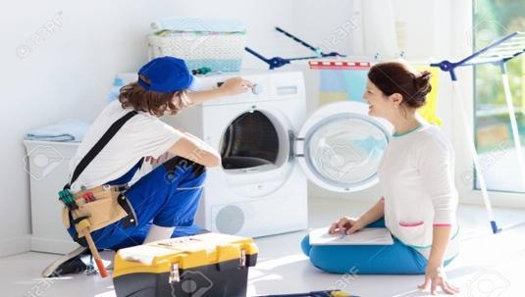
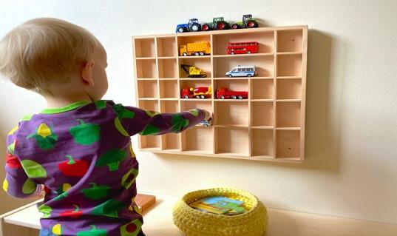
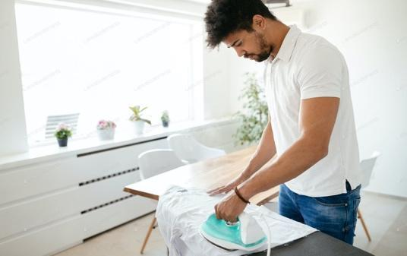
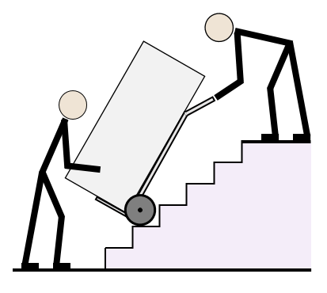
WARM-UP

Slide 7
WARM-UP

Slide 8
WARM-UP
make meals

Slide 9
WARM-UP
iron clothes

Slide 10
WARM-UP
repair a broken machine

Slide 11
WARM-UP
do the washing

Slide 12
WARM-UP
move heavy things

Slide 13
WARM-UP
put toys away

Slide 14
VOCABULARY
water (v)
/ˈwɔːtər/
to pour water on plants, etc.

Slide 15
VOCABULARY
guard (n)
/ɡɑːrd/
a person, such as a soldier, a police officer or a prison officer, who protects a place or people
Ex: He made several helpful suggestions.

Slide 16
VOCABULARY
helpful (adj)
/ˈhelpfl/
Ex: He made several helpful suggestions.
willing to help, or useful
New words | Pronunciation | Meaning
1. water (v) | /ˈwɔːtər/ | tưới nước
2. guard (n) | /ɡɑːrd/ | bảo vệ
3.helpful (adj) | /ˈhelpfl/ | có ích

Slide 17
/ˈhelpfl/
helpful (adj)
willing to help, or useful:
VOCABULARY
New words | Pronunciation | Meaning
1. water (v) | /ˈwɔːtər/ | tưới nước
2. guard (n) | /ɡɑːrd/ | bảo vệ
3.helpful (adj) | /ˈhelpfl/ | có ích
Ex: He made several helpful suggestions.

Slide 18
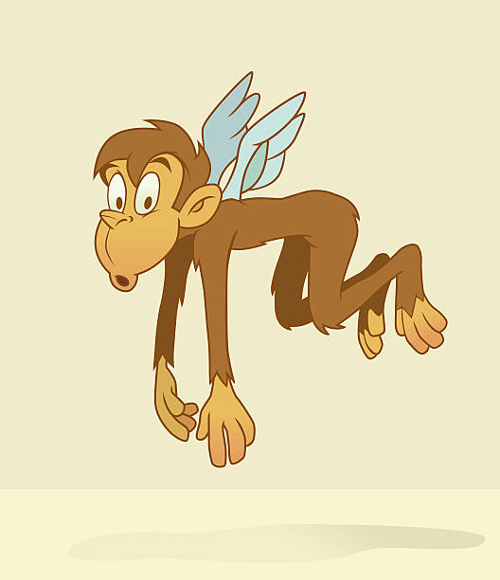
VOCABULARY
Match the verbs in column A to the words or phrases in column B. Then listen, check and repeat them.
A | B
1. understand | a. fruit
2. pick | b. the washing
3. do | c. our feelings
4. water | d. as a guard
5. work | e. plants
c
1.
2.
3.
4.
5.
a
b
e
d
CAN’T
The monkey can’t fly
CAN
The monkey can climb tree

Slide 19
VOCABULARY
Tell your partner the activities in 1 you can or can’t do.
CAN
The monkey can climb trees.
CAN’T
The monkey can’t fly.

Slide 20
VOCABULARY
Tell your partner the activities in 1 you can or can’t do.
Example:
I can pick fruit but I can’t understand your feelings.

Slide 21
VOCABULARY
Read the information about what V10, a robot, can or can’t do. Ask and answer questions.
Example:
Skills of V10 | Can | Can’t
repair a broken machine |  | 
do the washing | 
work as a guard | 
read our moods |  | 
water plants | 
understand what we say |  | 
A: Can V10 do the washing?
B: Yes, it can.
A: Can V10 repair a broken machine?
B: No, it can’t.

Slide 22
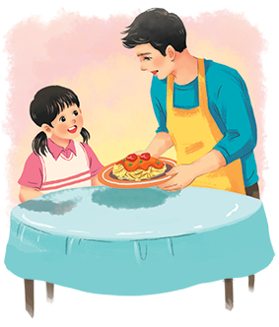
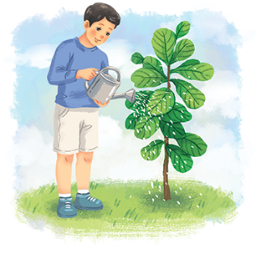
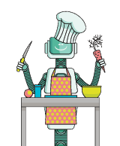
PRONUNCIATION
Listen and repeat the following sentences.
1.
I often water plants after school.
2.
Shifa can do many things like humans.
3.
My dad makes delicious meals at weekends.
4.
WB2 is the strongest of all the robots.
5.
H8 is a home robot.

Slide 23
PRONUNCIATION
Practise saying the statements in the following paragraph. Then listen and repeat.
My robot is Jimba. It’s a home robot. It’s very helpful. It can do the housework. It can also water plants and pick fruit. It can work as a guard. I love my robot very much.

Slide 24
EXTRA ACTIVITY
WORD JUMBLE RACE
1. I/ plants/ often/ after school./ water
2. My mother/ on Mondays./ delicious/ meals/ makes
3. Home robot/ housework/ pick/ can/ and/ fruit./ do
4. do / V10 Robot/ washing. / can/ the
I often water plants after school.
My mother makes delicious meals on Mondays.
Home robot can do housework and pick fruit.
V10 Robot can do the washing.

Slide 25
CONSOLIDATION
1
Wrap-up
What have we learnt in this lesson?
use the lexical items related to the topic Robots;
use the vocabulary and structures to talk about what a robot can and cannot do;
pronounce and recognize the falling tone in statements.

Slide 26
CONSOLIDATION
2
Homework
- Do exercises in the workbook.
- Write a text to describe V10 using the sample in Task 5 and information in Task 3.

Slide 27
Website: hoclieu.vn
Fanpage: facebook.com/www.tienganhglobalsuccess.vn/

