Slide 2
Unit
3
MY FRIENDS
LESSON 1: GETTING STARTED
A surprise guest
1

Slide 3
LESSON 1: GETTING STARTED
LESSON 1: GETTING STARTED
WARM-UP
The body part song
PRESENTATION
Vocabulary
Task 1: Listen and read.
Task 2: Fill the blanks with the words from the conversation.
Task 3: Label the body parts with the words in the box.
Task 4: Work in groups. Complete the word webs.
PRACTICE
PRODUCTION
Task 5: Game: Guessing
CONSOLIDATION
Wrap-up
Homework

Slide 4
WARM-UP
The
body part
song
Notes:
Teacher plays the song on speakers.
Teacher and students sing along and point at the mentioned body parts in the song lyrics. Do 2-3 times and make it faster each time.
Link: https://www.youtube.com/watch?v=YGi3f_fHIzg

Slide 5
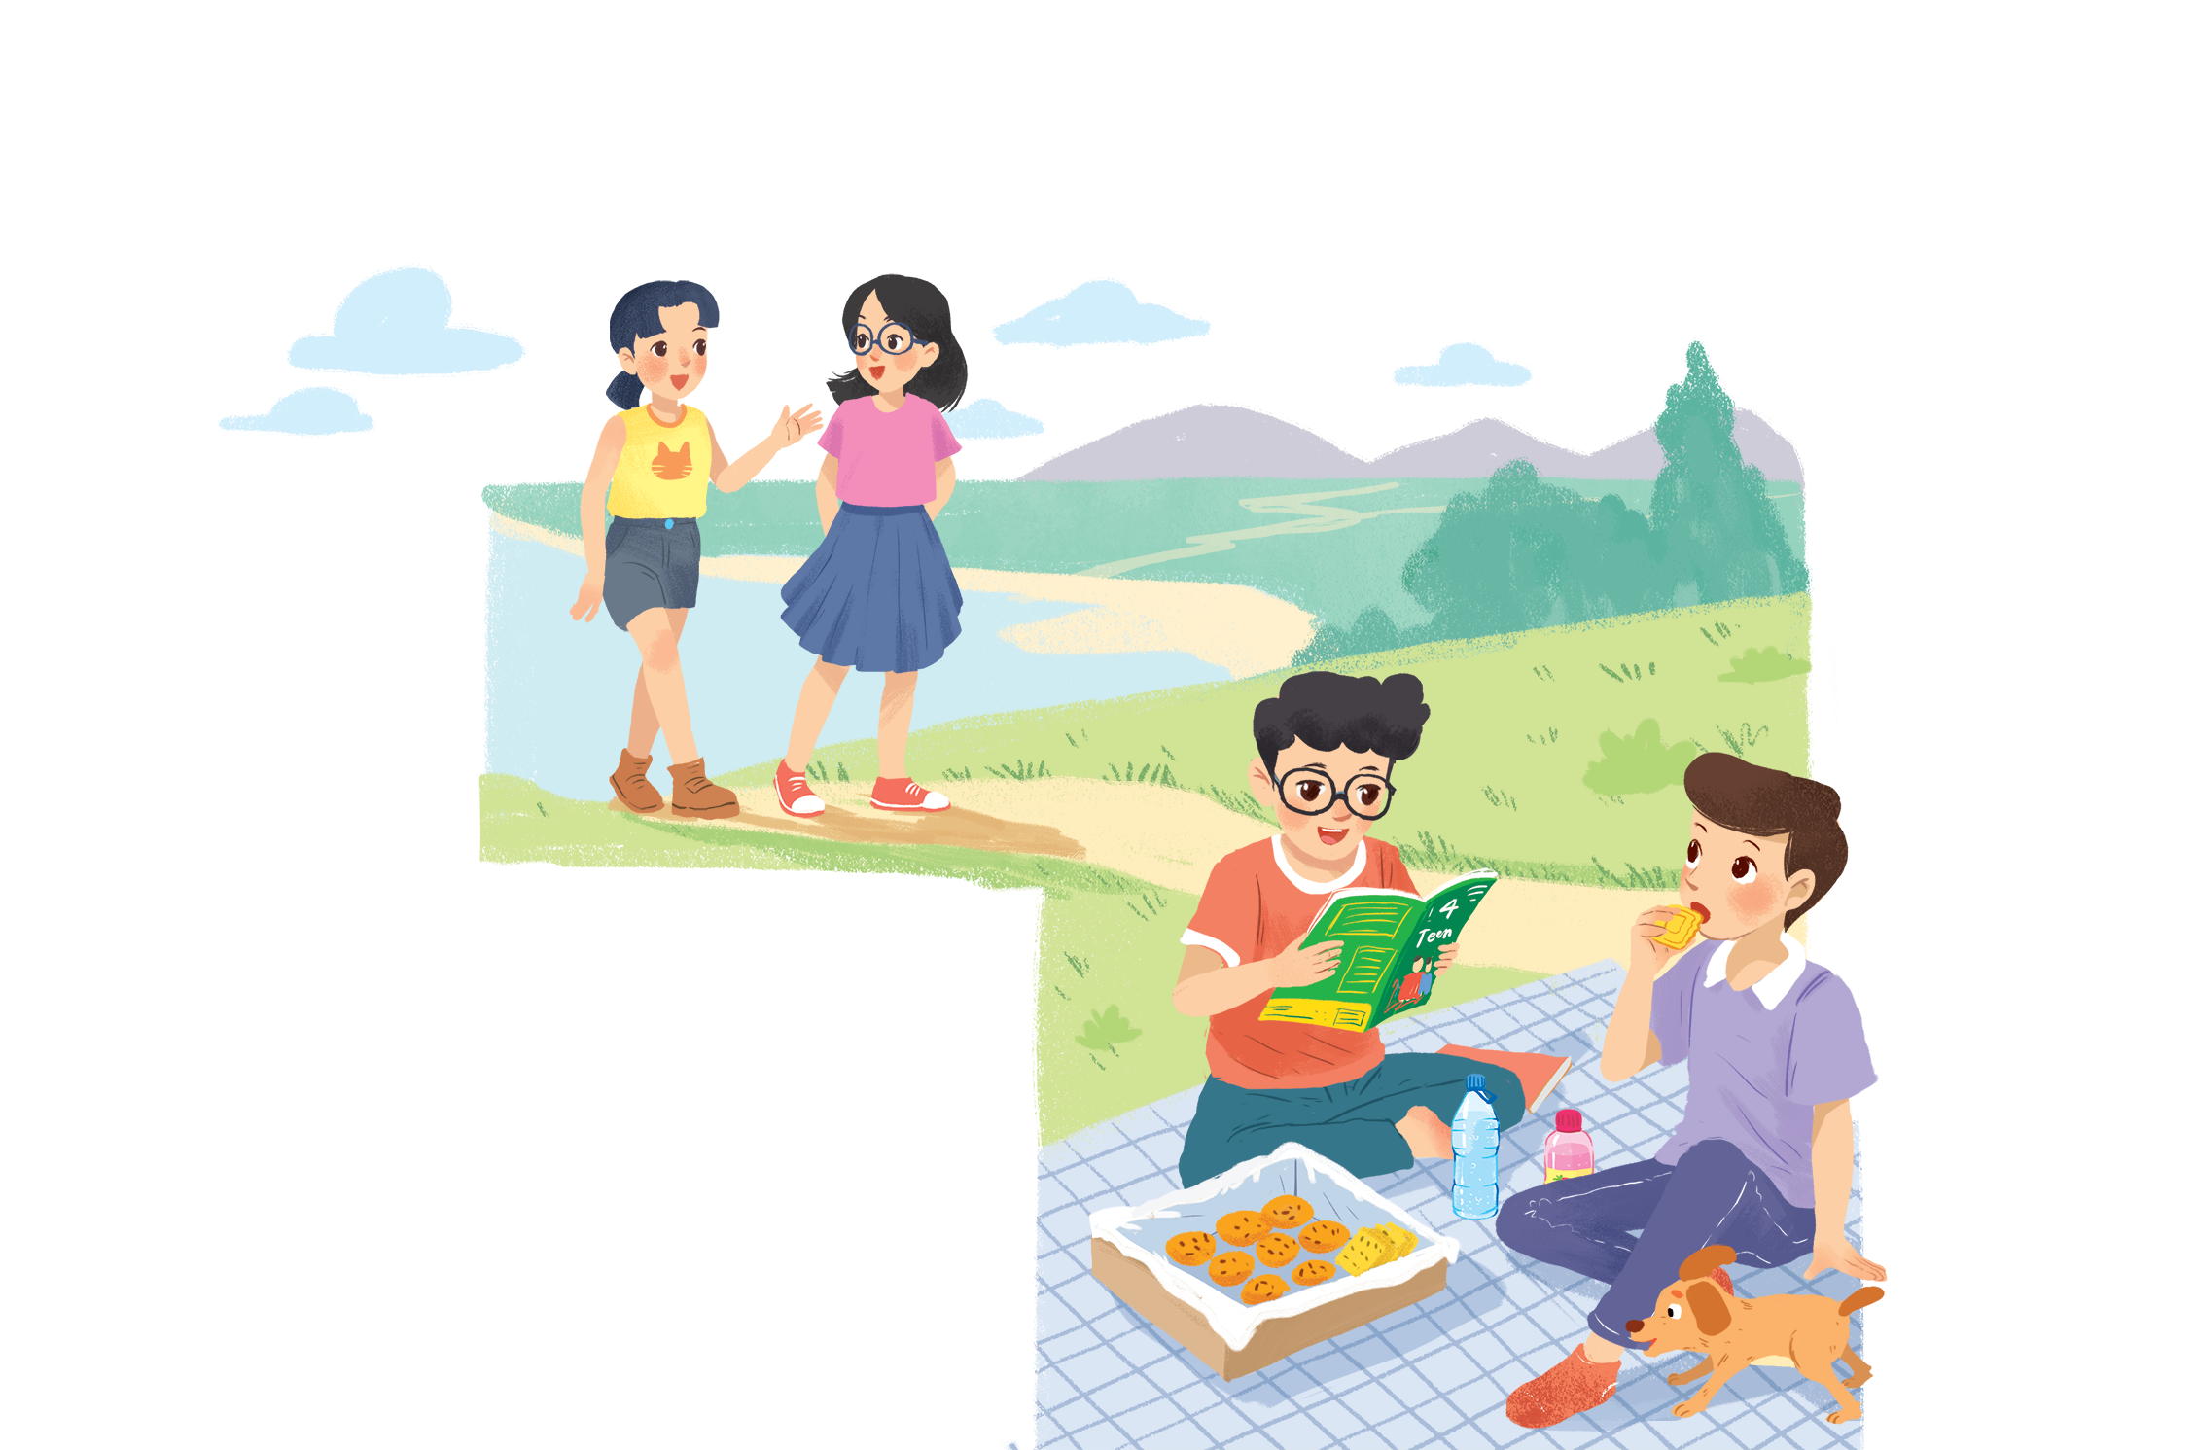
WARM-UP
A surprise guest
Answer the questions
1. What are Phong and Nam doing?
2. What is Phong’s favourite magazine?
3. Who do Phong and Nam see?
4. Where are the two girls going?
Notes:
Suggested answers:
They are having a picnic.
It’s …
They see …
They are going to …

Slide 6
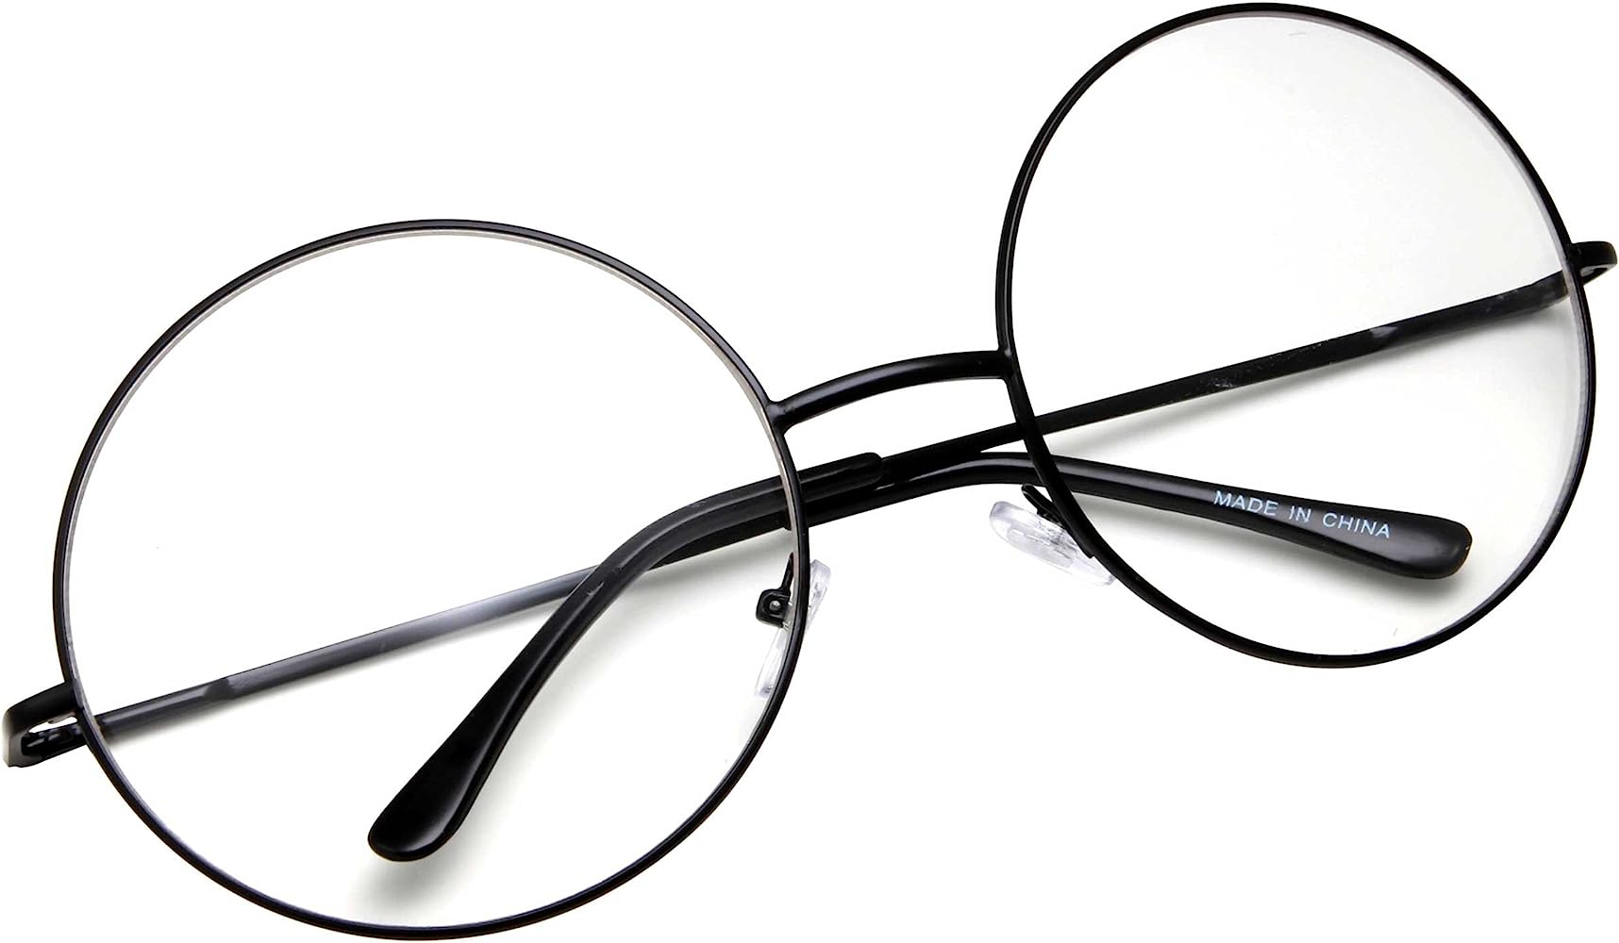
PRESENTATION
glasses (n)
/ˈɡlɑːsɪz/
mắt kính

Slide 7
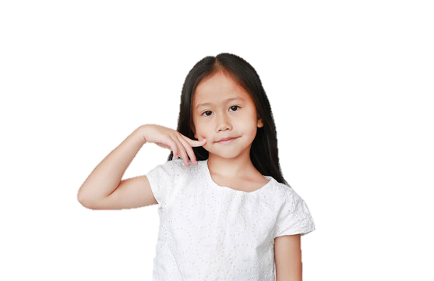
PRESENTATION
cheek (n)
/tʃiːk/
má

Slide 8
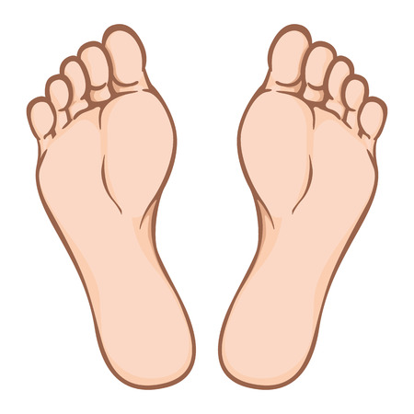
PRESENTATION
foot (n-s)
feet (n-p)
/fʊt/
/fiːt/
bàn chân

Slide 9
PRESENTATION
New words | Pronunciation | Meaning
1. glasses (n) | /ʌnˈjuːʒuəl/ | kính
2. cheek (n) | /tʃiːk/ | má
3. foot (n-s) / feet (n-p) | /fʊt/ /fiːt/ | bàn chân

Slide 10
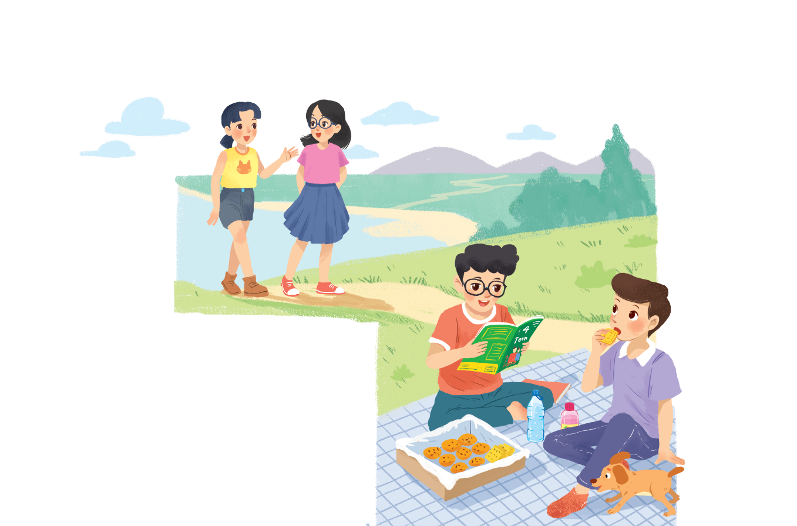
PRACTICE
1
Listen and read.
Phong: That was a great idea, Nam. I love picnics!
Nam: Please pass me the biscuits.
Phong: Sure. Here you are.
Nam: Thanks. What are you reading, Phong?
Phong: 4Teen. It’s my favourite magazine!
Nam: Look! It’s Mai. And she is with someone.
Phong: Oh, who’s that? She has glasses and long black hair.
Nam: I don’t know. They’re coming over.
Mai: Hi there. This is my friend Chau.
Phong & Nam: Hi, Chau. Nice to meet you.
Chau: Nice to meet you, too.
Nam: Would you like to sit down? We have lots of food.
Mai: Oh, sorry, we can’t. We’re going to the bookshop.
Chau: Bye for now.
Phong & Nam : Bye bye.

Slide 11
PRACTICE
1. What are Phong and Nam doing?
2. What is Phong’s favourite magazine?
3. Who do Phong and Nam see?
4. Where are the two girls going?
They are having a picnic.
It’s 4Teen.
They see their friends.
They are going to the bookstore.
Notes:
Suggested answers:
They are having a picnic.
It’s …
They see …
They are going to …

Slide 12
PRACTICE
2
Fill the blanks with the words from the conversation.
1. Phong and Nam are having a _______.
2. 4Teen is Phong’s __________________.
3. Phong and Nam see _____ and ______.
4. Chau has _________ and _______________.
5. Mai and Chau _____________ the bookshop.
picnic
favourite magazine
Mai
Chau
glasses
long black hair
are going to

Slide 13
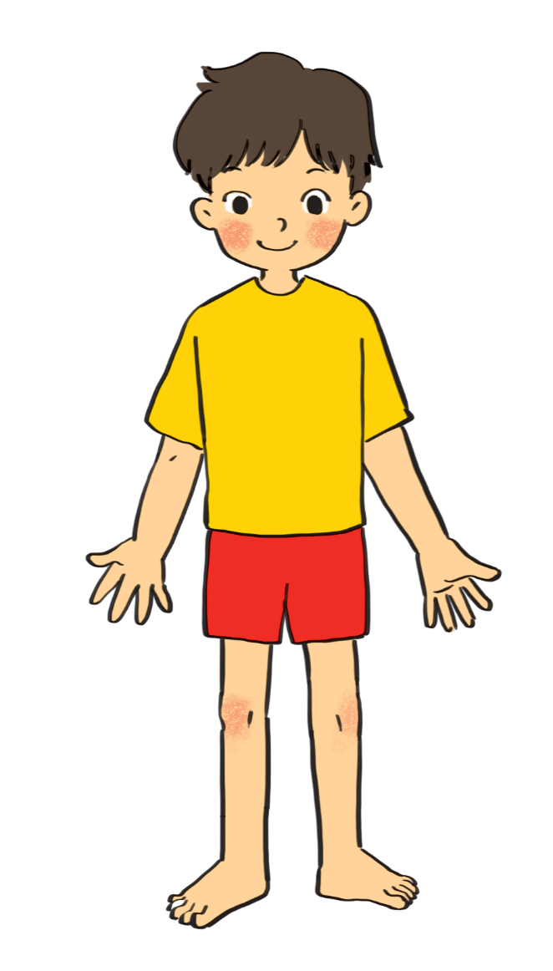
PRACTICE
3
Label the body parts with the words in the box.
1.
10.
9.
2.
8.
3.
7.
4.
5.
6.

Slide 14
PRACTICE
3
cheek
eye
hand
arm
mouth
cheek
eye
hand
arm
mouth
leg
nose
hair
shoulder
foot
leg
nose
hair
shoulder
foot
eye
hair
1.
10.
Do you know any other words for body parts?
2.
nose
9.
cheek
shoulder
8.
mouth
3.
7.
arm
4.
hand
5.
leg
foot
6.

Slide 15
PRACTICE
4
Work in groups. Complete the word webs.
arms
hair
nose
eyes
Example:
long / short
big / small
leg
hair
blonde
curly
hair

Slide 16
PRACTICE
4
Work in groups. Complete the word webs.
Example:
nose
eyes
big / small
head
feet
hand
ears

Slide 17
PRACTICE
4
Work in groups. Complete the word webs.
Example:
blonde
curly
long/ short
black
hair
wavy
straight
fair

Slide 18
PRODUCTION
5
Guessing
Work in groups. Take turns to describe a classmate. Other group members guess who he / she is.
Example:
A: She has long hair and big eyes.
B: Is that Lan?
A: That’s right.

Slide 19
CONSOLIDATION
1
Wrap-up
What have we learnt in this lesson?
identify the topic of the unit
use lexical items related to friends
identify the language features that are covered in the unit

Slide 20
CONSOLIDATION
2
Homework
- Write some sentences to describe at least 3 classmates.
- Do exercises in the workbook.
- Start preparing for the Project of the unit.

Slide 21
Website: hoclieu.vn
Fanpage: facebook.com/www.tienganhglobalsuccess.vn/

