Slide 2


Unit
2
MY HOUSE
LESSON 7: LOOKING BACK & PROJECT
1

Slide 3
LESSON 1: GETTING STARTED
LESSON 1: GETTING STARTED
WARM-UP
Categorising (Task 1)
Task 2: Complete the second sentence with the correct possessive form
Task 3: Make sentences using prepositions of place.
Task 4: Write three sentences to describe your favorite room
LOOKING BACK
PROJECT
Strange houses
CONSOLIDATION
Wrap-up
Homework

Slide 4

WARM-UP
CATEGORISING

Slide 5
TYPES OF HOUSE
ROOMS
FURNITURE
WARM-UP
flat,
town house,
kitchen,
bedroom,
sink,
fridge,
country house,
bathroom,
living room,
dishwasher,
cupboard,
stilt house,
cottage,
guest room,
hall,
chest of drawers,
farmhouse,
microwave,
villa,
dining room,
stool,
bungalow,
utility room,…
air conditioner, …

Slide 6

PRACTICE
2
Complete the second sentence with the correct possessive form.
1. My teacher has a house next to our house.
Our house is next to my ___________ house.
2. My brother has a TV.
This is my __________ TV.
3. Elena has a big bookshelf in her bedroom.
→ There’s a big bookshelf in _______ bedroom.
teacher’s
brother’s
Elena’s

Slide 7

PRACTICE
2
Complete the second sentence with the correct possessive form.
4. My grandfather likes the kitchen the best.
The kitchen is my _________ favourite room.
5. My aunt has a daughter, Vy.
I’m ______ cousin.
grandfather’s
Vy’s

Slide 8
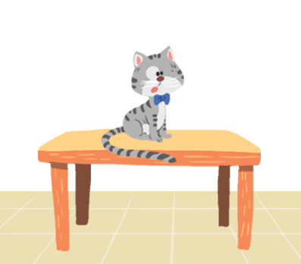
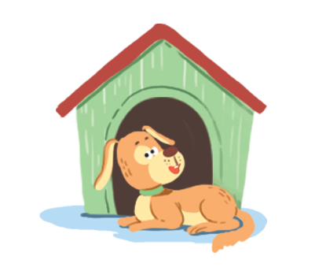


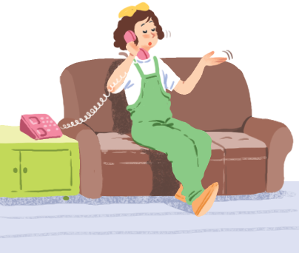
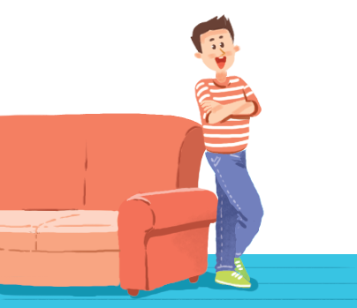
PRACTICE
3
Make sentences. Use prepositions of place.
1
2
3
4
5
6

Slide 9
PRACTICE
1. The cat _____________.
is on the table

Slide 10
PRACTICE
2. The dog _______________________.
is in front of the doghouse

Slide 11
PRACTICE
3. The cat ________________________________.
is between the sofa and the bookshelf

Slide 12
PRACTICE
4. The cat ____________________.
is behind the computer

Slide 13
PRACTICE
5. The girl _____________.
is on the sofa

Slide 14
PRACTICE
6. The boy ________________.
is next to the sofa

Slide 15
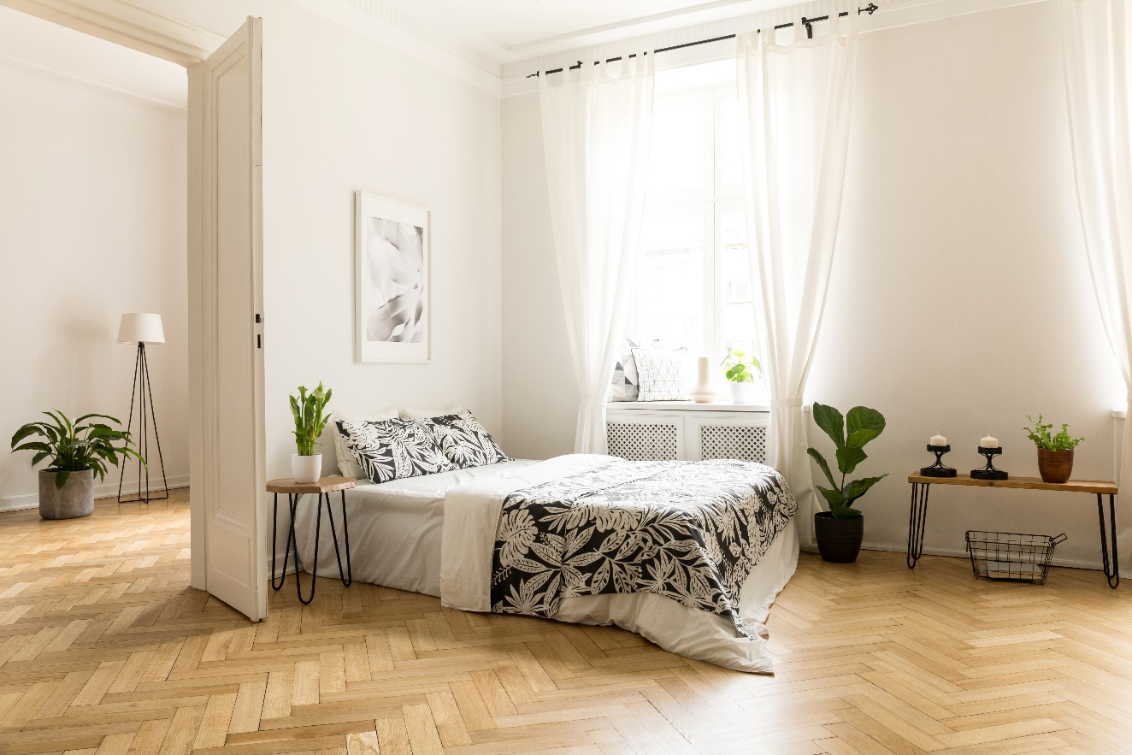
PRACTICE
4
Write three sentences to describe your favourite room in your house.
Write the sentences in your notebook.
Example:
There’s a big bed next to the door.

Slide 16
Unit
2
MY HOUSE
1
PROJECT

Slide 17


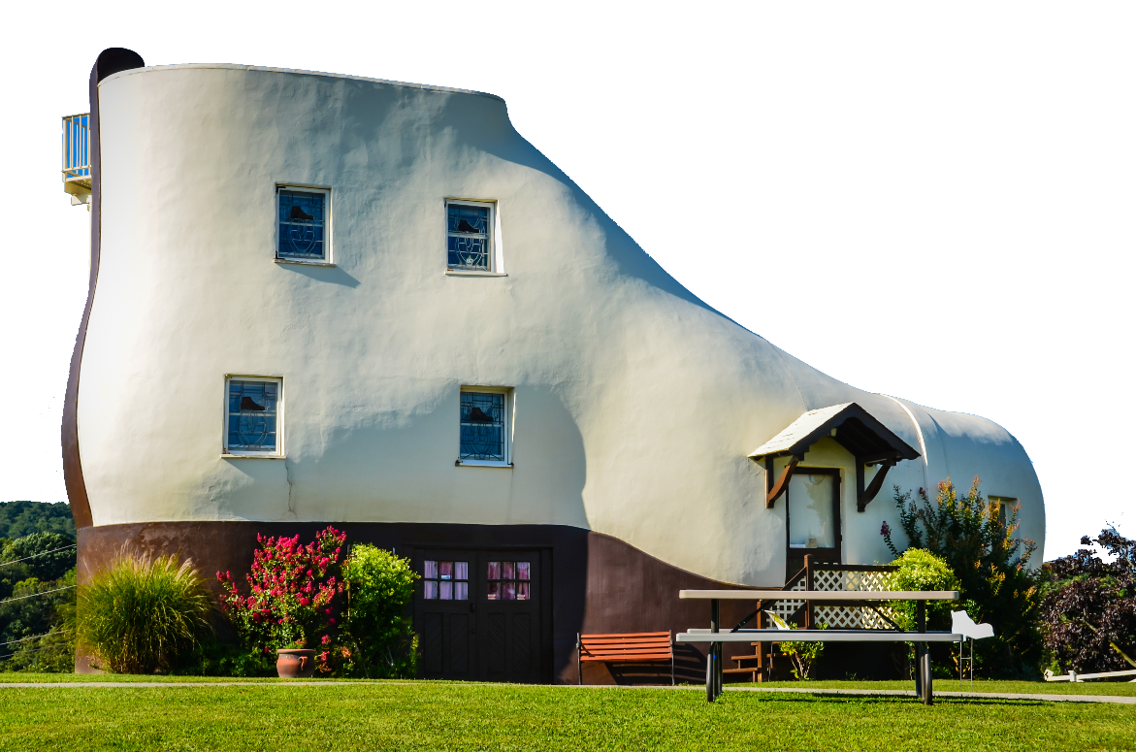
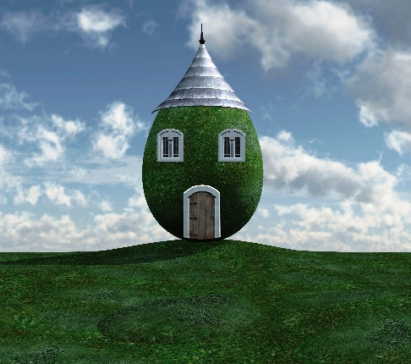
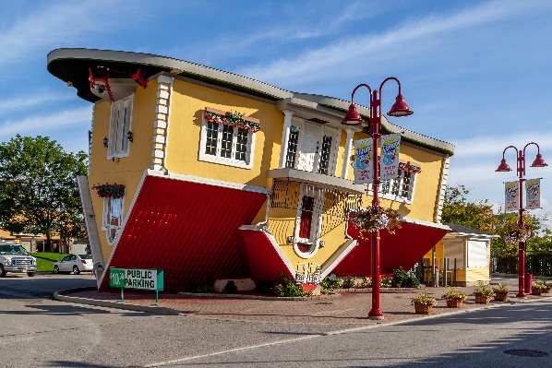
Work in groups.
Tell the class about your house.
There are some strange houses
around the world.
C
B
A

Slide 18

CONSOLIDATION
1
Wrap-up
What have we learnt in this unit?
use the words for types of house, rooms and furniture
use possessive case to describe possession
use prepositions of place to describe where people or things are
give suggestions

Slide 19

CONSOLIDATION
2
Homework
Prepare for the next lesson:
Unit 3 – Lesson 1: Getting started

Slide 20






Website: hoclieu.vn
Fanpage: facebook.com/www.tienganhglobalsuccess.vn/

