Slide 2
Unit
2
MY HOUSE
LESSON 4: COMMUNICATION
1

Slide 3
LESSON 4: COMMUNICATION
LESSON 1: GETTING STARTED
WARM-UP
Picture describing
Giving suggestions
Task 1: Listen and read the dialogue.
Task 2: Make similar dialogues.
EVERYDAY ENGLISH
Task 3: Look at the pictures and complete the sentences.
Task 4: Find the differences between the two houses.
Task 5: Game: Draw a simple picture of your house. Tell your partner about it.
LIVING PLACES
CONSOLIDATION
Wrap-up
Homework

Slide 4
Everyday English
Giving suggestions

Slide 5
WARM-UP
Pictures describing:
Look at the picture of Nam’s house.
Describe as many things in the picture as possible.

Slide 6
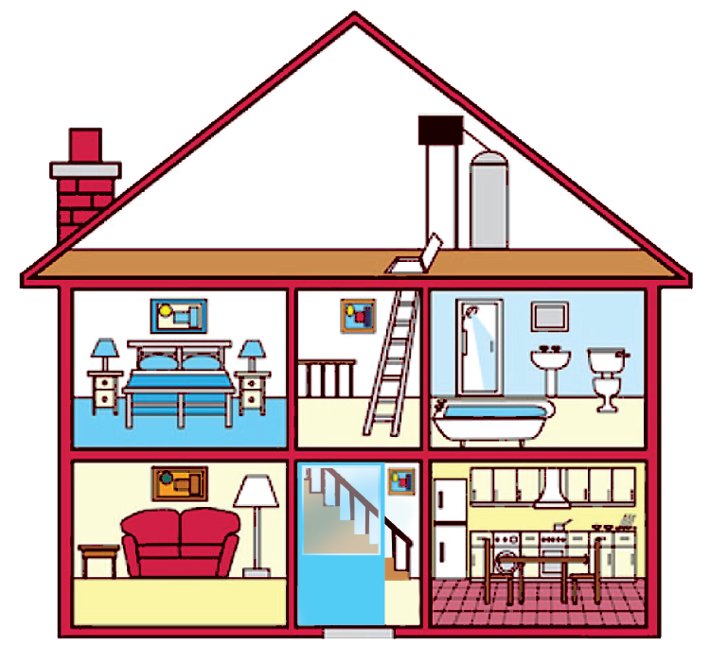
WARM-UP
Pictures describing:
Suggested answer:
There are 4 rooms in Nam’s house.
In the living room, there is a lamp, a picture, a table and a sofa.
In the kitchen, there is a fridge, a dishwasher and a sink.

Slide 7
PRESENTATION
1
Elena and her mum are discussing how to decorate her bedroom. Listen and read the dialogue. Pay attention to the highlighted sentences.
…
Elena: My bedroom isn’t nice.
Mum: How about putting a picture on the wall?
Elena: Great idea, Mum.
Mum: Let’s go to the department store to buy one.
…

Slide 8
PRESENTATION
Structure
How about + V-ing?
Example: How about putting a picture on the wall?
Let’s + V
Example: Let’s go to the department store to buy one.

Slide 9
PRACTICE
2
Work in pairs. Make a similar dialogue. Remember to use the structures:
How about + Ving?
Let’s + V.
Situation 1: You want to buy some furniture for your home.
Situation 2: You want to do some activities at the weekend with your friend.
Situation 3: You want to buy some new school things.

Slide 10
PRACTICE
2
Work in pairs. Make a similar dialogue. Remember to use the structures:
How about + Ving?
Let’s + V.
Suggested answer:
Situation 2: You want to do some activities at the weekend with your friend.
A: I am so bored.
B: How about going to the cinema this weekend?
A: Great idea!

Slide 11
Living places

Slide 12
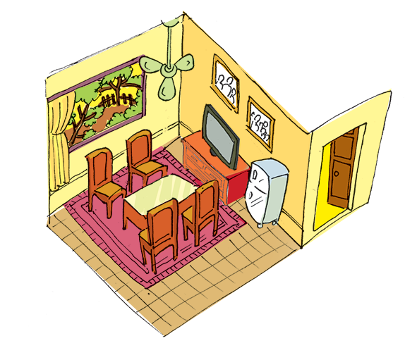
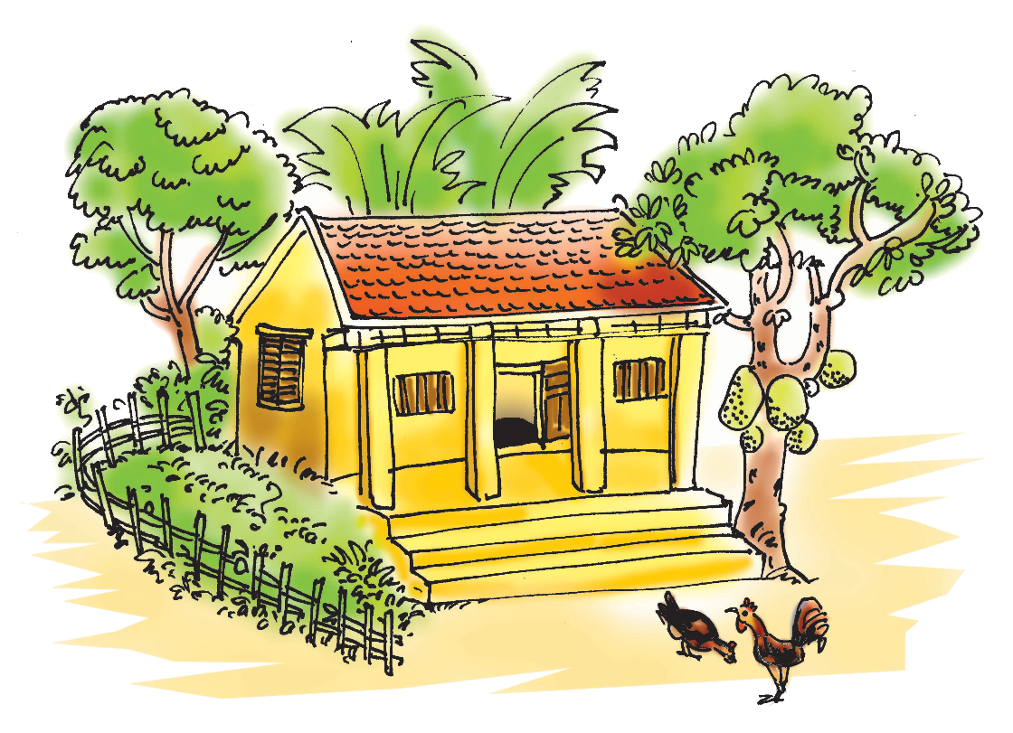
PRESENTATION
3
Mi tells Nick about her grandparents’ country house. Look at the pictures of her grandparents’ house and complete the sentences.

Slide 13
PRESENTATION
3
Mi tells Nick about her grandparents’ country house. Look at the pictures of her grandparents’ house and complete the sentences.
1. My grandparents live in a ________ house in Nam Dinh.
country
2. There ______ four rooms in the house and a big garden.
are

Slide 14
PRESENTATION
3
Mi tells Nick about her grandparents’ country house. Look at the pictures of her grandparents’ house and complete the sentences.
3. I like the living room. There ______ a big window in this room.
is
4. There are four ________ and a table in the middle of the room.
chairs

Slide 15
PRESENTATION
3
Mi tells Nick about her grandparents’ country house. Look at the pictures of her grandparents’ house and complete the sentences.
5. There are two family photos _____ the wall.
on

Slide 16
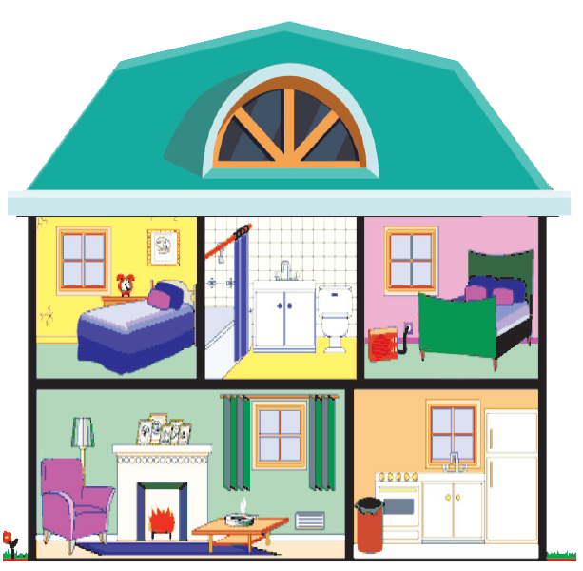
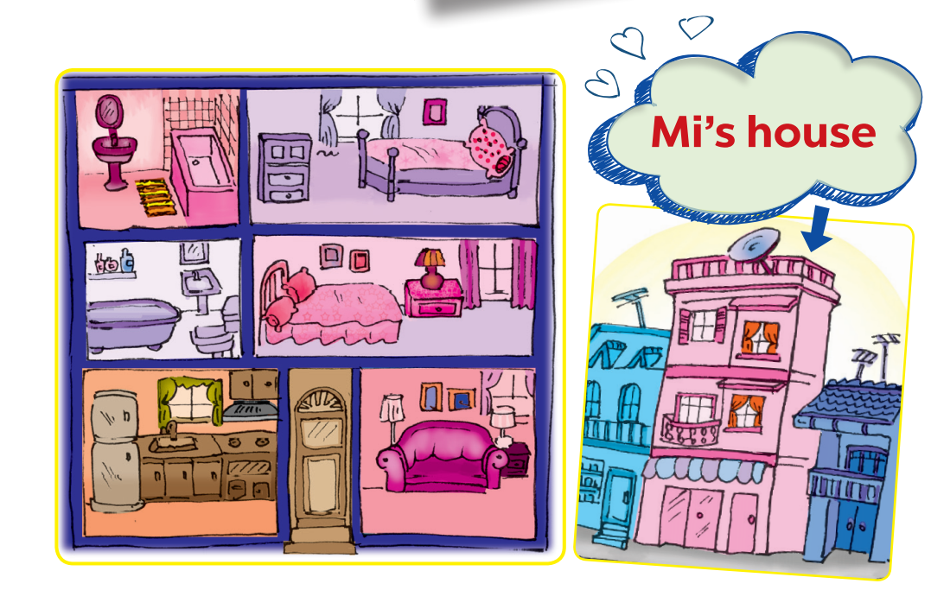
PRESENTATION
4
Student A looks at the pictures of Nick’s house on this page. Student B looks at the pictures of Mi’s house on page 25. Ask questions to find the differences between the two houses.
Example:
A: Where does Mi live?
B: She lives in a town house.

Slide 17
PRODUCTION
5
Draw a simple picture of your house. Tell your partner about it.

Slide 18
CONSOLIDATION
1
Wrap-up
What have we learnt in this lesson?
give suggestions
practise using some grammar points and vocabulary related to the topic

Slide 19
CONSOLIDATION
2
Homework
Do exercises in the workbook
Prepare for the next lesson: Skills 1

Slide 20
Website: hoclieu.vn
Fanpage: facebook.com/www.tienganhglobalsuccess.vn/

