Slide 2


Unit
2
MY HOUSE
LESSON 3: A CLOSER LOOK 2
GRAMMAR
Possessive case
Prepositions of place
1
1

Slide 3
LESSON 3: A CLOSER LOOK 2
LESSON 1: GETTING STARTED
WARM-UP
Memory game
PRESENTATION
The possessive case
Prepositions of place
Task 1: Choose the correct answer.
Task 2: Complete the sentences with the correct possessive forms.
Task 3: Write the correct preposition in the box under each picture. Say a sentence to describe the picture.
Task 4: Look at the picture and write T (True) or F (False) for each sentence. Correct the false ones.
PRACTICE
PRODUCTION
Task 5: Game: Memory challenge
CONSOLIDATION
Wrap-up
Homework

Slide 4

WARM-UP
Memory game
Students work in 4 groups.
Students study the picture and try to remember the things belonging to each person in 30 seconds.
After 30 seconds, student will answer the questions about the picture.
The group with more correct sentences will be the winner.

Slide 5


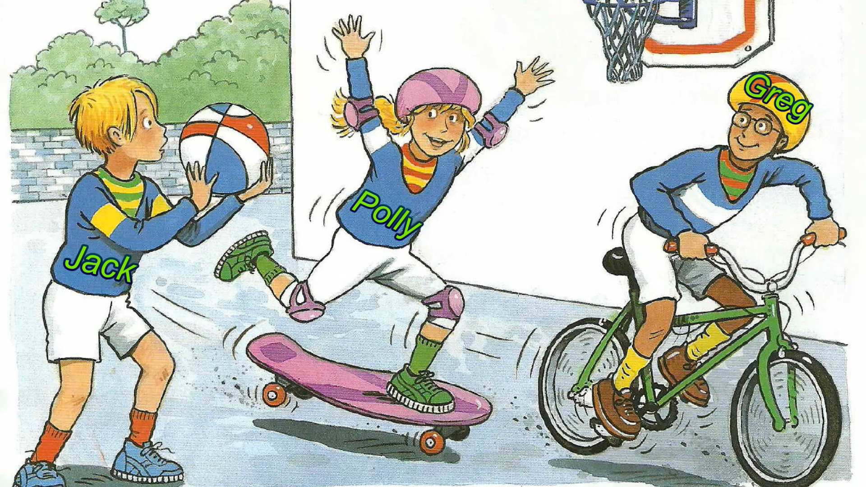
WARM-UP
Memory game

Slide 6
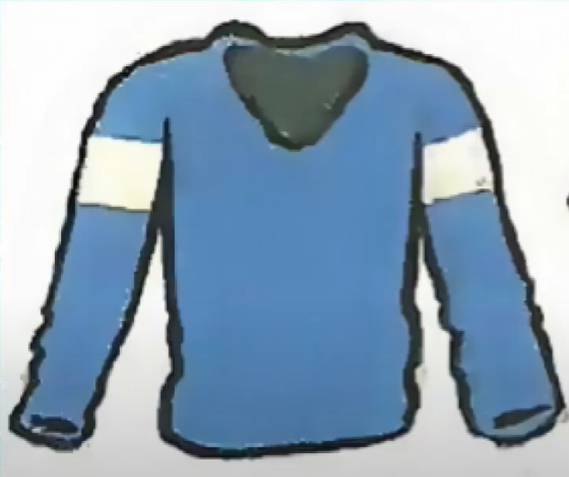
WARM-UP
Memory game
1. Whose jumper is it?
It’s Polly’s jumper.

Slide 7
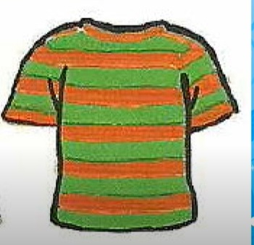
WARM-UP
Memory game
2. Whose T-shirt is it?
It’s Greg’s T-shirt.

Slide 8

WARM-UP
Memory game
3. Whose ball is it?
It’s Jack’s ball.

Slide 9
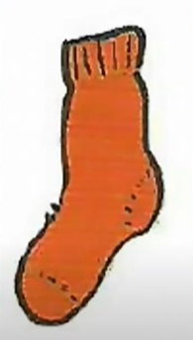
WARM-UP
Memory game
4. Whose sock is it?
It’s Jack’s sock.

Slide 10
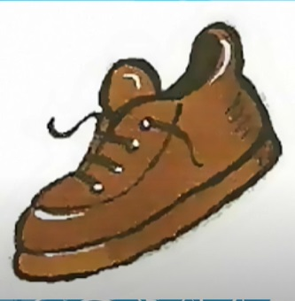
WARM-UP
Memory game
5. Whose shoe is it?
It’s Greg’s shoe.

Slide 11
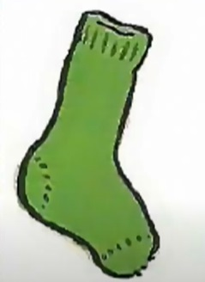
WARM-UP
Memory game
6. Whose sock is it?
It’s Polly’s sock.

Slide 12
PRESENTATION
Grammar
Possessive case

Slide 13

PRESENTATION
Jack’s T-shirt
Greg’s ball
Polly’s sock
POSSESSIVE CASE
To show possession

Slide 14

PRESENTATION
STRUCTURE
Name’s + noun
Example: Polly’s sock
Singular noun’s + noun
Example: teacher’s book

Slide 15
PRESENTATION
Grammar
Prepositions of place

Slide 16



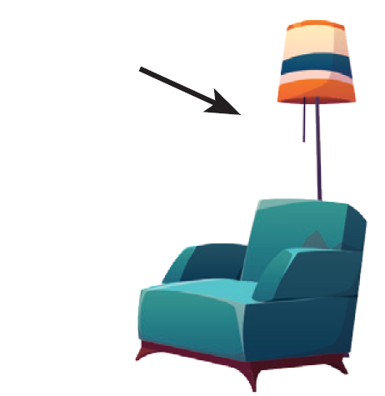
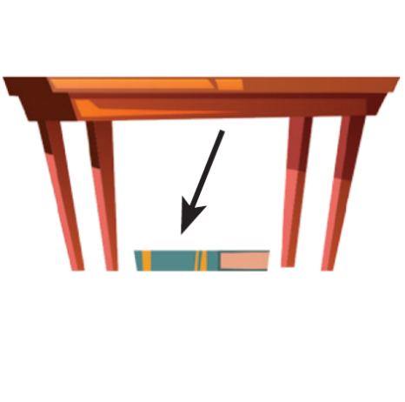

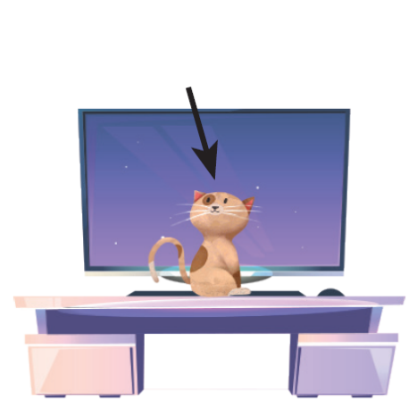
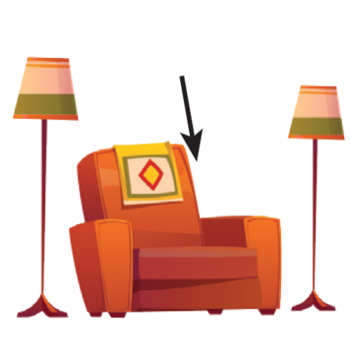
PRESENTATION
Prepositions of place describe where people or things are. These are some prepositions of place.
in
on
behind
under
next to
in front of
between

Slide 17
PRACTICE
1
Choose the correct answer.
1. My (grandmothers / grandmother’s) house is in Ha Noi.
2. This is my (sister’s / sister’) desk.
3. My (cousin’s / cousin) dad is my uncle.
4. (Nam’s / Nam’) house is small.
5. There are two bedrooms in (Ans / An’s) flat.

Slide 18

PRACTICE
2
Complete the sentences with the correct possessive forms.
1. Thuc Anh is ______ cousin. (Mi)
2. This is their _________ chair. (teacher)
3. Where is _______ computer? (Nick)
Mi’s
teacher’s
Nick’s

Slide 19
PRACTICE
2
Complete the sentences with the correct possessive forms.
4. My _________ motorbikes is in the garden. (father)
5. My _________ bedroom is next to the living room. (brother)
father’s
brother’s

Slide 20

PRACTICE
3
Write the correct preposition in the box under each picture. Say a sentence to describe the picture
on
next to
behind
in
on
in front of
under
between
Example:
1.
on
The dog is on the chair.

Slide 21

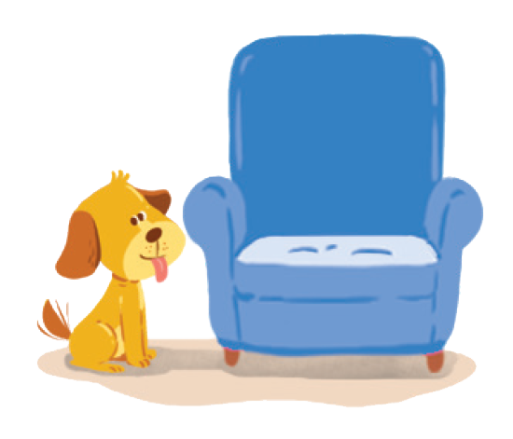
behind
on
next to
behind
in
next to
in front of
under
between
2.
next to
3.
behind
The dog is next to the armchair.
The cat is behind the TV.

Slide 22


in
on
next to
behind
in
in front of
under
between
in front of
4.
in
5.
in front of
The cat is in the wardrobe.
The dog is in front of the doghouse.

Slide 23
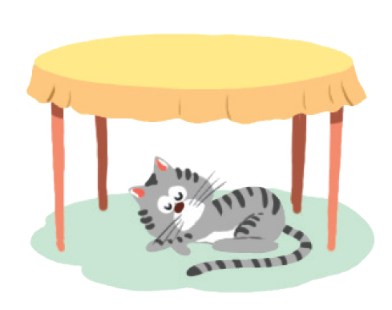

in
on
next to
behind
under
between
in front of
under
between
6.
between
7.
under
The cat is between
the lamp and the armchair.
The cat is under the table.

Slide 24
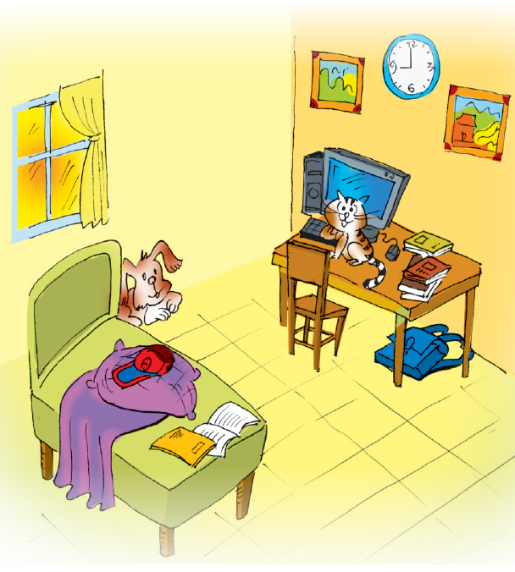
PRACTICE
4
Look at the picture and write T (True) or F (False) for each sentence. Correct the false ones.
Example: The books are under the table. ______
→ The books are on the table.
F

Slide 25
PRACTICE
4
Look at the picture and write T (True) or F (False) for each sentence. Correct the false ones.
1. The dog is behind the bed. ______
→ _________________________________
T
2. The school bag is on the table. ______
→ _________________________________
F
The school bag is under the table.

Slide 26
PRACTICE
4
Look at the picture and write T (True) or F (False) for each sentence. Correct the false ones.
3. The picture is between the clocks. _____
→ _________________________________
F
The clock is between the (two) pictures.
4. The cat is in front of the computer. _____
→ _________________________________
T
5. The cap is under the pillow. _____
→ _________________________________
F
The cap is on the pillow.

Slide 27
PRODUCTION
5
GAME: Memory challenge
Work in pairs.
Look at the picture carefully in 30 seconds then cover it.
Ask and answer questions about the position of the things in the picture.

Slide 28
PRODUCTION
5
GAME: Memory challenge
Example:
A: Where are the books?
B: They’re on the table.

Slide 29

CONSOLIDATION
1
Wrap-up
What have we learnt in this lesson?
identify the possessive case and prepositions of place correctly.
use the possessive case and prepositions of place correctly.

Slide 30

CONSOLIDATION
2
Homework
Do exercises in workbook
Prepare for the next lesson: Communication

Slide 31






Website: hoclieu.vn
Fanpage: facebook.com/www.tienganhglobalsuccess.vn/

