Slide 2


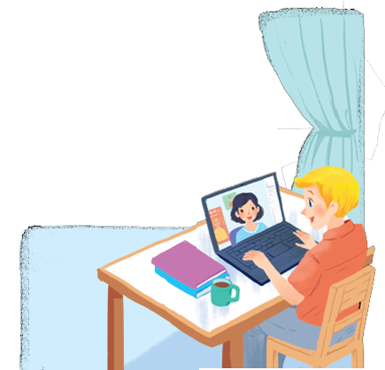

Unit
2
MY HOUSE
LESSON 1: GETTING STARTED
A look inside
1

Slide 3
LESSON 1: GETTING STARTED
LESSON 1: GETTING STARTED
WARM-UP
The hidden word
PRESENTATION
Vocabulary
Task 1: Listen and read.
Task 2: Which family members does Mi talk about? Put a tick (✔).
Task 3: Read the conversation again. Complete each sentence with ONE word.
Task 4: Game: Networking (Types of house)
PRACTICE
PRODUCTION
Task 5: Work in groups. Ask your friends where they live. Then report their answers.
CONSOLIDATION
Wrap-up
Homework

Slide 4

WARM-UP
The hidden words
Students work in groups.
Answer correctly each question to get 1 point and 1 secret letter to find the hidden word.
There is 1 question including 2 points and 2 secret letters.

Slide 5

WARM-UP
The hidden words
7 letters
__ __ __ __ __ __ __

Slide 6


WARM-UP
Question 1: - What is this?
- It’s a room.
_ _ _ _
1 point

Slide 7
WARM-UP
The hidden words
7 letters
__ __ __ __ __ __ __
M

Slide 8
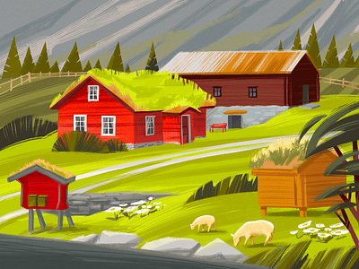
WARM-UP
Question 2: We have a small house in the country.
_ _ _ _ _ _ _
1 point

Slide 9
WARM-UP
The hidden words
7 letters
__ __ __ __ __ __ __
M
S

Slide 10
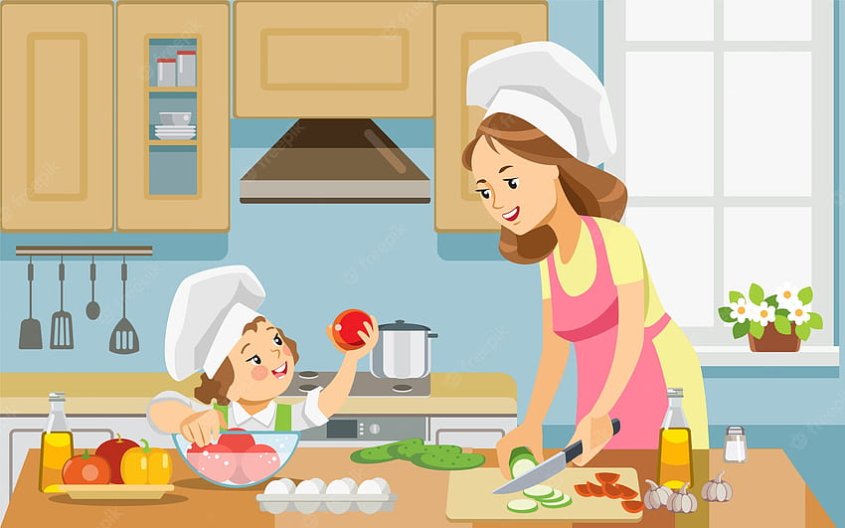
WARM-UP
Question 3: - Where are they?
- They are in the kitchen.
_ _ _ _ _ _ _
1 point

Slide 11
WARM-UP
The hidden words
7 letters
__ __ __ __ __ __ __
M
H
S

Slide 12

WARM-UP
Question 4: They have a house in the town.
_ _ _ _
1 point

Slide 13
WARM-UP
The hidden words
7 letters
__ __ __ __ __ __ __
M
Y
H
S

Slide 14
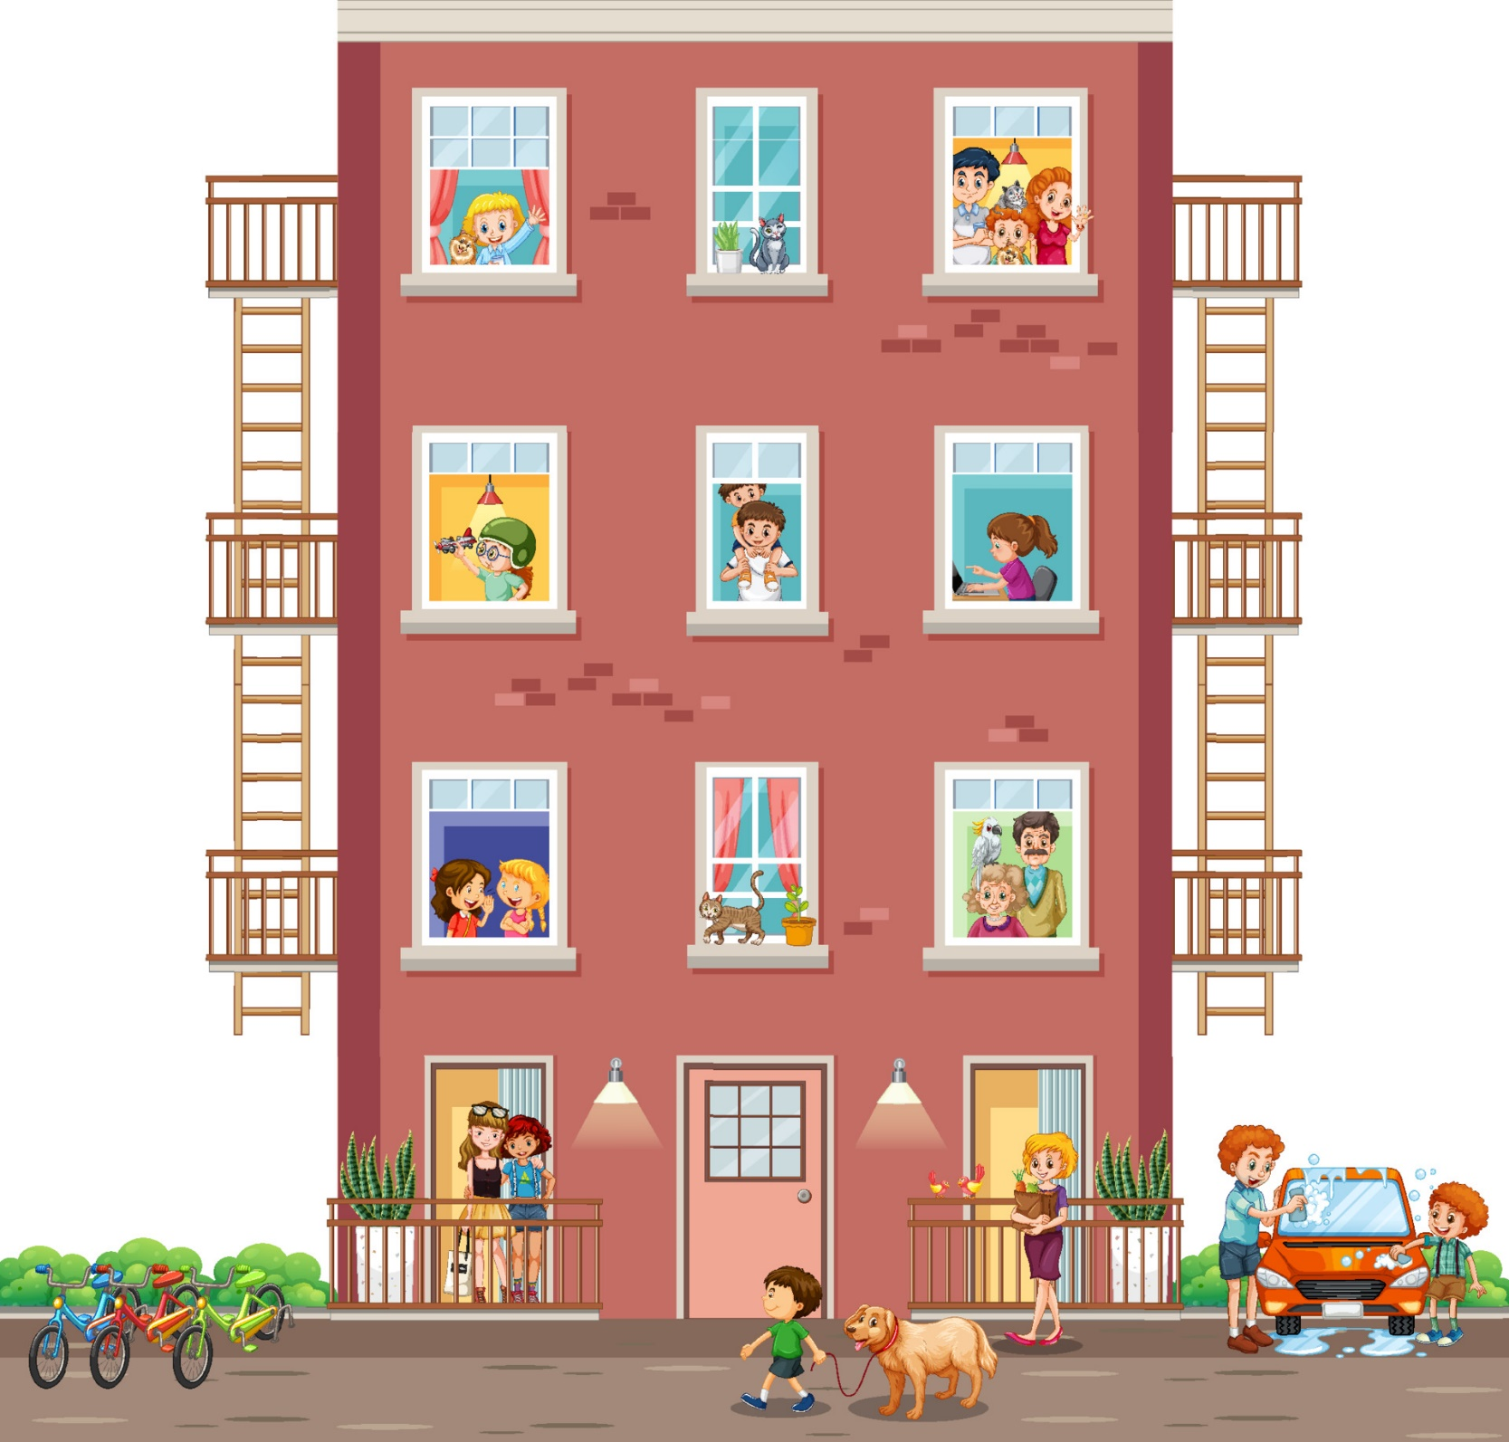
WARM-UP
Question 5: - Which house is this?
- It’s an apartment.
_ _ _ _ _ _ _ _ _
2 points

Slide 15
WARM-UP
The hidden words
7 letters
__ __ __ __ __ __ __
M
Y
H
O
S
E

Slide 16
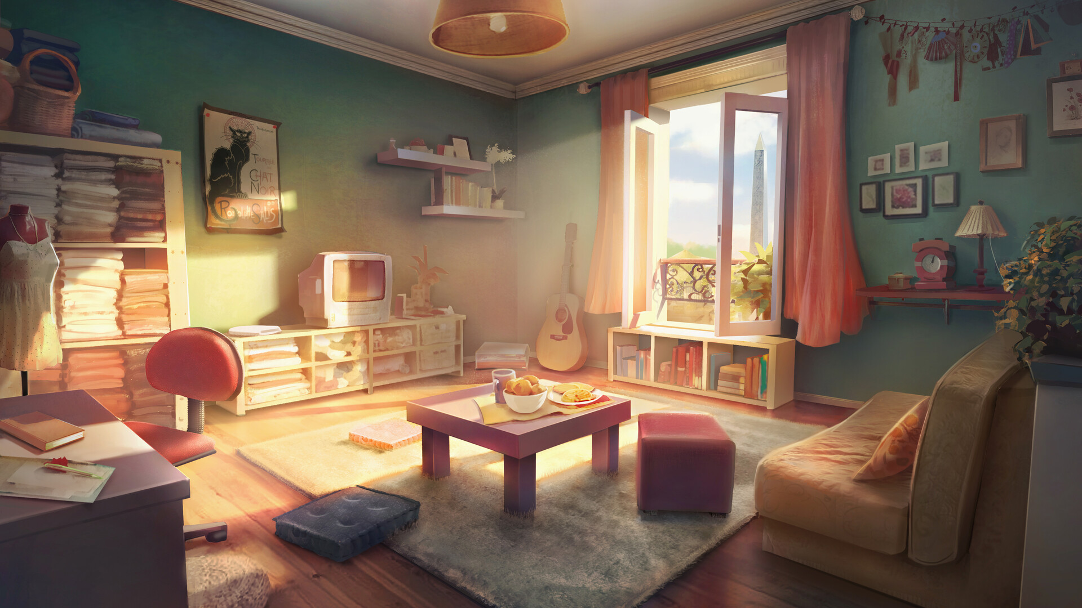
WARM-UP
Question 6: My sister lives in a flat.
_ _ _ _
1 point

Slide 17
WARM-UP
The hidden words
7 letters
__ __ __ __ __ __ __
M
Y
H
O
U
S
E

Slide 18

WARM-UP
The hidden words
7 letters
M Y H O U S E

Slide 19
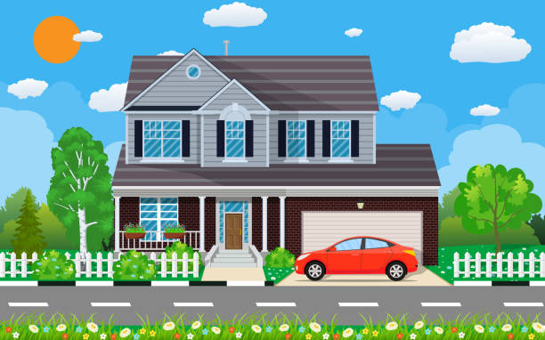

PRESENTATION
town house (n)
/ˈtaʊn haʊs/
nhà phố

Slide 20
PRESENTATION
country house (n)
/ˌkʌntri ˈhaʊs/
nhà ở vùng quê

Slide 21

PRESENTATION
flat (n)
/flæt/
căn hộ

Slide 22
PRESENTATION
flat (n)
= apartment (n)
/əˈpɑːtmənt/
căn hộ

Slide 23
PRESENTATION
New words | Pronunciation | Meaning
1. town house (n) | /ˈtaʊn haʊs/ | nhà phố
2. country house (n) | /ˌkʌntri ˈhaʊs/ | nhà ở vùng quê
3. flat (n) | /flæt/ | căn hộ
4. apartment (n) | /əˈpɑːtmənt/ | căn hộ

Slide 24
PRACTICE
LESSON 1: GETTING STARTED
What are Nick and Mi doing?
What might they talk about?
1

Slide 25
PRACTICE
1
A look inside
Listen and read.
Mi: Wow! Your room looks so big, Nick.
Nick: It’s Elena’s room. She’s my sister.
Mi: I see. Is there a TV behind you?
Nick: Yes, there is. Where do you live, Mi?
Mi: I live in a town house. And you?
Nick: I live in a country house. Who do you live with?
Mi: My parents and younger brother. We’re moving to a ﬂat next month!
Nick: Are you?
Mi: Yes. My aunt lives near there, and I can play with my cousin.
Nick: Are there many rooms in your new ﬂat?
Mi: Yes, there are. There’s a living room, three bedrooms, a kitchen and two bathrooms.

Slide 26
PRACTICE
What are Nick and Mi doing?
→ They are talking online with each other.
LESSON 1: GETTING STARTED
1
What might they talk about?
→ They are talking about their house.

Slide 27
PRACTICE
2
Which family members does Mi talk about? Put a tick ().
1. | parents
2. | sister
3. | brother
4. | aunt
5. | cousin





Slide 28
PRACTICE
3
Read the conversation again. Complete each sentence with ONE word.
1. Elena is Nick’s ______.
2. There is a ____ in Elena’s room.
3. Now Mi lives in a _____ house.
4. Nick lives in a ________ house.
5. Mi’s new flat has _____ bedrooms.
sister
TV
town
country
three

Slide 29

PRACTICE
4
GAME: Complete the word web: Types of house
Students work in groups.
Discuss about the topic “Types of house” in 2 minutes
Then, a student from each team one by one runs to the board and writes one word.
The team which has more correct answers is the winner.
Types of house

Slide 30

PRACTICE
4
GAME: Complete the word web: Types of house
Types of house

Slide 31
PRACTICE
4
GAME: Complete the word web: Types of house (Suggested answer)
villa
cottage
town house
country house
Types of house
stilt house
flat
farmhouse

Slide 32

PRODUCTION
5
Work in groups. Ask your friends where they live. Then report their answers.
Students work in groups of 4
Take turns to ask and answer about where they live
By the end of the activity, one student from each group can stand up and report to the class.
SURVEY

Slide 33

CONSOLIDATION
1
Wrap-up
What have we learnt in this lesson?
Vocabulary about house and types of house.
Read and understand content of the conversation.

Slide 34

CONSOLIDATION
2
Homework
- Do exercises in the workbook.
- Prepare for the Project of the unit.

Slide 35






Website: hoclieu.vn
Fanpage: facebook.com/www.tienganhglobalsuccess.vn/

