Slide 2


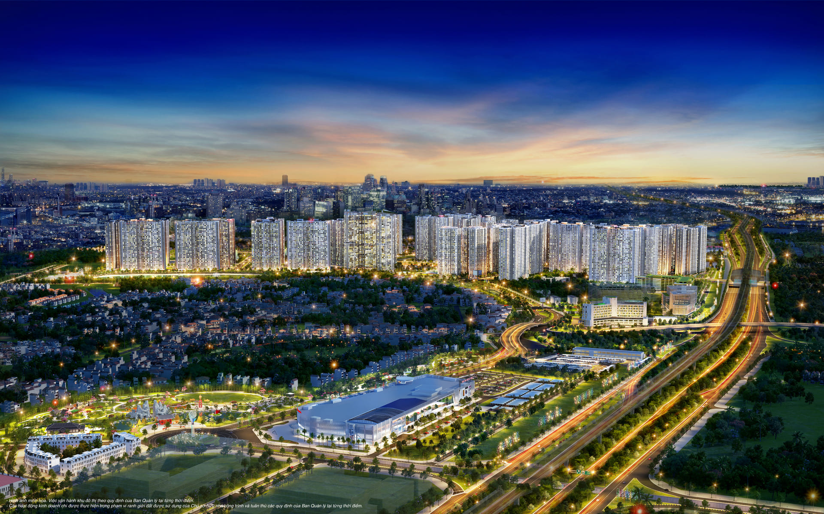
Unit
2
CITY LIFE
LESSON 6: SKILLS 2

Slide 3
LESSON 6: SKILLS 2
LESSON 1: GETTING STARTED
WARM-UP
Option 1: Think!
Option 2: Pass the ball!
Task 1: Work in pairs. Tick (√) the things that you want in your home town. Add more ideas if you have any.
Task 2: Listen to an interview with three teenagers about life in their cities. Decide if the statements are true (T) or false (F).
Task 3: Listen again. Choose the correct answer A, B, or C.
LISTENING
Task 4: Work in pairs. Put the phrases from the box in the correct column.
Task 5: Write a paragraph.
WRITING
CONSOLIDATION
Wrap-up
Homework

Slide 4
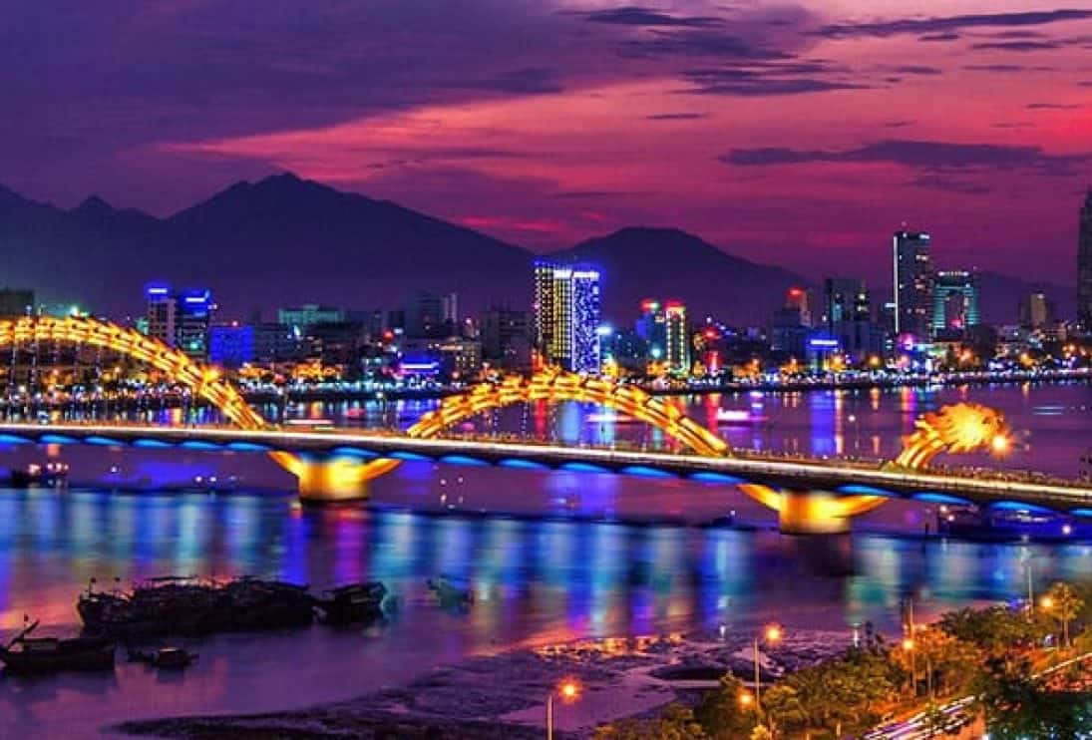
WARM-UP
OPTION 1
- Do you like this city? Why?

Slide 5

WARM-UP
OPTION 2
PASS THE BALL

Slide 6
WARM-UP
OPTION 2
HOW TO PLAY
- When the music starts, students pass the balls to the students next to them.
- When the music stops, the two students has a ball must stand up to ask and answer the questions on the PPT.

Slide 7

WARM-UP
OPTION 2
PASS THE BALL

Slide 8
WARM-UP
OPTION 2
STOP

Slide 9
WARM-UP
OPTION 2
Question:
Which city do you want to live in? Why?

Slide 10
WARM-UP
OPTION 2
PASS THE BALL

Slide 11
WARM-UP
OPTION 2
STOP

Slide 12
WARM-UP
OPTION 2
Question:
Which city do you want to live in? Why?

Slide 13
WARM-UP
OPTION 2
PASS THE BALL

Slide 14
WARM-UP
OPTION 2
STOP

Slide 15
WARM-UP
OPTION 2
Question:
Which city do you want to live in? Why?

Slide 16
LISTENING
1
Work in pairs. Tick (√) the things that you want in your home town. Add more ideas if you have any.
a. Nice parks
b. Modern cinemas
c. Air-conditioned buses
d. Free sports facilities
e. Convenient food stalls
f. Wide roads

Slide 17
LISTENING
2
Listen to an interview with three teenagers about life in their cities. Decide if the statements are true (T) or false (F).
 | T | F
1. There are many facilities for public use in Tom’s city
2. Elena likes spending her free time in shopping malls.
3. Food stalls are not popular in Chi’s city
4. In Chi’s city, many teens like street food more than food prepared at home.
T
F
F
T

Slide 18
LISTENING
3
Listen again. Choose the correct answer A, B, or C.
1. Where might this interview come from? | 2. What is a problem in Tom’s city?
A. A chat show. B. A documentary. C. The daily news. | A. Some buses don’t have air-conditioners. B. There are no parks. C. Some roads are too wide

Slide 19
LISTENING
3
Listen again. Choose the correct answer A, B, or C.
3. What change does Elena suggest for her city? | 4. Chi thinks that ______ should tell teens about the drawbacks of street food.
A. A new shopping mall. B. More free sports facilities. C. More modern sports centres. | A. parents and the city council B. the city council and schools C. parents and schools

Slide 20
TRANSITION
- Work in pairs and recall information about Tom, Elena and Chi.
- Note down the answers to the questions:
 | What does each person like about life in their city? | What does each person dislike about life in their city?
Tom
Elena
Chi

Slide 21
TRANSITION
 | What does each person like about their city life? | What does each person dislike about their city life?
Tom
Elena
Chi
The traffic is getting worse. The buses are quite old and uncomfortable.
It has good parks, libraries, and cinemas
There is a shopping mall.
The shopping mall is very costly.
It lacks free sport facilities
It’s really convenient. There are food stalls at almost all street corners.
Many teens like street food and are too lazy to cook on their own

Slide 22
WRITING
4
Work in pairs. Put the phrases from the box in the correct column.
too much noise good health service high crime rate beautiful buildings | easy shopping air pollution heavy traffic green space
What I like about city life | What I dislike about city life

Slide 23
WRITING
too much noise good health service high crime rate beautiful buildings | easy shopping air pollution heavy traffic green space
What I like about city life | What I dislike about city life
easy shopping
too much noise
good health service
air pollution
beautiful buildings
high crime rate
green space
heavy traffic

Slide 24
WRITING
Write a paragraph (about 100 words) about what you like or dislike about living in a city. You can use the ideas in 4 or your own ideas.
5
Outline:
I love / dislike city life. First, __________
______________________________
Second, _______________________
______________________________
______________________________
Third, _________________________
______________________________
In conclusion, ___________________
______________________________.

Slide 25
WRITING
5
Sample paragraph:
I love city life. First, it is very convenient to live in the city. The public transport system reaches almost all areas of the city, so it is easy for me to get around. In addition, there are many shops that sell all kinds of goods, so I can buy almost everything I need. Second, the city often has many good schools and hospitals. Therefore, people here can enjoy quality education and healthcare. Finally, city life is exciting. There are many entertainment places for me and my friends. For example, we can hang out at shopping malls, watch movies at the cinema, and visit beautiful parks downtown. In conclusion, I find the city a liveable place for me. (120 words)

Slide 26

CONSOLIDATION
1
Wrap-up
What have we learnt in this lesson?
Listen for specific information in an interview about life in the city.
Write a paragraph about what they like or dislike about city life.

Slide 27

CONSOLIDATION
2
Homework
- Rewrite the paragraph in the notebooks.
- Do exercises in the workbook.

Slide 28
Website: hoclieu.vn
Fanpage: facebook.com/www.tienganhglobalsuccess.vn/

