Slide 2
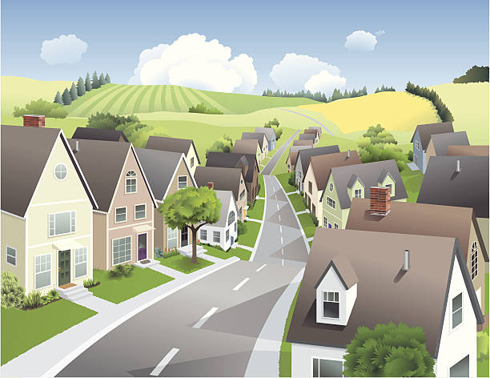
Unit
1
LOCAL COMMUNITY
LESSON 7: LOOKING BACK & PROJECT
1

Slide 3
LESSON 6: SKILLS 2
LESSON 1: GETTING STARTED
WARM-UP
Warm up: Brainstorming
- Task 1: Write a word or phrase for each description below.
- Task 2: Circle the correct word or phrase to complete each sentence.
VOCABULARY
- Task 3: Complete the sentences with the present simple.
- Task 4: Complete the text with the correct form of the verbs in brackets.
GRAMMAR
Projects
Wrap-up
Homework
PROJECT &
CONCOLIDATION

Slide 4
WARM-UP
Write as many community services as possible
BRAINSTORMING

Slide 5
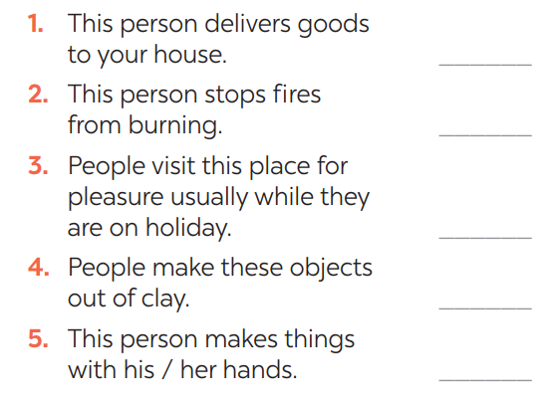
VOCABULARY
1
Write a word or phrase for each description below.
delivery person
firefighter
tourist attraction
pottery
artisan

Slide 6
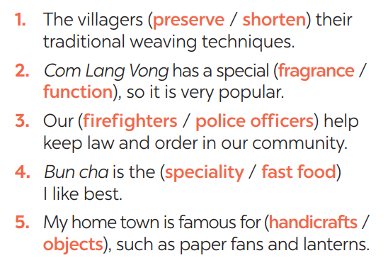
VOCABULARY
2
Circle the correct word or phrase to complete each sentence.
1- preserve
2- fragrance
3- police officers
4- speciality 5- handicrafts

Slide 7
GRAMMAR
3
Choose the correct answer A, B, C, or D.
1. You should decide ______ to move to the new house. A. while B. when C. where D. who 2. Do you know ______ to sort rubbish? A. who B. which C. how D. what 3. She didn’t tell me ______ to meet, in the library or in the lab. A. how B. when C. what D. where 4. Could you tell me ______ to do in this situation? A. what B. when C. where D. who 5. I wonder ______ to ask for advice, my teacher or my parents. A. where B. when C. who D. what

Slide 8
GRAMMAR
4
Rewrite each sentence so that it contains the phrasal verb in brackets. You may have to change the form of the verb.
1. In some villages, people reduce the number of steps to make the handicraft. (cut down on) ______________________________ 2. My grandparents gave the skills to my parents. (hand down) ______________________________ 3. In their community, the eldest child is usually responsible for his or her parents. (take care of) ______________________________
In some villages, people cut down on the number of steps to make the handicraft.
My grandparents handed down the skills to my parents.
In their community, the eldest child usually takes care of his or her parents.

Slide 9
GRAMMAR
4
Rewrite each sentence so that it contains the phrasal verb in brackets. You may have to change the form of the verb.
4. Before we go to a new place, we always get information about it. (find out) ______________________________
5. They have a good relationship with all neighbours. (get on with) ______________________________
Before we go to a new place, we always find out about it.
They get on with all neighbours.

Slide 10
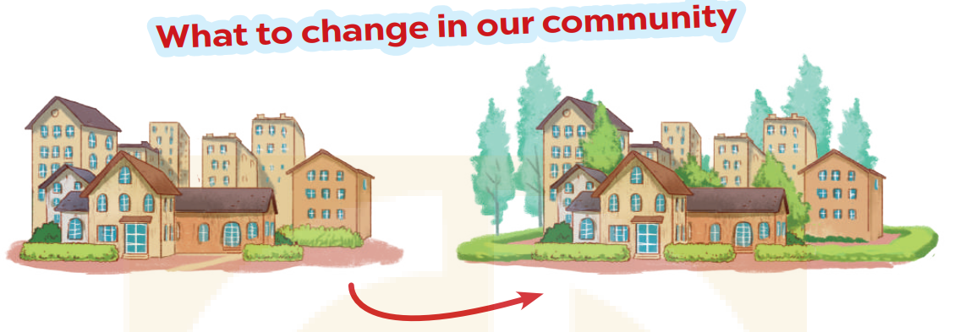
PROJECT

Slide 11
CONSOLIDATION
1
Wrap-up
What have we learnt in this lesson?
Review the vocabulary and grammar of Unit 1.
Apply what they have learnt (vocabulary and grammar) into practice through a project.

Slide 12
CONSOLIDATION
2
Homework
- Do exercises in the Workbook.
- Prepare for the next lesson.

Slide 13
Website: hoclieu.vn
Fanpage: facebook.com/www.tienganhglobalsuccess.vn/

