Slide 2




Unit
1
MY NEW SCHOOL
LESSON 6: SKILLS 2
LISTENING
WRITING

Slide 3
LESSON 6: SKILLS 2
LESSON 1: GETTING STARTED
WARM-UP
Crossword puzzle
Task 1. Guess the answers to the questions. Listen to the talk and check your guesses.
Task 2: Listen again and choose the correct answer A or B.
LISTENING
Task 3: Write the answers to the questions about your school.
Task 4: Use the answer in Task 3 to write a paragraph of 40-50 words about your school.
WRITING
CONSOLIDATION
Wrap-up
Homework

Slide 4

WARM-UP
CROSSWORD PUZZLE
6 questions
01
Take turns to open the crossword, read the clues.
02
2 teams
Give your answers.
03

Slide 5
WARM-UP
Q1: 10 letters
This is an area designed for children to play outside, especially at school or in a park.

Slide 6
WARM-UP
P | L | A | Y | G | R | O | U | N | D
Q2: 5 letters
This is an adjective used to describe people who have a clean, tidy and stylish appearance.

Slide 7
WARM-UP
P | L | A | Y | G | R | O | U | N | D
S | M | A | R | T
Q3: 7 letters
Complete the following sentence with a suitable word:
Mrs. Nguyen teaches all my history _____.

Slide 8

WARM-UP
P | L | A | Y | G | R | O | U | N | D
S | M | A | R | T
L | E | S | S | O | N | S
Q4: 5 letters
What is the name of this subject?

Slide 9
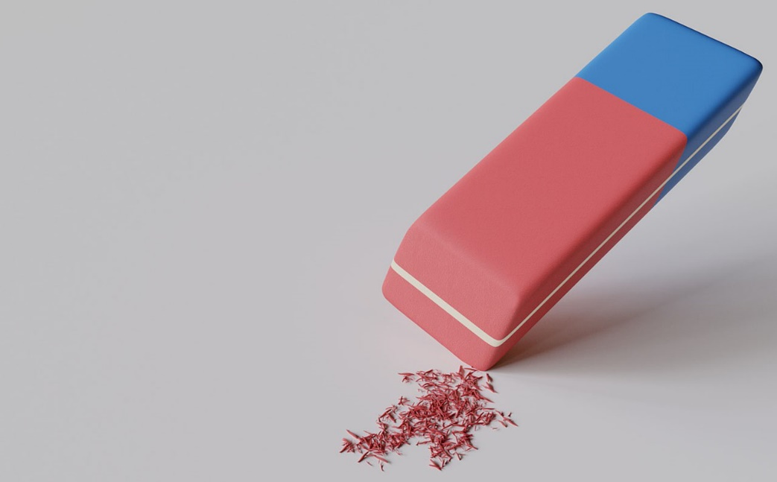
WARM-UP
P | L | A | Y | G | R | O | U | N | D
S | M | A | R | T
L | E | S | S | O | N | S
M | U | S | I | C
Q5: 5 letters
What is the name of this school item?

Slide 10
WARM-UP
P | L | A | Y | G | R | O | U | N | D
S | M | A | R | T
L | E | S | S | O | N | S
M | U | S | I | C
R | U | B | B | E | R
Q6: 5 letters
This is a small electronic device that is used for calculations.

Slide 11
WARM-UP
P | L | A | Y | G | R | O | U | N | D
P
A
L
M
E
R
S | M | A | R | T
L | E | S | S | O | N | S
M | U | S | I | C
R | U | B | B | E | R
C | A | L | C | U | L | A | T | O | R
→ PALMER

Slide 12
LISTENING
1
Janet, a student at Palmer School in america, is talking about her school. Guess the answers to these questions. Listen to the talk and check your guesses.
1. Do you think the students there wear uniforms?
→ Yes, they do.
2. Do they learn Vietnamese as a foreign language?
→ Yes, they do.

Slide 13

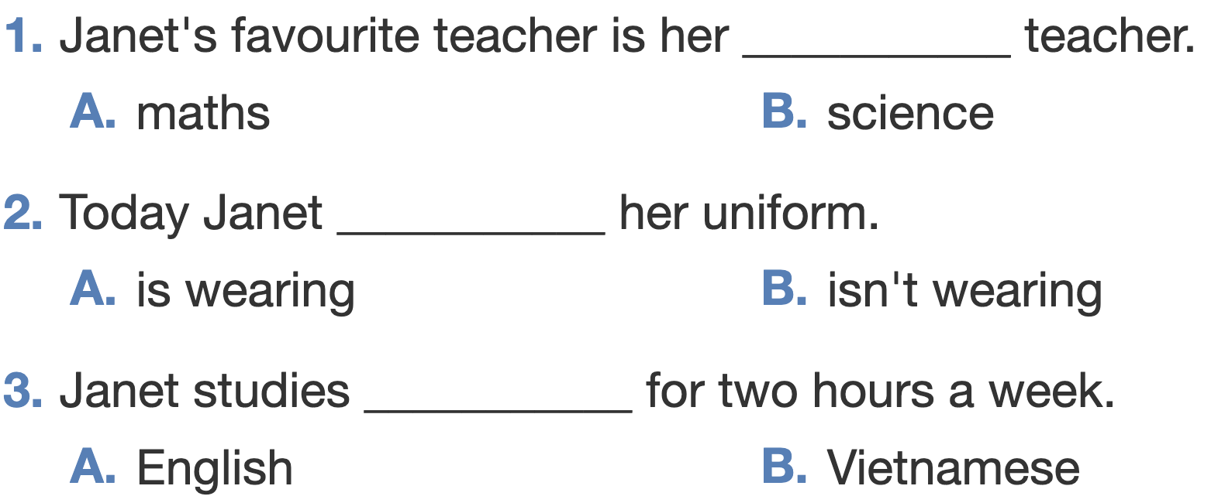
LISTENING
2
Listen again and choose the correct answer A or B.

Slide 14
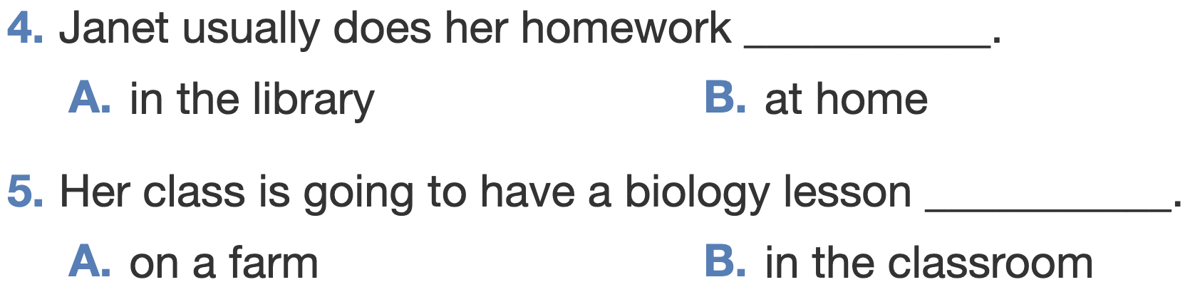
LISTENING
2
Listen again and choose the correct answer A or B.

Slide 15
WRITING
3
Write the answers to the following questions about your school.
1. What is the name of your school?
2. Where is your school?
3. How many classes does your school have?
4. What do students do at your school?
5. What do you like about your school?

Slide 16
WRITING
4
Use the answer in Task 3 to write a paragraph of 40-50 words about your school. You can refer to the reading passages to help you.
My school is ____________________________________

Slide 17

CONSOLIDATION
1
Wrap-up
What have we learnt in this lesson?
Listen about school activities
Write about a school

Slide 18

CONSOLIDATION
2
Homework
- Rewrite the paragraph in your notebooks.
- Do the exercises in the workbook.

Slide 19






Website: hoclieu.vn
Fanpage: facebook.com/www.tienganhglobalsuccess.vn/

