Slide 1
Hello every one !!!

Slide 2
LESSON 1
My future house

Slide 3
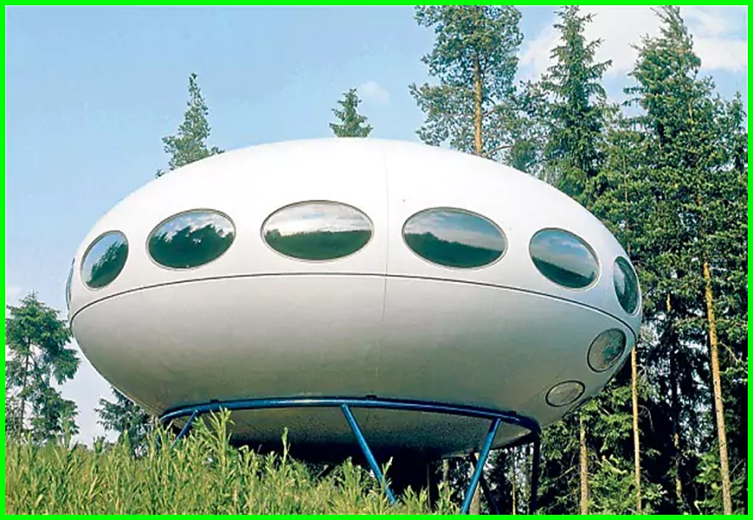
Unit 10: Houses in the future
Lesson 1: Getting started

Slide 4
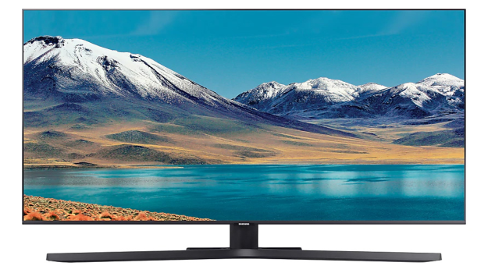
1, solar energy | A
2, smart TV | B
3, appliance | C
4, UFO | D

Slide 5
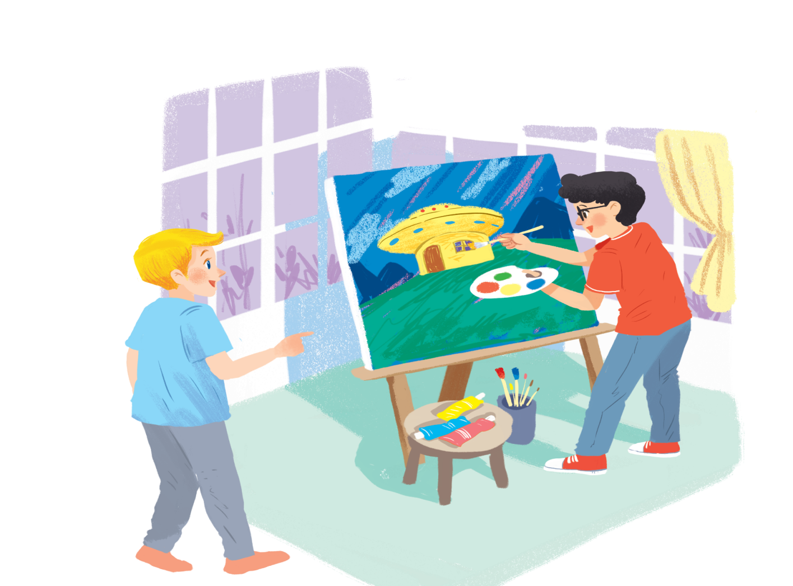
Listen and read.
1.Who are they?
2. What is Phong doing?
3. What are they talking about?
Phong
Nick

Slide 6
My future house
Nick: What are you doing, Phong?
Phong: I’m painting a picture of my house.
Nick: Your house! That’s a UFO.
Phong: It looks like a UFO but it’s my house in the future.
Nick: Where will it be?
Phong: It’ll be in the mountains.
Nick: What will it be like?
Phong: It’ll be a large house. It’ll have twenty rooms.
Nick: Twenty rooms!
Phong: Yes, and it’ll have solar energy.
Nick: Fantastic! Which room will you like best?
Phong: My bedroom, of course.
Nick: What appliances might the house have?
Phong: My house might have some smart TVs and ten robots.
Nick: Sounds great! And how much will ...

Slide 7
Read the conversation again. Find and write down the words or phrases that show:
Type of house
Location
Appliances in the house
UFO
in the mountains
some smart TVs and ten robots

Slide 8
My future house
Nick: What are you doing, Phong?
Phong: I’m painting a picture of my house.
Nick: Your house! That’s a UFO.
Phong: It looks like a UFO but it’s my house in the future.
Nick: Where will it be?
Phong: It’ll be in the mountains.
Nick: What will it be like?
Phong: It’ll be a large house. It’ll have twenty rooms.
Nick: Twenty rooms!
Phong: Yes, and it’ll have solar energy.
Nick: Fantastic! Which room will you like best?
Phong: My bedroom, of course.
Nick: What appliances might the house have?
Phong: My house might have some smart TVs and ten robots.
Nick: Sounds great! And how much will ...

Slide 9
Read the conversation again. Tick () T (True) or F (False).
 | T | F
1. Phong’s house will be in the mountains.
2. His house will be large.
3. There’ll be a lot of rooms in his house.
4. He might have a smart TV and five robots.





Slide 10
Order the words to make a phrase about a place.
Each group has one extra word.
Example: ocean / in / on / the
=> in the ocean
1. sea/ a/ by/ the
...........................................
2. on/ in/ the / city
............................................
3. the / in/ at / town
..........................................
4 the/ on/ in/ mountains
...........................................
5. countryside / a/ the / in
.............................................
6. Moon / in / the / on
............................................
7. in / at/ the / sky
...........................................

Slide 11
Order the words to make a phrase about a place.
Each group has one extra word.
* Answer key:
1. by the sea
2. in the city
3. in the town
4. in the mountains
5. in the countryside
6. on the Moon
7. in the sky

Slide 12
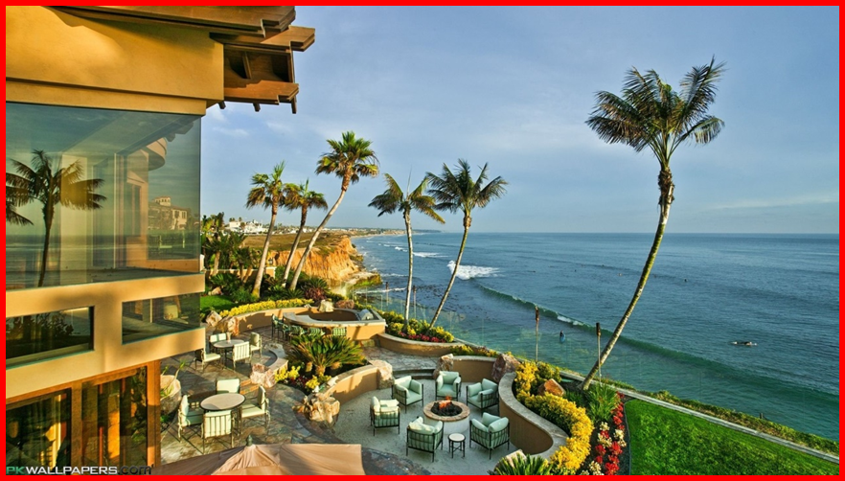
In groups, describe to your classmates what you can see outside the window of your future house. Your group tries to guess where your house is.
Example:
A: Outside my window I can see the beach and the water. Where’s my house?
B: It’s in the sea.
A: Correct!

Slide 13
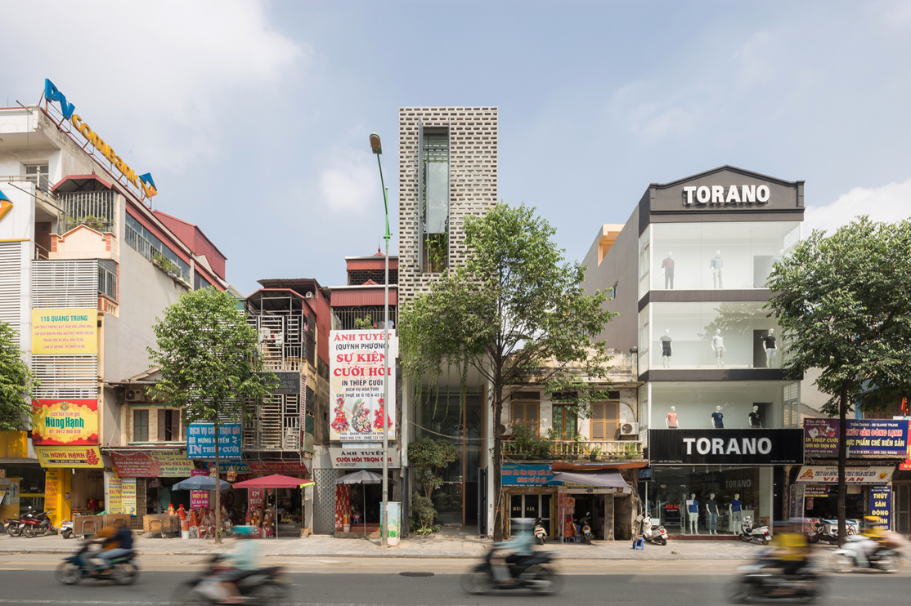
A : Outside my window I can see the building office and shopping center. Where's my house?
B: It's in the city.
A: Correct.

Slide 14
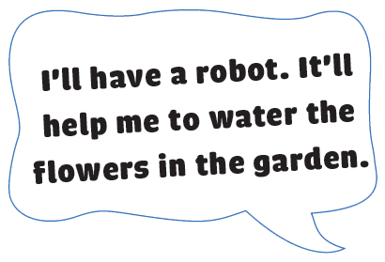
Think about an appliance you would like to have in the future.

Slide 15
HOMEWORK
- Learn by heart all the new words.
- Read the dialogue again.
- Prepare lesson 2 ( A closer look 1).

Slide 16
Goodbye!
See you again
Thank you!
Have a nice day!

