Slide 2
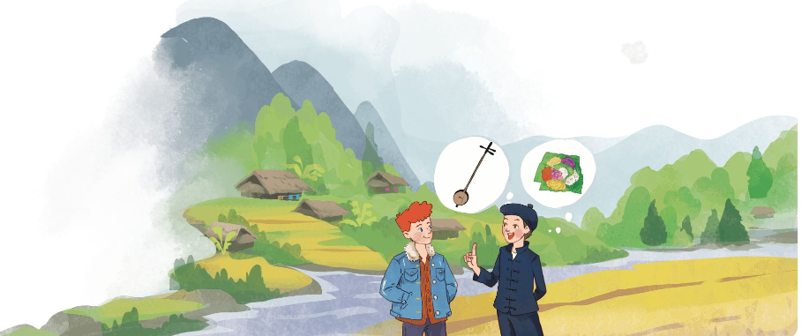

Slide 3
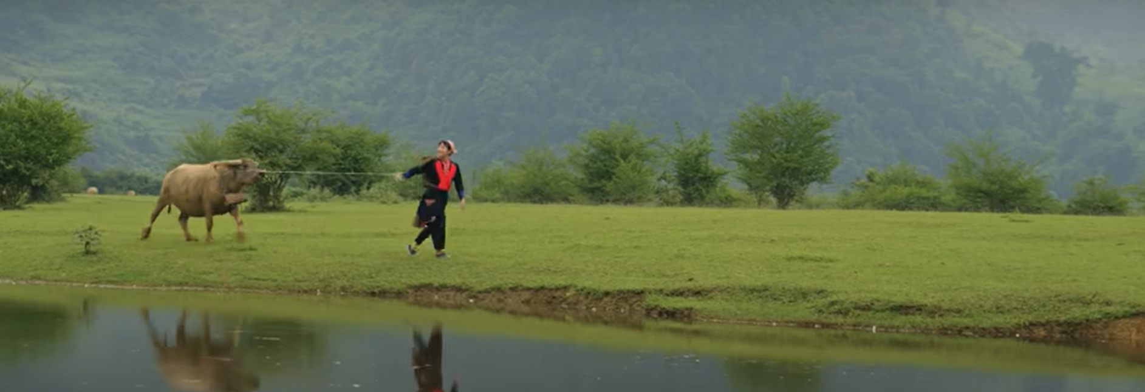

Slide 4
Unit
4
ETHNIC GROUPS OF VIET NAM
LESSON 2: A CLOSER LOOK 1
VOCABULARY
PRONUNCIATION
Unit
HOBBIES

Slide 5
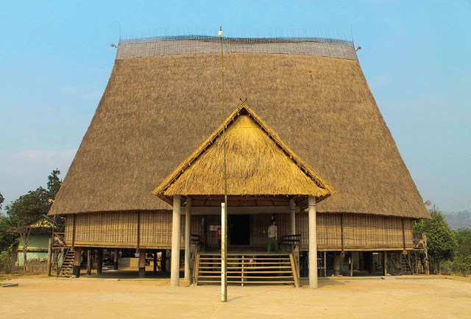
VOCABULARY
communal house (n)
/kəˈmjuːnəl haʊs/
nhà rông, nhà sinh hoạt cộng đồng

Slide 6
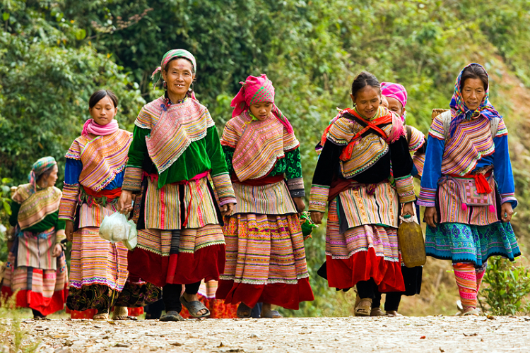
VOCABULARY
minority (n)
/maɪˈnɔːrəti/
dân tộc thiểu số

Slide 7
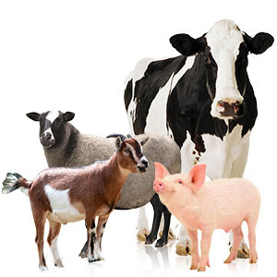
VOCABULARY
livestock (n)
/ˈlaɪvstɒk/
gia súc

Slide 8
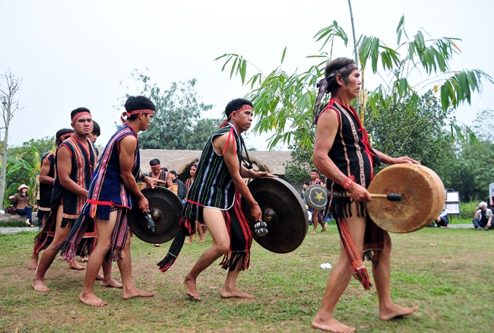
VOCABULARY
gong (n)
/ɡɒŋ/
cái cồng,
cái chiêng

Slide 9
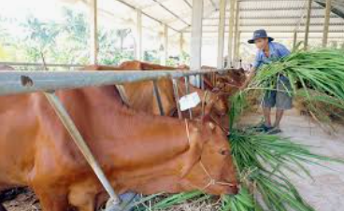
VOCABULARY
raise (v)
/reiz/
chăn nuôi

Slide 10
VOCABULARY
New words | Pronunciation | Meaning
1. communal house (n) | /kəˈmjuːnəl haʊs/ | nhà rông, nhà sinh hoạt cộng đồng
2. minority (n) | /maɪˈnɔːrəti/ | dân tộc thiểu số
3. livestock (n) | /ˈlaɪvstɒk/ | gia súc
4. raise (v) | /reiz/ | chăn nuôi
5. gong (n) | /ɡɒŋ/ | cái cồng, cái chiêng

Slide 11
VOCABULARY
Communal house
Livestock
2
1
Minority
Gong
Raise
3
5
4

Slide 12
VOCABULARY
Communal house
Livestock
2
1
Minority
Gong
Raise
3
5
4

Slide 13
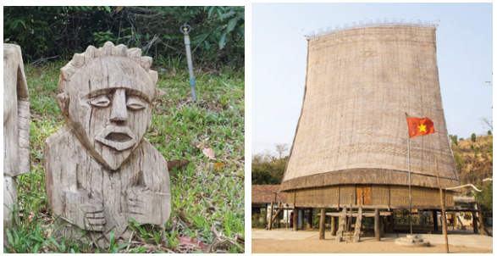
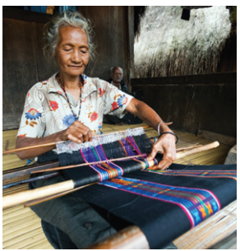
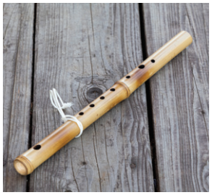
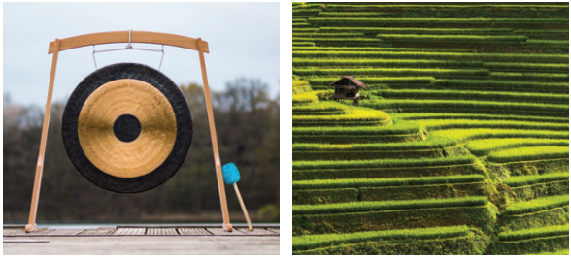
VOCABULARY
1
Write a word or phrase from the box under each picture.
Rong house weaving terraced fields
gong bamboo flute wooden statue
1.___________
2. _______________
3.___________
4.___________
5.___________
6.___________

Slide 14
VOCABULARY
1
Write a word or phrase from the box under each picture.
Rong house weaving terraced fields
gong bamboo flute wooden statue
wooden statue
Rong house
1.___________________
2. __________________

Slide 15
VOCABULARY
1
Write a word or phrase from the box under each picture.
Rong house weaving terraced fields
gong bamboo flute wooden statue
weaving
bamboo flute
3.___________________
4.___________________

Slide 16
VOCABULARY
1
Write a word or phrase from the box under each picture.
Rong house weaving terraced fields
gong bamboo flute wooden statue
gong
terraced fields
5.___________________
6.___________________

Slide 17
VOCABULARY
2
Match the words and phrases with their meanings.
A |  | B
 |  | a. the animals we keep on a farm like cows and sheep
 |  | b. a large room for community activities
 |  | c. a group smaller in size than other groups in the same country
 |  | d. a traditional musical instrument
 |  | e. work like growing, watering, weeding, and harvesting
1. minority group
2. livestock
3. gardening
4. gong
5. communal house

Slide 18
VOCABULARY
3
Complete the sentences with the words and phrases from the box.
communal house unique features minority group
raise weave livestock
unique features
1. It’s interesting to learn about the _______________ of an ethnic group’s traditional culture.
2. Most mountain girls know how to ______ clothing.
3. The Cham in Ninh Thuan _____ sheep and cows.
4. A _______________ is for community meetings and events.
5. There are fewer Nung than Kinh, so they are an ethnic _________.
6. Children in both the lowlands and highlands help raise their family’s _________.

Slide 19
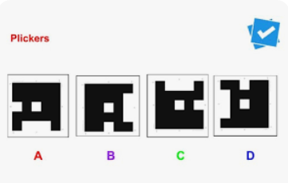

Slide 20
VOCABULARY
3
Complete the sentences with the words and phrases from the box.
communal house unique features minority group
raise weave livestock
unique features
1. It’s interesting to learn about the _______________ of an ethnic group’s traditional culture.
2. Most mountain girls know how to ______ clothing.
3. The Cham in Ninh Thuan _____ sheep and cows.
weave
raise

Slide 21
VOCABULARY
3
Complete the sentences with the words and phrases from the box.
communal house unique features minority group
raise weave livestock
4. A _______________ is for community meetings and events.
5. There are fewer Nung than Kinh, so they are an ethnic ______________.
6. Children in both the lowlands and highlands help raise their family’s _________.
communal house
minority group
livestock

Slide 23
PRONUNCIATION
4
Listen and repeat the words. Pay attention to the sounds /k/ and /g/.
/k/ | /g/
cultural communal musical folk overlook | gong garden gathering tiger pig

Slide 24
PRONUNCIATION
5
Listen and repeat the sentences. Pay attention to the underlined words.
1. The kitchen is for family gatherings.
2. Tigers and monkeys live in the forest.
3. I love the five-colour sticky rice.
4. Yesterday, we harvested cucumbers from our garden.
5. Most girls know how to cook.
/k/ and /g/

Slide 25
Can cultural gatherings of communal gardens grow greater with a gong and folk music, or will the folk overlook the five-color sticky rice.

Slide 26
CONSOLIDATION
1
Wrap-up
VOCABULARY
PRONUNCIATION

Slide 27
CONSOLIDATION
2
Homework
- Learn by heart all the learnt words.
- Do exercises in the workbook.
- Prepare for Lesson 3 - A closer look 2.

Slide 28
https://www.youtube.com/watch?v=5Tswhol-Z1M&t=231s
The Tay /most popular ethnic minorities/The Tay ethnic group /Vietnam with 1,700,000 people./ They live /mainly / Vietnam’s northern / northwestern provinces /Cao Bang, Bac Can, Lang Son, Ha Giang, Thai Nguyen, and Lao Cai. /The Tay / farmers/have a long tradition / wet rice cultivation/ they plant rice / terraced fields /along with the other crops / fruit trees. /Cattle and poultry raising /well-developed/. The market/also an important economic activity. /On festival occasions/ they make many kinds of cakes/ square rice cakes, round rice cakes,…5 sticky rice /. The Tay plays/very important role /creating its characteristics /culture, customs, and cuisine of the Vietnamese people.

Slide 29
The Tay is one of the most popular ethnic minorities. The Tay ethnic group occupy Vietnam with 1,700,000 people. They live mainly in Vietnam’s northern and northwestern provinces such as Cao Bang, Bac Can, Lang Son, Ha Giang, Thai Nguyen, and Lao Cai. Moreover, some of them emigrated to other provinces of Center highlands as Dak Lak, Lam Dong. The Tay are farmers who have a long tradition of wet rice cultivation, they plant rice on terraced fields along with the other crops and fruit trees. Cattle and poultry raising are well-developed, but a free-range style of animal husbandry is still popular. The market is also an important economic activity. On festival occasions, they make many kinds of cakes, such as square rice cakes, round rice cakes, black rice sesame cake, lime-water dumpling, fried rice cake, etc. To sum up, each ethnic group has its characteristics in its culture and customs. The Tay plays a very important role in creating its characteristics in the culture, customs, and cuisine of the Vietnamese people.

Slide 30
Hello, teacher and students! ⏱ ⏱
Yes, I'm glad to talk to you. ⏱ ⏱
I'll ask you some questions about Tay ethnic group. ⏱
Are you ready? ⏱ ⏱
Let's start. ⏱
What type of house do the Tay often live in? ⏱ ⏱
Where do their houses often overlook? ⏱ ⏱
What is the Tay's most popular musical instrument? ⏱ ⏱
What's their special food? ⏱ ⏱
What is life in their village like? ⏱ ⏱
Can you tell me something about the Tay culture? ⏱ ⏱
Excellent! You know about the Tay very well.
Thank you teacher and students. I'm glad to meet you today. Goodbye!See you later.

Slide 31
Website: hoclieu.vn
Fanpage: facebook.com/www.tienganhglobalsuccess.vn/

