Slide 1
https://bestflashcard.com/learning-english-vocabulary/v1-sgk-tieng-anh-8-global-success-unit-08/ai-la-trieu-phu

Slide 3
shopping online
Adantages
Disadantages
easy pay for the shipping
unexpected products convenient
save time
no trouble of travelling save money
become a shopaholic
promotions no trouble of bad weather
fall into cheated website
lots of goods cheap price
overshopping
……………………..……………………………..

Slide 4
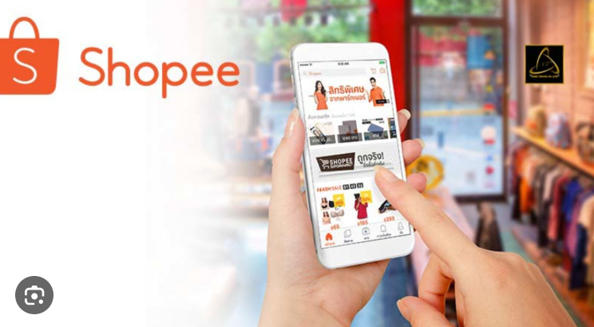

Slide 5
Unit
8
SHOPPING
LESSON 6: SKILLS 2
1

Slide 6
LISTENING
VOCABULARY
access (n)
/ˈækses/
quyền truy cập vào

Slide 7
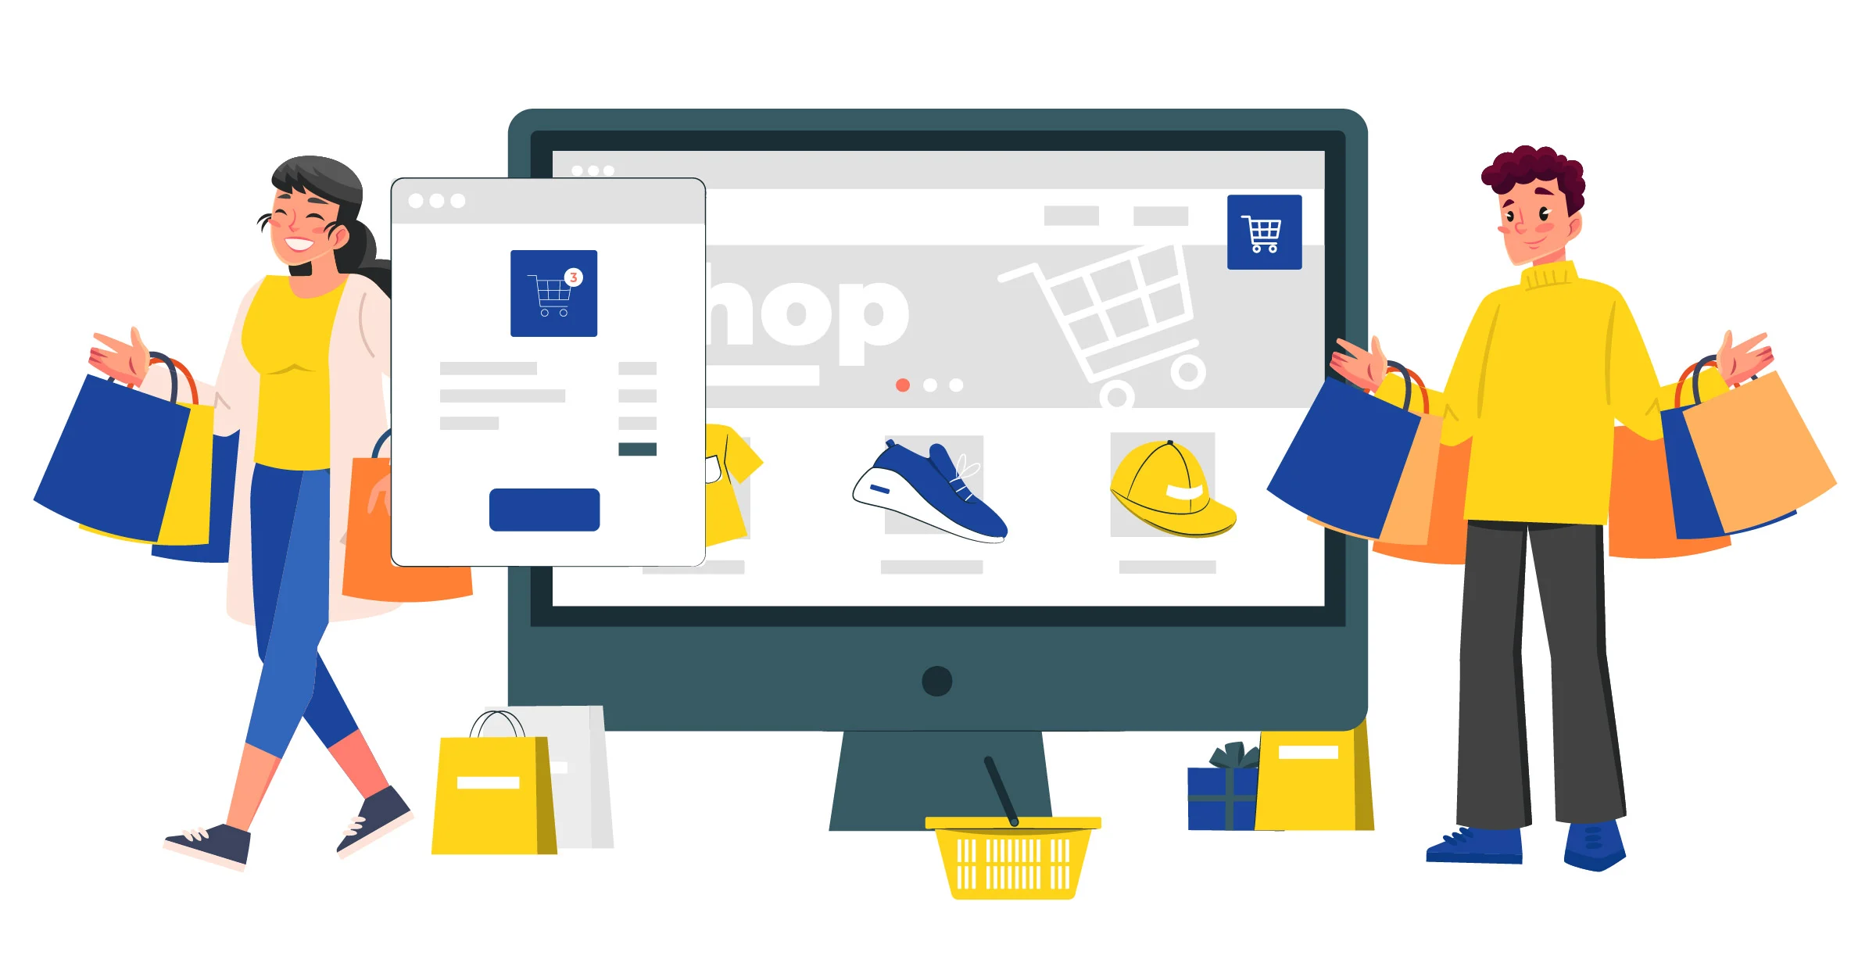
LISTENING
VOCABULARY
purchase (v)
/ˈpɜːtʃəs/
mua sắm

Slide 8
LISTENING
VOCABULARY
return (v)
/ri'tɜ:n/
trả lại, hoàn lại

Slide 9
LISTENING
VOCABULARY
product (n)
/'prɒdʌkt/
sản phẩm

Slide 10
LISTENING
VOCABULARY
service (n)
/'sɜ:vis/
dịch vụ

Slide 11
VOCABULARY
PRESENTATION
New words | Pronunciation | Meaning
access (n) | /ˈækses/ | quyền truy cập vào
purchase (v) | /ˈpɜːtʃəs/ | mua sắm
return (v) | /ri'tɜ:n/ | trả lại, hoàn lại
product (n) | /'prɒdʌkt/ | sản phẩm
servive(n) | /'sɜ:vis/ | dịch vụ

Slide 12
LISTENING
1
Work in pairs. Discuss and tick the things related to online shopping.
1. Internet access
2. travelling
3. a smartphone/ laptop
4. a credit card
https://hoclieu.vn/skill/519fbd26-24d8-4c8d-b7b7-9c76f2e0d550?lessonId=08dc404a-f746-4a63-8cb5-fb35a33f6944

Slide 13
LISTENING
2
Listen to a talk about online shopping and fill in each blank with a suitable word.
1. You can buy a product or ___________ online.
2. When shopping online, you visit a _________ website.
3. Online shopping helps you save time and ___________.
4. If you return a product, you still must pay for the ___________.
5. Shopping online can make you become a ___________.
service
seller’s
money
shipping
shopaholic

Slide 14
LISTENING
3
Listen again and choose the correct answer A, B, or C.
1. When you shop online, you can pay ______ ways.
A. one B. two C. three
2. The talk does NOT describe online shopping as _______.
A. convenient B. easy C. interesting
3. The talk is mainly about _______ of online shopping.
A. the popularity
B. the convenience C. the advantages and disadvantages

Slide 15
WRITING
4
Work in pairs. Choose a type of shopping from the list. Discuss and take notes of its advantages and disadvantages.
1. Shopping online
Advantages: easy, convenient, save the trouble of travelling, time, and money.
Disadvantages: the products you receive might not exactly be what you expect, you can return an item, but you have to pay for the shipping, and you can easily become a shopaholic.
2. Shopping at a supermarket
Advantages: easy, convenient, availability of many goods under one roof, a lot of promotions, don’t have to bargain, safe from heat and rain, no need to travel to multiple shops.
Disadvantages: unnecessary shopping because of discounts and convenience.
3. Shopping at an open-air market
Advantages: you can bargain, sellers can share advice about the things you buy, you can taste what you buy (bread, fruits…), develop close relations between sellers and buyers.
Disadvantages: limited operating hours, the number of sellers depends on weather, not easy to return items, affected by the weather (hot, rainy, snowy…), often lacks parking lots.

Slide 16
WRITING
5
Write a paragraph (80-100 words) about the advantages or disadvantages of a type of shopping. Use the ideas in 4.
You can use the suggestions below:
Shopping … is interesting/ convenient/ safe/ …
Firstly, …
Secondly, …
Writing

Slide 17
Website: hoclieu.vn
Fanpage: facebook.com/tienganhglobalsuccess.vn/

Slide 18
WRITING
Sample writing:
I often go shopping at the open-air market near my house. However, there are some things I do not like about it. Firstly, it is outdoor. On rainy or hot days, it is uncomfortable to shop. Secondly, the sellers usually ask for a higher price than the value of the goods, so you have to bargain. It is not easy if you do not know the actual price of an item. Another disadvantage is hygiene. Fresh products like vegetables are often not very clean.

Slide 19
CONSOLIDATION
1
Wrap-up
What have we learnt in this lesson?
Listen about online shopping
Write a paragraph about advantages or disadvantages of a kind of shopping.

Slide 20
CONSOLIDATION
2
Homework
Do the exercises in the workbook
Rewrite the paragraph in the notebook.

Slide 21
Website: hoclieu.vn
Fanpage: facebook.com/tienganhglobalsuccess.vn/

