Slide 2
3
Match the phrases with the correct pictures.

Slide 3
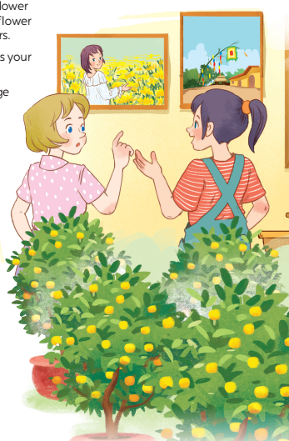
1
Listen and read.
- What can you see in each picture?
- Can you guess the places that the picture show?

Slide 4
Listen and read.
Elena: Wow, this girl looks so cute.
Trang: Yeah ... She’s my cousin. She’s at Sa Dec Flower Village. Tet is coming soon, so many people visit flower villages to take pictures with the blooming flowers.
Elena: Oh, I’m fond of admiring the flowers. Does your family visit places like this too?
Trang: Yes, we do. We usually visit nhat Tan Village to buy kumquat trees and peach blossoms.
Elena: I see flowers and ornamental trees everywhere these days. What are they for?
Trang: We, Vietnamese, use plants and flowers for decorations and for oﬀerings. They are an important part of our Tet tradition.
Elena: And what’s that tall tree in the photo?
Trang: Well, it’s actually a bamboo pole. People place it in the yard of the communal house. They hang decorative items like small bells and lanterns on it. They want to chase away bad luck and pray for a lucky new year.
Elena: Interesting! I didn’t know that.

Slide 5
Read the conversation again and tick T (True) or F (False).
Sentences | T | F
1. Elena and Trang are at Sa Dec Flower Village.
2. Many people visit ﬂower villages to take photos.
3. Trang’s family usually buys kumquat trees and peach blossoms at Nhat Tan Village.
4. Flowers are not part of any Vietnamese traditions.
5. People decorate bamboo poles with small bells and lanterns for New Years.
Trang’s cousin is at Sa Dec Flower Village
Plants and flowers are an important part of Tet

Slide 6
4
Complete the sentences with the verbs from the box.
1. The British decorate their Christmas trees and ______ presents under them.
2. Tom likes to ______ the view from the hill.
3. In many cultures, knocking on wood is a way to ______ away bad spirits.
4. Many Asians go to Buddhist temples to ______ for good luck.
place
admire
chase
pray

Slide 7
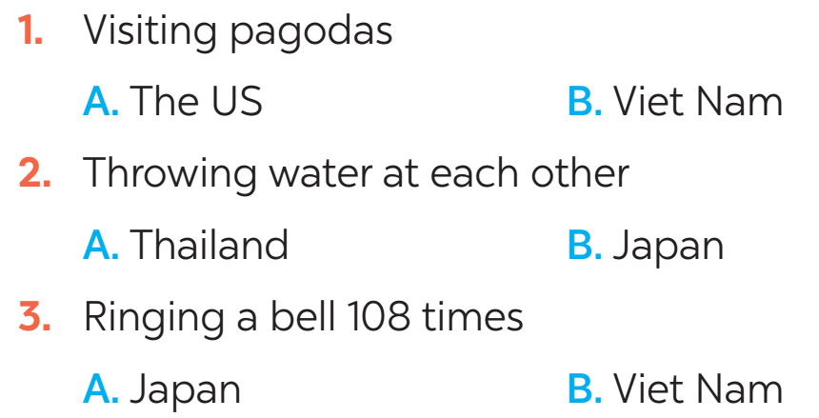
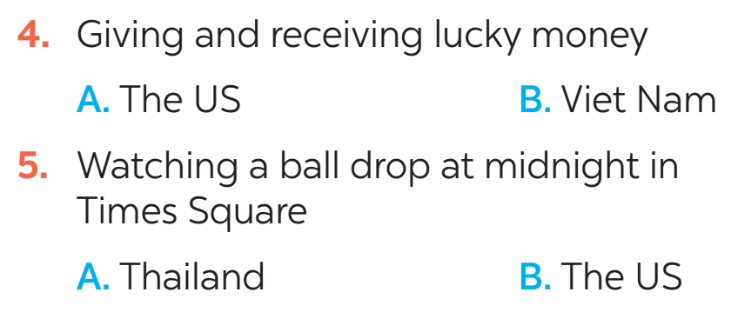
5
New Years around the world.
People around the world celebrate New Years differently. Choose the tradition below.

