Slide 1
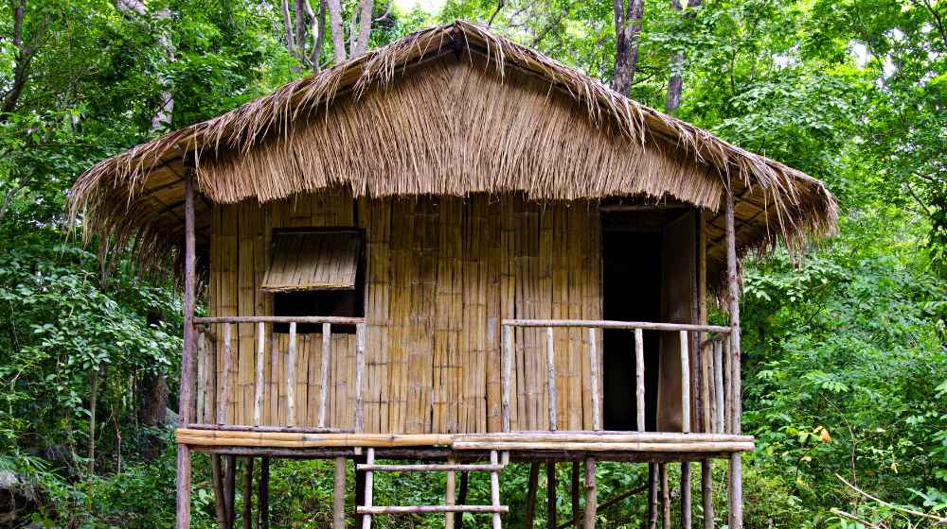
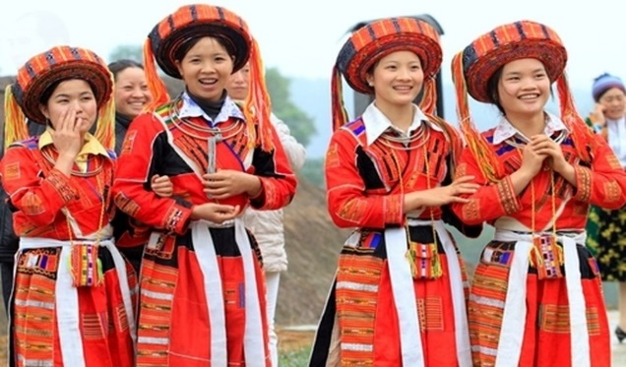
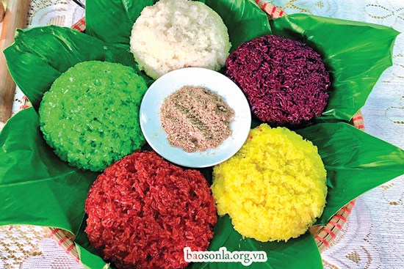
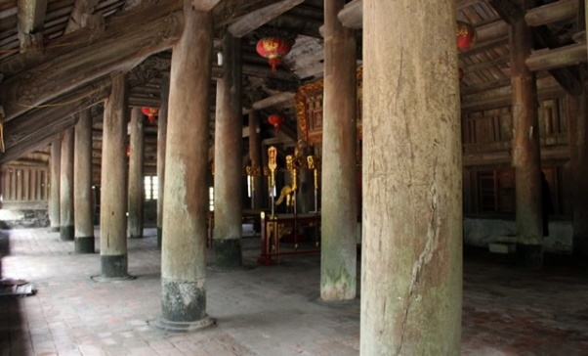
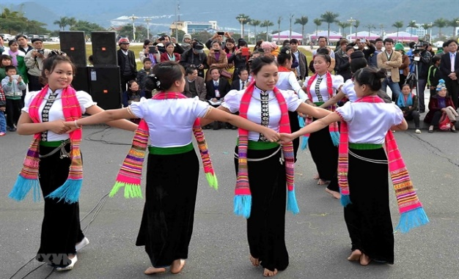
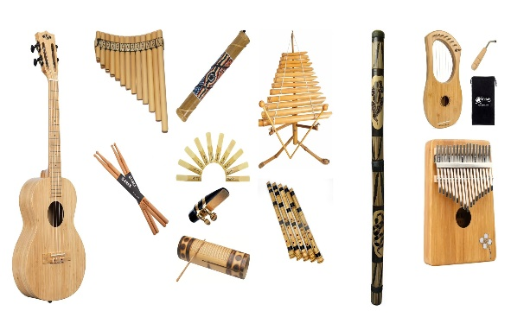
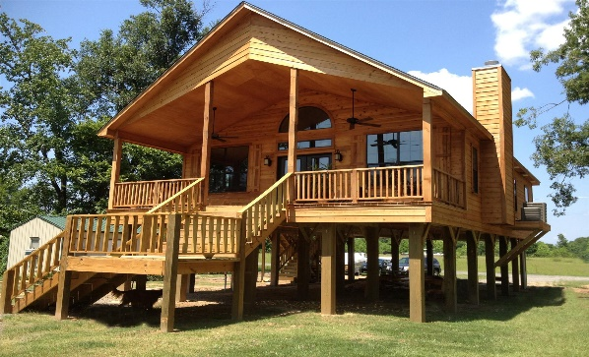
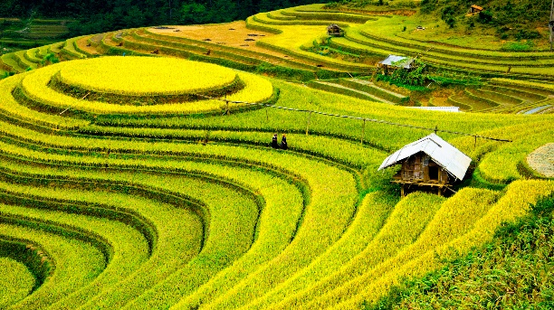
bamboo house
costume
five-colour sticky rice
post
terraced field
folk dance
musical instrument
stilt house

Slide 2
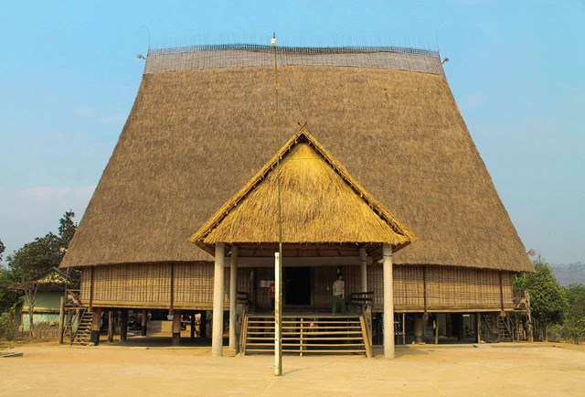
VOCABULARY
communal house (n)
/kəˈmjuːnəl haʊs/
nhà rông, nhà sinh hoạt cộng đồng

Slide 3
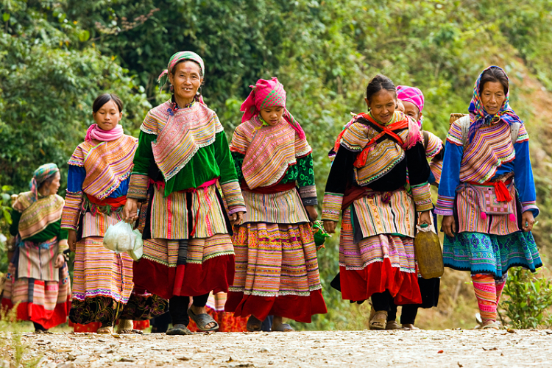
VOCABULARY
minority (n)
/maɪˈnɔːrəti/
dân tộc thiểu số

Slide 4
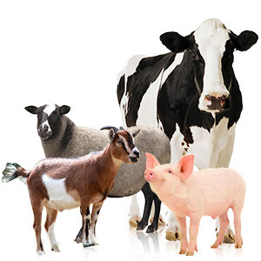
VOCABULARY
livestock (n)
/ˈlaɪvstɒk/
gia súc

Slide 5
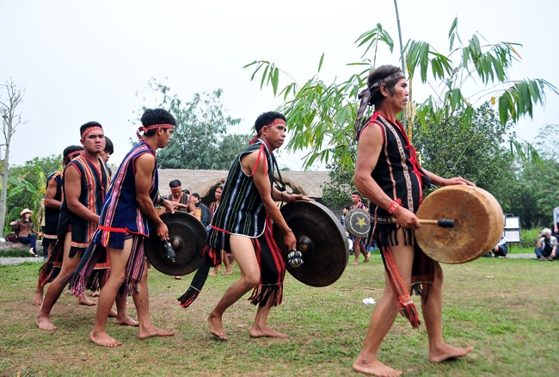
VOCABULARY
gong (n)
/ɡɒŋ/
cái cồng,
cái chiêng

Slide 6
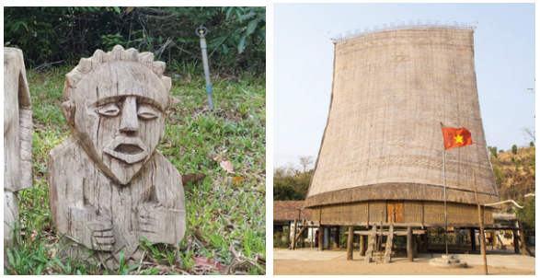
1
Write a word or phrase from the box under each picture.
Rong house weaving terraced fields
gong bamboo flute wooden statue
wooden statue
Rong house
1.___________________
2. __________________

Slide 7
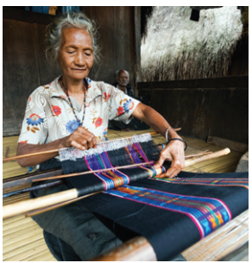
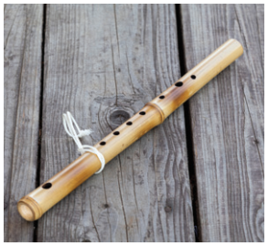
Rong house weaving terraced fields
gong bamboo flute wooden statue
weaving
bamboo flute
3.___________________
4.___________________

Slide 8
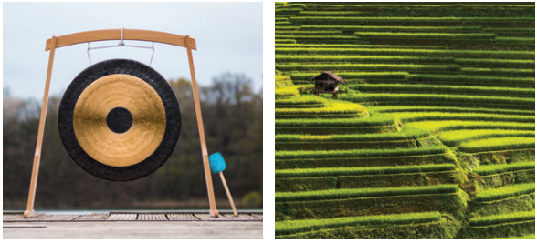
Rong house weaving terraced fields
gong bamboo flute wooden statue
gong
terraced fields
5.___________________
6.___________________

Slide 9
2
Match the words and phrases with their meanings.
A | B
 | a. the animals we keep on a farm like cows and sheep
 | b. a large room for community activities
 | c. a group smaller in size than other groups in the same country
 | d. a traditional musical instrument
 | e. work like growing, watering, weeding, and harvesting
1. minority group
2. livestock
3. gardening
4. gong
5. communal house

Slide 10
Complete the sentences with the words and phrases from the box.
communal house unique features minority group
raise weave livestock
1. It’s interesting to learn about the _______________ of an ethnic group’s traditional culture.
2. Most mountain girls know how to ______ clothing.
3. The Cham in Ninh Thuan _____ sheep and cows.
unique features
weave
raise
4. A _______________ is for community meetings and events.
5. There are fewer Nung than Kinh, so they are an ethnic ______________.
6. Children in both the lowlands and highlands help raise their family’s _________.
communal house
minority group
livestock

Slide 11
PRONUNCIATION
4
Listen and repeat the words. Pay attention to the sounds /k/ and /g/.
/k/ | /g/
cultural communal musical folk overlook | gong garden gathering tiger pig

Slide 12
5
Listen and repeat the sentences. Pay attention to the underlined words.
1. The kitchen is for family gatherings.
2. Tigers and monkeys live in the forest.
3. I love the five-colour sticky rice.
4. Yesterday, we harvested cucumbers from our garden.
5. Most girls know how to cook.
/k/ and /g/

