Slide 1
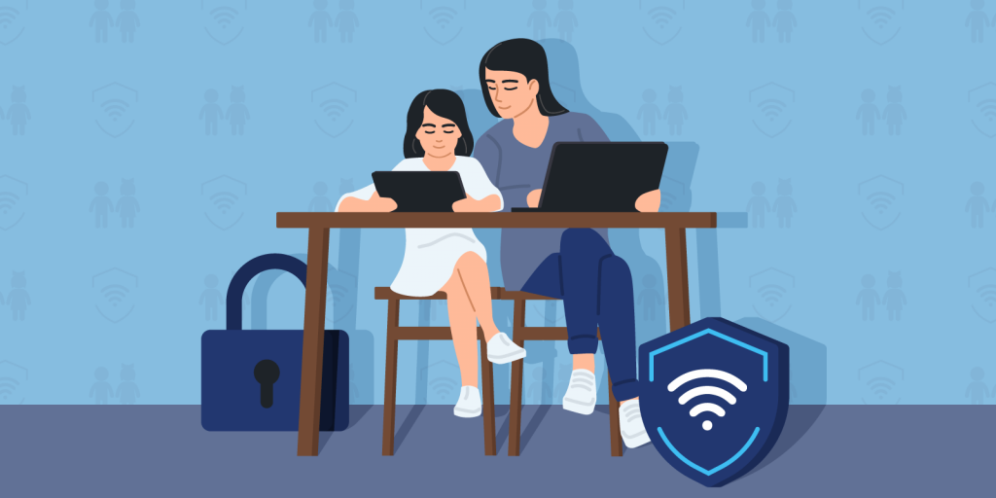
LISTENING
parental (adj)
/pəˈrentl/
liên quan tới bố mẹ, thuộc bố mẹ

Slide 2
LISTENING
peer (n)
/pɪə(r)/
người ngang hàng, bạn đồng lứa

Slide 3
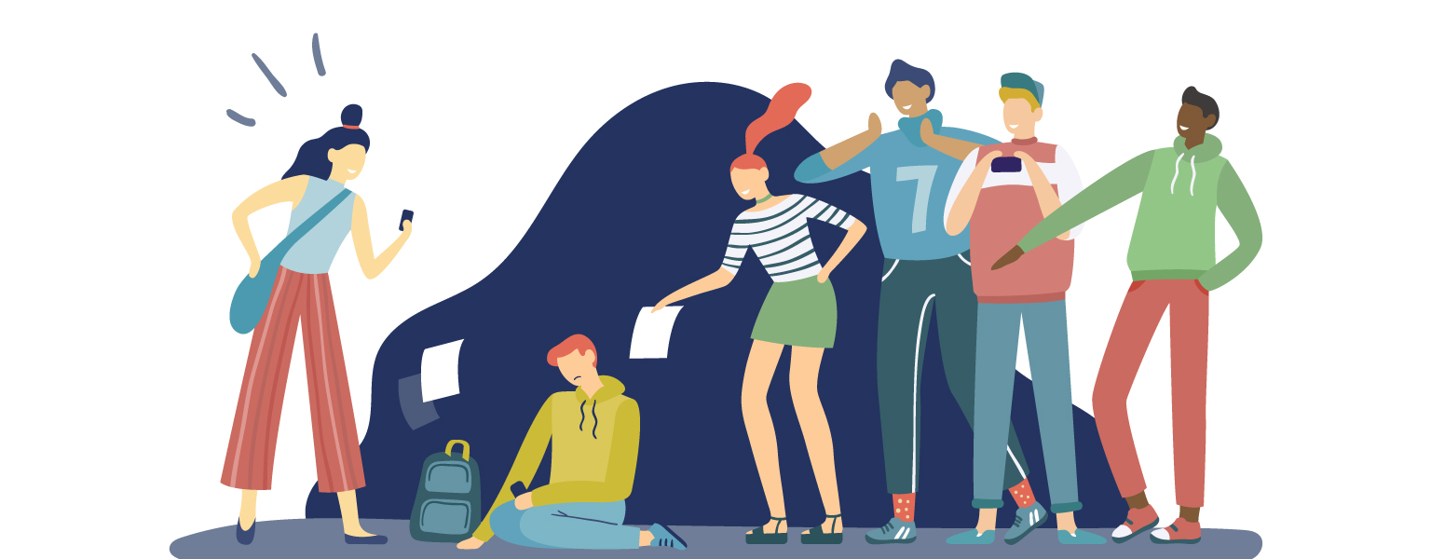
LISTENING
bully (v)
/ˈbʊli/
bắt nạt

Slide 4
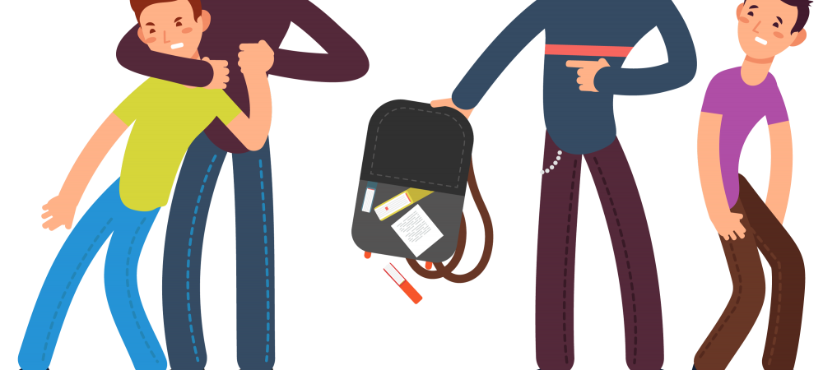
LISTENING
bullying (n)
/ˈbʊliɪŋ/
sự bắt nạt

Slide 5
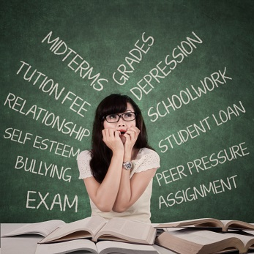
LISTENING
1
Which types of pressure below do you think teens face?
pressure from schoolwork
parental pressure
pressure from work
pressure from their clubs

Slide 6
LISTENING
2
Listen to a conversation and choose the correct answer to each question.
1. How many students are talking?
One.
Two.
Three.
2. What are they discussing?
Their class forum.
Their stress.
Their community activities.

Slide 7
LISTENING
3
Listen to the conversation again and fill each blank with ONE word.
Problems | Solutions
Minh has pressure from his (1)________. | Minh should tell his parents about his interests and (2) __________.
Ann is unhappy about her (3) _____________. | Ann should feel (4)________ about her body.
Mi doesn’t get on with her (5)________. | She should (6) ______ to her mum.
parents
abilities
good
body / weight
talk
sister

Slide 8
WRITING
4
Match the causes of teen stress with the possible solutions. There may be more than one solution to a problem.
Causes of teen stress |  | Possible solutions
peer pressure too much schoolwork spending too much time on social media bullying |  | avoiding bullies wherever possible staying calm and relaxed turning off smartphones talking to teachers

Slide 9
WRITING
5
Write a paragraph (80 - 100 words) about the cause(s) of your stress
and offer solutions.

Slide 10
I often feel stressed because of schoolwork, and here are the ways I deal with my stress. First, I often talk to my parents about how I feel and what I expect my parents to help. Second, I stopped staying up late to play games or chat with peers. I turn off my computer and smartphone at 10 p.m. Third, I also tell my parents that I am making efforts, but there are subjects that I
don’t really like so I can’t get very high marks as they expect. I also stop going to extra classes and increase self-study.

