Slide 1
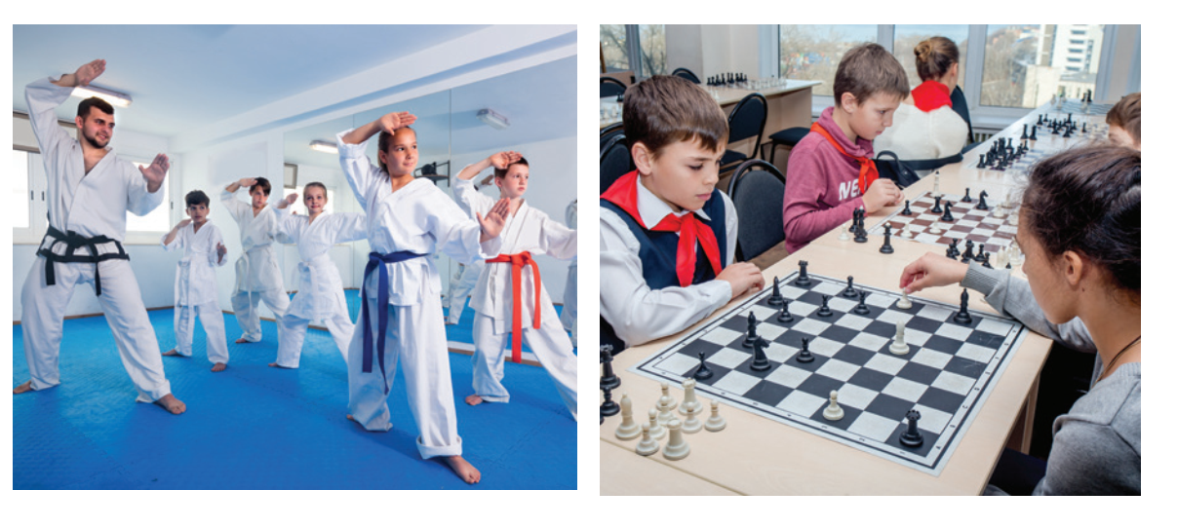
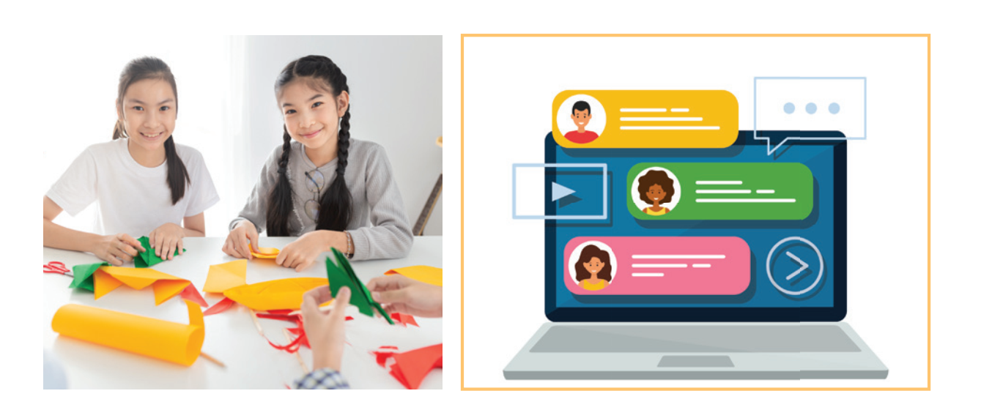
Write a word or phrases => pictures.
language club
pressure
1. _______________
2. _________
sports club
chess club
forum
3. _______
4. ________
arts and crafts club

Slide 2
Listen and read.
Teacher: It’s great to see you again, class. What’s going on? Minh: We’ve decided to use Facebook for our class forum, and we joined some school club activities. We’re also preparing for the midterm tests. It’s really stressful. Teacher: I’m sorry to hear that. I know exams may give you a lot of stress. But stay calm and work hard. What other pressure do you have? Minh: Well, we also have pressure from our parents and friends. Teacher: Do you? Let’s discuss these problems in your new Facebook group. By the way, why did you choose Facebook? Ann: Because it’s user-friendly. Teacher: Good! How about club activities? Do you find them enjoyable? Ann: Yes. This year there are some new clubs like arts and crafts, and music. The club leaders will provide us with a variety of activities to suit different interests. And there will also be competitions as usual. Teacher: Awesome! I hope you all can join the clubs you like.

Slide 3
New words | Pronunciation | Meaning
1. forum (n) | /ˈfɔːrəm/ | diễn đàn
2. stress (n) | /stres/ | sự căng thẳng
3. stressful (adj) | /ˈstresfl/ | căng thẳng, tạo áp lực
4. pressure (n) | /ˈpreʃə(r)/ | áp lực
5. user-friendly (adj) | /ˌjuːzə ˈfrendli/ | thân thiện với người dùng, dễ dùng
6. midterm (adj) | /ˌmɪdˈtɜːm/ | giữa kì

Slide 4
Read the conversation again and write T (true) or F (False).
Sentences | T | F
1. The students finished their midterm tests
2. Minh mentions the different types of pressure they are facing.
3. The teacher tells them to stay calm and work hard.
4. The class will discuss their problems offline.
5. The school has different clubs for its students.
They are preparing for the midterm test.
The class will discuss their problems in their new Facebook group.

Slide 5
4
Complete each of the sentences with a word or phrase in 3. There is one extra word or phrase.
arts and crafts club
1. Minh is a member of our ________________. The greeting cards he makes are really creative.
2. Students can discuss their problems in their class ______.
3. We share the essays and stories that we write in English in our _____________.
4. She is not feeling very well this weekend because of all the _______
from her school work.
5. The coach of our _____________ tells us to drink plenty of water during our practice sessions.
forum
language club
pressure
sports club

Slide 6
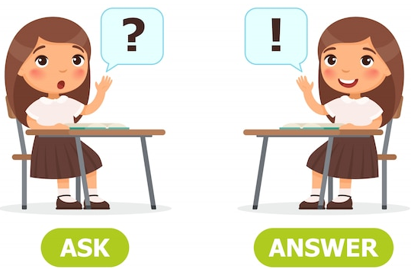
5
Work in pairs. Ask and answer the questions below. Report your friend’s answers to your class.
What types of social media do you use?
What kinds of pressure do you have?
What clubs do you participate in?
Why do you choose to participate in that club?

