Slide 2
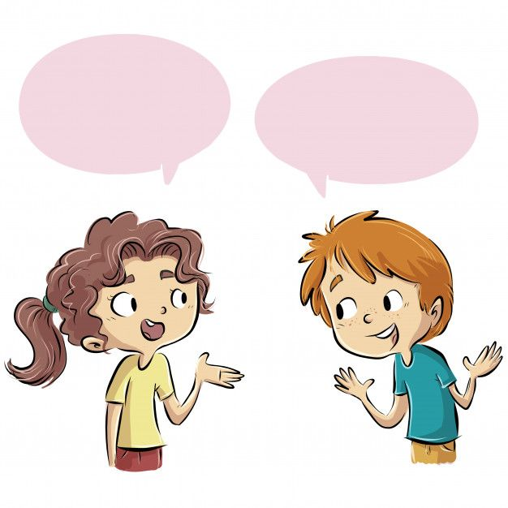
WARM-UP
Work in pairs. Discuss the following questions:
1. What are different types of tours? Give some information about them.
2. What types of tours have you been on?
3. Were they positive/negative experiences?

Slide 3
Some different types of tours? Give some information about them.
1. Guided Tours: Led by a professional guide. Includes historical, cultural, and sightseeing insights.
2. Self-Guided Tours: Travelers explore on their own using maps, apps, or audio guides.
3. Adventure Tours: Usually in natural landscapes such as mountains, jungles, or oceans.
4. Cultural and Heritage Tours:Emphasizes historical sites, traditions, and local customs.
5. Eco-Tours: Promotes sustainable travel and nature conservation. Includes wildlife sanctuaries, national parks, and eco-lodges.
6. Food and Wine Tours: Focuses on culinary experiences, wine tastings, and local specialties.
Usually includes visits to vineyards, markets, and restaurants.
7. Religious or Pilgrimage Tours: Travel to sacred sites and religious landmarks.
8. Cruise Tours: Travel by luxury ship, stopping at multiple destinations. Includes entertainment, dining, and shore excursions.

Slide 4
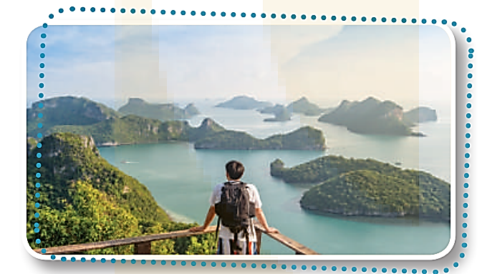
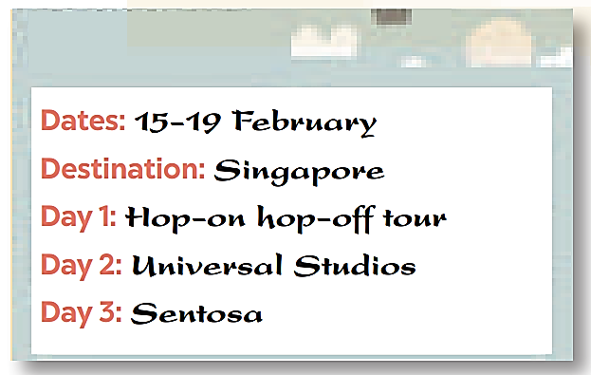
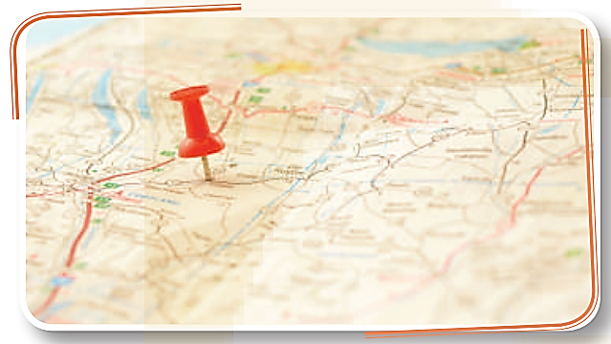
READING
1
Write the words under their correct pictures.
a. destination b. traveller c. itinerary
1. b. traveller
2. a. destination
3. c. itinerary

Slide 5
2
Read the passage and match the words and phrases in A with the definitions in B.
Nowadays, more young people choose self-guided tours which require them to do everything on their own. They have to look for a destination, work out an itinerary, and estimate the cost. They then hunt for tickets and accommodation, usually homestay. This type of holiday may require people more time and effort, but it is cheaper and more flexible than a package holiday. It gives travellers more freedom to decide where to go and how much time and money to spend at a place. However, to have a smooth trip and avoid trouble, these travellers should be good at using apps.
The two most popular types of tours now are package and self-guided tours. When you buy a package tour, a travel agency takes care of almost everything for you. You will get a notice about the places of your visit, the detailed itinerary, and the cost. They will protect you if something goes wrong during the trip. This type of holiday saves time and reduces stress for travellers. It offers a convienient option for people who are elderly, who do not want to spend much time searching on their own, or who are not confident about using online apps. One disadvantage of this type is you have to follow a fixed itinerary.

Slide 6
Read the text and match each highlighted word with its meaning.
1. cost
a. happening or continuing without any problems
b. money spent on something
c. not changing
d. look for
2. fixed
3. hunt for
4. smooth
Notes:
1. b 2. d 3. a 4. c

Slide 7
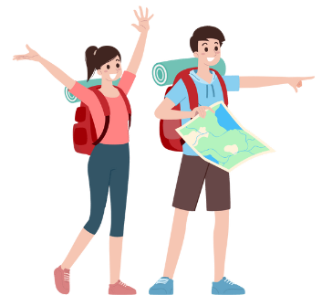
1. What can a package tour save you?
2. What disadvantage of a package tour does the passage mention?
3. What do travellers have to do on a self-guided tour?
4. What is an advantage of self-guided tours?
5. What skill should you have if you go on a self-guided tour?

Slide 8
Read the text again and answer the following questions.
What can a package tour save you?
2. What disadvantage of a package tour does the passage mention?
3. What do travellers have to do on a self-guided tour?
4. What is an advantage of self-guided tours?
5. What skill should you have if you go on a self-guided tour?
It can save you time and worry.
Travellers have to follow a fixed itinerary.
They have to do everything on their own.
It’s cheap and convenient.
It is using online apps.
Notes:
1. Time and worry.
2. Travellers have to follow a fixed itinerary.
3. They have to do everything on their own.
4. It’s cheap and convenient.
5. Using online apps.

Slide 9
SPEAKING
4
Work in pairs. Take turns to interview your partner about his /
her recent tour. Take notes of your partner’s answers.
You can ask about:
1. where he / she went
2. which tour he / she took: package or self-guided
3. how he / she travelled
4. where he / she stayed
5. what he / she did / saw

Slide 10
Last summer, Our school went to Da Nang. Since we did not have much time to organize the tour by ourselves, we booked a five-day package tour with the DatMo travel agency. The travel agency arranged everything for us: the package tour incluse accommodation, the places to visit, and transportation. We had to follow a fixed schedule, but we felt ok with it. The tour guide was friendly and helpful. Coming home, everybody was satisfied with the service the agency offered.

