Slide 2
1. Joining a performance
2. Attending an army course
3. Travelling to a new place without parents

Slide 3
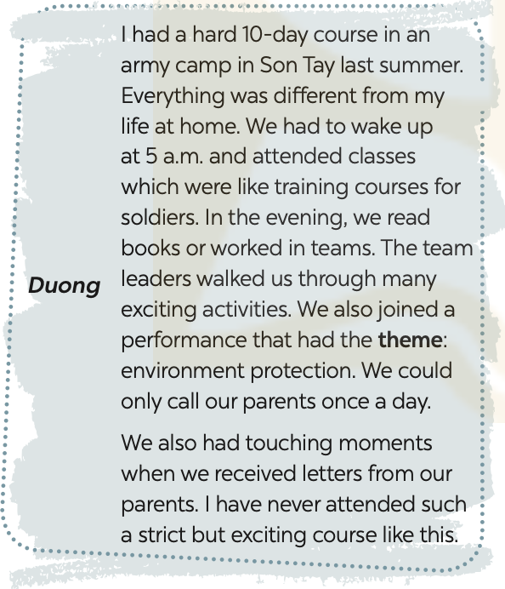
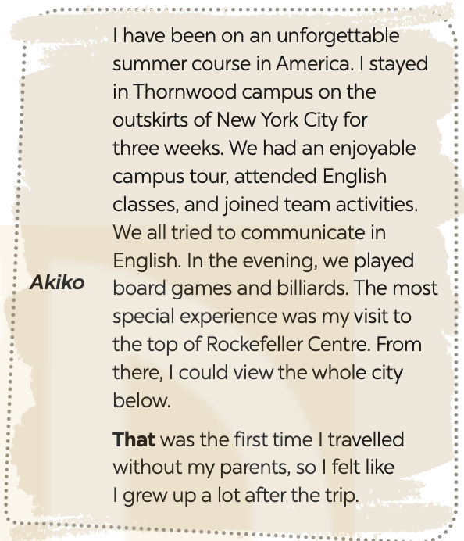

Slide 4
1. Duong and Akiko talked about ______.
A. their English summer courses B. experiences at summer courses C. activities in summer D. their army training
2. What didn’t Duong do during his course?
A. Get up early. B. Work as a leader. C. Receive letters from home. D. Work in teams.
3. The word “theme” means ______.
A. Performance B. environment C. activity D. topic
4. The experience at Rockefeller Centre was ______ for Akiko.
A. unforgettable B. enjoyable C. special D. touching
5. The word “that” refers to ______.
A. travelling to America B. touring the Thornwood campus
C. visiting Rockefeller Centre D. viewing the city below

Slide 5
Read the texts again and tick Duong or Akiko.
Experiences | Duong | Akiko
1. attending an English course
2. attending an army-like course
3. joining a performance
4. touring a campus
5. receiving letters from home

Slide 6
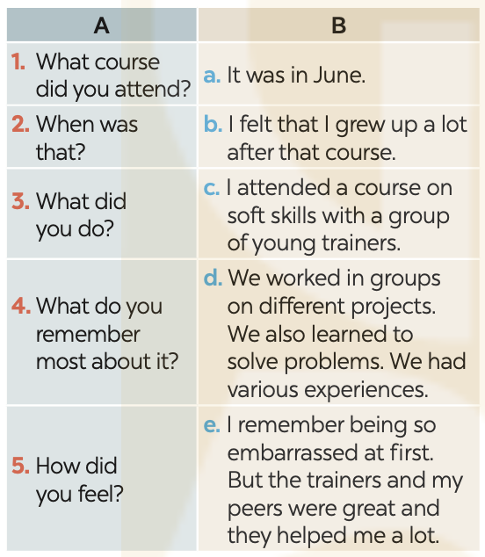
Match the questions in a with the answers in B.

Slide 7
5
Work in pairs. ask and answer about a course you have experienced. use the questions in 4 as cues. then report your partner’s answers to the class.
Minh attended a memorable summer course last year. It was a presentation skill course. He learnt how to organise the talk, and how to use visual aids. He also practised using gestures, and having eye contacts with the audience. He felt that the course was so impressive and memorable.
Example:

