Slide 2
WARM-UP
Let’s check the sentences
1. Sarah has joined the camp since the beginning of summer.
2. She has gone to Paris with her family since last December.
3. They haven’t played for the school’s band for 4 months.
4. Have you done your homework yet? No, I have not.
OUR
EXPERIENCES
Notes:
Asking the sentences are in what tense?

Slide 3
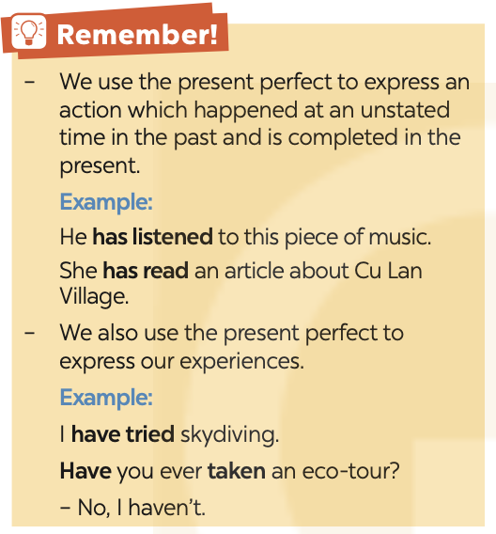
Form
S + Vp.p + … .
S + haven’t/ hasn’t + Vp.p + …
Have/ Has + S + Vp.p + … ?
P.P: Past participle

Slide 4
1
Write the correct forms of the verbs in the table.
Verbs | Past simple | Past participle
work join play be go do | worked | worked
joined
joined
played
played
was/were
been
went
gone
did
done

Slide 5
2
Complete the sentences with the correct forms of the verbs in the present perfect.
1. We (join) ___________ that project.
2. I (play) __________ a computer game at his house once.
3. She ______ never (work) ______ in such an unpleasant workplace.
4. He ______ never (be) ______ a class monitor.
5. They (go) __________ birdwatching several times.
have joined
have played
has
worked
has
been
have gone

Slide 6
Choose the correct answer A, B, C, or D to complete each sentence.
1. We ______ in our school’s sports competition once.
A. participate B. have participated
C. has participated D. are participating
2. Nam ______ any photos of his village for two years. A. has not taken B. have not taken
C. does not take D. is taking
3. They ______ detective stories several times.
A. were reading B. read C. has read D. have read
4. I ______ never ______ that film before.
A. did; watched B. has; watched C. have; watched D. was; watching
5. She ______ her cousin since she left school.
A. haven’t met B. doesn’t meet C. hasn’t met D. didn’t meet

Slide 7
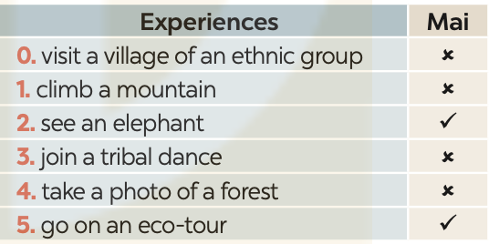
Write sentences about Mai’s experiences, using the information in the table.
Mai hasn’t visited a village of an ethnic group.

Slide 8
1. Mai hasn’t climbed a mountain.
2. Mai has seen an elephant.
3. Mai hasn’t joined a tribal dance.
4. Mai has taken a photo of the forest.
5. Mai has gone on an eco-tour.

Slide 9
Exercise 2. Viết lại câu sao cho nghĩa không đổi.
Exercise 3. Chia các động từ sau ở thì Hiện tại tiếp diễn hoặc Hiện tại hoàn thành.
1. My father (not/ play) ................................... any sport since last year.
2. Some people (attend) ................................... the meeting right now.
3. I’d better have a shower. I (not/have) ................................... one since Thursday.
4. I don’t live with my family now and we (not/see) ................................ each other for 5 years.
5. Where is your mother? - She (have) ................................... dinner in the kitchen.
6. Why are all these people here? What (happen) ...................................?
7. I (just/ realize) ................................... that there are only four weeks to the end of term.
8. The train drivers (go) ................................... on strike and they stopped working at twelve o’clock.
9. At the present, he (compose) ................................... a piece of music.
Exercise 2.
1. She hasn't come back to her hometown for 4 years.
2. He has worked as a bank clerk for 3 months.
3. We have not flown to Singapore for 5 years.
4. I haven't had my hair cut since November.
5. We haven't called each other for 5 months.
6. We haven't met each other for a long time.
7. How long have you had it?
8. I have never had such a delicious meal.

