Slide 2
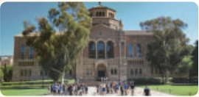
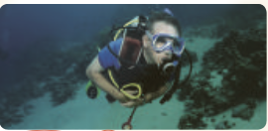
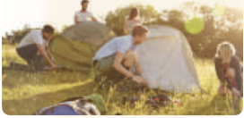
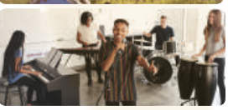
Write an activity next to each picture
1. ___________
touring a campus
2. ____________
going snorkelling
3. ____________
learning by rote
4. ___________
putting up tents
5. ____________
giving a performance

Slide 3
Complete each sentence with an adjective in the box.
1. He felt _______ when he couldn’t protect himself from bullying.
2. The parachute jump was a(n) __________ experience for the boy. He was so excited.
3. It was so _______ to view the mountain range from the distance.
helpless
exhilarating
amazing
4. I had a(n) __________ experience when I took her bag by mistake.
5. The Tom had a(n) __________ experience putting up a tent in the rain.
embarrassing
unpleasant

Slide 4
3
Choose the correct answer A, B, C, or D.
1. His mind ______ when I asked him how to do the homework.
A. went blank B. went empty C. became exhausted D. put up
2. Students could see the university’s facilities when they ______.
took an excursion B. toured the campus
C. gave a performance D. took an eco-tour

Slide 5
3. Snorkelling in the coral reef is a(n) ______.
A. touching moment B. happy time C. exciting experience D. embarrassing moment
4. Nam and his friends felt ______ when they couldn’t put up a tent by themselves.
A. pleasant B. embarrassing C. embarrassed D. pleased
5. I didn’t understand the lesson. I learnt it ______.
A. on purpose B. by chance
C. with memory D. by rote

Slide 6
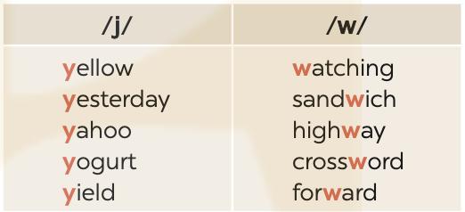
4
Listen and repeat the words. Pay attention to the sounds /j/ and /w/.

Slide 7
5
Listen to the sentences. Underline the words with /j/ and circle the words with /w/. Practise the sentences.
He tried sailing a yacht, and he did it well.
We’ve made a class yearbook. It looks wonderful.
They awarded him a gold medal yesterday.
Youngsters should be aware of their responsibilities.
5. They haven’t yet understood the role of wildlife.

