Slide 1
VOCABULARY
1
Choose the correct answer A, B, C, or D
1. In keeping with ______, we cook five-colour sticky rice on the first day of a lunar month.
A. tradition
B. habit
C. ritual
D. practice
2. Sam is very interested in history, and he remembers a lot of historical ______and dates.
A. traditions
B. events
C. anniversaries
D. practices

Slide 2
1
Choose the correct answer A, B, C, or D
3. The fire of London in 1666 destroyed thousands of old ______ and damaged a large part of London’s centre.
A. organisations
B. structures
C. associations
D. connections
4. This practice was more common in ______ times than it is now.
A. beginning
B. antique
C. historic
D. ancient

Slide 3
1
Choose the correct answer A, B, C, or D
5. This complex of buildings was ______ by foreign troops during the war.
A. received B. busy
C. occupied D. filled

Slide 4
2
Finish the sentence by completing each blank with a word. The first letter of each word is given.
1. The custom of w______ ancestors is a beautiful and rich tradition in Vietnamese culture.
orshiping
2. The custom of sending a greeting card has become a d______ tradition in many western countries.
eep-rooted
3. A country’s cultural h______ is a valuable resource
eritage
4. Festivals, which are handed down from one g______ to the next, are an important way to promote tourism
eneration
5. Besides the key i______, another secret to achieving the perfect fish and chips is the temperature of the oil.
ngredients

Slide 5
3
Put the verb in brackets in the past continuous to complete each sentence.
1. Luckily, the sun (shine) ______________ brightly when we reached the campsite
was shining
2. They (build) ______________ Ho Chi Minh Mausoleum from 1973 to 1975.
were building
weren’t studying
4. When their mum came home, they (not study) ____________; they (chat) _______________noisily.
were chatting

Slide 6
GRAMMAR
PAST CONTINUOUS
S + was/were + Ving
=> He was eating rice.
S + was/weren’t + Ving
=> They weren’t playing football
Was/Were + S + Ving?
=> Was she studying all night?

Slide 7
3
Put the verb in brackets in the past continuous to complete each sentence.
Were
4. ______ they still (wait) __________ when the tour guide arrived?
waiting
5. I (think) _________________ of my grandmother for years after she died.
was thinking

Slide 8
WISH + PAST SIMPLE
1. She doesn’t have an iPhone. She’d like to have one.
Subject + wish + subject + past simple
2. I’m sorry that I don’t have a three-month summer holiday as my grandma did.
I wish I had enough money to travel around the world.
I wish (that) my mother didn’t have to work so hard.

Slide 9
4
4
Rewrite the following sentences, using wish
3. I want my parents to let me make my own decisions, but they don’t.
1. She doesn’t have an iPhone. She’d like to have one.
She wishes (that) she had an IPhone.
2. I’m sorry that I don’t have a three-month summer holiday as my grandma did.
4. Mike wants to play musical instruments, but he can’t.
I wish I had three-month summer holiday as my grandma did.
5. My dad is very busy. I want him to have more time with me.

Slide 10
4
4
Rewrite the following sentences, using wish
1. She doesn’t have an iPhone. She’d like to have one.
3. I want my parents to let me make my own decisions, but they don’t.
I wish (that) my parents let me make my own decisions.
2. I’m sorry that I don’t have a three-month summer holiday as my grandma did.
4. Mike wants to play musical instruments, but he can’t.
Mike wishes (that) he could play musical instruments.
5. My dad is very busy. I want him to have more time with me.
I wish (that) my dad was not very busy, and (that) he had more time with me.

Slide 11
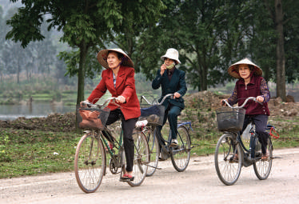
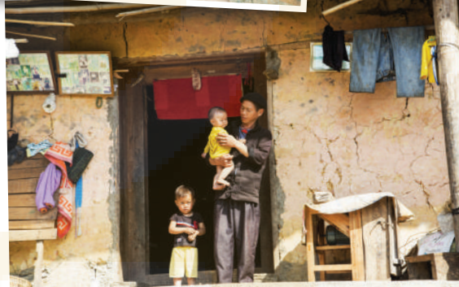
PROJECT
Life in your neighborhood
40 years ago

