Slide 2
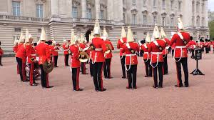
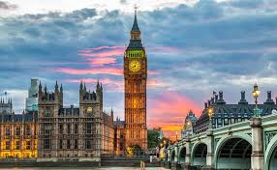
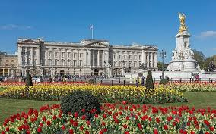
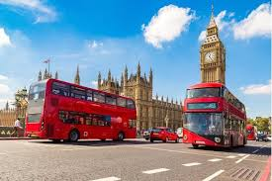

Slide 3
Look at the map
What do you know about
the UK and England

Slide 4
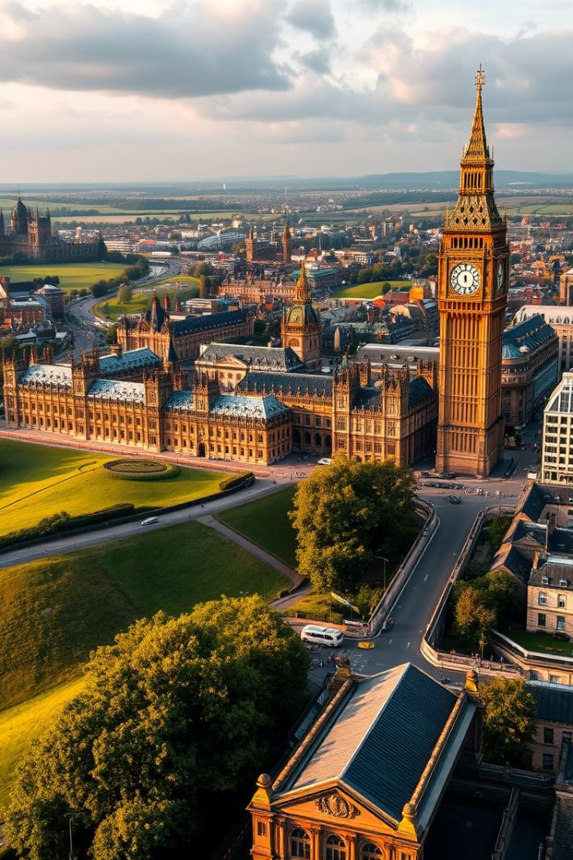
An Introduction to the United Kingdom
The United Kingdom is a captivating island nation that blends rich history, cultural diversity, and modern innovation. From the rugged landscapes of Scotland to the bustling streets of London, the UK offers a wealth of experiences for visitors to discover.
by Tổ 1

Slide 5
Geography and Regions
England
Scotland
Wales
Northern Ireland
Home to iconic landmarks like Buckingham Palace, the Tower of London, and the historical university towns of Oxford and Cambridge.
Known for its dramatic highlands, lochs, and castles, as well as the vibrant capital city of Edinburgh.
Renowned for its stunning coastal scenery, rugged mountains, and rich cultural heritage, including the Welsh language.
Featuring the iconic Giant's Causeway, the historic city of Belfast, and the scenic Antrim Coast.

Slide 6
Culture and Traditions
1
Iconic Landmarks
2
Vibrant Cities
3
Rich Cultural Heritage
From the Tower of London to Buckingham Palace, the UK is home to numerous historic and iconic landmarks that draw visitors from around the world.
The UK boasts lively and cosmopolitan cities, each with their own unique character, such as London, Edinburgh, and Cardiff.
The UK celebrates its diverse cultural heritage, with traditions ranging from the Highland Games of Scotland to the pub culture and afternoon tea.

Slide 7
What do you know about England?
Possible answer:
+ England: one of the 4 parts of the UK (England, Scotland, Wales, the Northern Ireland)
+ Capital: London
+ Population: over 56 million (2021)
+ Area: 130,279 km²
+ National language: English
+ National dishes: Fish and Chips, Sunday Roast, Full English Breakfast, …
+ ...

Slide 8
England’s traditions have been around for hundreds, even thousands of years. English cuisine is among the deep-rooted traditions that English people are proud to keep alive.
Typical English cuisine has developed over many centuries, and people say that fish and chips is the most English dish of all. It is believed that fish and chips appeared in England in the 19th century. The earliest fish and chip shop opened in London during the 1860s. Since then people have considered fish and chips to be England’s national dish, and it is now a common takeaway in the United Kingdom.
The basic ingredients of the dish are fried fish served with chips. People in different places may add peas, vinegar, lemon, or ketchup. Fish and chips is served hot as the main dish in England. Although there is oil and carbohydrates in fish and chips, it is healthier than other takeaway dishes.
Now there are fish and chip shops in many countries, and it is becoming more and more popular in other countries too. Preserving and promoting fish and chips is the way English people keep themselves associated with the past

Slide 9
very fixed and strong; difficult to change or to destroy.
deep-rooted (adj)
/ˌdiːp ˈruːtɪd/

Slide 10
connected
associated (adj)
/əˈsəʊ.si.eɪ.tɪd/

Slide 11
England’s traditions have been around for hundreds, even thousands of years. English cuisine is among the deep-rooted traditions that English people are proud to keep alive.
Typical English cuisine has developed over many centuries, and people say that fish and chips is the most English dish of all. It is believed that fish and chips appeared in England in the 19th century. The earliest fish and chip shop opened in London during the 1860s. Since then people have considered fish and chips to be England’s national dish, and it is now a common takeaway in the United Kingdom.
The basic ingredients of the dish are fried fish served with chips. People in different places may add peas, vinegar, lemon, or ketchup. Fish and chips is served hot as the main dish in England. Although there is oil and carbohydrates in fish and chips, it is healthier than other takeaway dishes.
Now there are fish and chip shops in many countries, and it is becoming more and more popular in other countries too. Preserving and promoting fish and chips is the way English people keep themselves associated with the past

Slide 12
Use the contexts in which these words appear to predict their meaning, and then do the matching.
Meaning/Explanation | Word
1. linked or connected
2. difficult to change or destroy
3. started to be seen
4. necessary and important
associated
deep-rooted
appeared
basic

Slide 13
Read the text again and tick (√) T (True) or F (False) for each sentence.
T
F
1. English people take great pride in their traditions.
√
2.Fish and chips has been around for hundreds of years.
√
3. The earliest fish and chip shop opened in London in 1860.
√
4. Peas, vinegar, lemon, or ketchup are necessary
for fish and chips.
√
√
5.Fish and chips is not healthy as it has a lot of oil.
6. Fish and chips is sold in many countries now.
√

Slide 14
1. Do the Vietnamese people feel proud of their traditions and customs?
2. Is the Vietnamese cuisine famous? Do foreigners like it?
3. What are some popular Vietnamese dishes?

Slide 15
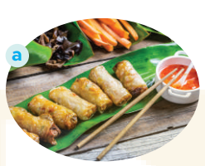
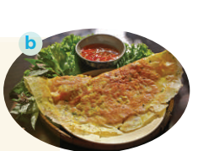
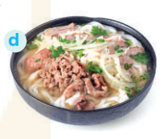
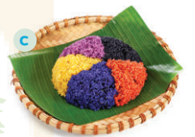
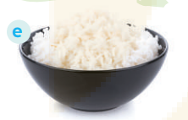
1. pancake
2. five-colour sticky rice
3. beef noodle soup
4. white rice
5. spring rolls

Slide 16
A | B
1. name of the dish | a. glutinous rice, green beans, pork | 1.
2. history | b. at Tet, on the Hung Kings’ anniversary | 2.
3. basic ingredients | c. banh chung | 3.
4. on what occasion it’s eaten | d. traditional dish | 4.
5. type of dish | e. originated in 6th Hung King’s time | 5.
c
e
a
b
d

Slide 17
Think about one traditional dish and prepare to talk about it.
Your talk should include:
– the name of the dish
– the basic ingredients
– when / on what occasion it is eaten
– whether you like it or not

