Slide 1
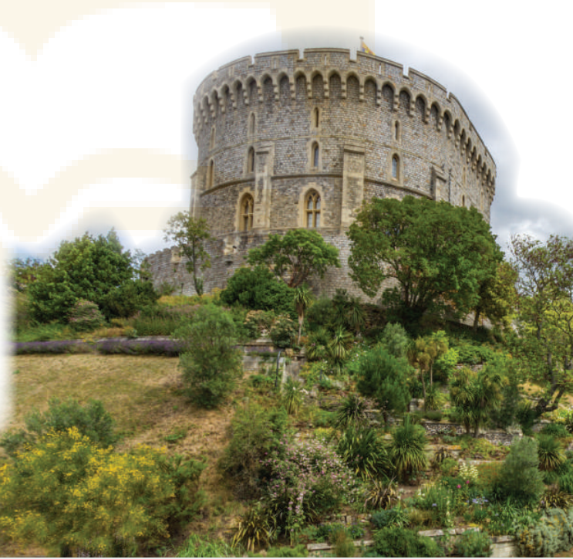
- Look at the title of the conversation. Then look at the picture
What do you think they are discussing?
What do you see in the picture(s)?
What do you know about it / them?

Slide 2
PRACTICE
1
Listen and read.
Teacher: Now let’s look at what you’ve done on your projects. Group one first, please.
Mi: OK. This is Angkor Wat in Cambodia. It’s a temple complex, the largest religious monument in the world.
Teacher: Fantastic! When did people build it?
Mi: They built it in the 12th century. It’s a World Heritage Site. Millions of visitors go there every year
Teacher: Thank you. I wish I could go there one day too. And now group two, please.

Slide 3
PRACTICE
1
Listen and read.
Nam: Our project is about Dinh Bang Communal House in Bac Ninh Province - a national historic site. People were building it for 36 years, and it’s about 300 years old!
Teacher: Great! It’s quite magnificent! Now group three, please.
Lan: Well, this is Windsor Castle in England. It was built about a thousand years ago. It’s been the home for about 40 English kings and queens.
Teacher: Yeah. It’s the oldest and largest occupied castle in the world.
Mi & Nam: Amazing! So we need to preserve our heritage for future
generations.
Teacher: Right. Thanks to preservation efforts, we know a lot about our history and life in the past.

Slide 4
Read the conversation again and answer the questions
1. How old is Angkor Wat?
About 900 years old/ Nearly a thousand years old.
2. What is Dinh Bang Communal House like?
It’s magnificent.
3. Where is Windsor Castle?
In England.
4. What helps us know about our history and life in the past?
preservation
1. The best way to preserve our cultural ___________ is to share it with others.
2. Vietnamese people take great pride in their culture which has been ________________for thousands of years.
3. The foreign tourists gave a _____________performance of the Vietnamese folk songs and dances

Slide 5
Complete each sentence with a word or a phrase from the box
1. heritage
2. well preserved
3. magnificent
4. Thanks to
5. occupied
5. Many beautiful old castles are no longer ____________.
4. ___________ your kind contribution, we were able to save the ancient monument.

Slide 6
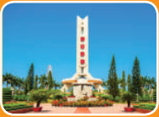
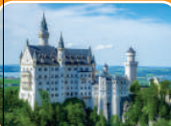
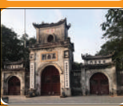
Look at the pictures and complete the sentences.
1. This is a standard serving of __________ with a slice of lemon.
communal
2. The ______ house has a significant meaning in the Bahnar community.
3. In the square, there is a ________ dedicated to the people killed in the war.
fish and chips
monument

Slide 7
4. They have decided to rebuild the _______ which was damaged in the disaster
5. In Nam Dinh City, there is a complex of three _______where people worship the Tran Dynasty’s Kings and royal family members.
castle
temples

Slide 8
5
1. Who decided to move our capital from Hoa Lu to Dai La (Thang Long) in 1010?
King Ly Thai To (Ly Cong Uan).
2. When did Columbus discover the Americas?
In 1492
3. When was the United States founded?
In 1776.

Slide 9
4. When did Nguyen Ai Quoc first go abroad?
5
In 1911.
5. What happened in world history in 1914?
World War I started/ broke out.
6. Who was the last king of Viet Nam?
King Bao Dai (1913 – 1997)

