Slide 1


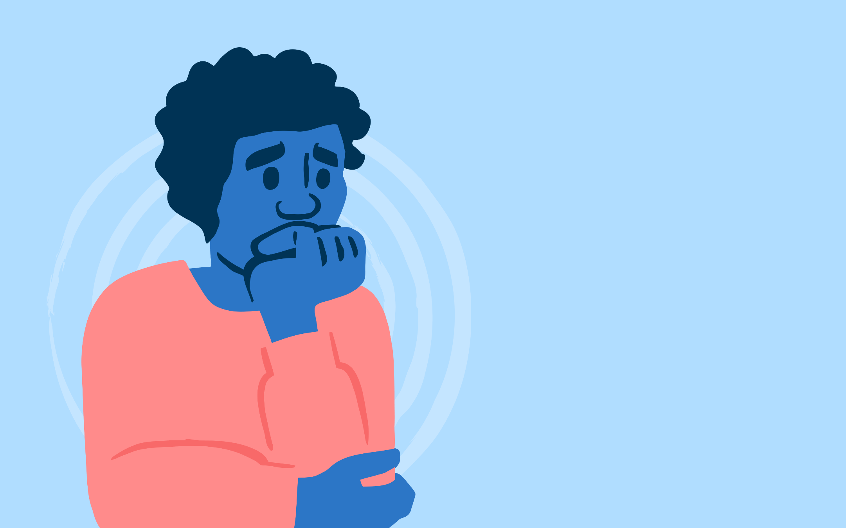

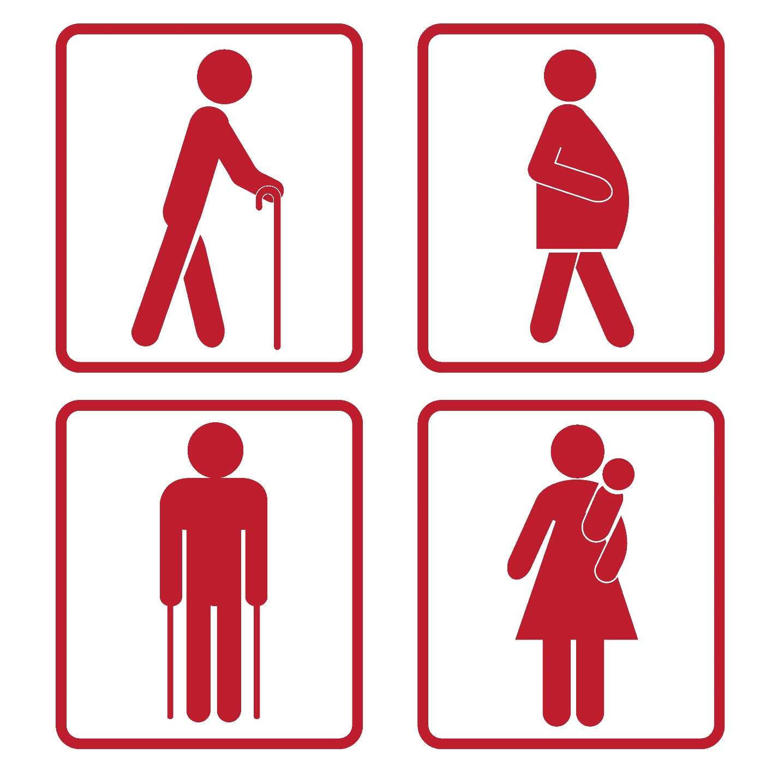


WARM-UP
KIM’S GAME

Slide 2
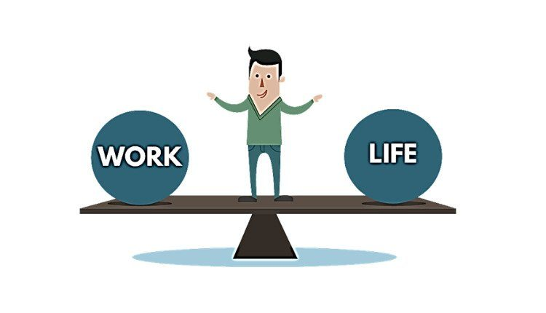



WARM-UP
KIM’S GAME
well-balanced / balance
anxiety
priority
distraction
advice
deadline / due date

Slide 3
Complete the sentences with the correct words and phrases in the box.
stressed out priority delay well-balanced due date
well-balanced
1. A ________________meal or diet contains all the different things you need to keep you healthy.
2. The ________________ for the project is next Friday.
3. I’ve got too much to do, and I’m completely ________________.
4. Nick gave ________________ to tasks at his job because he couldn’t do everything he wanted today.
5. You may not feel better if you ________________ going to the doctor.
due date
stressed out
priority
delay
Notes:
1. well-balanced 2. due date 3. stressed out 4. priority 5. delay

Slide 4
2
Choose the correct answer A, B, C, or D.
1. To most people, ______ living means both physical and mental health are functioning well together.
A. healthy B. unhealthy
C. health D. healthily
2. When we ______ our task, we headed home.
A. succeeded B. won
C. accomplished D. managed
Notes:
1. A 2. C 3. A 4. B 5. C

Slide 5
2
Choose the correct answer A, B, C, or D.
3. She’s in poor health, but she’s ______ about her future.
A. optimistic B. negative
C. pleased D. unhappy
4. There are too many ______ in this classroom – it’s hard for me to pay attention to the lesson.
A. difficulties B. distractions
C. obstacles D. omissions
Notes:
1. A 2. C 3. A 4. B 5. C

Slide 6
2
Choose the correct answer A, B, C, or D.
5. He was in a good ______ when he got home from school.
A. mind B. feeling
C. attitude D. mood
Notes:
1. A 2. C 3. A 4. B 5. C

Slide 7
3
Complete the sentences with the correct modal verbs in the box. A modal verb can be used twice.
can must should might
must
1. If you don’t want to get in an accident, you _________ follow these safety
instructions.
2. If you take these pills, you _________ feel better soon.
3. You _________ come and join us if you like.
4. If you feel unwell, you _________ consult a doctor.
5. If she tries hard, she _________ speak English better than you.
might
can
should
can
Notes:
1. must 2. might 3. can 4. should 5. Can

Slide 8
GRAMMAR
4
Circle the most suitable modal verbs to complete the sentences.
1. He shouldn’t / may not / cannot stay up late tonight if he wants to feel awake and alert tomorrow morning.
2. Nick should / can’t / might be very excited if we invite him to our home.
3. Mai can / must / should be good at time management if she takes a training course at school.
4. If you want to save on your electricity bills, you must / can / might turn off all the electric equipment before going out.
5. If you help me tidy our flat this morning, you must / can / can’t go out this afternoon.
Notes:
1. shouldn’t 2. might 3. can 4. must 5. can

Slide 9

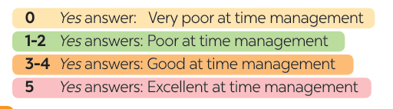
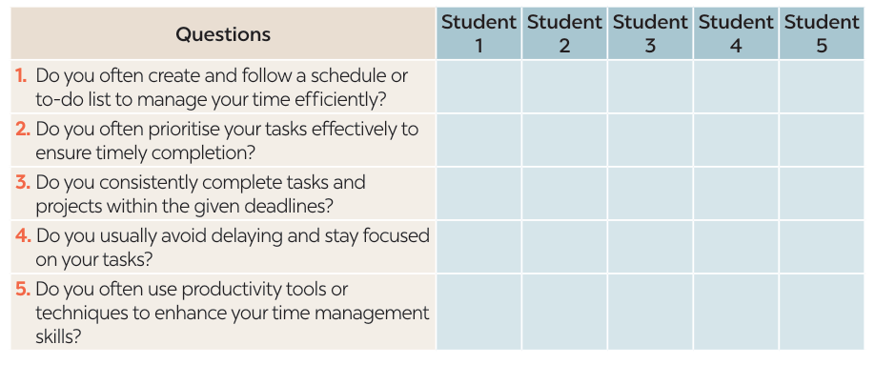
PROJECT
4
Notes:
1. shouldn’t 2. might 3. can 4. must 5. can

