Slide 1
submit (v)
.
/səbˈmɪt/
nộp, đệ trình
Notes:
to give or offer something for a decision to be made by others

Slide 2
1
Work in pairs. Discuss the following question.
How do you make time for study and other activities?

Slide 3
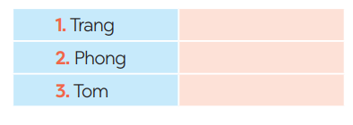
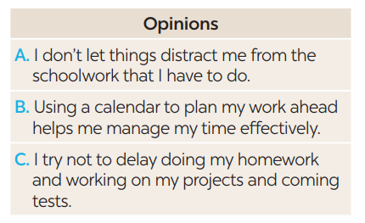
2
You will hear Trang, Phong, and Tom talking about how to manage their time effectively. For each student (1 – 3), choose the opinion (A – C) each of them expresses.
B
A
C
Notes:
Trang: B, Phong: A, Tom: C.

Slide 4
1. Trang enters what she has to do into a ___at the beginning of each term.
Poster B. routine C. calendar
2. Trang often uses ___ colors to mark project due dates and exam times on her calendar.
Different the same similar
3. Phong turns off his cell phone and signs out of social media __ when he starts his work.
Accounts B. networks C. websites
4. Tom tries not to __ homework until just before the due date.
Leave B. complete C. submit
5. Tom __ his projects and coming tests and adds them to his schedule.
Prepares B. reviews C. revises
Notes:
1. C 2. A 3. A 4. A 5. B

Slide 5
A | B
1. Making a plan or schedule for things you need to do, including appointments, projects, homework and tests | a. You should decide which is the most urgent and important task so that you can concentrate on it first. By doing this, you may not be at a loss to deal with too much work at the same time.
2. Giving priority to the most important task | b. An effective routine can help you accomplish the things you need to do. The more you follow a daily routine, the less you will worry or get stressed.
3. Building an effective daily routine | c. You can plan your work ahead by using a calendar, a diary, or a mobile app. It helps you remember what you need to accomplish and when you should do it.
Notes:
Key: 1. c 2. a 3. b

Slide 6
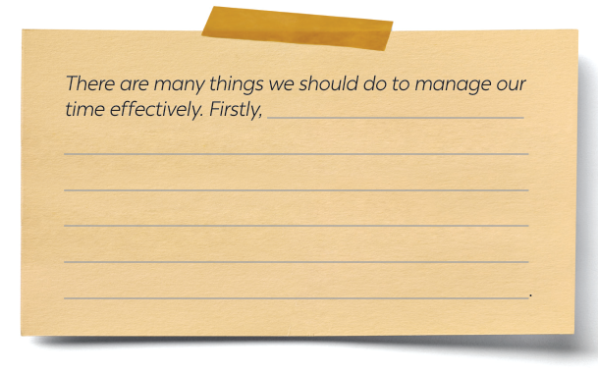
WRITING
5
Write a paragraph (about 100 words) about how to manage your time effectively. Use the tips in 4 or your own ideas.
Notes:
Key: 1. c 2. a 3. b

Slide 7
Write a paragraph (about 100 words) about how to manage your time effectively. Use the tips in 4 or your own ideas.
There are many things we should do to manage our time effectively. Firstly, we should set specific goals and prioritise them according to their importance level. This will help us keep focused on our most important tasks and avoid wasting time on tasks that do not contribute to our goals. Secondly, creating a schedule or to-do list can help us manage our time efficiently by breaking down our day into manageable chunks. We should also be realistic about how long each task will take and build in extra time for unexpected interruptions or delays. Thirdly, it is essential to eliminate distractions and time-wasting activities, such as social media or unnecessary meetings, which can reduce our productivity. By following these tips, you we can effectively manage your time and achieve success in all aspects of your life.
Notes:
Key: 1. c 2. a 3. b

