Slide 1
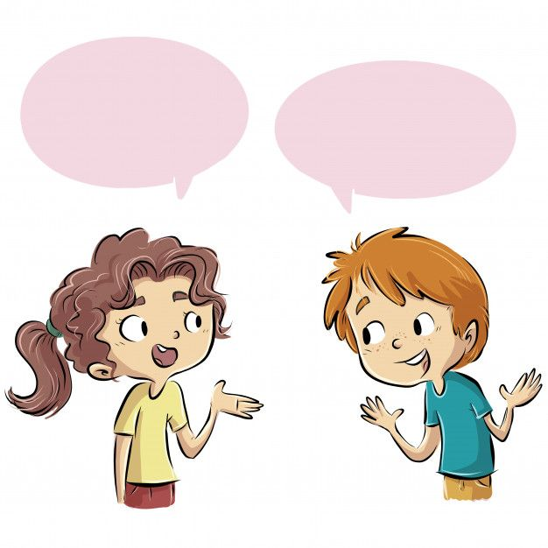
+ Do you have a well-balanced life?
+ Can you make any adjustments to achieve a more well-balanced life?

Slide 2
When I was at school, I had to learn how to have a well-balanced life in order to reduce stress and anxiety. Below are some of the typical things I did.
Firstly, I managed my time properly. I started to plan my schedule, made a weekly work list and gave priority to some of my work. This helped me concentrate my efforts on my most important tasks.
In addition, I communicated with my family, friends, and teachers about my busy schedule and problems, so they would offer me additional support.
I also took breaks appropriately because they helped me keep away from stress and anxiety, and gave my brain a rest and improved my mood.
Finally, I looked after my physical health. I got at least eight hours of sleep a day. I played football with my classmates twice a week and went for a walk with my grandparents early every morning. Besides, I also tried to follow a healthy diet. I ate a lot of fruit and vegetables. I ate little fattening foods and avoided junk foods like chips, cookies, pizza, etc.

Slide 3
a. more than the amount you expected or agreed to
b. likely to make you fat
c. the state of feeling nervous or worried that something bad is going to happen
d. in a way that is suitable or right for a particular situation
1. anxiety
2. additional
3. appropriately
4. fattening

Slide 4
3
Read the text again and answer the following questions.
1. Why did the teen celebrity have to learn how to have a well-balanced life when he was a student?
2. What did he do to manage his time properly?
3. Why did he communicate with his family, friends, and teachers about his schedules and problems?
4. Why did he take breaks?
5. How did he follow a healthy diet?

Slide 5
3
Read the text again and answer the following questions.
1. Why did the teen celebrity have to learn how to have a well-balanced life when he was a student?
2. What did he do to manage his time properly?
Because he wanted to avoid stress and anxiety.
He planned his schedule, made a weekly work list and gave priority to his work, which helped him concentrate his efforts on his most important tasks.
Notes:
1. Because he wanted to avoid stress and anxiety.
2. He planned his schedule, made a weekly task list and gave priority to his work, which helped him concentrate his efforts on his most important tasks.
3. Because they would offer him additional support.
4. Because they helped him avoid stress and anxiety, and gave his brain a rest and improved
his mood.

Slide 6
3. Why did he communicate with his family, friends, and teachers about his schedules and problems?
4. Why did he take breaks?
5. How did he follow a healthy diet?
Because they would offer him additional support.
Because they helped him keep away from stress and anxiety, and gave his brain a rest and improved his mood.
He ate a lot of fruit and vegetables. He ate little fattening foods and avoided junk foods like chips, cookies, pizza, etc.

Slide 7
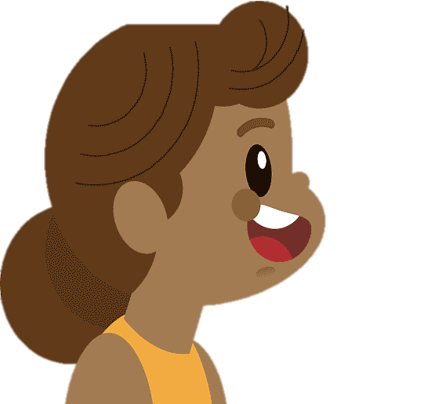
1. How can we manage our time properly?
2. How can we spend time with our friends, teachers, and parents?
3. How can we avoid stress and anxiety?
4. How can we take care of our physical health?

Slide 8
First, I manage my time properly by creating a to do list and give priority to …
Second, I plan regular times to connect with …
Next, I practise mindfulness techniques such as deep breathing…..
Finally, I engage in regular physical activities that I enjoy like …..

Slide 9
Now I can tell you about how to have a well-balanced life. First, I manage my time properly by creating a to do list and give priority to my tasks based on their importance and deadlines. Second, I plan regular times to connect with friends, through study groups or social outings. I also maintain open communication with my teachers by asking questions and seeking help when needed. Next, I practise mindfulness techniques such as deep breathing, or yoga to manage stress and maintain a clear mind. Finally, I engage in regular physical activities that I enjoy like jogging, dancing, swimming, etc to help boost my energy.

