Slide 1
1. I'm sorry, I didn't quite _____ that.
2. Could you ____ that again?
3. I'm sorry. I still didn’t ___ that.
4. _____ more time?
5. Look! I can't hear a ____ you're saying.

Slide 2
1. I'm sorry, I didn't quite _____ that.
2. Could you ___ that again?
3. I'm sorry. I still didn’t _____ that.
4. ______ more time?
5. Look! I can't hear a _____ you're saying.
catch
say
get
One
word

Slide 3
EVERYDAY ENGLISH
1
Listen and read the dialogues below. Pay attention to the highlighted sentences.
Mai: Can you open the door, Tom?
Tom: Sorry?
Mai: Can you open the door, please?
Nick: Excuse me. Would you mind showing me the way to the post office?
Woman: I beg your pardon.
Nick: Would you mind showing me the way to the post office?

Slide 4
ASKING FOR REPETITION | RESPONDING
Sorry? | Repeat/Simplify what you have said
I beg your pardon.
I'm sorry, I didn't quite catch that.
Could you say that again?
One more time?
Look! I can't hear a word you're saying.

Slide 5
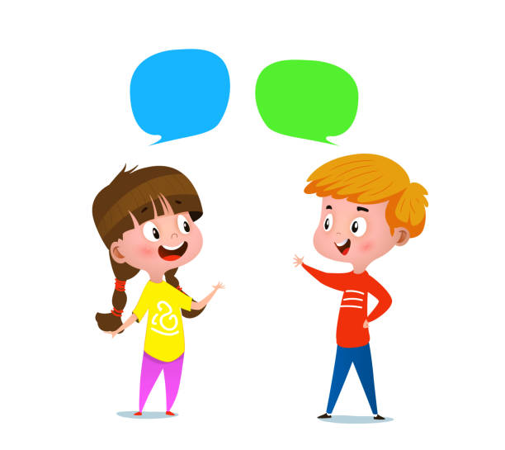
2
Work in pairs. Make similar conversations for the following situations.
Situation 1: You ask your friend to pass the book, but he / she can’t hear what you say.
Situation 2: A stranger asks you the way to the nearest bus station, but you can’t hear what he / she says.

Slide 6
2
Work in pairs. Make similar conversations for the following situations.
Situation 1: You ask your friend to pass the book, but he / she can’t hear what you say.
Suggested answer:
A: Can you pass me the book?
B: Sorry?
A: Can you pass me the book, please?

Slide 7
Situation 2: A stranger asks you the way to the nearest bus station, but you can’t hear what he / she says.
Suggested answer:
A: Excuse me. Could you tell me the way to the nearest bus station, please?
B: I beg your pardon.
A: Could you tell me the way to the nearest bus station, please?
2

Slide 8
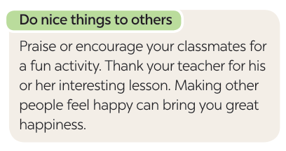
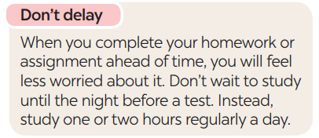
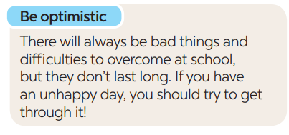
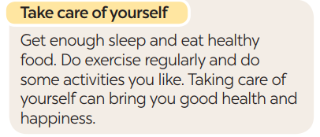

Slide 9
3
Read the text and complete each sentence that follows with a suitable word.
happy
1. You should make others feel ______ by giving them encouragement or being thankful to them.
2. You shouldn’t ______ doing your homework or assignment or preparing for a test. This will reduce your stress.
3. Getting enough sleep, eating healthy food, and doing what you like can bring you good health and ___________.
4. You should always be expecting good things to happen and try to ____________ difficulties.
delay
happiness
overcome
Notes:
1. happy 2. delay 3. happiness 4. overcome

Slide 10
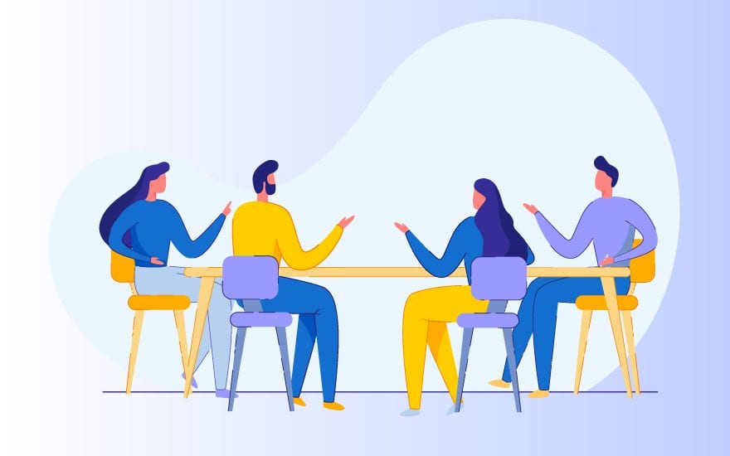
Work in groups. Write tips for one of the following situations.
Situation 1: A friend of yours cannot get a good night’s sleep.
Situation 2: A friend of yours does not feel very well.
Situation 3: A friend of yours cannot remember the words he / she learnt.
Notes:
1. happy 2. delay 3. happiness 4. overcome

