Slide 1
 | IF - CLAUSE | MAIN CLAUSE
 | If you do physical exercise regularly, | Your health will improve.
 | If she trains harder, | she can run faster than you.
 | If you finish your paper, | you can hand it in and leave for home.
 | If you want to have good mental health, | you should balance your study and life.
 | If he is good at IT, | he may / might get a good job.
 | If you want to manage your time effectively, | you must get rid of all the distractions.
standard form
ability
permission
advice
possibility
necessity

Slide 2
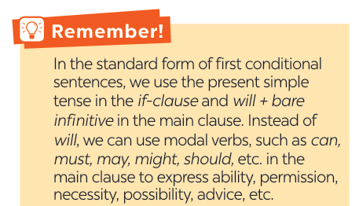

Slide 3
Work in pairs.
Write a short dialogue where you use at least three different modal verbs in first conditional sentences.
Example:
A: If you have time tonight, you should go to the cinema.
B: I agree. If I don’t, I might watch a movie at home……"

Slide 4
mental
counsellor
well-balanced
physical
Write the correct form of each verb in brackets.
1. If Mai (not want) ______________to gain weight, she shouldn’t eat much fast food.
2. If you stay up too late tonight, you might (feel) ______ tired tomorrow morning.
3. You should (sleep) ______ eight hours a night if you want to be awake and fully alert.
4. If Tom (complete) ___________ his assignment on Friday, he can go out with his friends at the weekend.
5. You must (be) _____ careful if you don’t want to get burnt.
doesn’t want
feel
sleep
completes
be

Slide 5
2
Circle the correct modal verbs to complete the following sentences.
1. She can / should go home early if she finishes her work.
2. If you train hard, you might / shouldn’t win the first prize.
3. If they don’t want to be punished, they must / may follow the rules.
4. If students have an upcoming exam, they shouldn’t / can’t wait to study until the day before it.
5. If you’re having a bad day, you should / may do your best to get through it.

Slide 6
3
Match the first half of the sentence in A with the second half in B.
1. If you spend too much time on the computer,
2. If you put too much sugar in your coffee,
3. If you want to manage your time effectively,
4. If you want to have perfect white teeth,
5. If you take a cooking class,
a. you can make your favorite food at home.
b. you should use a calendar to plan your work ahead.
c. you may put on more weight.
d. you might get shoulder pains.
e. you must brush your teeth regularly.

Slide 7
4
What will you say in each situation below? Use first conditional
sentences with modal verbs.
1. Your friend wants to lose weight. You advise him / her to eat less high fat food and do more exercise.
=> If you want to lose weight, you should eat less high fat food and do more exercise.
3. Your roommate often stays up late at night. You think it is necessary to get enough sleep every night; otherwise,
his health will suffer.
=> If you want to have good health, you must get 8 hours of sleep per night.

Slide 8
4. Your little brother wants to go for a swim. You agree but ask him to finish all his homework first.
=> You can go for a swim if you finish all your homework.
5. You’re able to make a delicious pizza when you have all the needed ingredients.
=> If I have all needed ingredients, I can make a delicious pizza.

Slide 9
5
Complete the sentences with your own ideas using the modal verbs you have learnt.
1. If you spend too much time playing
computer games, ________________ ______________________________.
2. If you want to get a good night’s sleep,
______________________________
______________________________.
3. If you don’t feel well, ___________
______________________________.

Slide 10
Complete the sentences with your own ideas using the modal verbs you have learnt.
SUGGESTED ANSWER
1. If you spend too much time playing computer games, ________________________________________________________
2. If you want to get a good night’s sleep, _____________
________________________________________________________
3. If you don’t feel well, __________________________
________________________________________________________
you might miss out on other important activities like exercising, socialising, and studying.
you should avoid
drinking caffeine or alcohol before bed and try to establish a regular sleep schedule.
you should consult a doctor
or a medical professional to get a proper diagnosis and treatment.

