Slide 1


Slide 2

Unit
12
LIFE ON OTHER PLANETS
LESSON 2: A CLOSER LOOK 1
VOCABULARY
PRONUNCIATION
1

Slide 3

OBJECTIVES
By the end of the lesson, students will be able to:
Vocabulary:
+ use the lexical items related to outer space.
Pronunciation: Use intonation for making lists correctly.

Slide 4
LESSON 2: A CLOSER LOOK 1
WARM-UP
Quiz time
Task 1: Put the eight planets in order from the closest to the farthest from the sun.
Task 2: Match the words (1 - 5) with the pictures (a - e).
Task 3: Complete the following sentences with the words from the box.
VOCABULARY
Task 4: Listen and repeat the sentences. Pay attention to the tones of the underlined words in each sentence.
Task 5: Listen to the conversations. Do you think the voice goes up or down on the underlined words in each second sentence? Draw a suitable arrow (↗ or ↙ ) on each underlined word.
PRONUNCIATION
CONSOLIDATION
Wrap-up
Homework

Slide 5
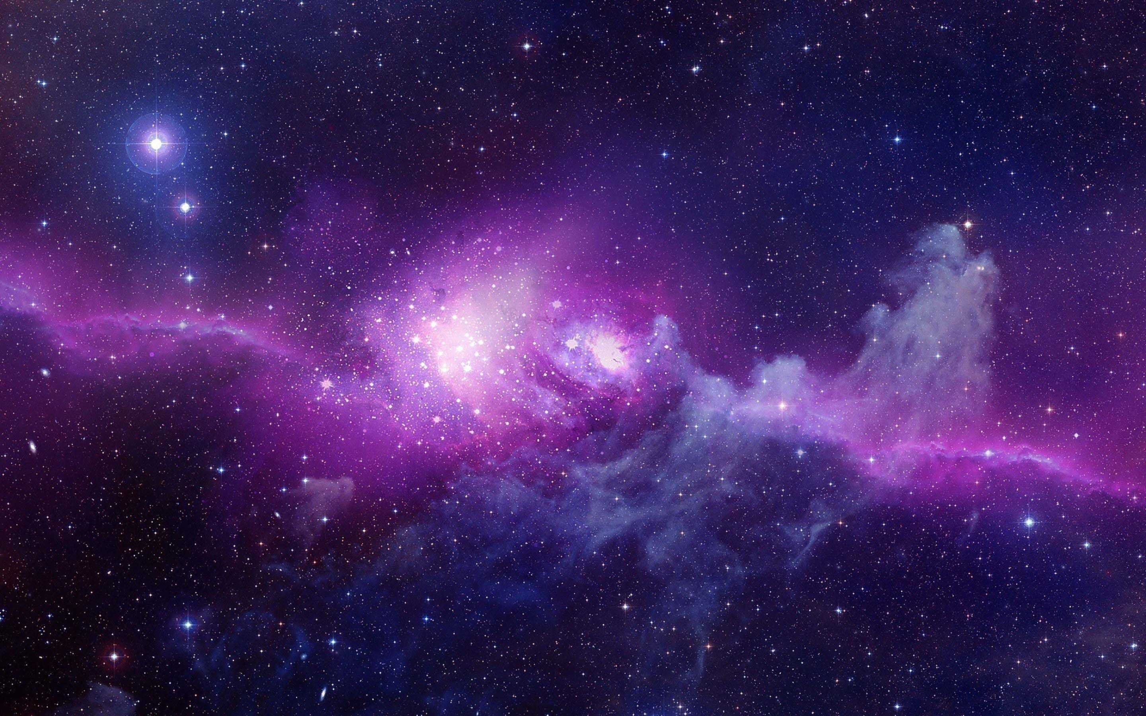
QUIZ TIME
1.How many planets do we have in our solar system?
8 planets

Slide 6
QUIZ TIME
2.Is the sun a planet or a star?
A star

Slide 7
QUIZ TIME
3.Have humans ever walked on Mars?
No/not yet.

Slide 8
QUIZ TIME
4.How many moons (including moonlets) does Saturn have?
150.

Slide 9
QUIZ TIME
5.Which galaxy is the Earth found in?
Milky Way Galaxy

Slide 10
LESSON 2: A CLOSER LOOK 1
WARM-UP
Quiz time
Task 1: Put the eight planets in order from the closest to the farthest from the sun.
Task 2: Match the words (1 - 5) with the pictures (a - e).
Task 3: Complete the following sentences with the words from the box.
VOCABULARY

Slide 11
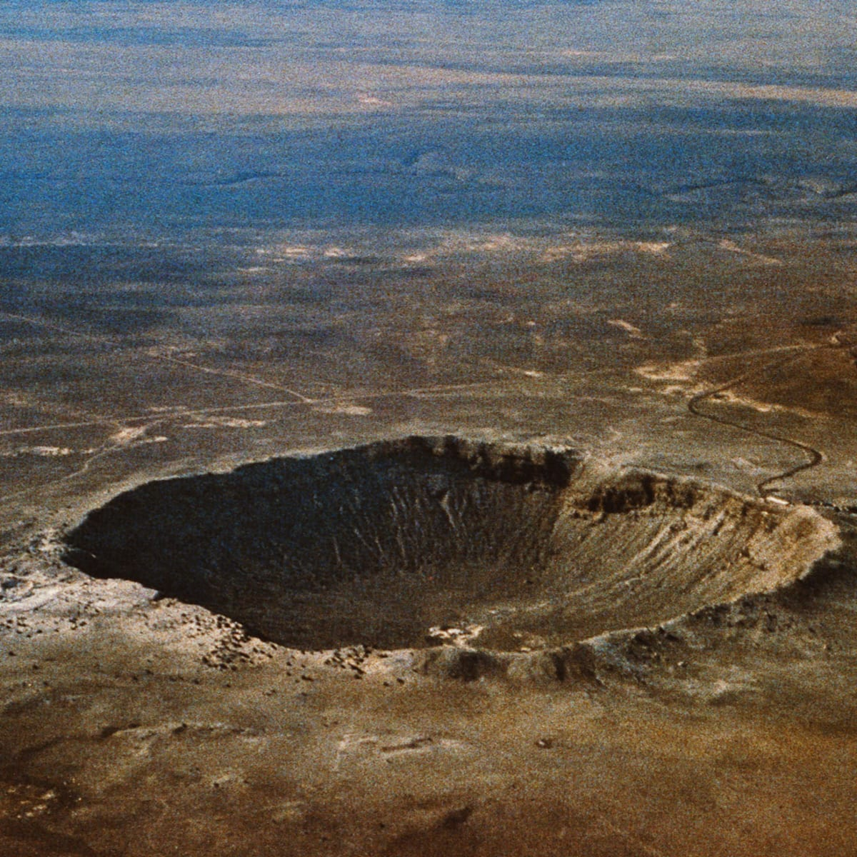

VOCABULARY
crater (n)
/ˈkreɪtə/
miệng núi lửa

Slide 12
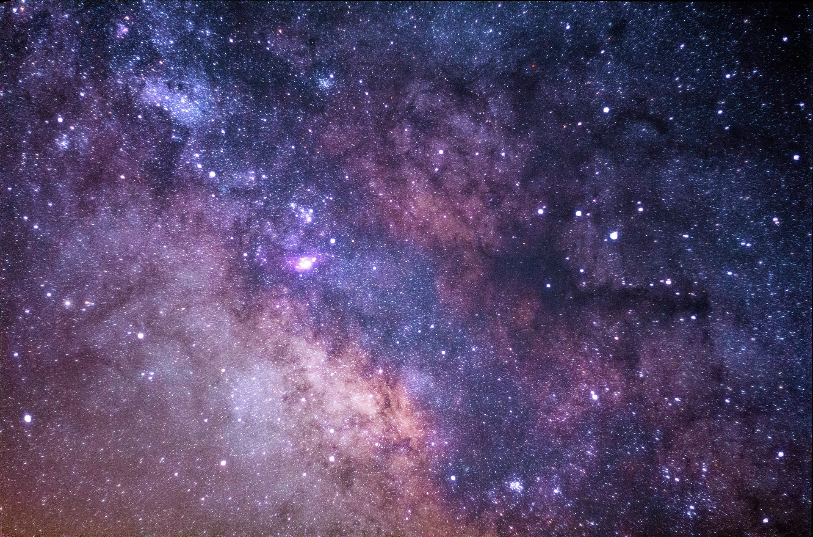
VOCABULARY
galaxy (n)
/ˈɡæləksi/
thiên hà

Slide 13
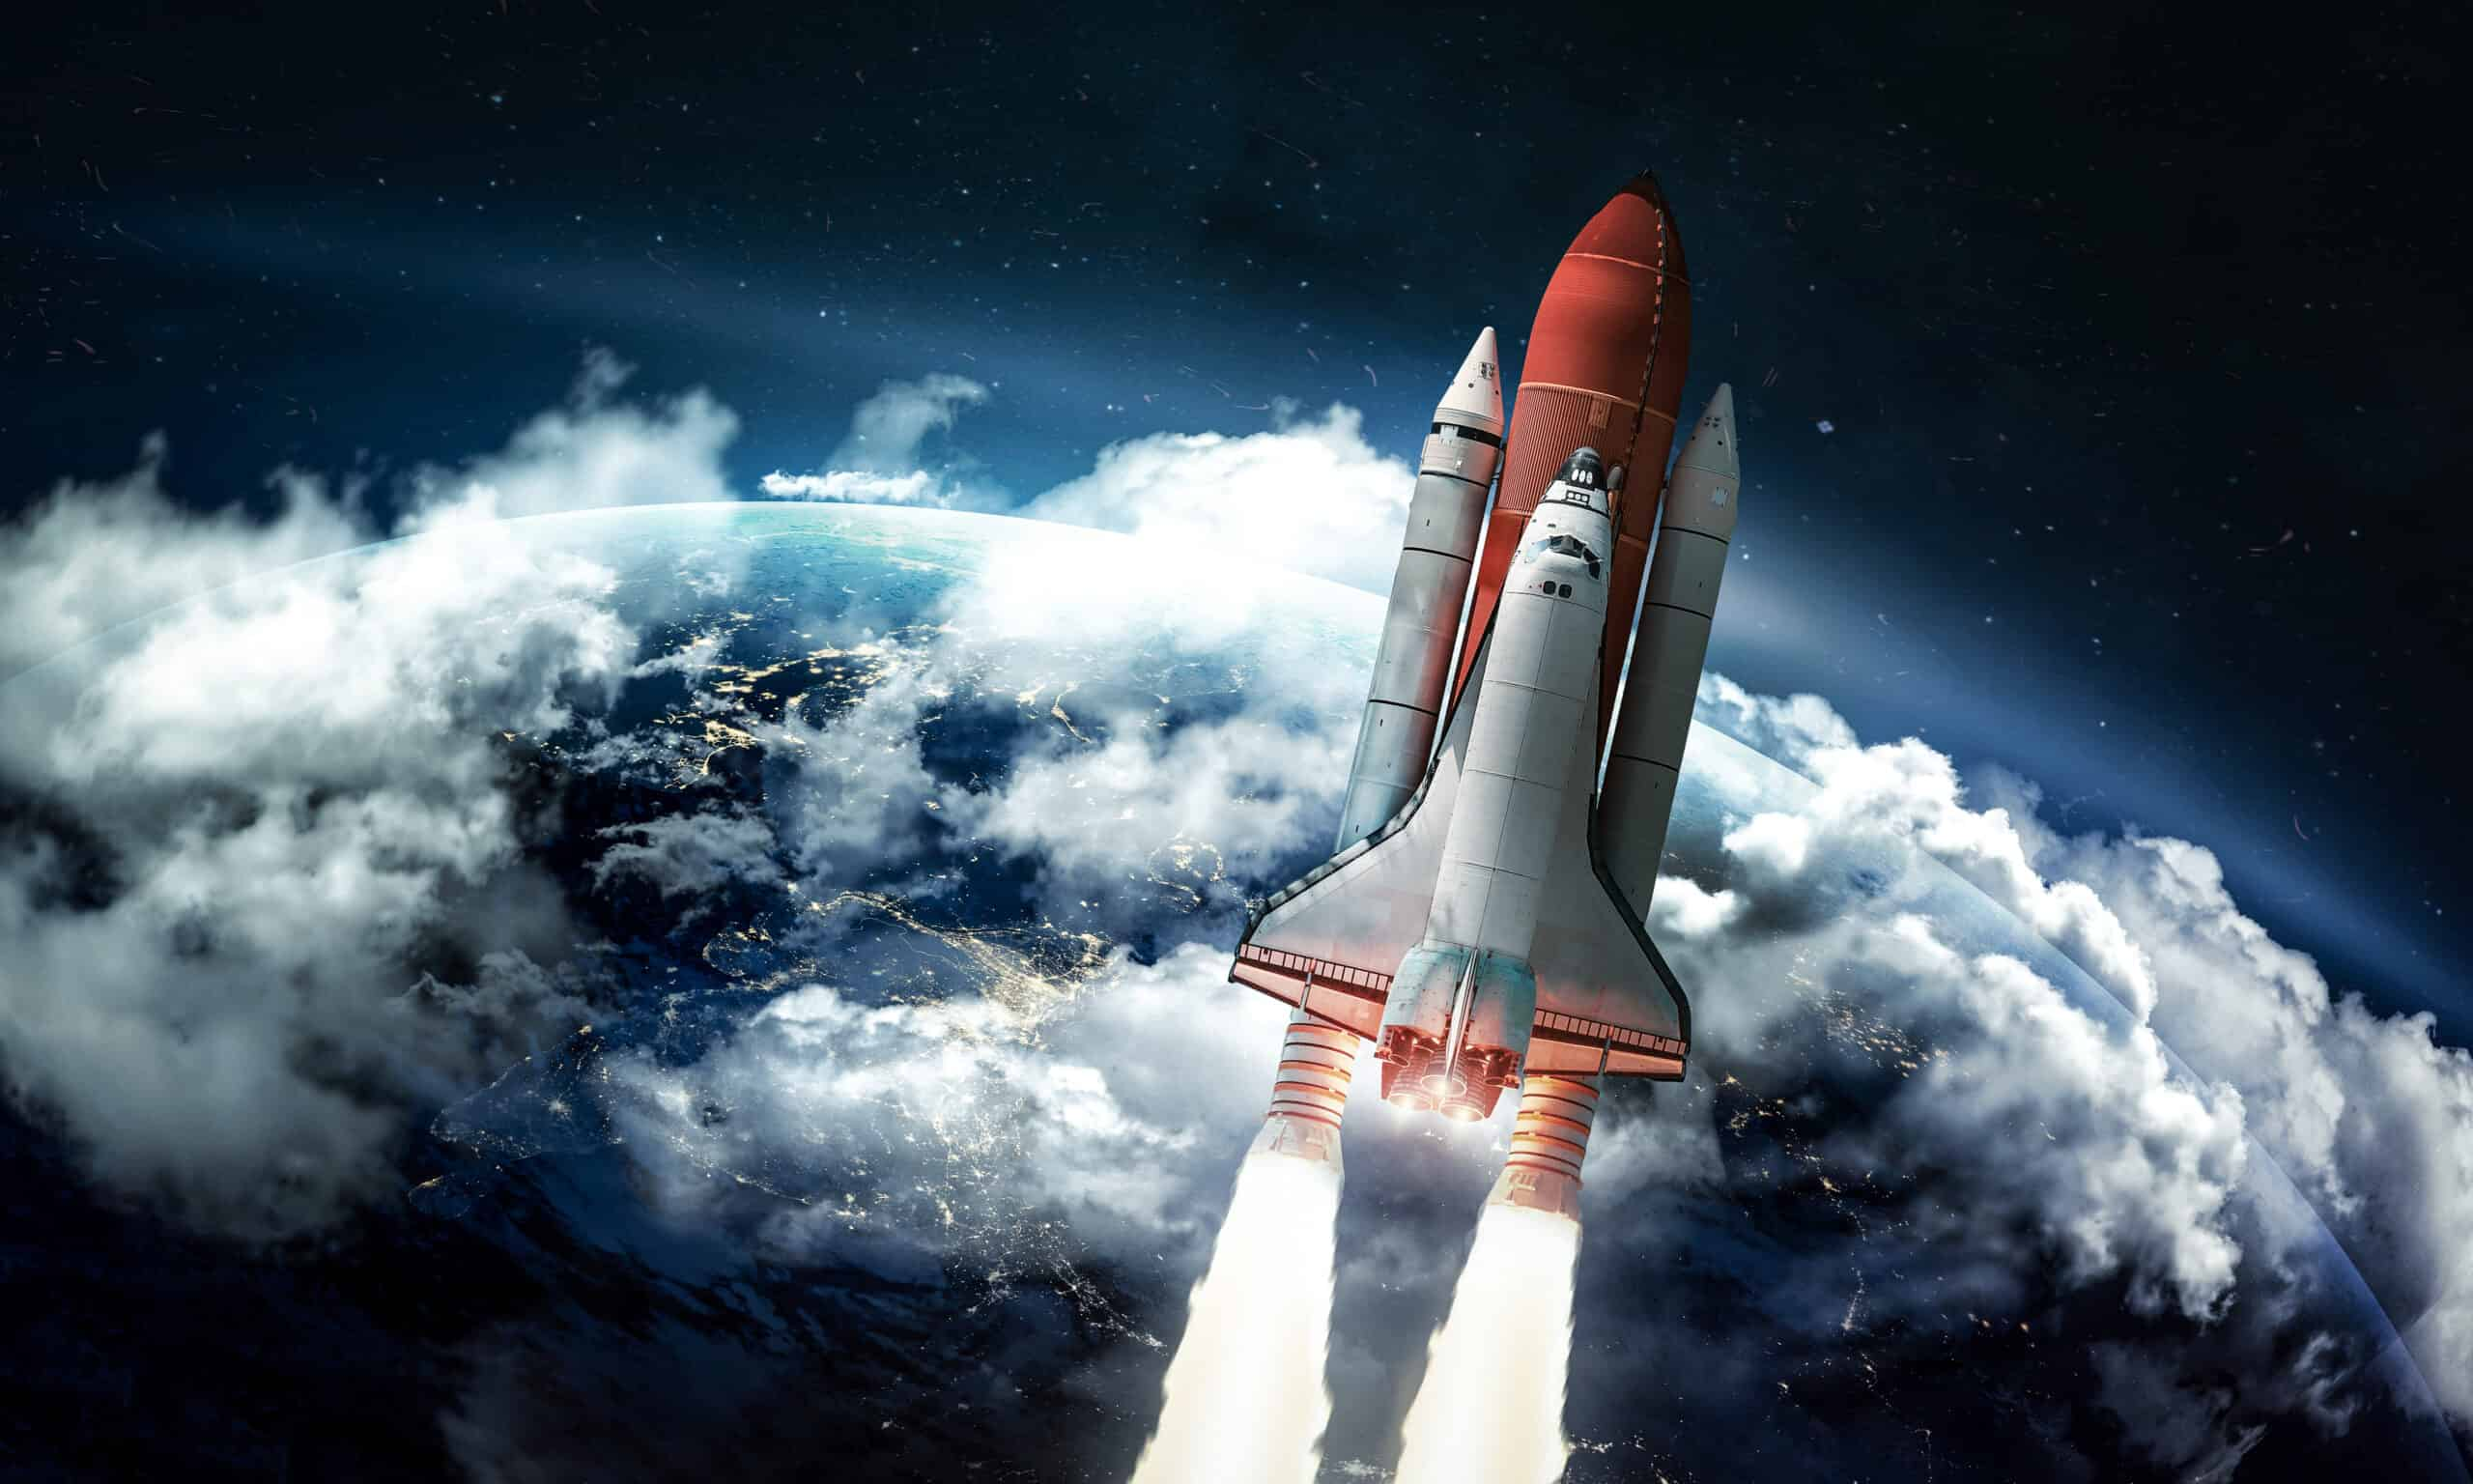
VOCABULARY
rocket (n)
/ˈrɒkɪt/
tàu vũ trụ con thoi

Slide 14
VOCABULARY
telescope (n)
/ˈtelɪskəʊp/
kính thiên văn

Slide 15
VOCABULARY
UFO (n)
/ˈjuːfəʊ/
/ˌjuː ef ˈəʊ/
vật thể bay không xác định

Slide 16
VOCABULARY
Jupiter (n)
/ˈdʒuːpɪtə/
sao Mộc

Slide 17
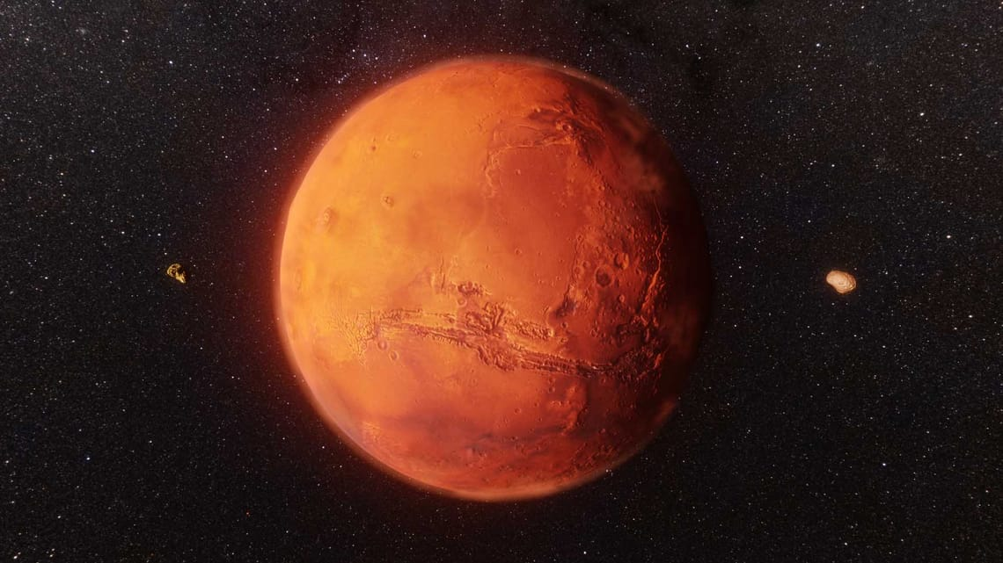
VOCABULARY
Mars (n)
/mɑːz/
sao Hỏa

Slide 18
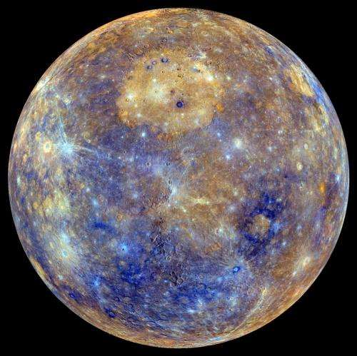
VOCABULARY
Mercury (n)
/ˈmɜːkjəri/
sao Thủy

Slide 19
VOCABULARY
Neptune (n)
/ˈneptjuːn/
sao Hải Vương

Slide 20
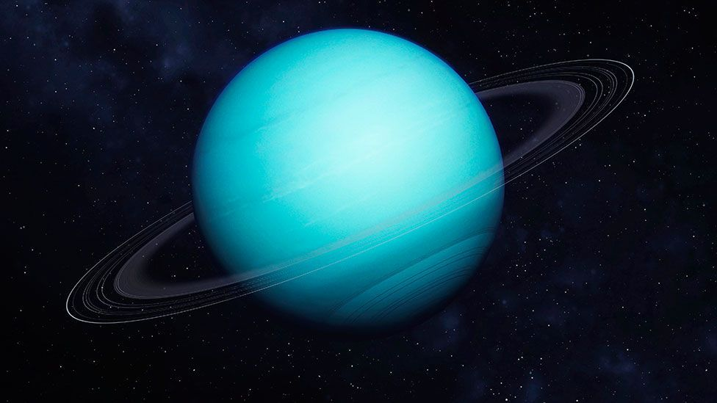
VOCABULARY
Uranus (n)
/ˈjʊərənəs/
sao Thiên Vương

Slide 21
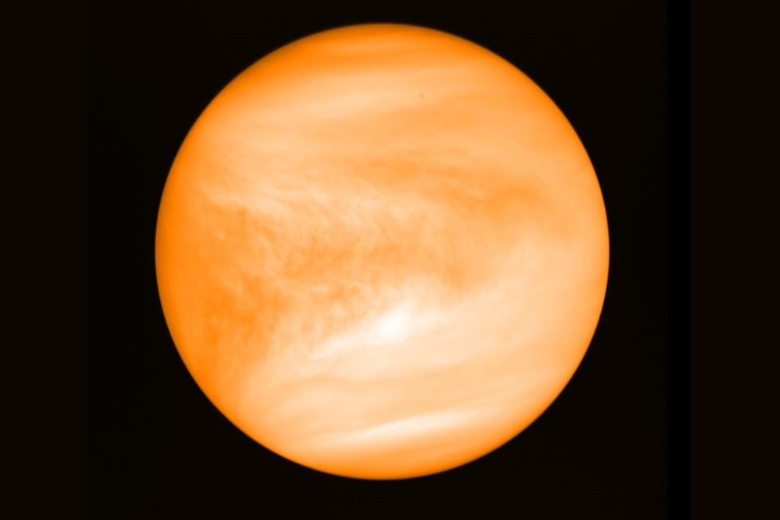
VOCABULARY
Venus (n)
/ˈviːnəs/
sao Kim

Slide 22
VOCABULARY
New words | Pronunciation | Meaning
1. crater (n) | /ˈkreɪtə/ | miệng núi lửa
2. galaxy (n) | /ˈɡæləksi/ | thiên hà
3. rocket (n) | /ˈrɒkɪt/ | tàu vũ trụ con thoi
4. telescope (n) | /ˈtelɪskəʊp/ | kính thiên văn
5. UFO (n) | /ˈjuːfəʊ/ /ˌjuː ef ˈəʊ/ | vật thể bay không xác định
6. Jupiter (n) | /ˈdʒuːpɪtə/ | sao Mộc
7. Mars (n) | /mɑːz/ | sao Hỏa

Slide 23
VOCABULARY
New words | Pronunciation | Meaning
8. Mercury (n) | /ˈmɜːkjəri/ | sao Thủy
9. Neptune (n) | /ˈneptjuːn/ | sao Hải Vương
10. Uranus (n) | /ˈjʊərənəs/ | sao Thiên Vương
11. Venus (n) | /ˈviːnəs/ | sao Kim

Slide 24
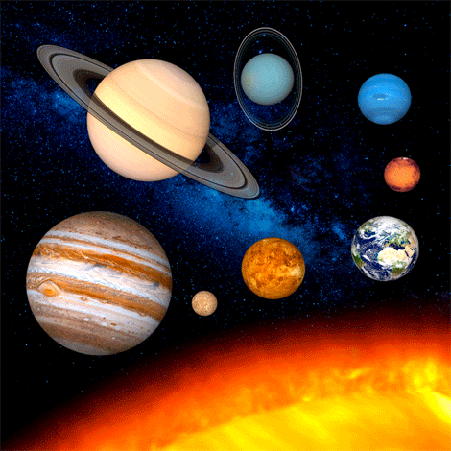
VOCABULARY
1
The following are the eight planets that go around the sun:
Earth Jupiter Mars Venus
Mercury Neptune Saturn Uranus
Put them in order from the closest to the farthest from the sun. This sentence will help you learn the order of the planets:
My Very Excellent Mother Just Served Us
Noodles.
Mercury
Venus
Earth
Mars
1. | 2. | 3. | 4.
5. | 6. | 7. | 8.
Jupiter
Saturn
Uranus
Neptune

Slide 25
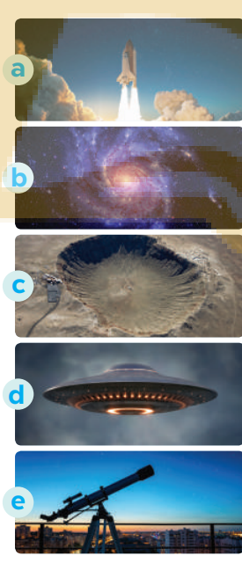
VOCABULARY
2
Match the words (1 - 5) with the pictures (a - e).
1. telescope
2. UFO
1. e 2. d 3. a 4. b 5. c
3. rocket
4. galaxy
5. crater

Slide 26
VOCABULARY
3
Complete the following sentences with the words from the box.
Venus telescope craters
rocket galaxy
craters
1. There are many ______ on the surface of the moon.
2. We use a ______, which is in the shape of a big tube, for travelling or carrying things into space.
3. We need to use a ______ to clearly see the surface of the moon.
4. The planet which is the second closest to the sun is ______.
5. The Milky Way is the ______ that includes our solar system.
rocket
telescope
Venus
galaxy

Slide 27
LESSON 2: A CLOSER LOOK 1
WARM-UP
Quiz time
Task 1: Put the eight planets in order from the closest to the farthest from the sun.
Task 2: Match the words (1 - 5) with the pictures (a - e).
Task 3: Complete the following sentences with the words from the box.
VOCABULARY
Task 4: Listen and repeat the sentences. Pay attention to the tones of the underlined words in each sentence.
Task 5: Listen to the conversations. Do you think the voice goes up or down on the underlined words in each second sentence? Draw a suitable arrow (↗ or ↙ ) on each underlined word.
PRONUNCIATION

Slide 28

PRONUNCIATION
Intonation for making lists
Aims of the stage:
to help students use intonation for making lists correctly.

Slide 29
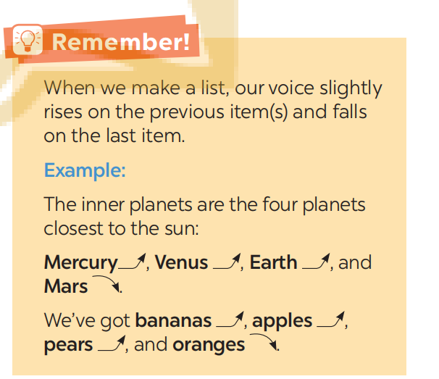
PRONUNCIATION
Look at the remember box p.126

Slide 30
PRONUNCIATION
4
Listen and repeat the sentences. Pay attention to the tones of the underlined words in each sentence.
1. I’d like some eggs, some milk, some cheese, and some bread, please.
2. My father can speak four languages: English, French, Russian, and Spanish.
3. My favourite sports are football, tennis, basketball, and volleyball.
4. My kitten is cute, smart, playful, and noisy.
5. The outer planets, which are made up mostly of gas, include Jupiter, Saturn, Uranus, and Neptune.

Slide 31
PRONUNCIATION
5
Listen to the conversations. Do you think the voice goes up or down on the underlined words in each second sentence? Draw a suitable arrow (↗ or ↙ ) on each underlined word
1. A: Good evening! What can I get you, sir?
B: I’d like some pork, some chicken, some tofu, and some vegetables.
2. A: What did you buy at the clothing store yesterday?
B: I bought a T-shirt, a jumper, a tie, and a cap.
3. A: What music do you like?
B: I like pop, blues, country, and jazz.
4. A: What do you think we should bring with us to Mars?
B: I think we should bring food, water, clothes, and a tent

Slide 32
LESSON 2: A CLOSER LOOK 1
WARM-UP
Quiz time
Task 1: Put the eight planets in order from the closest to the farthest from the sun.
Task 2: Match the words (1 - 5) with the pictures (a - e).
Task 3: Complete the following sentences with the words from the box.
VOCABULARY
Task 4: Listen and repeat the sentences. Pay attention to the tones of the underlined words in each sentence.
Task 5: Listen to the conversations. Do you think the voice goes up or down on the underlined words in each second sentence? Draw a suitable arrow (↗ or ↙ ) on each underlined word.
PRONUNCIATION
CONSOLIDATION
Wrap-up
Homework

Slide 33

CONSOLIDATION
1
Wrap-up
What have we learnt in this lesson?
identify the topic of the unit
use the lexical items related to outer space.
use intonation for making lists correctly.

Slide 34
CONSOLIDATION
1
Wrap-up
Can you tell me some words in this lesson?

Slide 35

CONSOLIDATION
2
Homework
- Learn the new words by heart.
- Practice using intonation.

Slide 36

Website: hoclieu.vn
Fanpage: facebook.com/sachmem.vn/

