Slide 2
Unit
8
SHOPPING
LESSON 6: SKILLS 2
1

Slide 3
LESSON 1: GETTING STARTED
WARM-UP
Warm up
Listening
PRESENTATION
Task 1: Tick (v) the things that you think a robot teacher can do.
Task 2: Listen to the conversation and fill in each blank with ONE word.
Task 3: Listen again and tick (v) T (True) or F(False)
PRACTICE
Writing
Task 4: Work in pairs. Discuss if you agree or disagree that robots will soon replace teachers at schools. Write the reasons in the table.
Task 5: Now write a paragraph (80-100 words) to express your opinion. Use the notes in 4.
PRODUCTION
CONSOLIDATION
Wrap-up
Homework

Slide 4
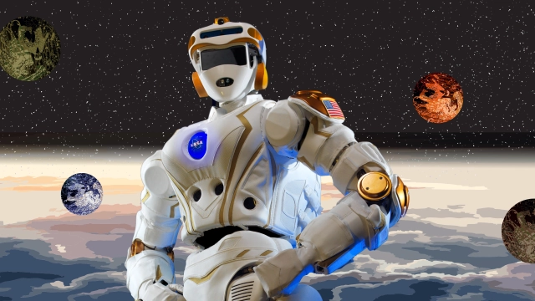
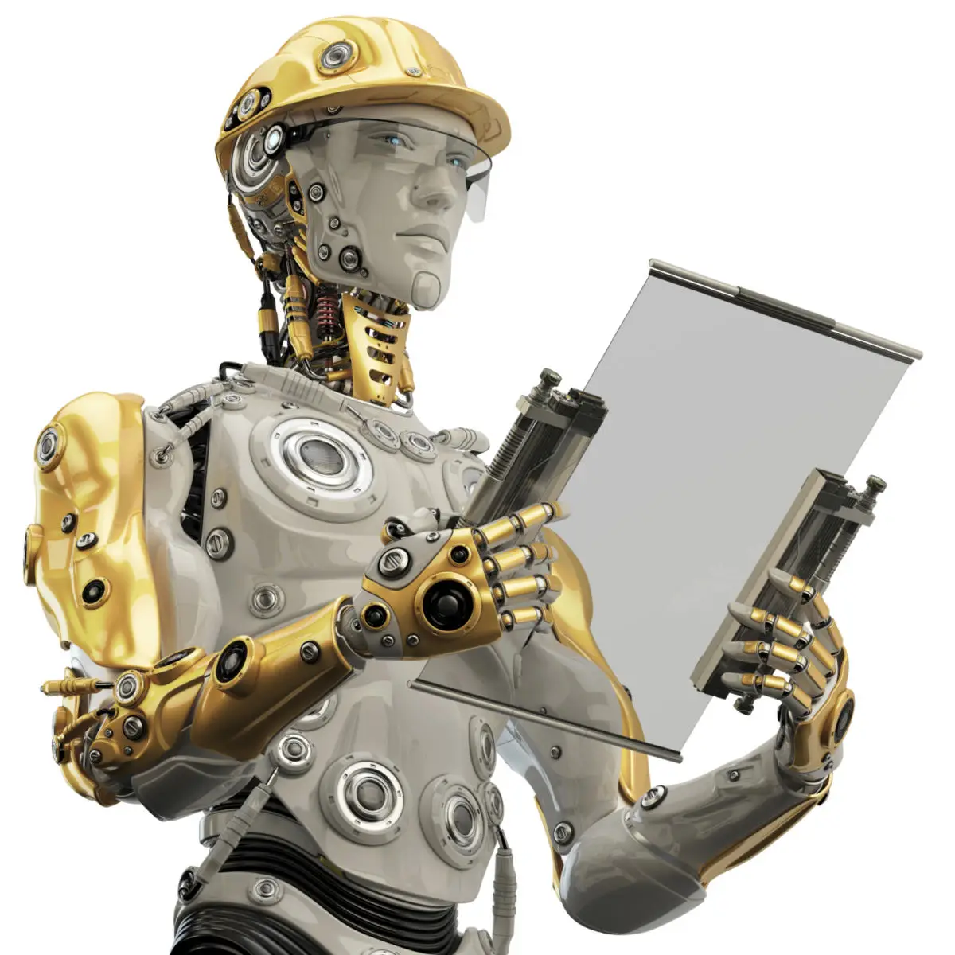
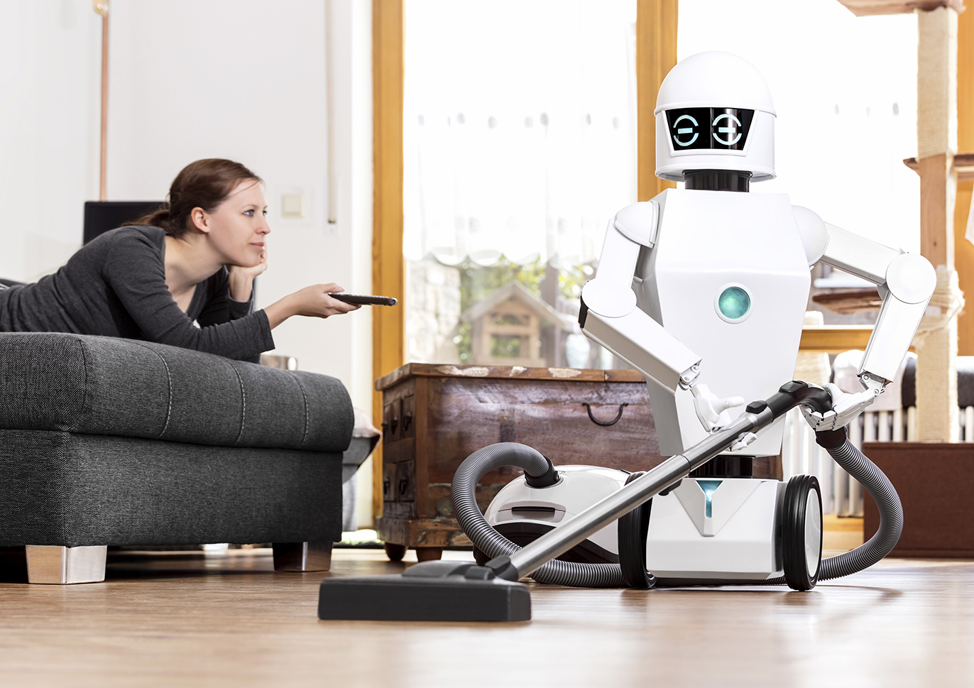
WARM-UP
NAME THE PICTURES
TYPES OF
ROBOTS

Slide 5
WARM-UP
BRAINSTORMING
DOCTOR ROBOT
SPACE ROBOT
WORKER ROBOT
TEACHER ROBOT
HOME ROBOT
TEACHER ROBOT
TYPES OF
ROBOTS

Slide 6
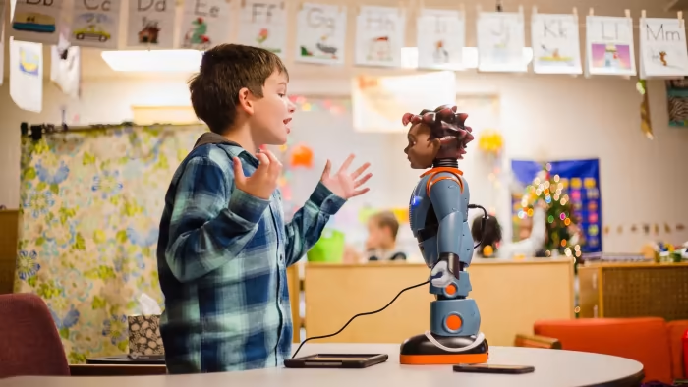
PRESENTATION
VOCABULARY
interact with (v)
/ˌɪntərˈækt wɪð/
Tương tác với

Slide 7
PRESENTATION
VOCABULARY
emotional (v)
/ɪˌməʊʃənl/
Thuộc tình cảm, dễ cảm động

Slide 8
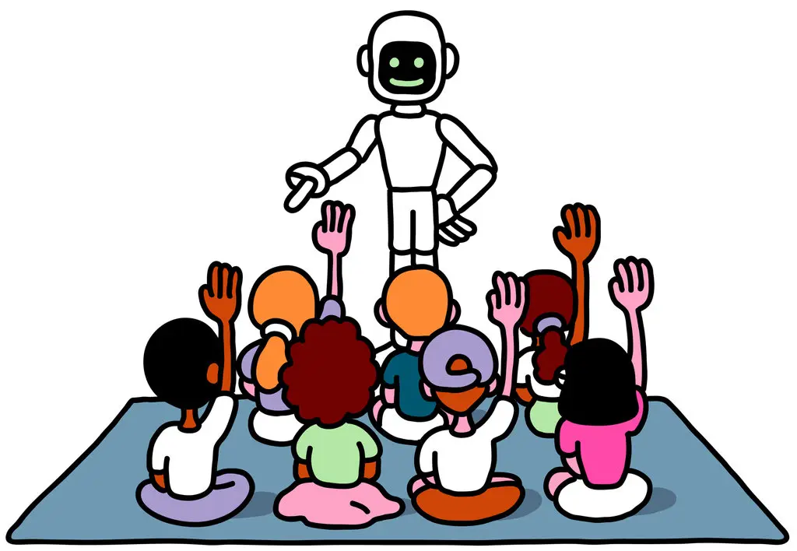
PRESENTATION
I. LISTENING
1
Listen and tick the things that you think a robot teacher can do.
1. It can teach different subjects
2. It can mark students’ work.
3. It can teach students how to behave.

Slide 9
PRACTICE
I. LISTENING
2
Listen to the conversation and fill in each blank with ONE word.
Things a robot teacher can do | Things a robot teacher can’t do
Speak many (1)___________ Teach languages, (2)_______ and many subjects. (3) _________ with students | Teach students how to (4)________ Have emotional connections with students. Solve (5)__________ between students.
languages
maths
behave
interact
problems

Slide 10
PRACTICE
I. LISTENING
3
Listen again and tick (v) T (True) or F(False)
STATEMENTS | T | F
1. Alias can do a Gangnam style dance.
2. Students can practise English with the robot in real time.
3. The robot asks tired when it repeats words.
4. The robot asks questions that are too difficult for students to answer.
5. Robots can teach students how to behave correctly.

Slide 11
PRODUCTION
II. WRITING
4
Work in pairs. Discuss if you agree or disagree that robots will soon replace teachers at schools. Write the reasons in the table.
Agree | Disagree
Robots can better remember things than teachers. _____________________________ _____________________________ _____________________________ _____________________________ _____________________________ _____________________________ ____________________________ | Robots can’t understand students’ emotions. ___________________________ ___________________________ ____________________________ ____________________________ ____________________________ 5. ____________________________ ____________________________
Robots can talk for a longer time and not feel tired.
Robots can’t teach students how to behave well.
Robots can still interact well with students.
Robots can’t help solve problems among students.
Robots can store more data and information and tell them to students.
Robots can’t motivate students.
Robots don’t have emotional connections with students.

Slide 12
PRODUCTION
II. WRITING
5
Now write a paragraph (80-100 words) to express your opinion. Use the notes in 4.
Start your paragraph as shown below:
I agree/ disagree that robot teachers will soon replace real teachers at schools. First, they…………………………………………

Slide 13
CONSOLIDATION
1
Wrap-up
What have we learnt in this lesson?
What a robot teacher can do and what it can’t do.
The reasons robot teachers can or can’t replace teachers at school.
How to write a paragraph expressing opinions.

Slide 14
CONSOLIDATION
2
Homework
Learn the new words by heart.
Rewrite the paragraph expressing opinions about whether a robot teacher can(not) replace teachers at school.
Do Exercise ………..page ……Unit 11/Workbook

Slide 15
Website: hoclieu.vn
Fanpage: facebook.com/sachmem.vn/

