Slide 2
Unit
11
SCIENCE AND TECHNOLOGY
LESSON 5: SKILLS 1
1

Slide 3
LESSON 1: GETTING STARTED
WARM-UP
Warm up
Reading
Task 1: Work in pairs. Name the technological applications in the pictures. Can they be used in schools?
Task 2: Read the passage and tick (v) B (Biometrics) or N (Nanolearning)
Task 3: Read the text again and choose the correct answer A, B, or C.
PRESENTATION
PRACTICE
Speaking
Task 4: Work in pairs. Discuss and match the questions in A with the answers in B, and then make a conversation about an invention.
Task 5: Work in groups. Ask and answer questions about a technology or an invention. Use the example in 4 as a cue. Then report your answers to the class.
PRODUCTION
CONSOLIDATION
Wrap-up
Homework

Slide 4
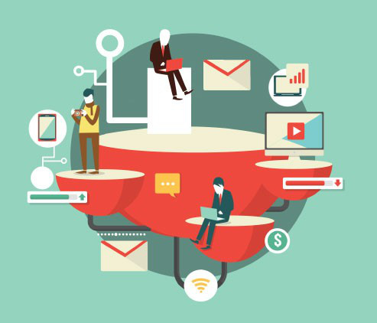
BRAINSTORMING
WARM-UP
Name the technological applications your school uses.

Slide 5
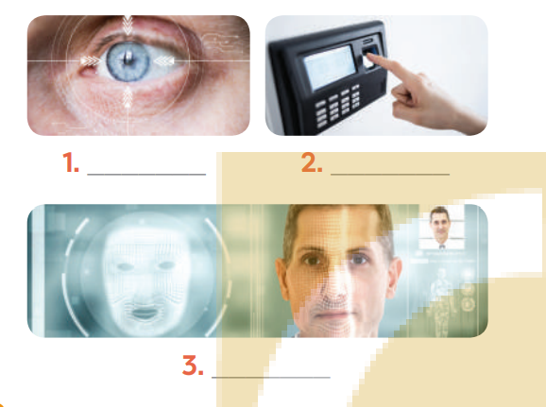
PRESENTATION
I. READING
1
Work in pairs. Name the technological applications in the pictures. Can they be used in schools?
eye-tracking
fingerprint scanner
face recognition

Slide 6
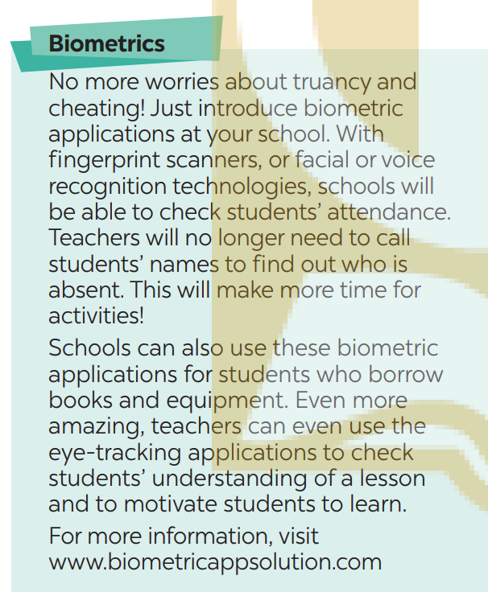
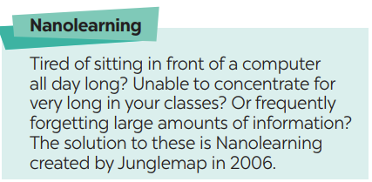
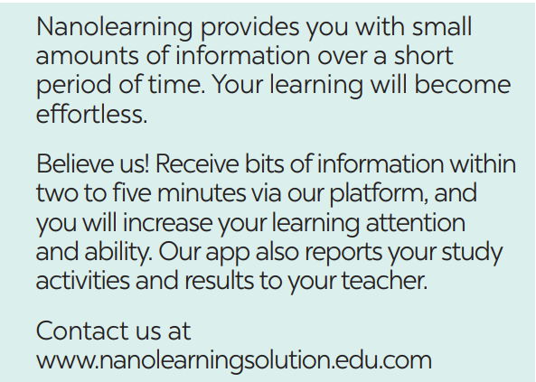
PRESENTATION
I. READING
Read the passage and pay attention to the underlined words and guess their meaning.

Slide 7
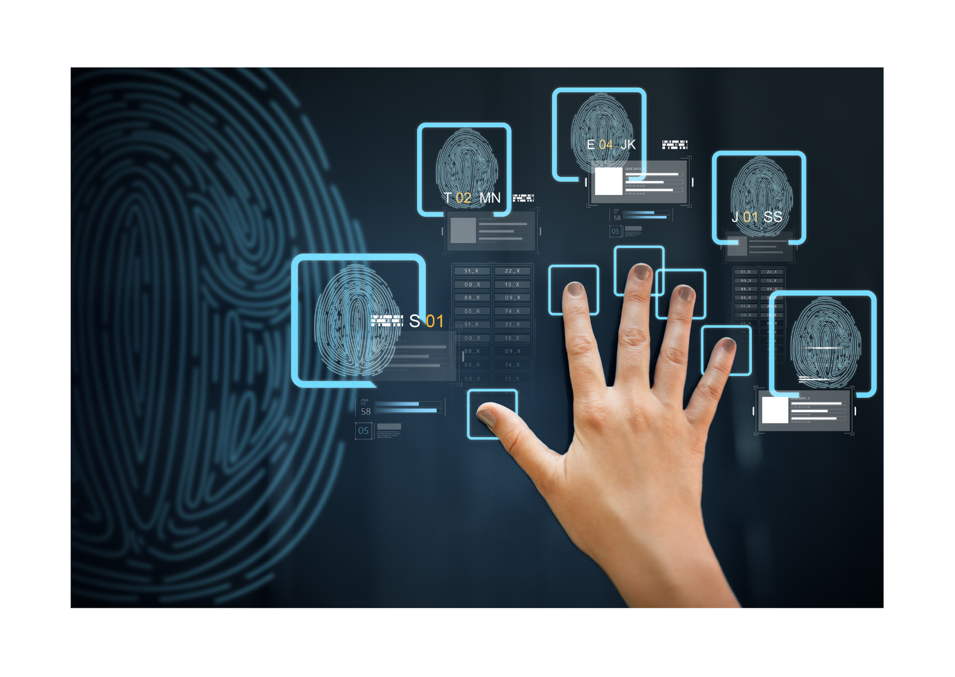
PRESENTATION
VOCABULARY
biometrics (n)
/ˌbaɪəʊˈmetrɪks/
Khoa học sinh trắc

Slide 8
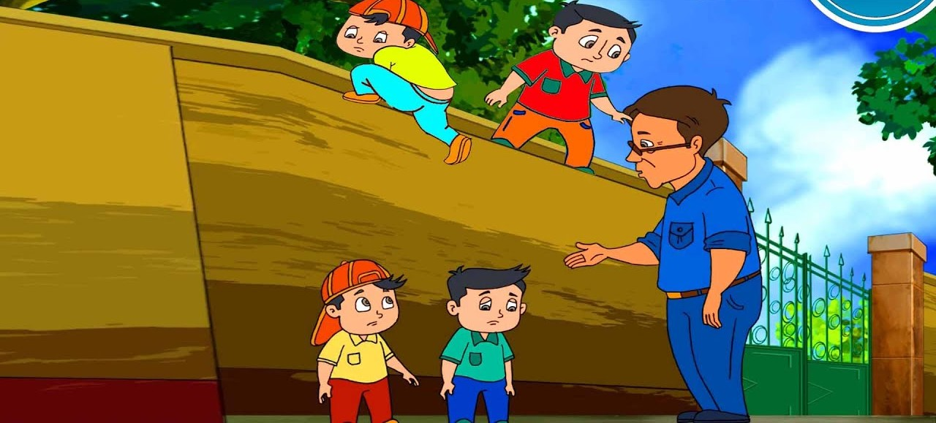
PRESENTATION
VOCABULARY
truancy (v)
/ˈtruːənsi/
Trốn học, nghỉ học không phép

Slide 9
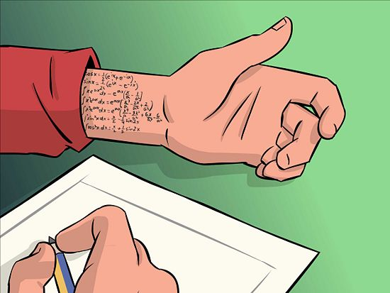
PRESENTATION
VOCABULARY
cheating (n)
/tʃiːtɪŋ/
Gian lận

Slide 10
PRESENTATION
VOCABULARY
Nanolearning(n)
/’nænəʊlɜːnɪŋ/
Một chương trình cho phép người tham gia học một chủ đề nhất định trong thời gian từ 2-10 phút thông qua việc sử dụng phương tiện điện tử và không tương tác với người hướng dẫn trong thời gian thực.

Slide 11
PRESENTATION
VOCABULARY
effortless (adj)
/ˈefətləs/
Không cần (nhiều) nỗ lực

Slide 12
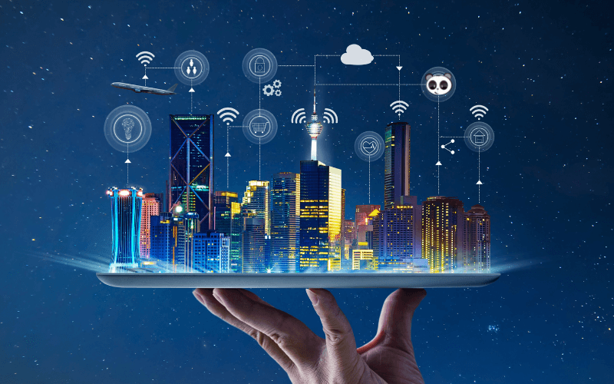
PRESENTATION
VOCABULARY
platform(n)
/ˈplætfɔːm/
Nền tảng

Slide 13
VOCABULARY
PRESENTATION
New words | Pronunciation | Meaning
1. biometrics (n) | /ˌbaɪəʊˈmetrɪks/ | Khoa học sinh trắc
2. truancy (n) | /ˈtruːənsi/ | Trốn học, nghỉ học không phép
3. Nanolearning (n) | /’nænəʊlɜːnɪŋ/ | Dạy học với bài dạy kích thước nhỏ
4. effortless(adj) | /ˈefətləs/ | Không cần nhiều nỗ lực
5. platform(v) |  | Nền tảng
6. cheating (n) | /tʃiːtɪŋ/ | Gian lận

Slide 14
PRESENTATION
I. READING
2
Read the passage and tick (v) B (Biometrics) or N (Nanolearning)

Slide 15
PRESENTATION
I. READING
2
Read the passage and tick B (Biometrics) or N (Nanolearning)
Benefits | B | N
1. It makes learning effortless.
2. It checks students’ understanding of the lessons.
3. Students use it when they borrow books and equipment.
4. It helps increase students’ learning attention.
5. It records students’ study activities and result.

Slide 16
PRACTICE
I. READING
3
Read the passage and choose the correct answer A, B, or C.
1. What does checking students’ attendance mean?
A. Checking their presence B. Scanning their faces C. Checking their fingerprints
2. With Nanolearning students can______.
access large amounts of information
improve their learning quality
Concentrate longer
3. What DOESN’T Nanolearning do?
Provide platform B. Report students’ results C. entertain students
4. The texts are from______.
A. Science books B. advertisements C. manuals

Slide 17
PRACTICE
I. READING
3
Read the passage and choose the correct answer A, B, or C.
1. What does checking students’ attendance mean?
A. Checking their presence B. Scanning their faces C. Checking their fingerprints
No more worries about truancy and cheating! Just introduce biometric applications at your school. With fingerprint scanners, or facial voice recognition technologies, schools will be able to check students’ attendance. Teachers will no longer need to call students’ names to find out who is absent. This will make more time for activities.

Slide 18
PRACTICE
I. READING
3
Read the passage and choose the correct answer A, B, or C.
2. With Nanolearning students can______.
access large amounts of information
improve their learning quality
Concentrate longer
Believe us! Receive bits of information within two to five minutes via our platform, and you will increase your learning attention and ability. Our app also reports your study activities and results to your teacher.

Slide 19
PRACTICE
I. READING
3
Read the passage and choose the correct answer A, B, or C.
3. What DOESN’T Nanolearning do?
Provide platform B. Report students’ results C. entertain students
Believe us! Receive bits of information within two to five minutes via our platform, and you will increase your learning attention and ability. Our app also reports your study activities and results to your teacher.

Slide 20
PRACTICE
I. READING
3
Read the passage and choose the correct answer A, B, or C.
4. The texts are from______.
A. Science books B. advertisements C. manuals
Believe us! Receive bits of information within two to five minutes via our platform, and you will increase your learning attention and ability. Our app also reports your study activities and results to your teacher.
Contact us at.
www.nanolearningsolution.edu.com

Slide 21
PRACTICE
I. READING
3
Read the passage and choose the correct answer A, B, or C.
1. What does checking students’ attendance mean?
A. Checking their presence B. Scanning their faces C. Checking their fingerprints
2. With Nanolearning students can______.
access large amounts of information
improve their learning quality
Concentrate longer
3. What DOESN’T Nanolearning do?
Provide platform B. Report students’ results C. entertain students
4. The texts are from______.
A. Science books B. advertisements C. manuals

Slide 22
PRODUCTION
II. SPEAKING
4
Work in pairs. Discuss and match the questions in A with the answers in B, and then make a conversation about an invention.
A | B
What invention? Who invented it? When invented? What benefit? | Alphonse Bertillon Check identities of people at airports or offices. Biometrics 1800s Check students’ attendance

Slide 23
PRODUCTION
II. SPEAKING
4
Work in pairs. Discuss and match the questions in A with the answers in B, and then make a conversation about an invention.
A | B
What invention? Who invented it? When invented? What benefits? | Alphonse Bertillon Check identities of people at airports or offices. Biometrics 1800s Check students’ attendance
A: What technology do you like?
B: I like ____________________
A: Who invented it?
B: ________________________
A: When did he invent it?
B: In ______________________
A: How can it help us?
B: It can help us________________

Slide 24
PRODUCTION
II. SPEAKING
5
Work in groups. Ask and answer questions about a technology or an invention. Use the example in 4 as a cue. Then report your answers to the class.
Example:
Mi likes biometrics. Alphonse Bertillon invented it in 1800s. It is a very important technology. We use it to …

Slide 25
CONSOLIDATION
1
Wrap-up
What have we learnt in this lesson?
Some new technologies that are applied at schools
Information about some inventions or technologies

Slide 26
CONSOLIDATION
2
Homework
Learn the new words by heart.
Do Exercise ………..page ……Unit 11/Workbook

Slide 27
Website: hoclieu.vn
Fanpage: facebook.com/sachmem.vn/

