Slide 2
Unit
10
COMMUNICATION IN THE FUTURE
LESSON 4: COMMUNICATION
1

Slide 3
LESSON 4: COMMUNICATION
WARM-UP
Asking questions
Vocabulary
EVERYDAY ENGLISH
Task 1: Listen and read the conversations below. Pay attention to the highlighted parts.
Task 2: Work in pairs. Make similar conversations with the following situations.
Task 3: Work in pairs. Read Mark’s prediction about a popular means of communication in the near future. Then ask and answer the questions.
THE FUTURE OF LANGUAGE
Task 4: Work in pairs. Choose one means of communication below. Ask and answer questions about it.
Task 5:Report your pair’s conversation to the class by making a similar talk to Mark’s prediction in 3.
PRODUCTION
CONSOLIDATION
Wrap-up
Homework

Slide 4
WARM-UP
Answer the questions:
Question: How do you see you in 10 years.
Answer: I will _____________ in 10 years.
Your future

Slide 5
EVERYDAY ENGLISH
1
Listen and read the conversations. Pay attention to the highlighted parts.
Mark: Now, about the video conference ... Everyone must be here at 9:30 a.m., and ...
Trang: Sorry for interrupting, but I think we should meet at 9:00 a.m. We need to test the devices.
1
Nick: This webcam is easy to handle. You click these buttons to move it up or down and these to ...
Lan: Hold on. Can you repeat that, please?
2
Structure | Examples
How to interrupt politely | Sorry for interrupting, but Hold on.

Slide 6
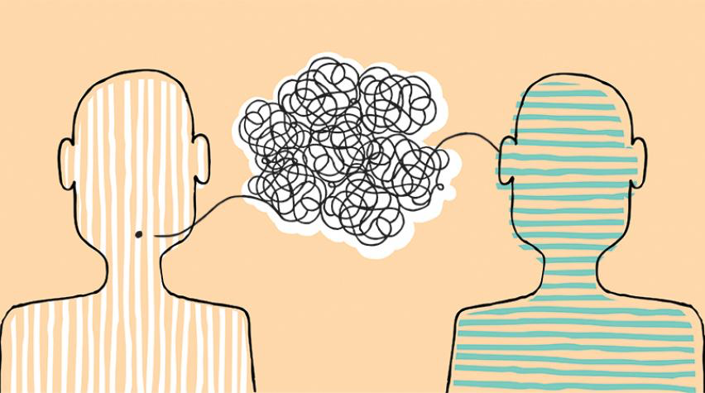
PRACTICE
2
Work in pairs. Make similar conversations with the following situations.
1. Student A is telling student B how to make a video call. Student B interrupts student A to ask for clarification.
2. Student A is telling student B the place for their next meeting. Student B interrupts student A to suggest another place.

Slide 7
THE FUTURE OG LANGUAGE
3
Work in pairs. Read Mark’s prediction about a popular means of communication in the near future. Then ask and answer the questions.
1. What means of communication is Mark talking about?
2. When will emojis become more commonly used?
3. Who will be using them?
4. How will they help in communication?
5. Why will they become more popular?
Mark: In 20 years, people of all ages will be using emojis even more than now. Emojis help people communicate their emotions effectively regardless of the language they speak. For example, a smiley face expresses the same meaning everywhere. An emoji can replace words to a certain extent. One day, we might receive an email that contains only emojis!
Emojis
In 20 years
People of all ages
Emojis help people communicate their attitudes effectively regardless of the language they speak.
Because an emoji can replace words to a certain extent.

Slide 8
THE FUTURE OG LANGUAGE
4
Work in pairs. Choose one means of communication below. Ask and answer questions about it.
1. Automatic translation function
– When: in 10 years
– Who: social network users
– How: translate comments and private messages in all languages
– Why: remove language barriers
2. Chatbot
– When: in 10 years
– Who: sellers of online shops
– How: instantly reply to customers in all languages
– Why: help sell more products to customers from other countries

Slide 9
PRODUCTION
5
Report your pair’s conversation to the class by making a similar talk to Mark’s prediction in 3.
Mark: In 20 years, people of all ages will be using emojis even more than now. Emojis help people communicate their emotions effectively regardless of the language they speak. For example, a smiley face expresses the same meaning everywhere. An emoji can replace words to a certain extent. One day, we might receive an email that contains only emojis!

Slide 10
CONSOLIDATION
1
Wrap-up
What have we learnt in this lesson?
How to interrupt politely

Slide 11
CONSOLIDATION
2
Homework
Student’s workbook

Slide 12
Website: hoclieu.vn
Fanpage: facebook.com/sachmem.vn/

