Slide 2
Unit
10
COMMUNICATION IN THE FUTURE
LESSON 2: A CLOSER LOOK 1

Slide 3
LESSON 2: A CLOSER LOOK 1
WARM-UP
Game: anagram
Vocabulary
VOCABULARY
Task 1: Write the correct word or phrase from the box under each picture.
Task 2: Choose the correct answer A, B, or C.
Task 3: Complete the sentences with the words from the box.
PRACTICE
Task 4: Stress in words ending in -ese and –ee. Listen and repeat the words. Pay attention to the word stress.
Task 5: Mark the stress in the underlined words. Then listen and repeat the sentences.
PRONUNCIATION
CONSOLIDATION
Wrap-up
Homework

Slide 4
WARM-UP
Work in pairs. Rearrange the letters to make words related to communication.
devio receonnfc
atlbet
tinerent neitonccon
oomz ni
cebwam
ANAGRAM
video conference
tablet
internet connection
zoom in
webcam

Slide 5
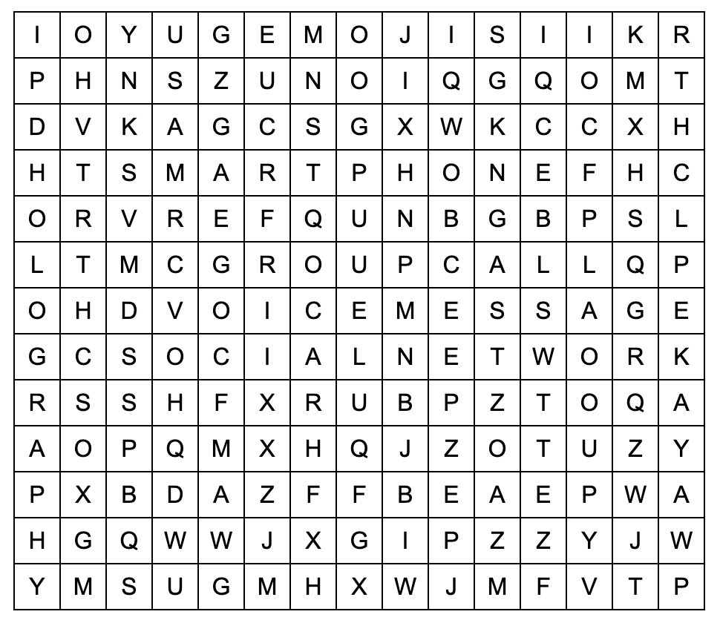
VOCABULARY
Work in pairs. Find the words in the word search.
voice message
social network
group call
smart phone
emojis
holography

Slide 6
VOCABULARY
Words | Pronunciation | Vietnamese equivalent
1. social network (n) | /vɔɪs ˈmɛsɪdʒ/ | mạng xã hội
2. voice message (n) | /ˈsoʊʃəl ˈnɛtwɜːrk/ | tin nhắn thoại
3. group call (n) | /ɡruːp kɔːl/ | cuộc gọi nhóm
4. smartphone (n) | /smɑrt ˈfoʊn/ | điện thoại thông minh
5. emojis (n) | /ɪˈmoʊdʒiːz/ | biểu tượng cảm xúc
6. holography (n) | /həˈlɑɡrəfi/ | hình chiếu 3 chiều

Slide 7
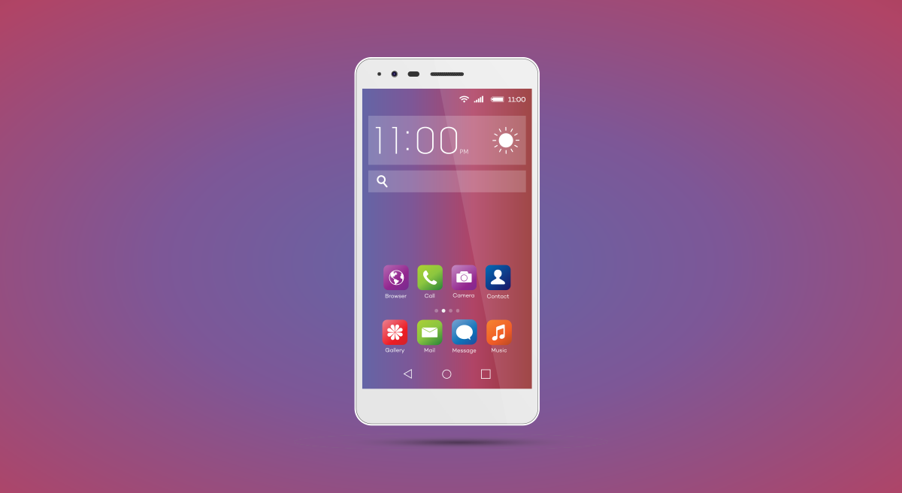
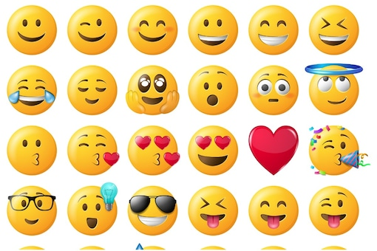
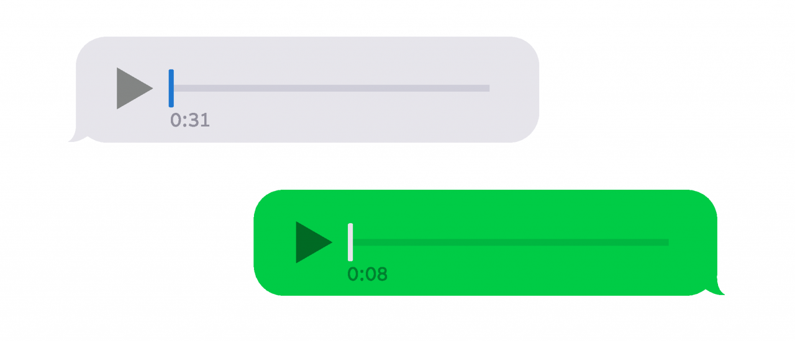
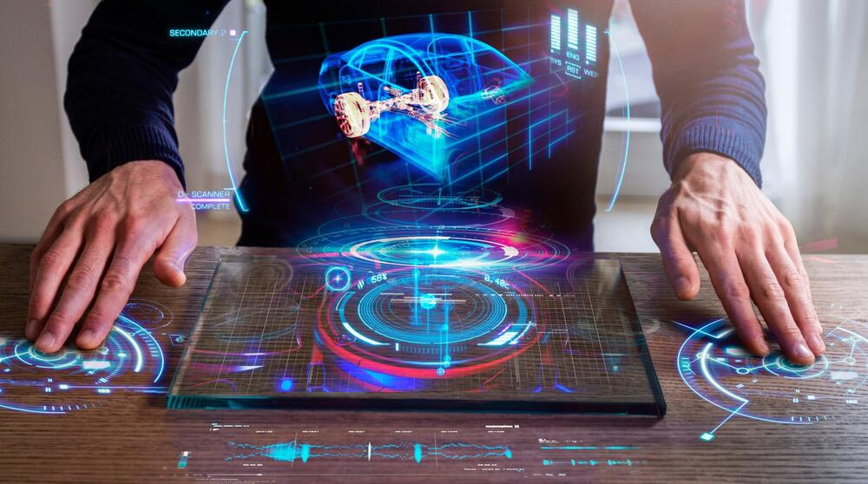
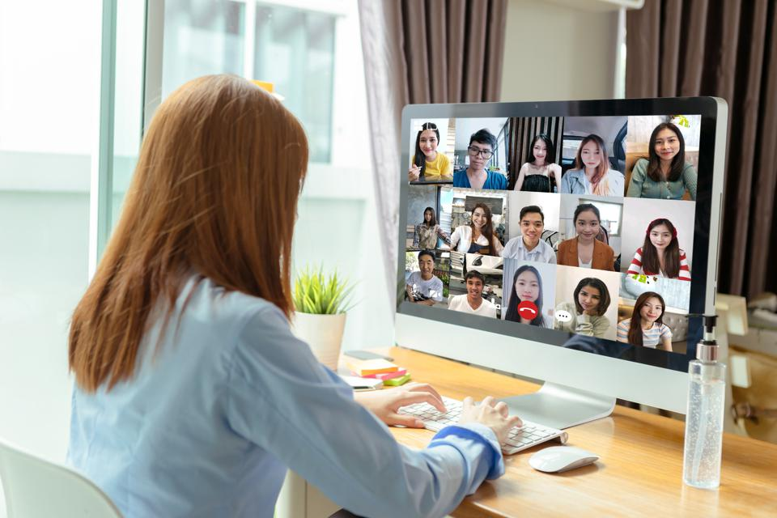
PRACTICE
1
Write the correct word or phrase from the box under each picture.
voice message smartphone social network
emojis group call holography
1. ___________
emojis
3. ___________
smart phone
2. ___________
voice message
4. ___________
5. ___________
6. ___________
holography
smartphone
group call

Slide 8
PRACTICE
2
Choose the correct answer A, B, or C.
1. Many people add ______ to their text messages to express their feelings.
A. emojis B. words C. letters
2. I send ______ messages when I don’t feel like typing.
A. group B. text C. voice
3. Many teenagers like to meet on social ______ rather than face to face.
A. television B. networks C. projects
4. In a ______, people in different places can join the conversation.
A. voice message B. group call C. system of emojis
5. By using ______, you can attend a meeting with your 3D image instead of being there in person.
A. holography B. voice messages C. social network

Slide 9
PRACTICE
3
Complete the sentences with the words from the box.
translation real language
instantly private
private
Do you often send ____________ messages to your friends?
Can learning English help you overcome the _________ barrier when living abroad?
Telephone helps you communicate in ____________ time.
Do you think translators will lose their jobs when ____________ machines become popular?
Many people reply to messages _________, but others take a long time to respond.
language
real
translations
instantly

Slide 10
PRONUNCIATION

Slide 11
PRONUNCIATION
4
Listen and repeat the words. Pay attention to the word stress.
-ese | -ee
Chinese Bhutanese Japanese Taiwanese Vietnamese | agree trainee awardee interviewee guarantee

Slide 12
PRONUNCIATION
5
Mark the stress in the underlined words. Then listen and repeat the sentences.
The interviewees said that they were Taiwanese.
Joe agrees with me that learning Chinese is difficult.
She obtained a bachelor’s degree in Japanese.
The Taiwanese company gave each awardee a smartphone.
The Japanese teacher sent a video to the absentees on Monday.
interview’eses
Taiwa’nese
ag’rees
Chi’nese
deg’rees
Japa’nese
Taiwa’nese
awar’dee
Japa’nese
absen’tees

Slide 13
CONSOLIDATION
1
Wrap-up
What have we learnt in this lesson?
- Vocabulary: The lexical items related to Communication
- Pronunciation: How to correctly stress words that end with: -ese and -ee

Slide 14
CONSOLIDATION
2
Homework
Students’ workbook

Slide 15
Website: hoclieu.vn
Fanpage: facebook.com/sachmem.vn/

