Slide 2
WARM-UP
Game: Who is faster?
Notes:
Teacher divides the class into 2 teams. Each team will send a leader to play the game on the board.
Teacher explains the instructions of the game:
Each leader stands against the board.
Teacher shows/ writes the names of the festivals (exercise 5 – page 93).
Other members from each team describe the festivals and let the leader guess the names of the festivals.
The team with more correct answers is the winner.

Slide 3
WARM-UP
La Tomatina

Slide 4
WARM-UP
Christmas

Slide 5
WARM-UP
Mid-Autumn Festival

Slide 6
WARM-UP
Cheese rolling

Slide 7
WARM-UP
Tet

Slide 8
Period 70
Unit
9
FESTIVALS AROUND THE WORLD
LESSON 2: A CLOSER LOOK 1
VOCABULARY
PRONUNCIATION
Unit
HOBBIES

Slide 10
VOCABULARY
1
Write under each picture a festival name from the box.
Cannes Film Festival Mid-Autumn Festival Thanksgiving Christmas Halloween Easter
1. ___________
2. ___________
3. ___________
4. ___________
5. _________________
6. ___________

Slide 11
VOCABULARY
1
Write under each picture a festival name from the box.
Cannes Film Festival Mid-Autumn Festival Thanksgiving Christmas Halloween Easter
1. ___________
2. ___________
3. ___________
4. ___________
5. _________________
6. ___________

Slide 12
VOCABULARY
1
Write under each picture a festival name from the box.
Cannes Film Festival Mid-Autumn Festival Thanksgiving Christmas Halloween Easter
1. ___________
2. ___________
3. ___________
Halloween
Christmas
Mid-Autumn Festival
4. ___________
5. _________________
6. ___________
Cannes Film Festival
Easter
Thanksgiving

Slide 13
VOCABULARY
2
Complete the table below with the phrases from the box.
having a feast moon cakes chocolate eggs candy apples turkey painting eggs carving pumpkins performing a lion dance
Festival | Food | Activity
Easter
Halloween
Mid-Autumn Festival
Thanksgiving
https://wordwall.net/vi/resource/87563072/complete-the-table-below-with-the-phrases-from-the-box

Slide 14
VOCABULARY
2
Complete the table below with the phrases from the box.
having a feast moon cakes chocolate eggs candy apples turkey painting eggs carving pumpkins performing a lion dance
Festival | Food | Activity
Easter
Halloween
Mid-Autumn Festival
Thanksgiving
chocolate eggs
painting eggs
candy apples
carving pumpkins
moon cakes
performing a lion dance
turkey
having a feast

Slide 15
VOCABULARY
3
Fill in each blank with a word/phrase from the box.
painting eggs Christmas Mid-Autumn Festival candy apples Cannes Film Festival turkey
At ______________, people give gifts to each other.
My children love ______________ at Easter.
How many ______________ do you need for the Halloween party?
At the _________________, there are many interesting films.
Performing lion dances is one of the activities at the _________________.
Bill’s mum is cooking a ______________ for Thanksgiving.
Christmas

Slide 16
VOCABULARY
3
Fill in each blank with a word/phrase from the box.
painting eggs Christmas Mid-Autumn Festival candy apples Cannes Film Festival turkey
At ______________, people give gifts to each other.
My children love ______________ at Easter.
How many ______________ do you need for the Halloween party?
At the _________________, there are many interesting films.
Performing lion dances is one of the activities at the _________________.
Bill’s mum is cooking a ______________ for Thanksgiving.
Christmas
painting eggs
candy apples
Cannes Film Festival
Mid-Autumn Festival
turkey

Slide 18
PRONUNCIATION
Stress in two-syllable words

Slide 19
PRONUNCIATION
4
Listen and repeat. Then underline the stressed syllable in each word.
Nouns and Adjectives | Verbs
costume fireworks turkey happy | enjoy decide discuss prepare

Slide 20
PRONUNCIATION
4
Listen and repeat. Then underline the stressed syllable in each word.
Nouns and Adjectives | Verbs
costume fireworks turkey happy | enjoy decide discuss prepare

Slide 21
PRONUNCIATION
5
Listen and repeat the sentences. Underline the stressed syllables in the bold words.
We’re going to attend an Easter party at Nick’s house.
The dancers will perform traditional dances at the festival.
At Christmas, people usually buy presents for their family.
Did you go to the Da Lat Flower Festival with your parents?
My aunt is clever and patient.

Slide 22
PRONUNCIATION
5
Listen and repeat the sentences. Underline the stressed syllables in the bold words.
We’re going to attend an Easter party at Nick’s house.
The dancers will perform traditional dances at the festival.
At Christmas, people usually buy presents for their family.
Did you go to the Da Lat Flower Festival with your parents?
My aunt is clever and patient.

Slide 23
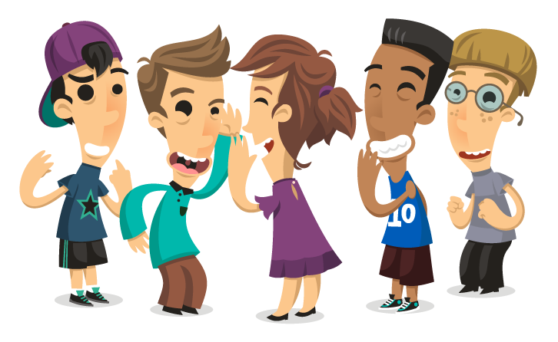
PRODUCTION
Game: Up and down
Aims of the stage:
To test students' quick reaction.
Notes:
Teacher says 1-15 words containing two-syllable words. Students stand up for the ones with first main stress pattern, sit down for the second main stress pattern.

Slide 24
CONSOLIDATION
1
WRAP-UP
VOCABULARY
PRONUNCIATION

Slide 25
CONSOLIDATION
2
HOMEWORK
Learn new words
Redo all the exercises in the text book
Do exercises in workbook
Prepare the new lesson: Unit 9 A closer look 2

