Slide 2
Unit
7
TRAFFIC
LESSON 7: LOOKING BACK & PROJECT
VOCABULARY REVIEW
IT -> DISTANCE
GRAMMAR REVIEW
PRODUCTION
PROJECT: TRAFFIC/ROAD SIGNS
TRAFFIC PROBLEMS AND MEANS OF TRANSPORT
Unit

Slide 3
OBJECTIVES
By the end of the lesson, students will be able to:
review the vocabulary and grammar of Unit 7
apply what they have learnt (vocabulary and grammar) into practice through a project

Slide 4
LESSON 7: LOOKING BACK & PROJECT
WARM-UP
QUICK REVISION CHECK
VOCABULARY REVIEW
Task 1: Label each sign. Work in pairs. What does each sign tell us to do?
Task 2: Fill in each gap with one word to complete the sentences.
Task 3: Write complete sentences, using these cues.
Task 4: Choose A, B, or C to complete the sentences.
GRAMMAR REVIEW
Traffic signs
Task 5: Show the prepared signs. Make your own sign.
Task 6: Traffic signs exhibition
PROJECT
CONSOLIDATION
Wrap-up
Home work

Slide 5
LESSON 7: LOOKING BACK & PROJECT
WARM-UP
QUICK REVISION CHECK
Aims of the stage:
To help students revise the vocabulary items they have learnt in the unit.To enhance students’ skills of cooperating with team mates.
Notes:
Wordwall link to spin the wheel in real time: https://wordwall.net/resource/27022823

Slide 6
LESSON 7: LOOKING BACK & PROJECT
WARM-UP
QUICK REVISION CHECK
VOCABULARY REVIEW
Task 1: Label each sign. Work in pairs. What does each sign tell us to do?
Task 2: Fill in each gap with one word to complete the sentences.

Slide 7
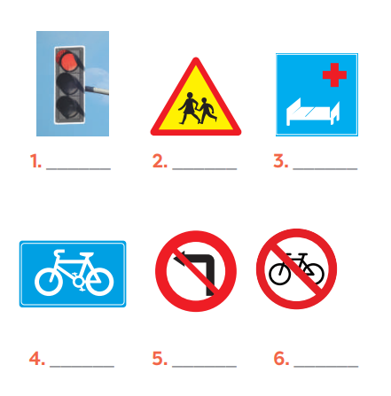
VOCABULARY REVIEW
1
Label each sign. Work in pairs. What does each sign tell us to do?

Slide 8
VOCABULARY REVIEW
1
Label each sign. Work in pairs. What does each sign tell us to do?
KEYS
1. Red light
2. School ahead
3. Hospital ahead
4. Cycle lane
5. No left turn
6.No cycling

Slide 9
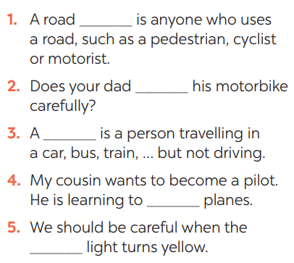
VOCABULARY REVIEW
2
Fill in each gap with one word to complete the sentences.

Slide 10
VOCABULARY REVIEW
2
Fill in each gap with one word to complete the sentences.
KEYS:
1. user
2. ride
3. passenger
4. fly
5. traffic

Slide 11
LESSON 7: LOOKING BACK & PROJECT
WARM-UP
QUICK REVISION CHECK
VOCABULARY REVIEW
Task 1: Label each sign. Work in pairs. What does each sign tell us to do?
Task 2: Fill in each gap with one word to complete the sentences.
Task 3: Write complete sentences, using these cues.
Task 4: Choose A, B, or C to complete the sentences.
GRAMMAR REVIEW

Slide 12
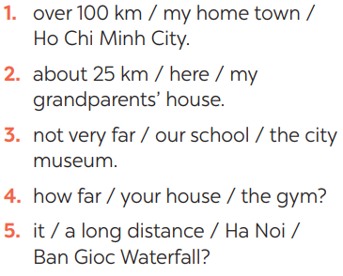
GRAMMAR REVIEW
Aim of the task:
To help Ss revise grammar points.
3
Write complete sentences, using these cues.

Slide 13
GRAMMAR REVIEW
Aim of the task:
To help Ss revise grammar points.
3
Write complete sentences, using these cues.
ANSWER KEYS
1- It’s over 100km from my hometown to Ho Chi Minh city.
2- It’s about 25 km from here to my grandparents’ house.
3- It’s not very far from our school to the city museum.
4- How far is it from your house to the gym?
5- Is it a long distance from Ha Noi to Ban Gioc Waterfall?

Slide 14
GRAMMAR REVIEW
4
Choose A, B, or C to complete the sentences.

Slide 15
GRAMMAR REVIEW
4
Choose A, B, or C to complete the sentences.

Slide 16
LESSON 7: LOOKING BACK & PROJECT
WARM-UP
QUICK REVISION CHECK
VOCABULARY REVIEW
Task 1: Label each sign. Work in pairs. What does each sign tell us to do?
Task 2: Fill in each gap with one word to complete the sentences.
Task 3: Write complete sentences, using these cues.
Task 4: Choose A, B, or C to complete the sentences.
GRAMMAR REVIEW
Traffic signs
Task 5: Show the prepared signs. Make your own sign.
Task 6: Traffic signs exhibition
PROJECT

Slide 17
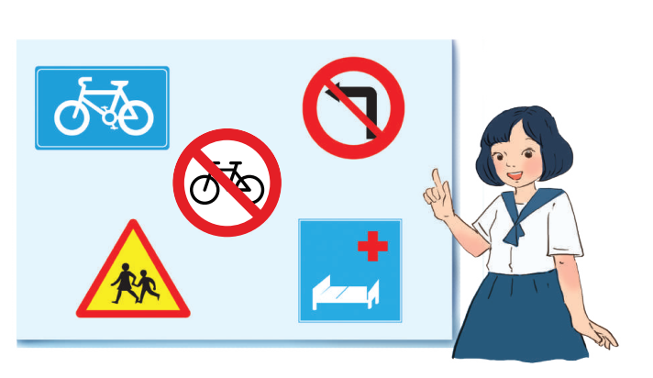
PROJECT
5
5
Show the prepared signs. Make your own sign.

Slide 18
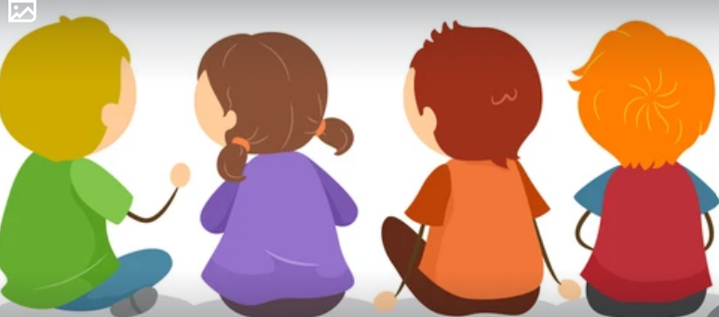
PROJECT
6
5
Traffic signs exhibition

Slide 19
LESSON 7: LOOKING BACK & PROJECT
WARM-UP
QUICK REVISION CHECK
VOCABULARY REVIEW
Task 1: Label each sign. Work in pairs. What does each sign tell us to do?
Task 2: Fill in each gap with one word to complete the sentences.
Task 3: Write complete sentences, using these cues.
Task 4: Choose A, B, or C to complete the sentences.
GRAMMAR REVIEW
Traffic signs
Task 5: Show the prepared signs. Make your own sign.
Task 6: Traffic signs exhibition
PROJECT
CONSOLIDATION
Wrap-up
Home work

Slide 20
Unit
7
TRAFFIC
LESSON 7: LOOKING BACK & PROJECT
VOCABULARY REVIEW
IT -> DISTANCE
GRAMMAR REVIEW
PRODUCTION
PROJECT: TRAFFIC/ROAD SIGNS
TRAFFIC PROBLEMS AND MEANS OF TRANSPORT
Unit

Slide 21
CONSOLIDATION
2
HOMEWORK
Prepare for the next lesson: Unit 8 – Getting started

