Slide 2
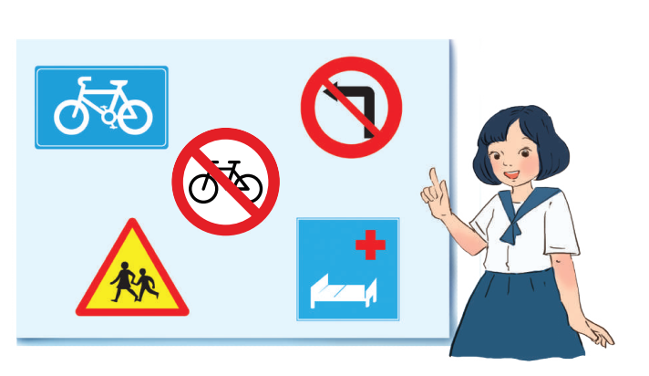
Unit
7
TRAFFIC
LESSON 5: SKILLS 2

Slide 3
OBJECTIVES
By the end of the lesson, students will be able to:
Listening
- use the lexical items related to the topic Traffic
- listen for main ideas and specific information about traffic problems in Mumbai.
Writing: write about traffic problems in your area.

Slide 4
LESSON 5: SKILLS 2
WARM-UP
BRAIN STORMING
* Listening
Task 1: Discuss: What can you see in this picture? What is special about it?
Task 2: Listen to the recording and choose the correct answer A, B, or C
Task 3: Listen again and write ONE word or number in each gap
Task 4: Discuss: Compare traffic problems in Mumbai to the traffic problems in Hanoi.
LISTENING
WRITING
* Writing
Task 5: Discuss and brainstorm ideas.
Task 6: Write a paragraph of about 70 words about the traffic problems in your town / city.
CONSOLIDATION
Wrap-up
Home work

Slide 5
LESSON 1: GETTING STARTED
WARM-UP
BRAIN STORMING
Aims of the stage:
To activate students’ prior knowledge and vocabulary related to the lesson.

Slide 6
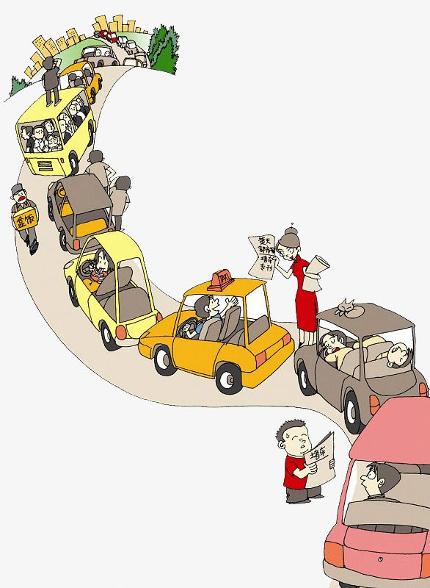
WARM-UP
TRAFFIC PROBLEMS

Slide 7
LESSON 5: SKILLS 2
WARM-UP
BRAIN STORMING
* Listening
Task 1: Discuss: What can you see in this picture? What is special about it?
Task 2: Listen to the recording and choose the correct answer A, B, or C
Task 3: Listen again and write ONE word or number in each gap
Task 4: Discuss: Compare traffic problems in Mumbai to the traffic problems in Hanoi.
LISTENING
Aims of the stage:
To help Ss brainstorm the topic and prepare for the listening text

Slide 8
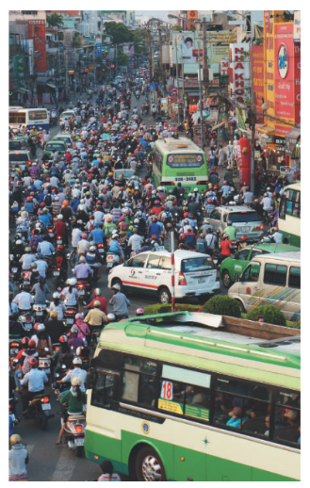
PRE-LISTENING
1
Discuss: What can you see in this picture? What is special about it?

Slide 9
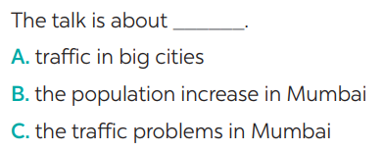
PRE-LISTENING
2
Listen to the recording and choose the correct answer A, B, or C

Slide 10
PRE-LISTENING
2
Listen to the recording and choose the correct answer A, B, or C

Slide 11
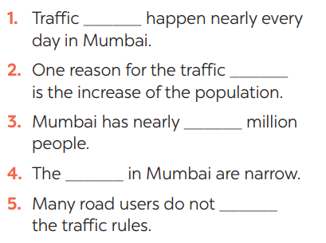
WHILE-LISTENING
3
Listen again and write ONE word or number in each gap

Slide 12
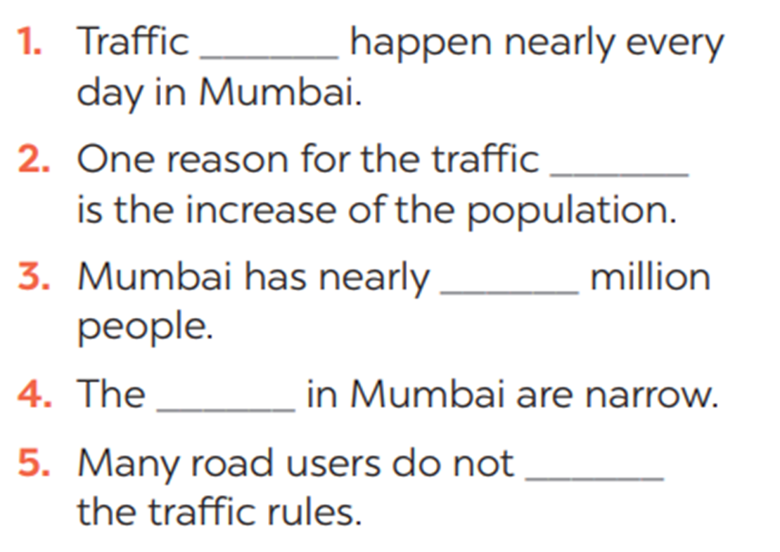
WHILE-LISTENING
3
Listen again and write ONE word or number in each gap
1. jams
2. jams
3. 20
4. roads
5. obey

Slide 13
POST - LISTENING
4
Discuss: Compare traffic problems in Mumbai to the traffic problems in Hanoi.
The traffic jams in Hanoi are as serious and frequent as they are in Mumbai.

Slide 14
LESSON 5: SKILLS 2
WARM-UP
BRAIN STORMING
* Listening
Task 1: Discuss: What can you see in this picture? What is special about it?
Task 2: Listen to the recording and choose the correct answer A, B, or C
Task 3: Listen again and write ONE word or number in each gap
Task 4: Discuss: Compare traffic problems in Mumbai to the traffic problems in Hanoi.
LISTENING
WRITING
* Writing
Task 5: Discuss and brainstorm ideas.
Task 6: Write a paragraph of about 70 words about the traffic problems in your town / city.
Aims of the stage:
To help Ss prepare ideas to write a passage.

Slide 15
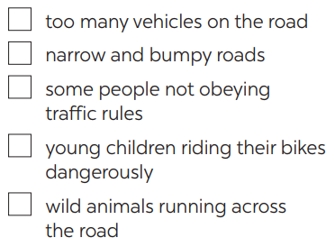
PRE-WRITING
5
Tick the traffic problems in big cities in Viet Nam.

Slide 16
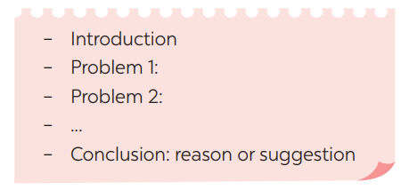
WHILE-WRITING
6
Write a paragraph of about 70 words about the traffic problems in your town / city.
The most serious traffic problem in our city – Hanoi is the traffic jams. Although the public transport system in Hanoi is quite modern and covenient, many people prefer using their own motorbikes. The reason for that is because most roads and streets in Hanoi are quite smalls and include many tiny lanes. Therefore, using private vehicles allows them to get there without walking long distance. The situation usually gets worse at rush hours when people all go to work or return home from work and schools. In conclusion, people should try to use public transport more often to reduce the traffic jams and exhaust.

Slide 17
POST - WRITING
Peer check and cross check
Students can:
go and see other’s work
give comments to each other

Slide 18
CONSOLIDATION
1
WRAP-UP
In this lesson, we have learnt to:
use the lexical items related to the topic Traffic
listen for main ideas and specific information about traffic problems in Mumbai.
write about traffic problems in your area.

Slide 19
CONSOLIDATION
2
HOMEWORK
Prepare for the next lesson: Looking back & Project

