Slide 2
Unit
7
TRAFFIC
LESSON 3: A CLOSER LOOK 2
GRAMMAR:
- It to indicate distance
- should and shouldn’t
Unit
HOBBIES

Slide 3
OBJECTIVES
By the end of the lesson, students will be able to:
Know how to use:
- It to indicate distance
- should and shouldn’t

Slide 4
LESSON 3: A CLOSER LOOK 2
WARM-UP
Slap the board
PRESENTATION
- It to indicate distance
- should and shouldn’t
Task 1: Write sentences with It. Use these cues.
Task 2: Work in pairs. Ask and answer questions about distances in your neighbourhood.
Task 3: Choose the correct option in brackets.
Task 4: Complete each sentence, using should / shouldn’t.
PRACTICE
PRODUCTION
Task 5: Look at the pictures. Make sentences, using should /shouldn’t and the cues.
CONSOLIDATION
Wrap-up
Home work

Slide 5
LESSON 3: A CLOSER LOOK 2
WARM-UP
Slap the board
Aims of the stage:
To activate students’ prior knowledge and vocabulary related to the targeted grammar

Slide 6
WARM-UP

Slide 7
LESSON 3: A CLOSER LOOK 2
WARM-UP
Slap the board
PRESENTATION
- It to indicate distance
- should and shouldn’t

Slide 8
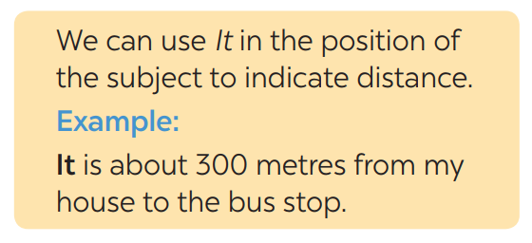
PRESENTATION
What does the sentences tell us about?
IT – INDICATING DISTANCE
What is the structure using in the sentence?

Slide 9
LESSON 3: A CLOSER LOOK 2
WARM-UP
Slap the board
PRESENTATION
- It to indicate distance
- should and shouldn’t
Task 1: Write sentences with It. Use these cues.
Task 2: Work in pairs. Ask and answer questions about distances in your neighbourhood.
Task 3: Choose the correct option in brackets.
Task 4: Complete each sentence, using should / shouldn’t.
PRACTICE

Slide 10
PRACTICE
1
Write sentences with It. Use these cues.
Aim of the task:
-To get students practice using the form

Slide 11
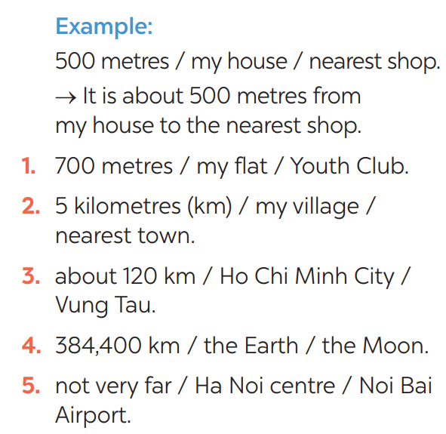
PRACTICE
1
Write sentences with It. Use these cues.
KEY
1- It is 700m from my house/home to the Youth club.
2- It is 5 kilometres from my village to the nearest town.
3- It is about 120 km from Ho Chi Minh city to Vung Tau.
4- It is 384,400 km from the Earth to the Moon.
5- It is not very far from Hanoi centre to Noi Bai airport.

Slide 12
PRACTICE
2
Work in pairs. Ask and answer questions about distances in your neighbourhood
Aim of the task:
To practise asking and answering about distance.

Slide 13
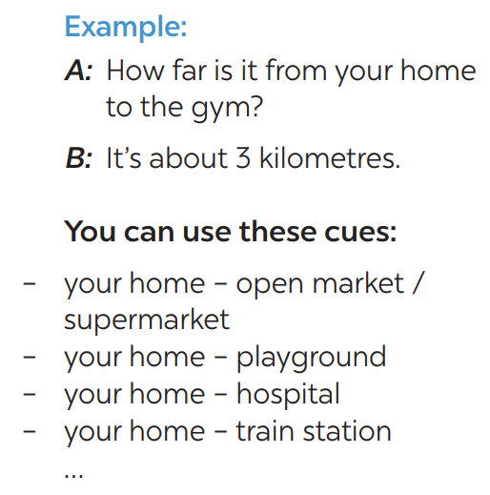
PRACTICE
2
How far is it from your house to the open market?
It’s about 1 km.

Slide 14
PRODUCTION
3
Choose the correct option in brackets.
1. That’s an interesting book. You (should / shouldn’t) read it. 2. You nearly fell off your bike! You really (should / shouldn’t) be more careful. 3. We (should / shouldn’t) go swimming right after eating. 4. I think that he (should / shouldn’t) eat less. He’s becoming overweight. 5. There are a lot of cars out today. He (should / shouldn’t) drive so fast.

Slide 15
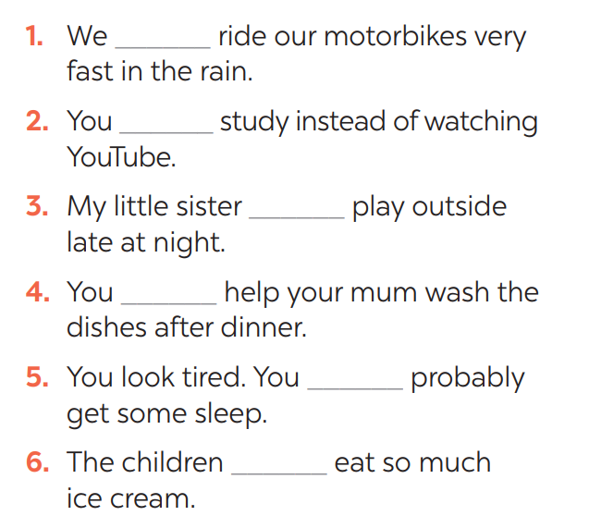
PRODUCTION
4
Complete each sentence, using should / shouldn’t.
shouldn’t
should
shouldn’t
should
should
shouldn’t

Slide 16
LESSON 3: A CLOSER LOOK 2
WARM-UP
Slap the board
PRESENTATION
- It to indicate distance
- should and shouldn’t
Task 1: Write sentences with It. Use these cues.
Task 2: Work in pairs. Ask and answer questions about distances in your neighbourhood.
Task 3: Choose the correct option in brackets.
Task 4: Complete each sentence, using should / shouldn’t.
PRACTICE
PRODUCTION
Task 5: Look at the pictures. Make sentences, using should /shouldn’t and the cues.

Slide 17
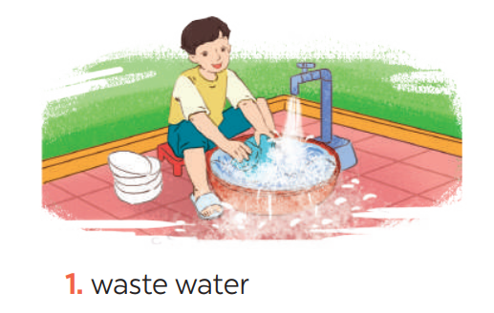
PRODUCTION
5
Look at the pictures. Make sentences, using should / shouldn’t and the cues
He shouldn’t waste water.

Slide 18
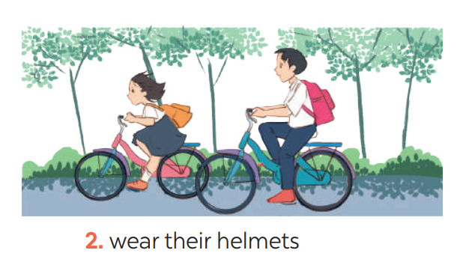
PRODUCTION
5
Look at the pictures. Make sentences, using should / shouldn’t and the cues
They should wear their helmets.

Slide 19
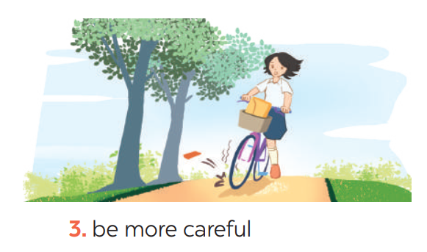
PRODUCTION
5
Look at the pictures. Make sentences, using should / shouldn’t and the cues
She should be more careful.

Slide 20
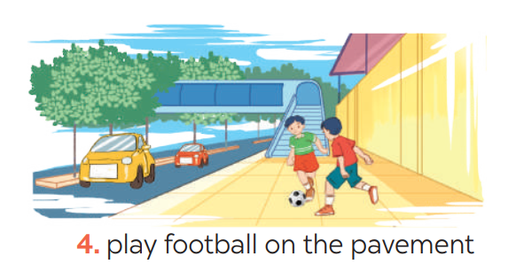
PRODUCTION
5
Look at the pictures. Make sentences, using should / shouldn’t and the cues
They shouldn’t play football on the pavement.

Slide 21
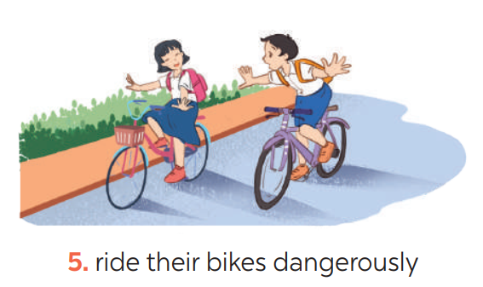
PRODUCTION
5
Look at the pictures. Make sentences, using should / shouldn’t and the cues
They shouldn’t ride their bikes dangerously.

Slide 22
He shouldn’t waste water.
They should wear their helmets.
She should be more careful.
They shouldn’t play football on the pavement.
They shouldn’t ride their bikes dangerously.

Slide 23
LESSON 3: A CLOSER LOOK 2
WARM-UP
Slap the board
PRESENTATION
- It to indicate distance
- should and shouldn’t
Task 1: Write sentences with It. Use these cues.
Task 2: Work in pairs. Ask and answer questions about distances in your neighbourhood.
Task 3: Choose the correct option in brackets.
Task 4: Complete each sentence, using should / shouldn’t.
PRACTICE
PRODUCTION
Task 5: Look at the pictures. Make sentences, using should /shouldn’t and the cues.
CONSOLIDATION
Wrap-up
Home work

Slide 24
CONSOLIDATION
1
WRAP-UP
GRAMMAR:
- It to indicate distance
- should and shouldn’t

Slide 25
CONSOLIDATION
2
HOMEWORK
Exercises in the workbook.

