Slide 1


Slide 2



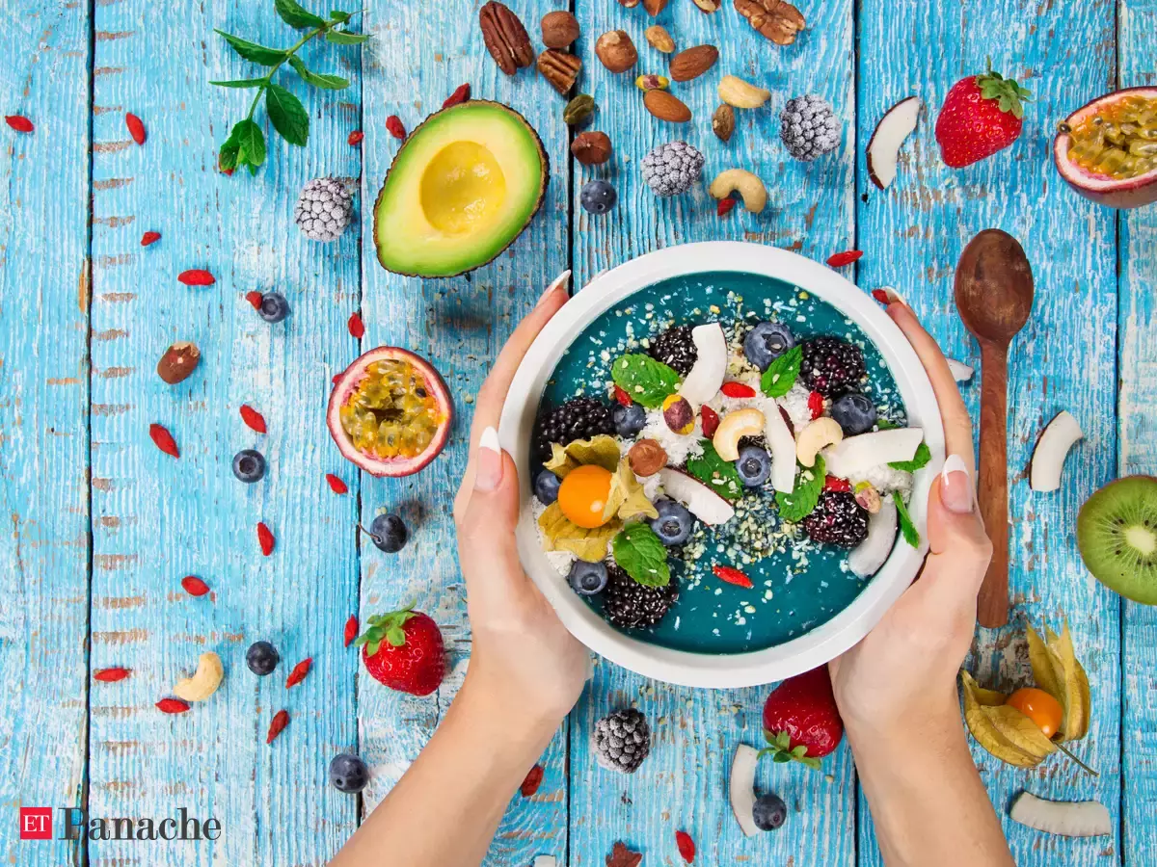


Unit
5
FOOD AND DRINK
Lesson 6: SKILLS 2

Slide 3

OBJECTIVES
By the end of this lesson, Ss will be able to:
1. Knowledge
Develop their listening skill for specific information about food and drink
Write a paragraph about eating habits in their area
2. Core competence
Develop communication skills and creativity
Be collaborative and supportive in pairwork and teamwork
Develop presentation skills
Actively join in class activities
3. Personal qualities
Promote pride in the values ​​of Vietnamese culture
Develop love for family and traditional food and drink

Slide 4
LESSON 6: SKILLS 2
WARM-UP
Mini game: Our eating habits
* Vocabulary
Task 1: Work in groups. Discuss the following questions.
Task 2: Listen to Minh talking about the eating habit in his area. Circle the food and drink you hear.
Task 3: Listen again and tick True (T) or False (F).
LISTENING
Task 4: Make notes about the eating habits in your area.
Task 5: Write a paragraph of about 70 words about the eating habits in your area.
WRITING
CONSOLIDATION
Wrap-up
Homework

Slide 5
LESSON 6: SKILLS 2
WARM-UP
Mini Game: Our eating habits
Stage aims:
To create an active atmosphere in the class before the lesson;
To lead into the new lesson.

Slide 6
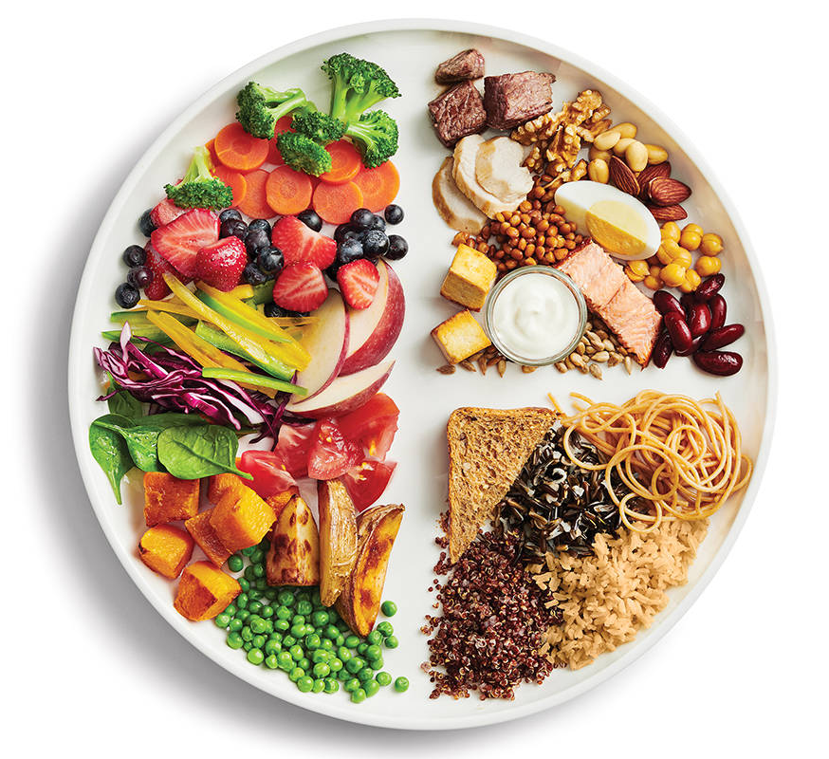
MINI GAME
Our eating habits
In your groups, talk about:
What you ate and drank yesterday
Who had healthy diets

Slide 7
LESSON 6: SKILLS 2
WARM-UP
Mini game: Our eating habits
* Vocabulary
Task 1: Work in groups. Discuss the following questions.
Task 2: Listen to Minh talking about the eating habit in his area. Circle the food and drink you hear.
Task 3: Listen again and tick True (T) or False (F).
LISTENING
Stage aims:
To help students use key language more appropriately;
To help Ss understand and activate their knowledge of the topic;
To help Ss understand what the monologue is about & listen for specific information.

Slide 8
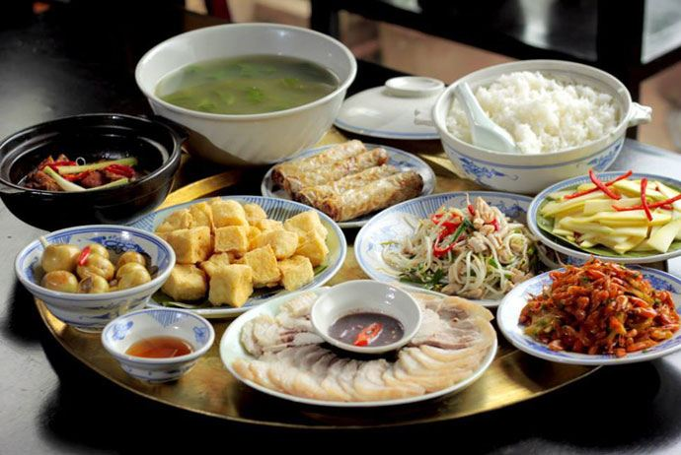
Vocabulary
meal
/mɪəl/
bữa ăn

Slide 9
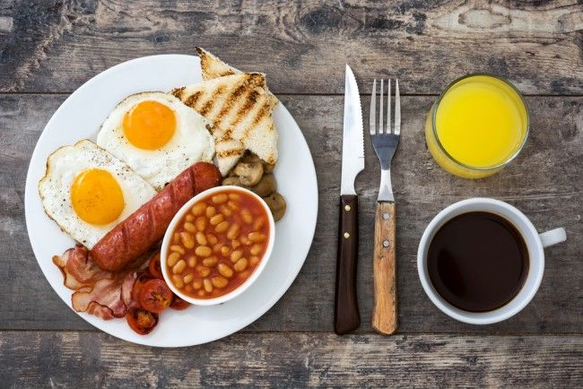
Vocabulary
breakfast
/ˈbrek.fəst/
bữa sáng

Slide 10
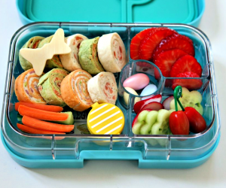
Vocabulary
lunch
/lʌntʃ/
bữa trưa

Slide 11
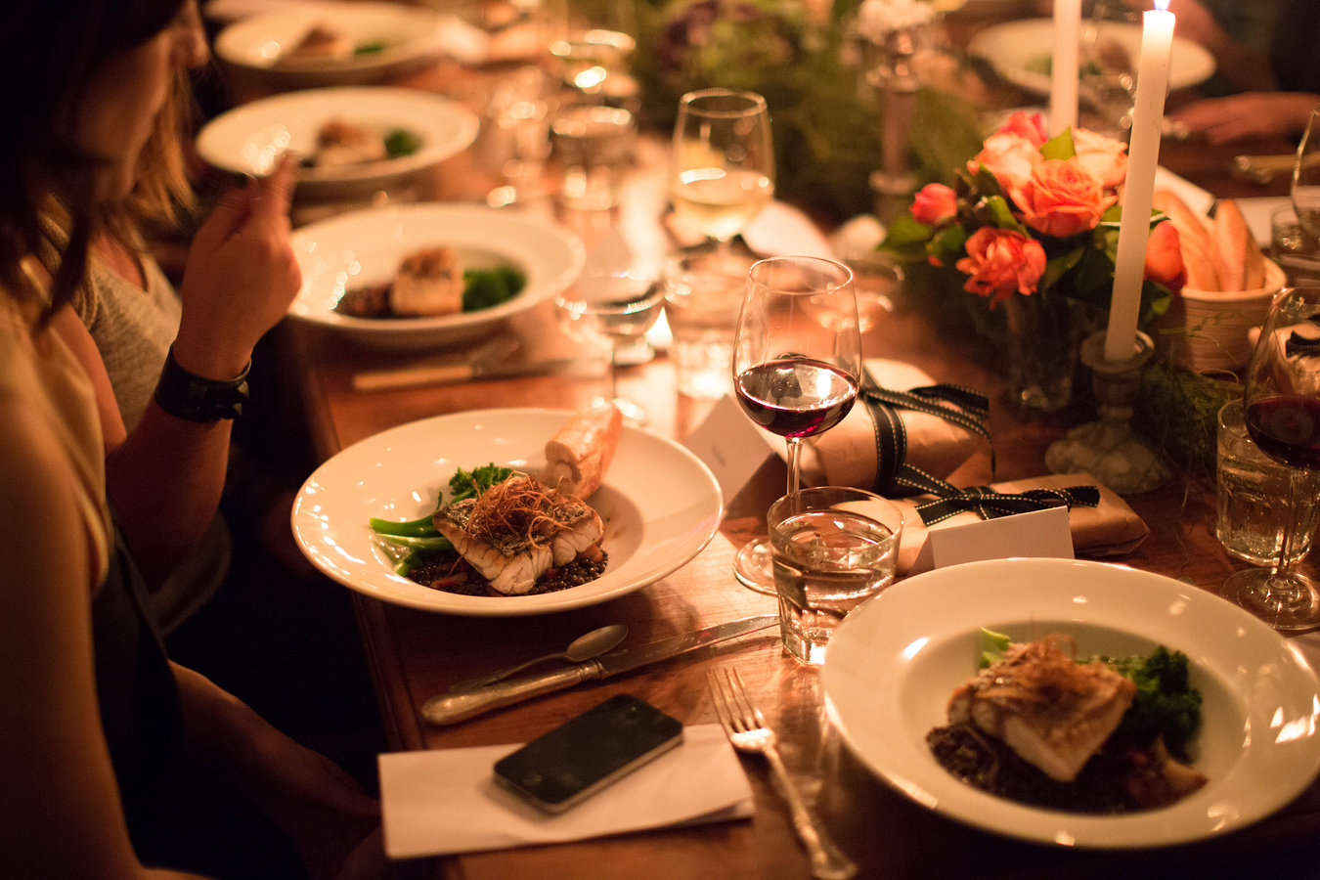
Vocabulary
dinner
/ˈdɪnər/
bữa tối

Slide 12
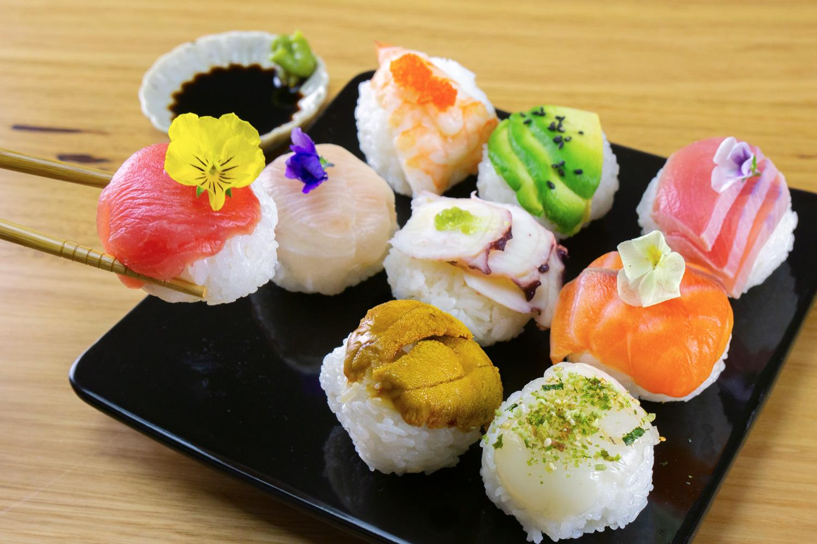
Vocabulary
fabulous
/ˈfæbjələs/
rất tuyệt vời

Slide 13
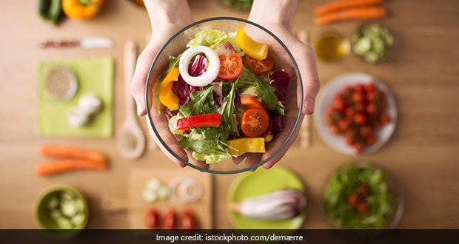
Vocabulary
healthy
/ˈhelθi/
tốt cho
sức khoẻ

Slide 14

LISTENING
1
Work in groups. Discuss the following questions.
1. What time do people in your area often have breakfast, lunch, and dinner?
2. What do they often have for breakfast, lunch, and dinner?

Slide 15

LISTENING
2
Listen to Minh talking about the eating habits in his area. Circle the food and drink you hear.
eel soup | cakes | green tea
coffee | toast

Slide 16
LISTENING
3
Listen again and tick True (T) or False (F).
 | T | F
1. People in Minh's area often have four meals a day.
2. Most of them have lunch at home.
3. Lunch is the main meal of the day in his area.
4. People in his neighbourhood often have rice, fresh vegetables, and seafood or meat for dinner.
5. After dinner, they often have some fruit and green tea.
F
T
F
T
T

Slide 17
LESSON 6: SKILLS 2
WARM-UP
Mini game: Our eating habits
* Vocabulary
Task 1: Work in groups. Discuss the following questions.
Task 2: Listen to Minh talking about the eating habit in his area. Circle the food and drink you hear.
Task 3: Listen again and tick True (T) or False (F).
LISTENING
Task 4: Make notes about the eating habits in your area.
Task 5: Write a paragraph of about 70 words about the eating habits in your area.
WRITING
Stage aims:
To help Ss prepare ideas for their writing;
To help Ss practise writing a paragraph about the eating habits in their area.

Slide 18
WRITING
4
Make notes about the eating habits in your area.
 | Time | Food and drink
Breakfast
Lunch
Dinner

Slide 19
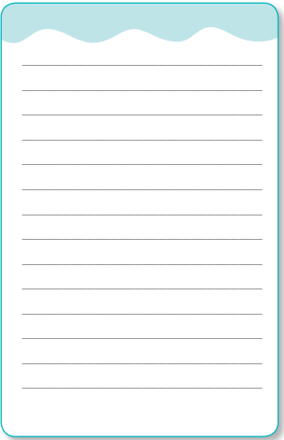
WRITING
4
Write a paragraph of about 70 words
about the eating habits in your area.
Use the information in 4 to help you.

Slide 20
LESSON 6: SKILLS 2
WARM-UP
Mini game: Our eating habits
* Vocabulary
Task 1: Work in groups. Discuss the following questions.
Task 2: Listen to Minh talking about the eating habit in his area. Circle the food and drink you hear.
Task 3: Listen again and tick True (T) or False (F).
LISTENING
Task 4: Make notes about the eating habits in your area.
Task 5: Write a paragraph of about 70 words about the eating habits in your area.
WRITING
CONSOLIDATION
Wrap-up
Homework

Slide 21
CONSOLIDATION
1
WRAP-UP
In this lesson, we have learnt to:
listen for specific information about eating habits
write a paragraph about eating habits in the area.

Slide 22
CONSOLIDATION
2
HOMEWORK
Write a paragraph about your eating habits and upload on the drive link given.
Prepare for the project.

Slide 23

Website: sachmem.vn Fanpage: www.facebook.com/sachmem.vn

