Slide 1
TRADITIONAL PERFORMANCES
Cheo singing

Slide 2
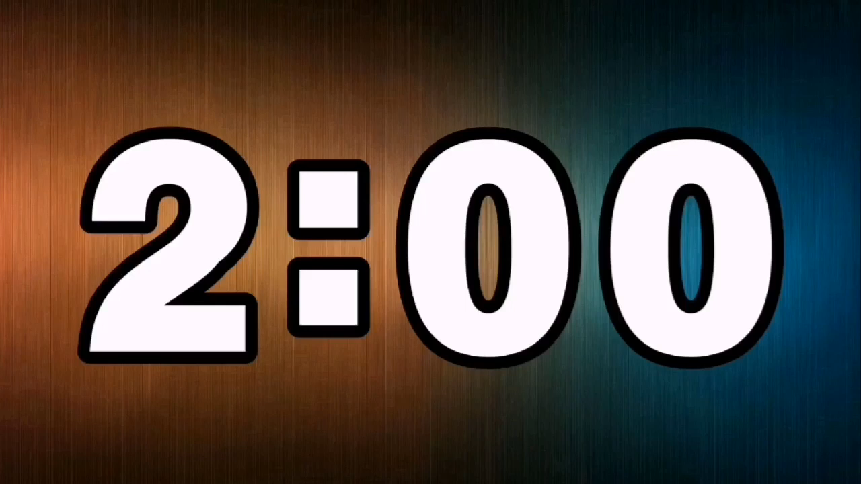
TRADITIONAL PERFORMANCES
Cheo singing

Slide 3
Ca Tru singing
Cai Luong singing
TRADITIONAL PERFORMANCES
Tuong singing
Water puppet show
Then singing
Quan Ho singing
Cheo singing

Slide 5
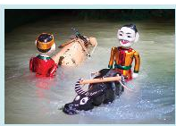
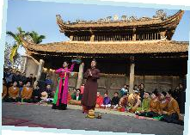
What does each photo show? Do you like it?

Slide 6
Water puppet show
Quan Ho singing
What does each photo show? Do you like it?

Slide 7
2.Read the email and match the highlighted words with their meanings
To: sue©fastmail.com
Subject: A water puppet show
Dear Sue, How are things with you? I arrived in Viet Nam three days ago, and everything is perfect. Yesterday I went to see a puppet show at a theatre in the centre of Ha Noi. The show was fantastic! The artists performed the show in a pool. They stood behind a screen. They used strings under the water to control the puppets and make them move on the water! The show was about rice farming and a festival in a village. People say that these shows are normally about everyday life in the countryside of Viet Nam. Water puppetry is a special traditional art form. People love it, and most tourists coming to Viet Nam love to see it. I wish you were here with me.
See you next week.
Love,
Mary

Slide 8
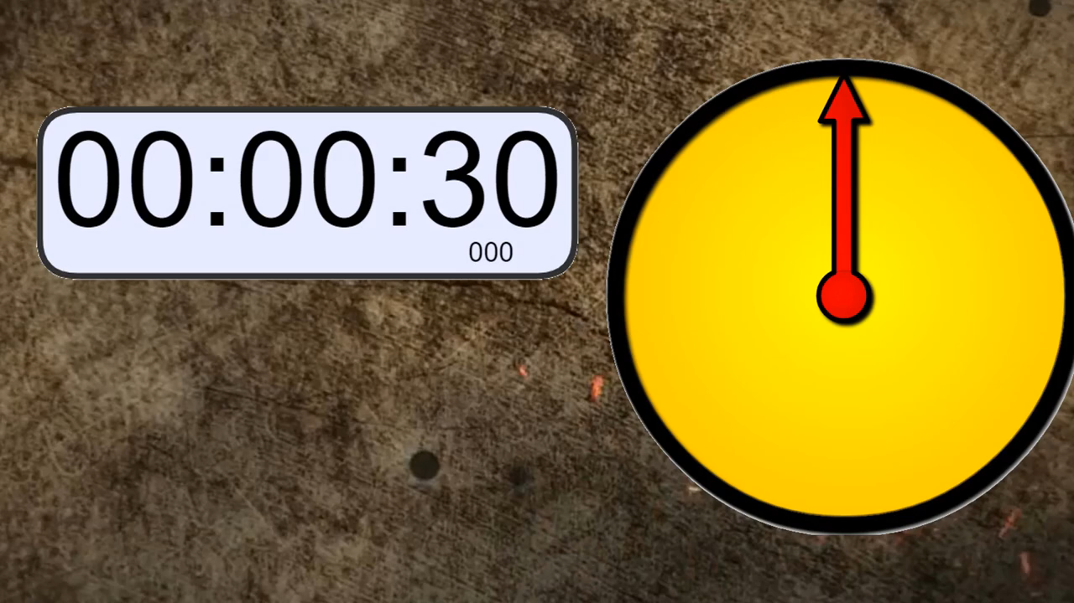
2. Read the email and match the highlighted words with their meanings
A B
1. showed or presented a. traditional
2. following tradition b. festival
3. nice, interesting c. performed
4. event or celebration d. fantastic

Slide 9
2. Read the email and match the highlighted words with their meanings
A B
1. showed or presented a. traditional
2. following tradition b. festival
3. nice, interesting c. performed
4. event or celebration d. fantastic
1. c 2. a 3. d 4. b

Slide 10
1. Who went to see a water puppet show yesterday?
2. Where did the artists perform the show?
3. Who controlled the puppets?
4. What are water puppet shows normally about?
5. Is water puppetry a traditional Vietnamese art form?
-Mary went to see a water puppet show yesterday.
- They performed the show in a pool.
-The artists controlled the puppets.
- The water puppet shows are about everyday life in the countryside of Viet Nam.
-Yes, it is.

Slide 12
SPEAKING
4
Work in pairs. Ask and answer about Mark’s school musical performance last year.
Mark's school performance
Time: Sat. night
Duration: 3 hours
Place: schoolyard
Items performed: plays, dances, songs, magic,

Slide 13
5. Your school is going to have a musical performance to celebrate Teachers' Day.
Make a plan for the performance and talk about the items you will contribute.
Your school performance
Time:
Duration:
Place:
Items contributed:

Slide 14
CONSOLIDATION
1
WRAP-UP
READING
SPEAKING

Slide 15
Homework:
- Learn new words
- Practice reading the text at home
- Practice speaking part 4,5 / page 46
- Prepare for the new lesson: Skills 2/ page 47

