Slide 1


Slide 2


WARM-UP: CHATTING

Slide 3
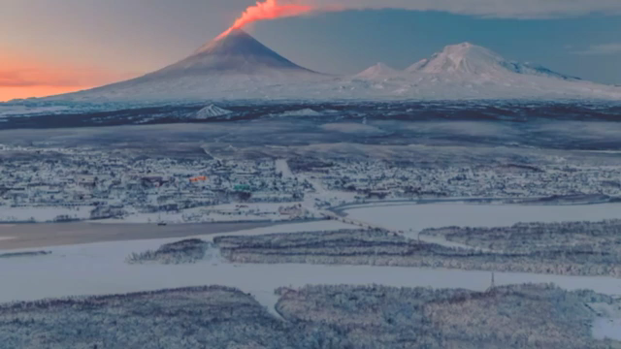
WARM-UP: CHATTING

Slide 4
WARM-UP: CHATTING
- Do you like the piece of music you have listened?
- When do you listen to music?
- How do you feel when you listen to music?
- Is music important in our life?

Slide 6




Period 25: Unit
4
MUSIC AND ARTS
LESSON 1: GETTING STARTED
A talk at the school gate
Unit
HOBBIES

Slide 7
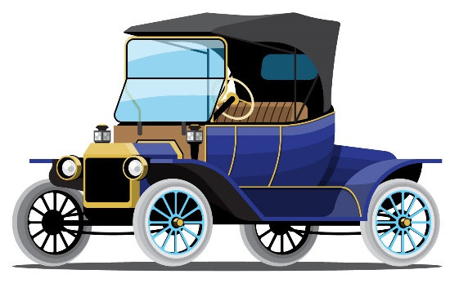
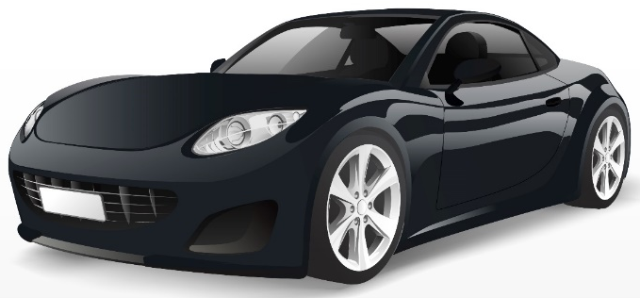
PRESENTATION
classical (adj)
modern
/ˈklæsɪkəl/
cổ điển

Slide 8
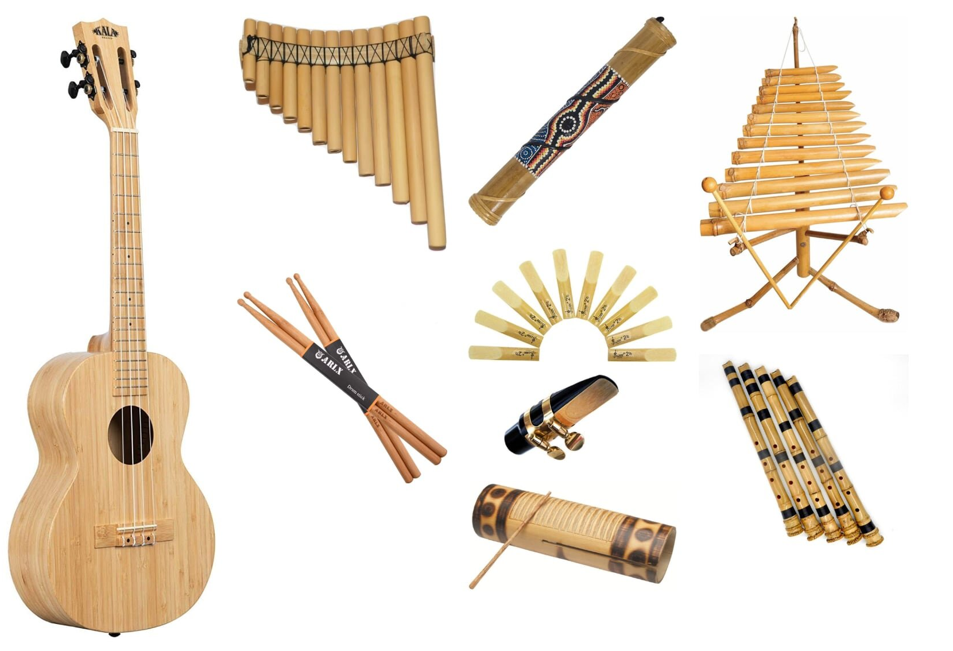
PRESENTATION
musical instruments (n)
/ˈmjuːzɪkəl ˈɪnstrəmənts/
nhạc cụ

Slide 9
PRESENTATION
New words | Pronunciation | Meaning
classical (adj) | /ˈklæsɪkəl/ | cổ điển
musical instruments (n) | /ˈmjuːzɪkəl ˈɪnstrəmənts/ | nhạc cụ

Slide 11
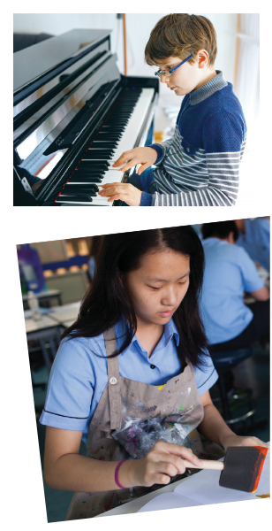
PRESENTATION: LISTEN AND READ
Who are they?
What are they doing?
What are they talking about?

Slide 12

PRESENTATION: LISTEN AND READ.
Trang: Hi Nick. What are you listening to?
Nick: I’m listening to music. I like classical music, and I often play the piano in my spare time.
Trang: Wow. I can’t play any instruments.
Nick: And what about you? What’s your hobby?
Trang: I like painting and taking photos.
Nick: Taking photos? I’ve never tried it. Is it fun?
Trang: Yeah, it is, but not as fun as painting.
Nick: Right. They seem quite different from each other. What do you normally paint?
Trang: Landscapes and animals, just for pleasure, you know. I sometimes share them with my friends.
Nick: Really? Um, maybe we should go to an art gallery next weekend?
Trang: Sounds good, but I’d prefer to go to the music festival at my school.
Nick: Well … OK. That’s fine.

Slide 14
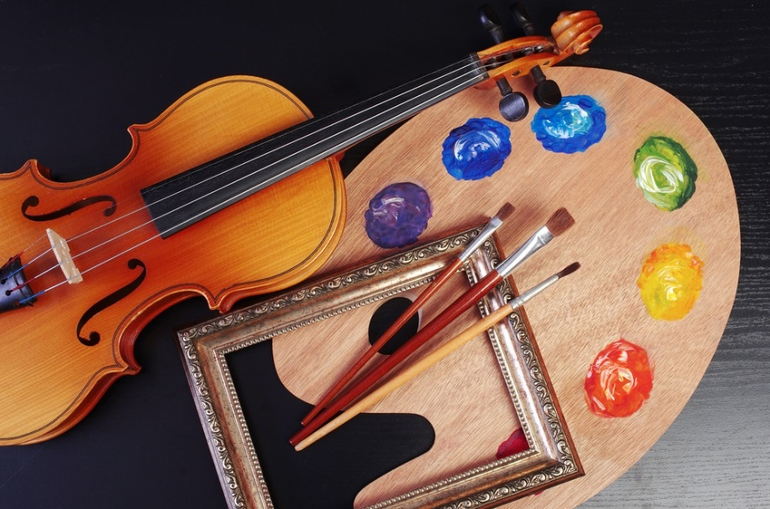
PRACTICE
2
Tick the correct answer.
1. What are Trang and Nick talking about?
A. Playing the piano.
B. Drawing and painting.
C. Music and arts.
Trang: Hi Nick. What are you listening to?
Nick: I’m listening to music. I like classical music, and I often play the piano in my spare time.
Nick: And what about you? What’s your hobby?
Trang: I like painting and taking photos.

Slide 15
PRACTICE
3
Complete each of the sentences with a suitable word or phrase from the box.
Game: WHO IS FASTER?
Rule:
Students in 2 teams have 1 minute to THINK of the answers,.
Students in each team turn by turn go to the board and WRITE 1 word or phrase in 2 minutes, the team has more right answers will be the winner.
photos like different from art gallery musical instruments
Nick wants to go to a(n) _____________ next week.
You can use your smartphone to take ________.
This photo is very bright. It is _____________ that dark one.
Nick and Trang agree that taking photos is not _____________ painting.
My friend David is very talented. He plays three _______________________.

Slide 16
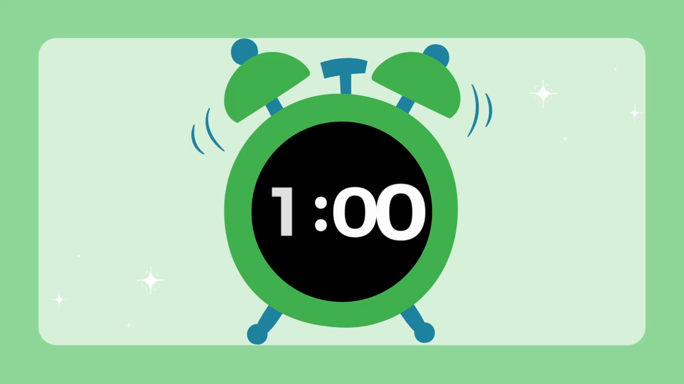
PRACTICE
3
Complete each of the sentences with a suitable word or phrase from the box.
Game: WHO IS FASTER?
Rule:
Students in 2 teams have 1 minute to think of the answers,.
Students in each team turn by turn go to the board and write 1 word or phrase in 2 minutes, the team has more right answers will be the winner.
photos like different from art gallery musical instruments
Nick wants to go to a(n) _____________ next weekend.
You can use your smartphone to take ________.
This photo is very bright. It is _____________ that dark one.
Nick and Trang agree that taking photos is not _____________ painting.
My friend David is very talented. He plays three _______________________.

Slide 17
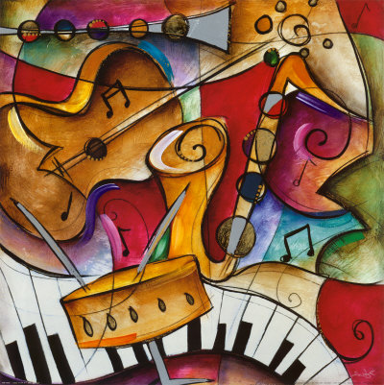

PRACTICE
3
Complete each of the sentences with a suitable word or phrase from the box.
photos like different from art gallery musical instruments
Nick wants to go to a(n) _____________ next weekend.
You can use your smartphone to take ________.
This photo is very bright. It is _____________ that dark one.
Nick and Trang agree that taking photos is not _____________ painting.
My friend David is very talented. He plays three _______________________.

Slide 18
PRACTICE
3
Complete each of the sentences with a suitable word or phrase from the box.
photos like different from art gallery musical instruments
art gallery
Nick wants to go to a(n) _____________ next weekend.
You can use your smartphone to take ________.
This photo is very bright. It is _____________ that dark one.
Nick and Trang agree that taking photos is not _____________ painting.
My friend David is very talented. He plays three _______________________.
photos
different from
like
musical instruments

Slide 19
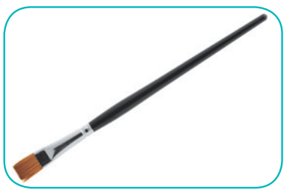

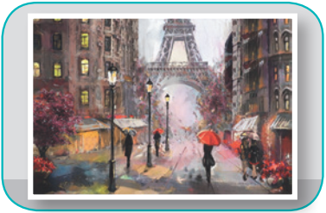
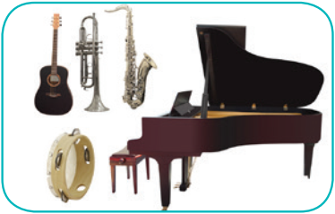
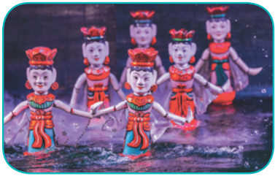
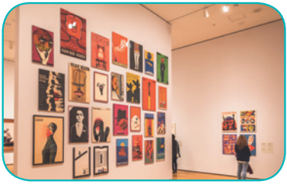
PRACTICE
43
Write the correct word or phrase under each picture. Then listen and repeat.
camera water puppet show art gallery
painting paintbrush musical instruments
1. ______________
2. ____________
3. ____________
4. __________________________
5. _________________________
6. ____________

Slide 20
PRACTICE
43
Write the correct word or phrase under each picture. Then listen and repeat.
camera water puppet show art gallery
painting paintbrush musical instruments
paintbrush
camera
painting
1. ______________
2. ____________
3. ____________
musical instruments
water puppet show
4. __________________________
5. _________________________
art gallery
6. ____________

Slide 21
Trang: Hi Nick. What are you listening to?
Nick: I’m listening to music. I like classical music, and I often play the piano in my spare time.
Trang: Wow. I can’t play any instruments.
Nick: And what about you? What’s your hobby?
Trang: I like painting and taking photos.
Nick: Taking photos? I’ve never tried it. Is it fun?
Trang: Yeah, it is, but not as fun as painting.
Nick: Right. They seem quite different from each other. What do you normally paint?
Trang: Landscapes and animals, just for pleasure, you know. I sometimes share them with my friends.
Nick: Really? Um, maybe we should go to an art gallery next weekend?
Trang: Sounds good, but I’d prefer to go to the music festival at my school.
Nick: Well … OK. That’s fine.

Slide 22
Trang: Hi Nick. What are you listening to?
Nick: I’m listening to music. I like classical music, and I often play the piano in my spare time.
Trang: Wow. I can’t play any instruments.
Nick: And what about you? What’s your hobby?
Trang: I like painting and taking photos.
Nick: Taking photos? I’ve never tried it. Is it fun?
Trang: Yeah, it is, but not as fun as painting.
Nick: Right. They seem quite different from each other. What do you normally paint?
Trang: Landscapes and animals, just for pleasure, you know. I sometimes share them with my friends.
Nick: Really? Um, maybe we should go to an art gallery next weekend?
Trang: Sounds good, but I’d prefer to go to the music festival at my school.
Nick: Well … OK. That’s fine.

Slide 23

PRACTICE
54
Quiz “How artistic are you?”.
1. Your hobby is __________.
playing an instrument
B. playing computer games
2. Do you like listening to music or playing sports?
Listening to music.
B. Playing sports.
3. Which of these do you prefer doing?
A. Going to an art gallery.
B. Going to a book fair.
4. You describe yourself as ________.
creative
B. hard-working
5. What do you want to be when you grow up?
A musician.
B. An engineer.
For each question, you get two points if your answer is A, zero if your answer is B. Add up your five answers and decide how artistic you are on a scale from 1-10.
Not very (1-4)
Somewhat (5-7)
Very (8-10)

Slide 24


PRACTICE
5
Quiz “How artistic are you?”.
1. Your hobby is __________.
playing an instrument
B. playing computer games
2. Do you like listening to music or playing sports?
Listening to music.
B. Playing sports.
3. Which of these do you prefer doing?
A. Going to an art gallery.
B. Going to a book fair.
4. You describe yourself as ________.
creative
B. hard-working
5. What do you want to be when you grow up?
A musician.
B. An engineer.
Eg: 1. B 2. A 3. A 4. A 5. B
My score: 6 => My artistic is somewhat.

Slide 25
CONSOLIDATION
1
WRAP-UP
MUSIC AND ARTS
ABOUT MUSIC
ABOUT ARTS
Topic of the unit
Vocabulary

Slide 26

CONSOLIDATION
2
HOMEWORK
Prepare the vocabulary for the next lesson: A closer look 1.
Do the Quiz “How artistic are you?”.
Prepare for the Project lesson.

Slide 27

Website: sachmem.vn
Fanpage: facebook.com/sachmem.vn/

