Slide 1
WARM-UP
Listen to the word the teacher says and give an example for that film type
Eg:
comedy
Mr Bean

Slide 2
WARM-UP
Listen to the word the teacher says and give an example for that film type
Eg:
comedy Mr Bean
fantasy Harry Potter and the Deathly Hollows
science fiction film Avatar
documentary Pirates of Southeast Asia
horror film Annabelle
Notes:
Wordwall link to spin the wheel in real time: https://wordwall.net/resource/27022823

Slide 3
Period 68: UNIT 8: FILMS
Lesson 7: Looking back + project
Vocabulary
1. Match the types of film in column A with their descriptions in column B.
UNIT 8: LOOKING BACK & PROJECT
VV
A | B
1. science fiction film | a. This type of film makes you laugh.
2. comedy | b. This type of film has supernatural.
3. horror film | c. This type of film gives us useful information about animals, science or technology.
4. documentary | d. This type of film is about life in the future, robots, and space travel.
5. fantasy | e. This is a frightening type of film.

Slide 4
1.d 2.a 3.e 4.c 5.b
LESSON 7: LOOKING BACK & PROJECT
1. Match the types of film in column A with their descriptions in column B.
A | B
1. science fiction film | a. This type of film makes you laugh.
2. comedy | b. This type of film has supernatural.
3. horror film | c. This type of film gives us useful information about animals, science or technology.
4. documentary | d. This type of film is about life in the future, robots, and space travel.
5. fantasy | e. This is a frightening type of film.

Slide 5
2. Choose the correct answer A, B, or C to complete each sentence.
1. The film was long and ______. Many people went home before it ended.
A. funny B. shocking C. dull
2. The film is too ______ with a lot of fighting and killing scenes.
A. funny B. violent C. interesting
3. A ______ story often makes us feel afraid.
A. moving B. interesting C. frightening
4. The news was ______. I couldn't believe it.
A. shocking B. funny C. confusing
5. ______ films often make us cry.
A. Amusing B. Moving C. Funny

Slide 6
2. Choose the correct answer A, B, or C to complete each sentence.
1. The film was long and ______. Many people went home before it ended.
A. funny B. shocking C. dull
2. The film is too ______ with a lot of fighting and killing scenes.
A. funny B. violent C. interesting
3. A ______ story often makes us feel afraid.
A. moving B. interesting C. frightening
4. The news was ______. I couldn't believe it.
A. shocking B. funny C. confusing
5. ______ films often make us cry.
A. Amusing B. Moving C. Funny

Slide 7
GRAMMAR REVIEW
3
Match the sentences or sentence halves in columns A and B.
A | B
1. Although he arrived late, | a. people still buy them.
2. The film received good reviews. | b. However, the number of people going to cinemas is increasing.
3. Though popcorn and other snacks in the cinema are very expensive, | c. I don’t want to stay home tonight.
4. Cinema tickets are expensive. | d. he left the cinema early.
5. Although I don’t really like to go to the cinema, | e. However, only a few people saw it.

Slide 8
GRAMMAR REVIEW
34
Match the sentences or sentence halves in columns A and B.
the connectors: although/though and however.

Slide 9
GRAMMAR REVIEW
3
Match the sentences or sentence halves in columns A and B.
A | B
1. Although he arrived late, | a. people still buy them.
2. The film received good reviews. | b. However, the number of people going to cinemas is increasing.
3. Though popcorn and other snacks in the cinema are very expensive, | c. I don’t want to stay home tonight.
4. Cinema tickets are expensive. | d. he left the cinema early.
5. Although I don’t really like to go to the cinema, | e. However, only a few people saw it.
1. d
2. e
3.a
4. b
5. c

Slide 10
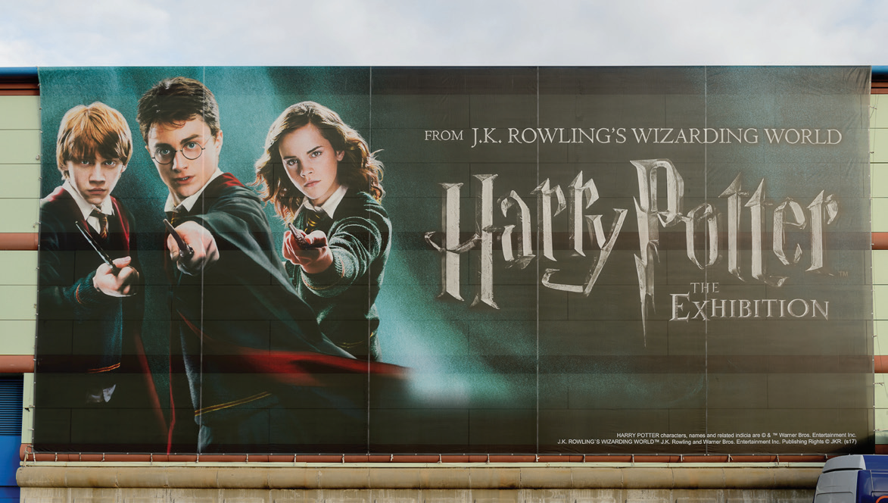
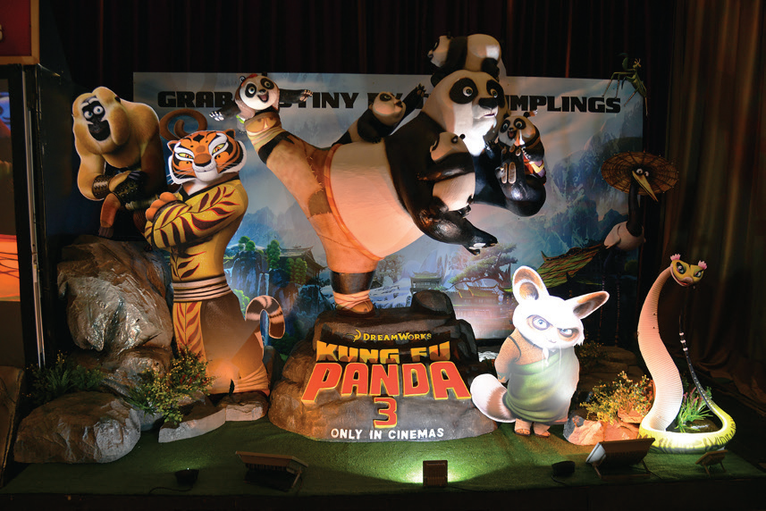
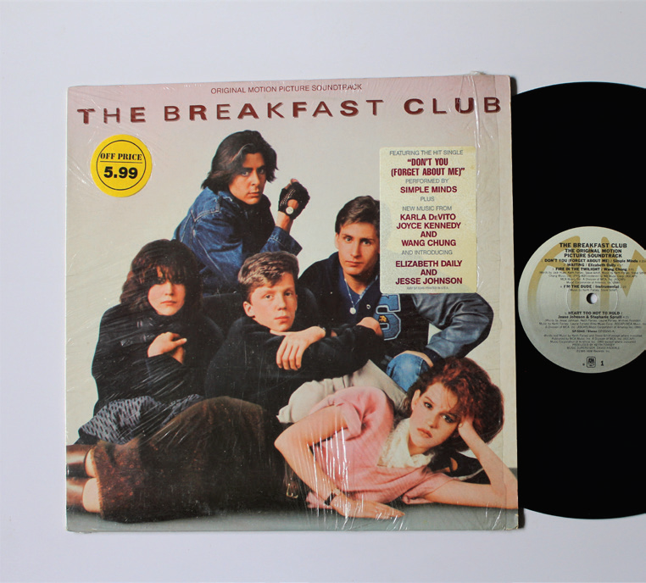
PROJECT
Posters exhibition
5
Work in groups.
1
Choose one of your favourite films and design a poster for it, including:
- name of the film; - type of film; - its director and main actors / actresses; - a short summary; - your overall opinions about the film; - the showtime and cinema; - pictures or photos to illustrate the film.
2
Organise them into an exhibition.
3
Vote for the best poster.

Slide 13
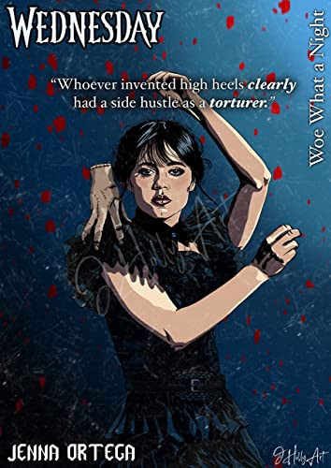
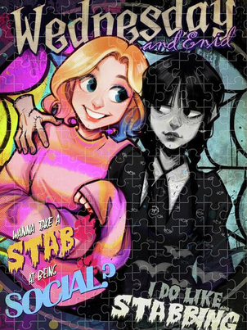
- Name of my favourite film: Wednesday
- Type of film: Horror film

Slide 14
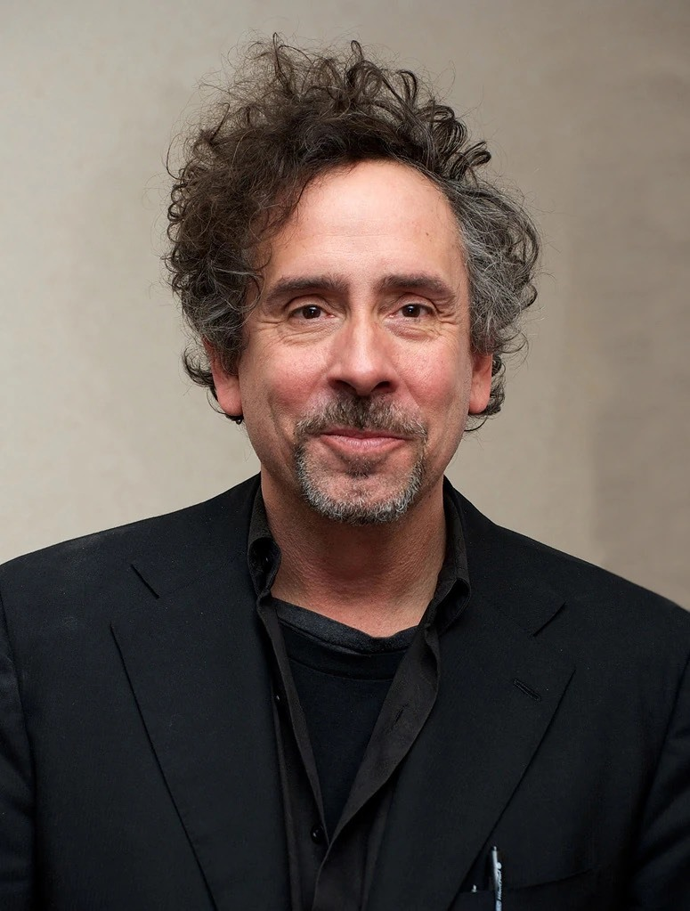
Director: Tim Burton

Slide 15
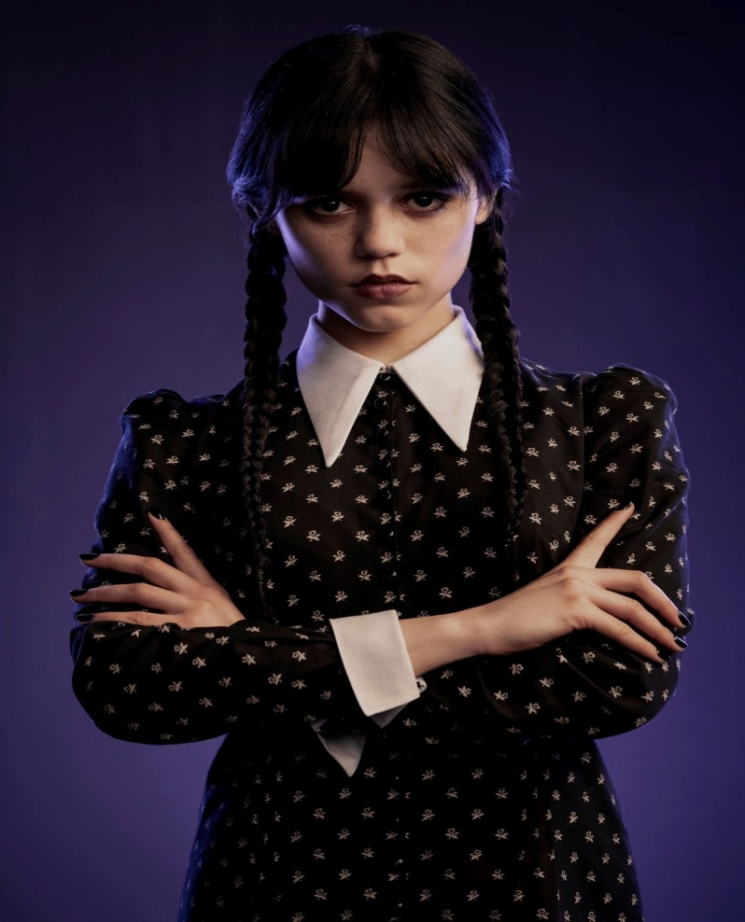
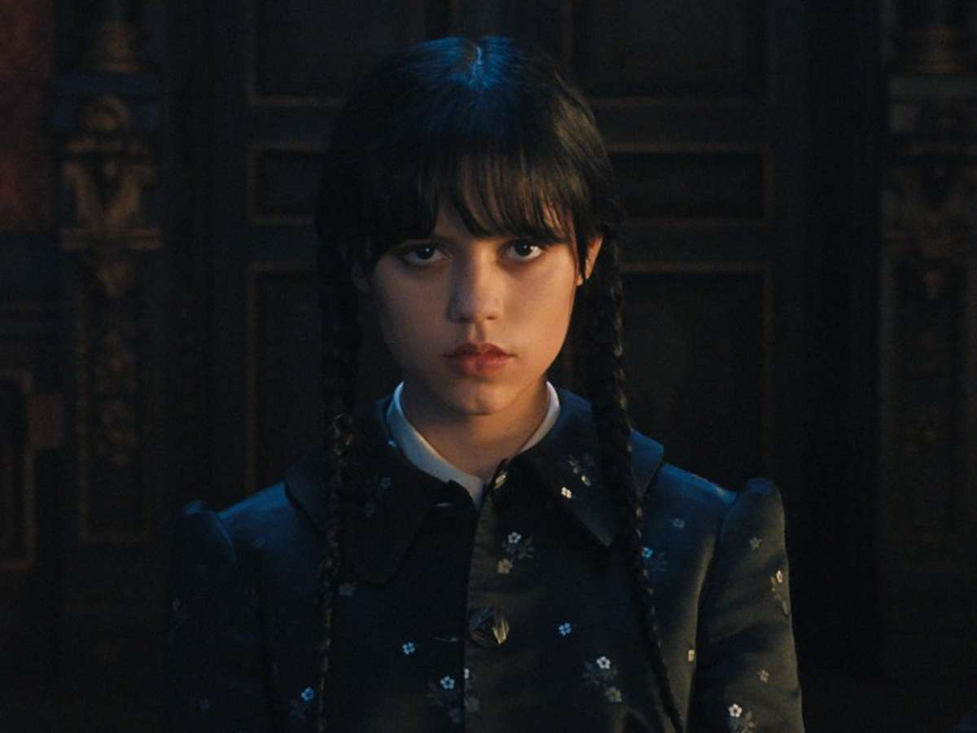
Main actor/actress

Slide 16
- Main content: In the movie, Wednesday Addams avenges her younger brother , Pugsley. This act resulted in her being explled from school and her parents sent her to Nevermore Academy. First, Wenesday protested and was about to run away but, upon witnessing the strange deaths in this town and getting caught up in it.

Slide 17
Reviews: Very interesting Time:2:30 p.m – 4 p.m Place: CGV Cinema

Slide 21
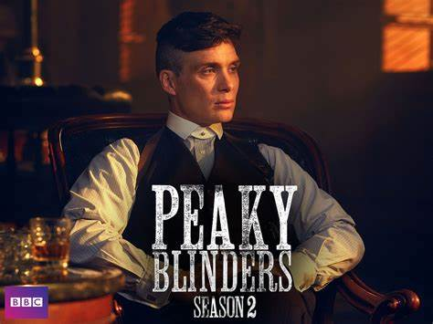

Slide 22
Director and main actors
-Cillian Murphy is the guy who played the main character Thomas Shelby in the film above in Peaky Blinders, he is the star of this film.
-Steven Knight is the director who created this film.

Slide 23
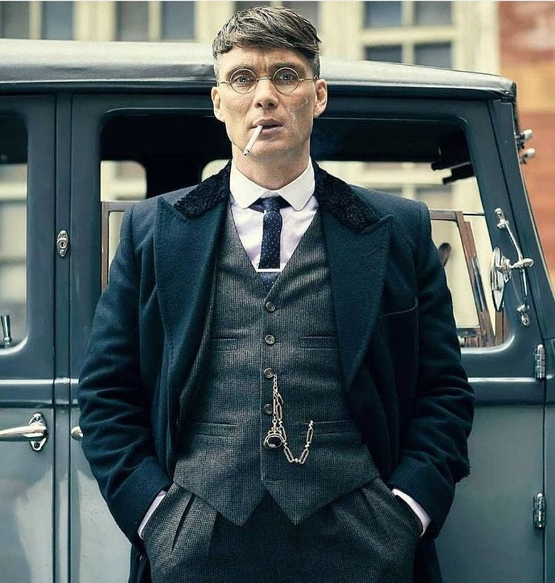
Content of the movie Peaky Blinders
Set in early 19th century England, Peaky Blinders tells the story of the Shelby family, the leaders of the Peaky Blinders gang making noise in a paused world with the brains of Tommy Shelby, the second son. . The film is Tommy's journey to advance in the underworld with ruthless skills and tricks.

Slide 24
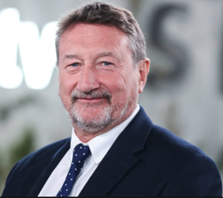
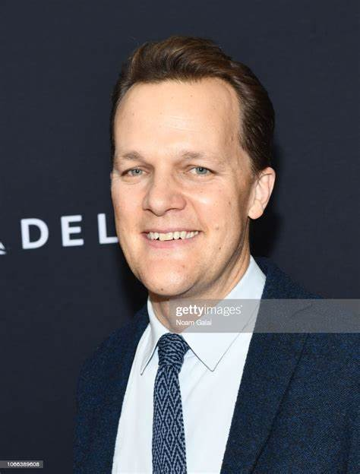
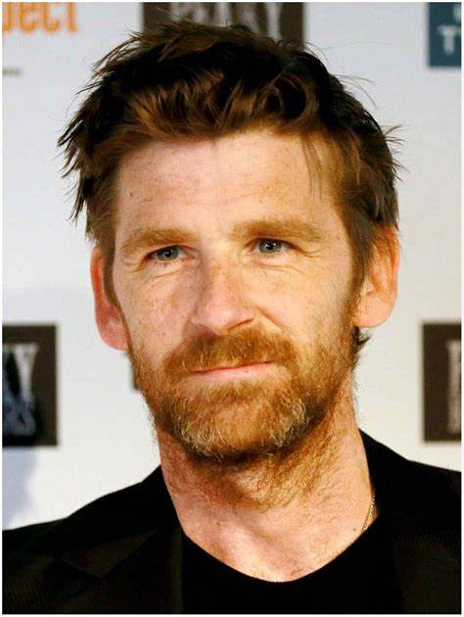
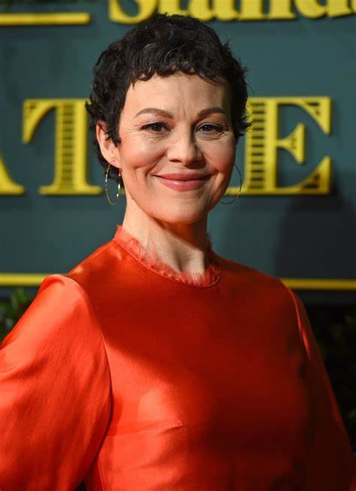
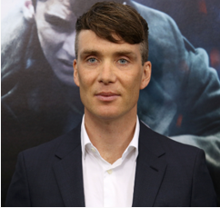
Steven Knight Otto Bathurst
-Director:
Paul Anderson Helen Mcrory Cillian Murphy
-Actors/
Actress:

Slide 25
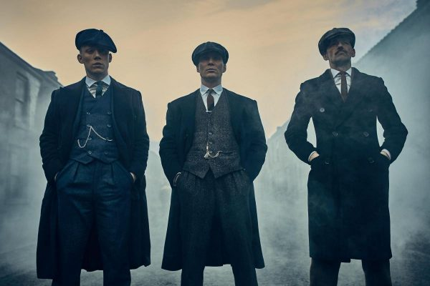
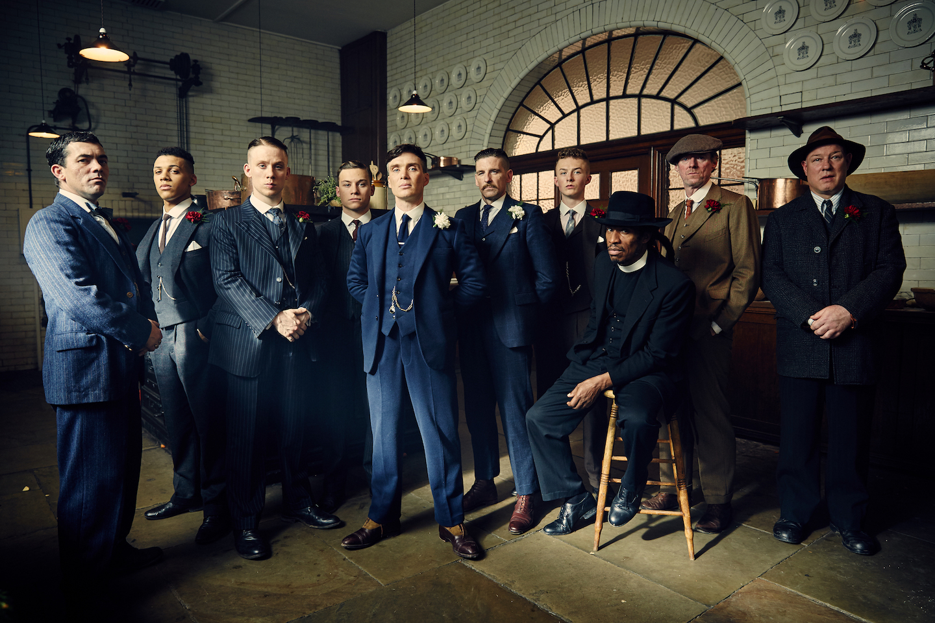
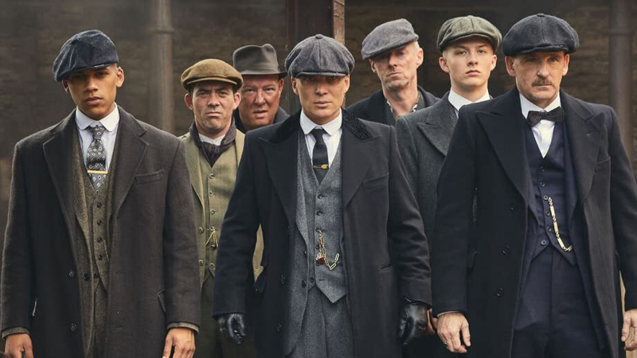

Slide 26
The showtime and cinema
The showtime:Sunday, February 27, 2022, at 9:00pm GMT
Cinema:BBC One and BBC iPlayer

Slide 28
CONSOLIDATION
1
Wrap-up
Vocabulary review
Grammar review
Project: Design film posters

Slide 29
CONSOLIDATION
2
Homework
Prepare for the next lesson: Unit 9: Festivals around the world Lesson 1: Getting started

